Slide 1
TechCorp SA Product Line Performance Analysis
Executive Market Analysis & Strategic Recommendations

Slide 2
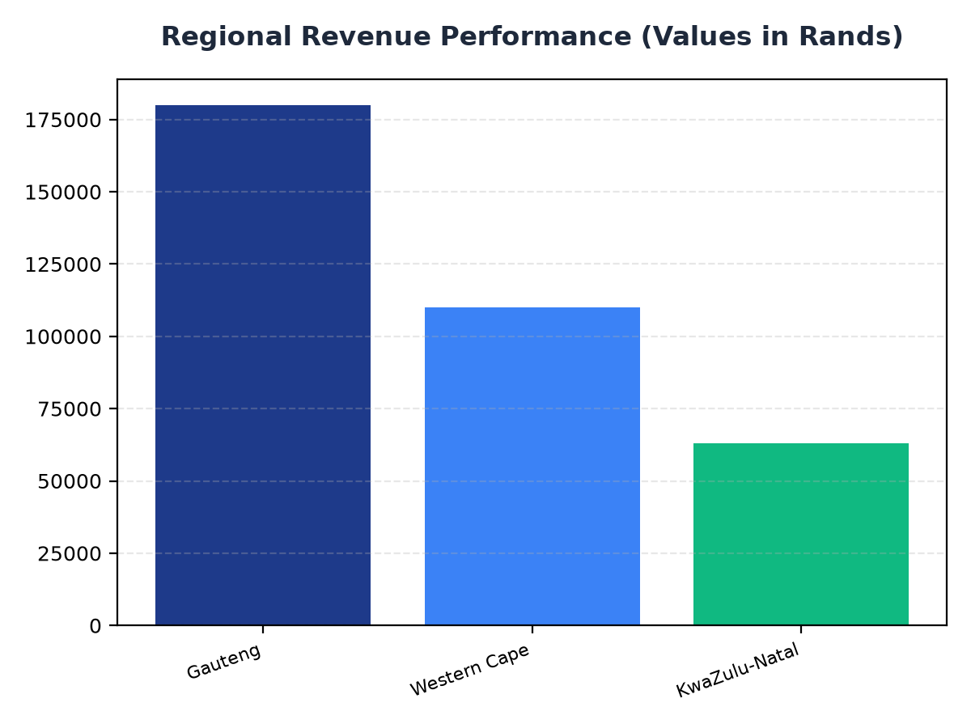
Regional Revenue Performance
• Gauteng has the highest revenue with R180,000.
• Western Cape has a middle revenue of R110,000.
• KwaZulu-Natal has the lowest revenue of R63,000, indicating a potential area for expansion.

Slide 3
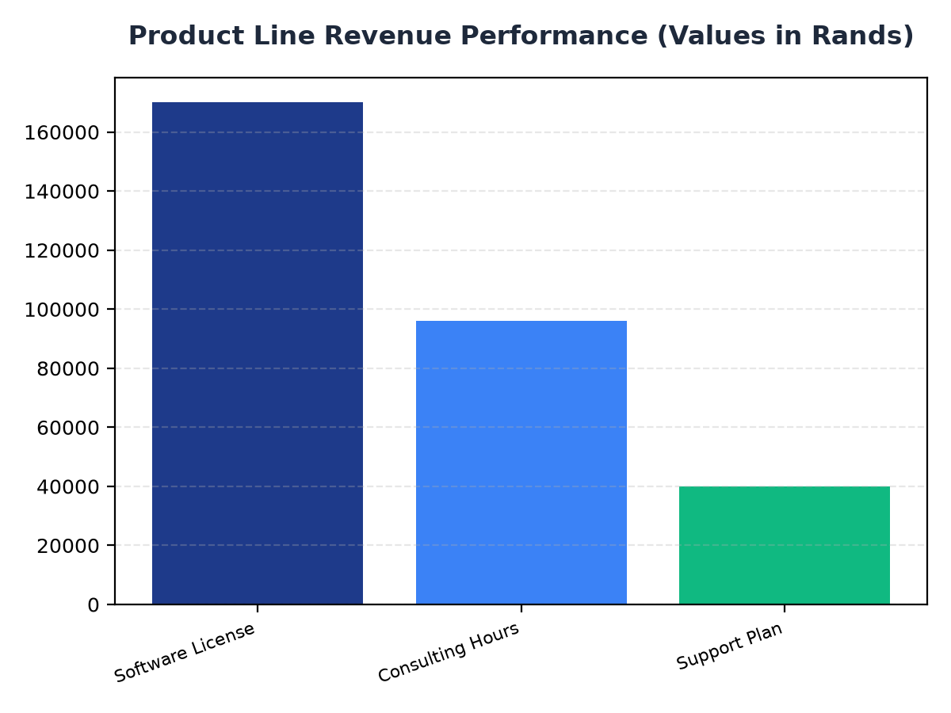
Product Line Revenue Performance
• Software License has the highest revenue with R170,000.
• Consulting Hours has a revenue of R96,000.
• Support Plan has the lowest revenue of R40,000 among the top products.

Slide 4
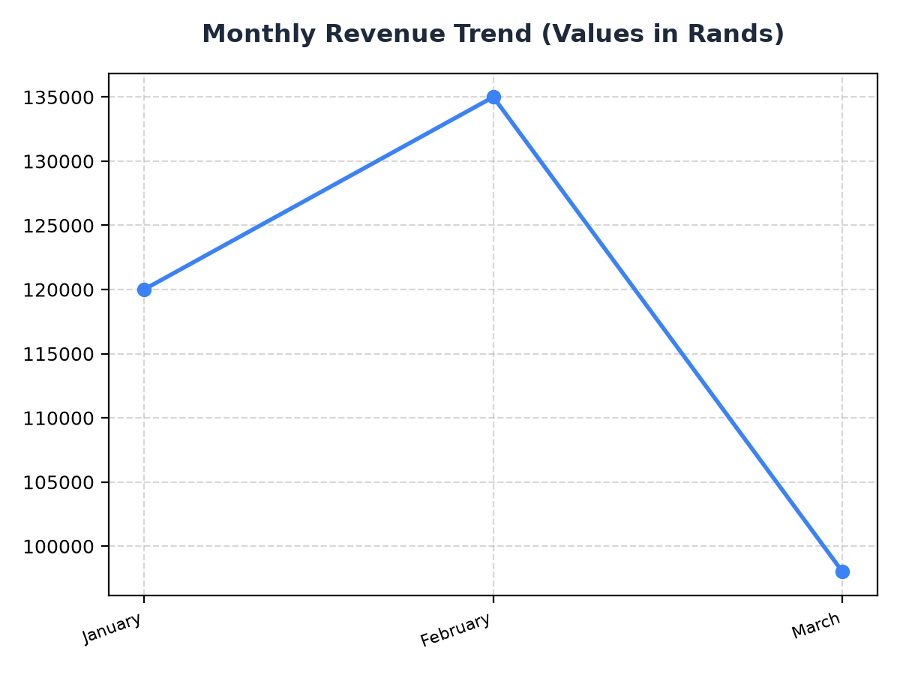
Monthly Revenue Trend
• January has the highest monthly revenue with R120,000.
• February has a revenue of R135,000, indicating an increase from January.
• March has the lowest monthly revenue of R98,000, suggesting a potential decline in sales.

