Slide 1
Supermarket Sales Analysis
Comparative Analysis of Product Line Performance Across Yangon, Naypyitaw, and Mandalay

Slide 2
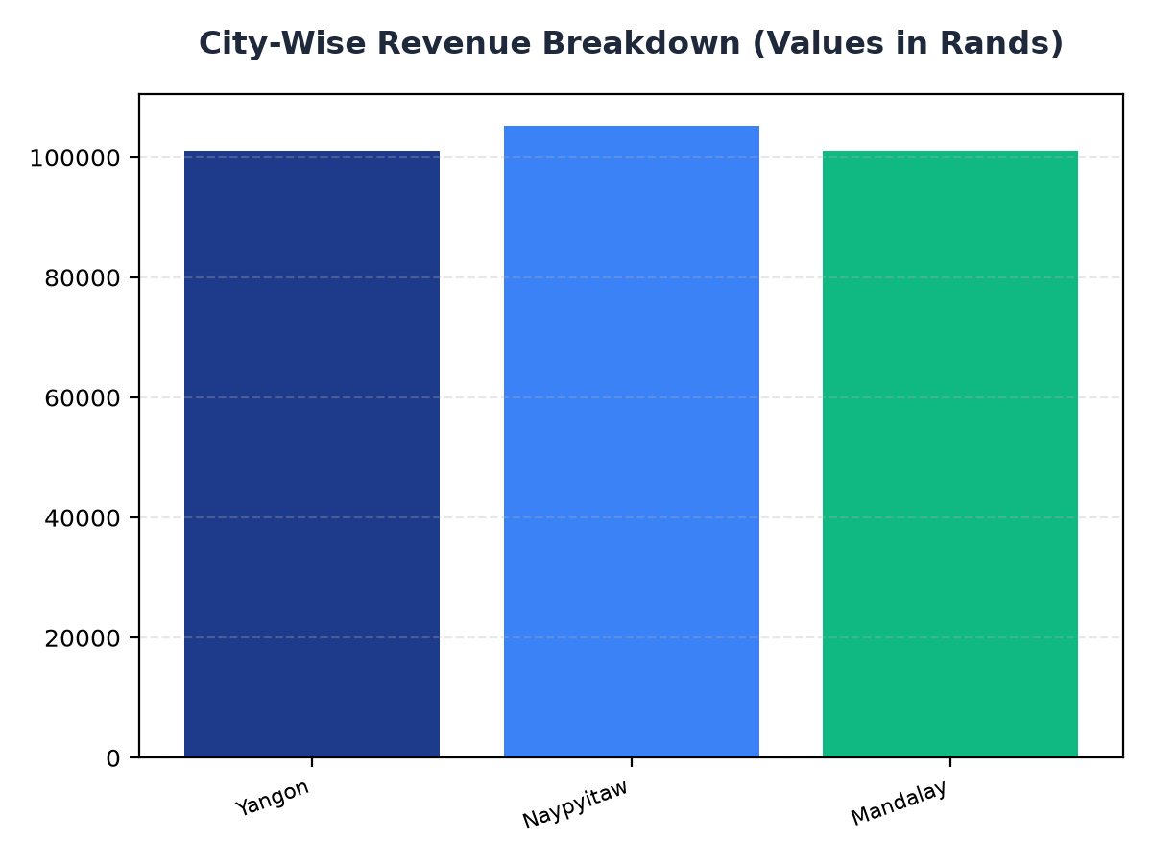
City-Wise Revenue Breakdown
• Naypyitaw is the highest-performing city with a revenue of R105,303.53.
• Mandalay is the lowest-performing city with a revenue of R101,140.64, indicating a need for strategic expansion.
• Yangon has a revenue of R101,143.21, slightly higher than Mandalay.

Slide 3
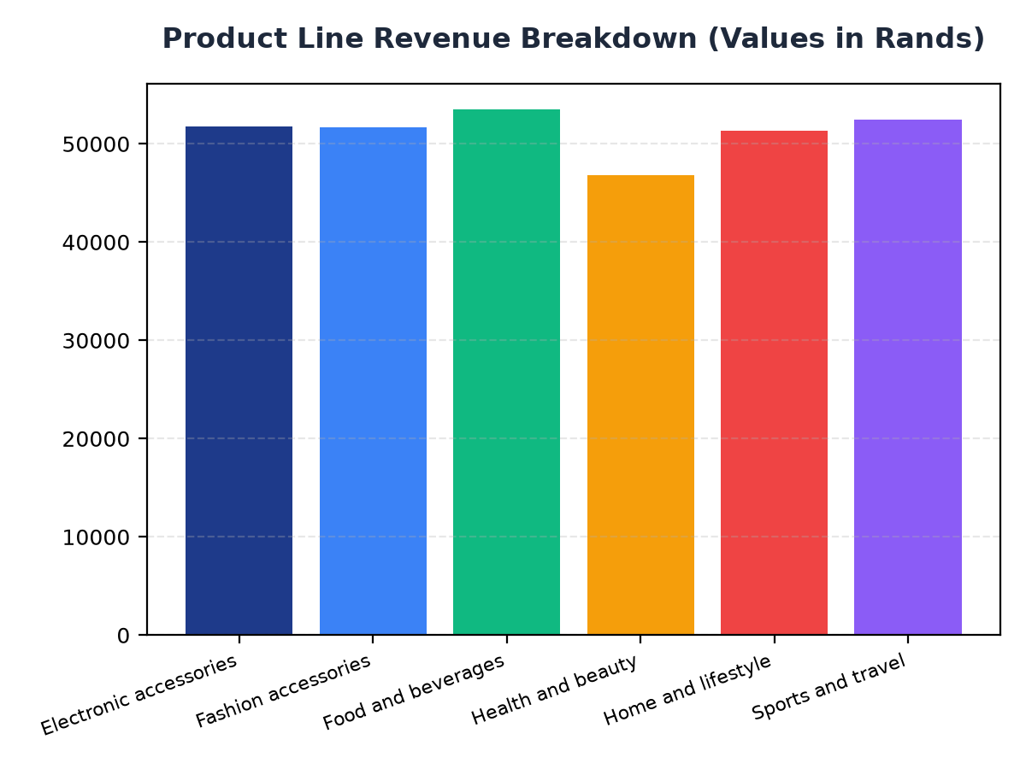
Product Line Performance
• Food and beverages is the highest-performing product line with a revenue of R53,471.28.
• Health and beauty is the lowest-performing product line with a revenue of R46,851.18.
• Electronic accessories and Fashion accessories have similar revenue figures, with R51,750.03 and R51,719.90 respectively.

Slide 4
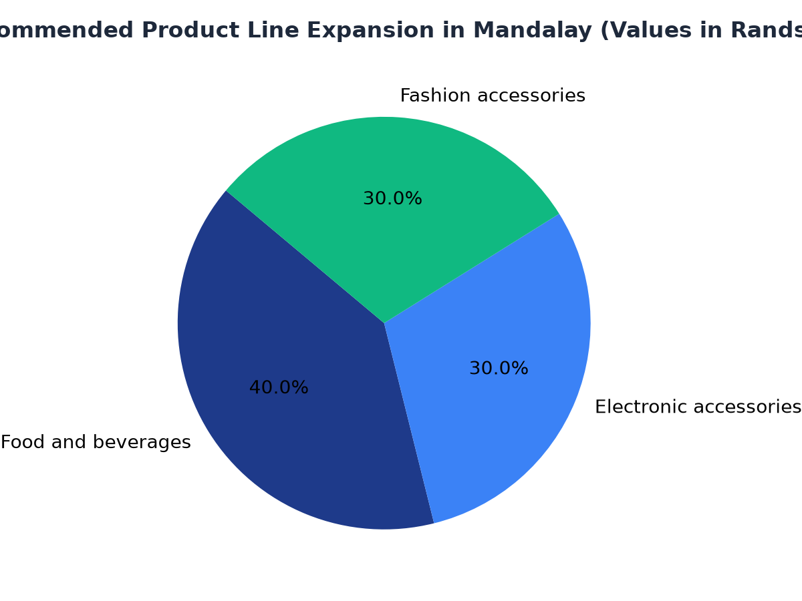
Strategic Recommendations for Mandalay
• Expand the Food and beverages product line in Mandalay to increase revenue.
• Consider increasing the inventory of Electronic accessories and Fashion accessories in Mandalay.
• Analyze customer demand and preferences in Mandalay to identify opportunities for growth.

