Slide 1
Revenue Drivers Analysis
Executive Market Analysis & Strategic Recommendations

Slide 2
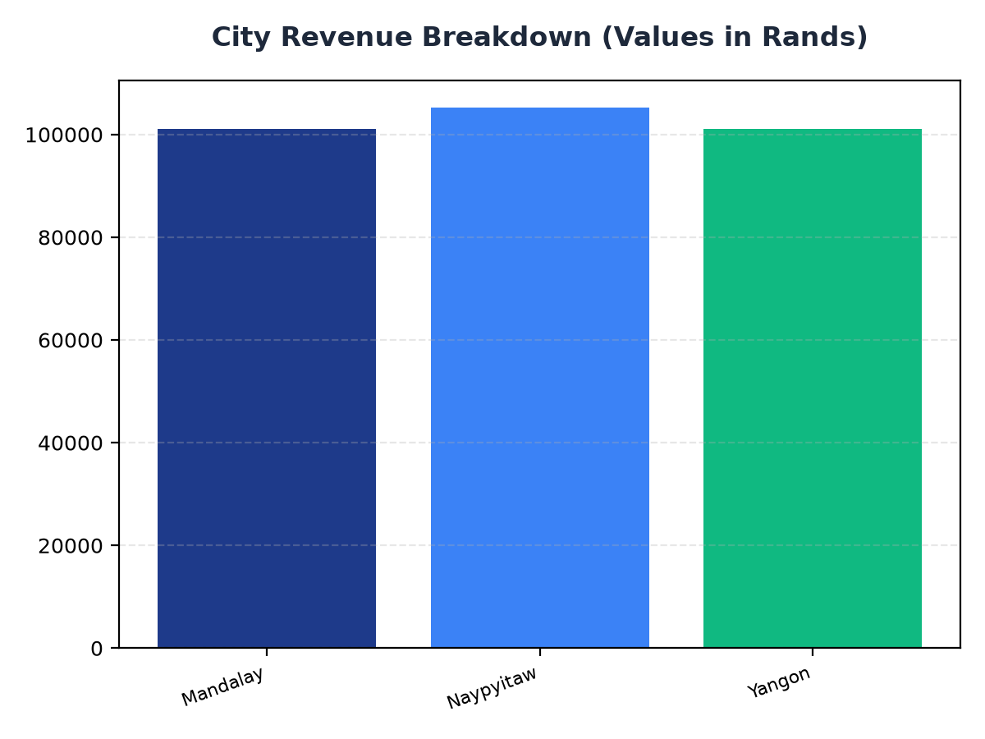
City Revenue Breakdown
• Naypyitaw generates the highest revenue with R105,303.53.
• Yangon and Mandalay follow closely with R101,143.21 and R101,140.64 respectively.
• Targeted marketing efforts should focus on these cities to maximize revenue.

Slide 3
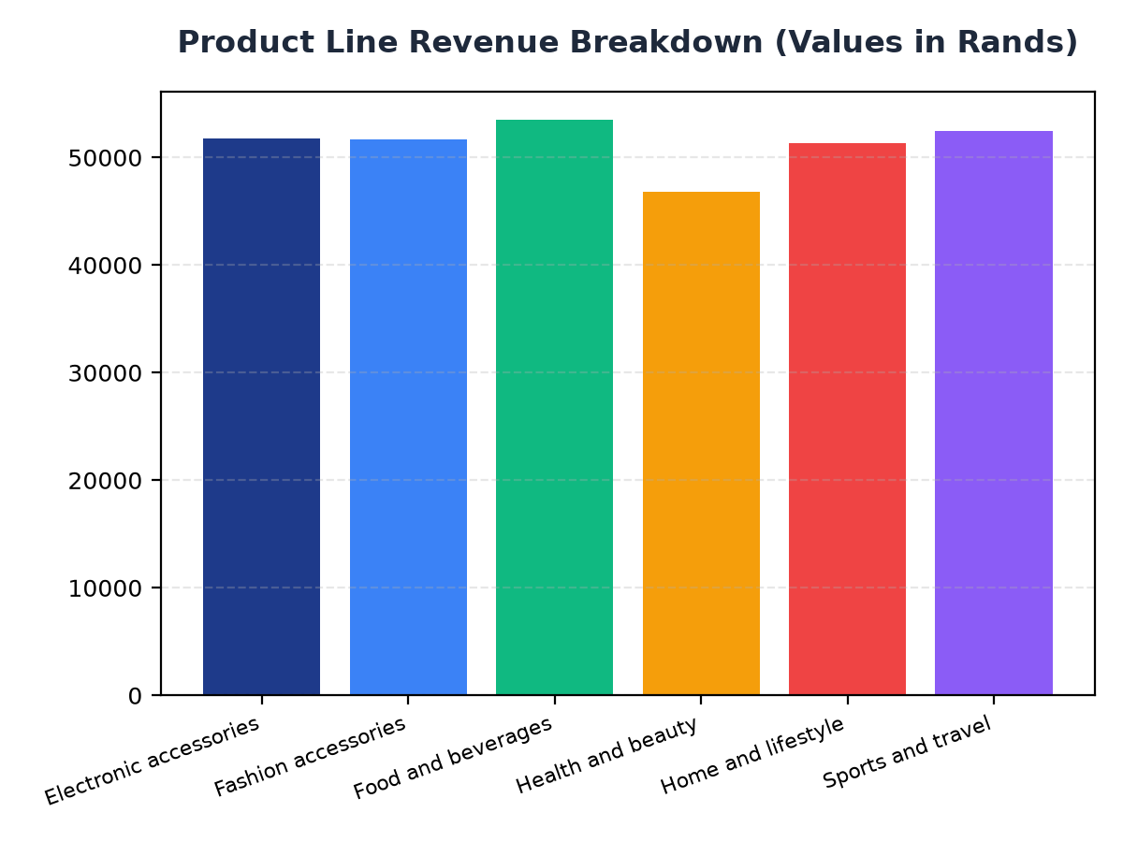
Product Line Revenue Breakdown
• Food and beverages generate the highest revenue with R53,471.28.
• Sports and travel, and Electronic accessories follow with R52,497.93 and R51,750.03 respectively.
• Strategic product placement and promotions should focus on these product lines to drive revenue.

