Slide 1
Supermarket Sales Analysis
Executive Market Analysis & Strategic Recommendations

Slide 2
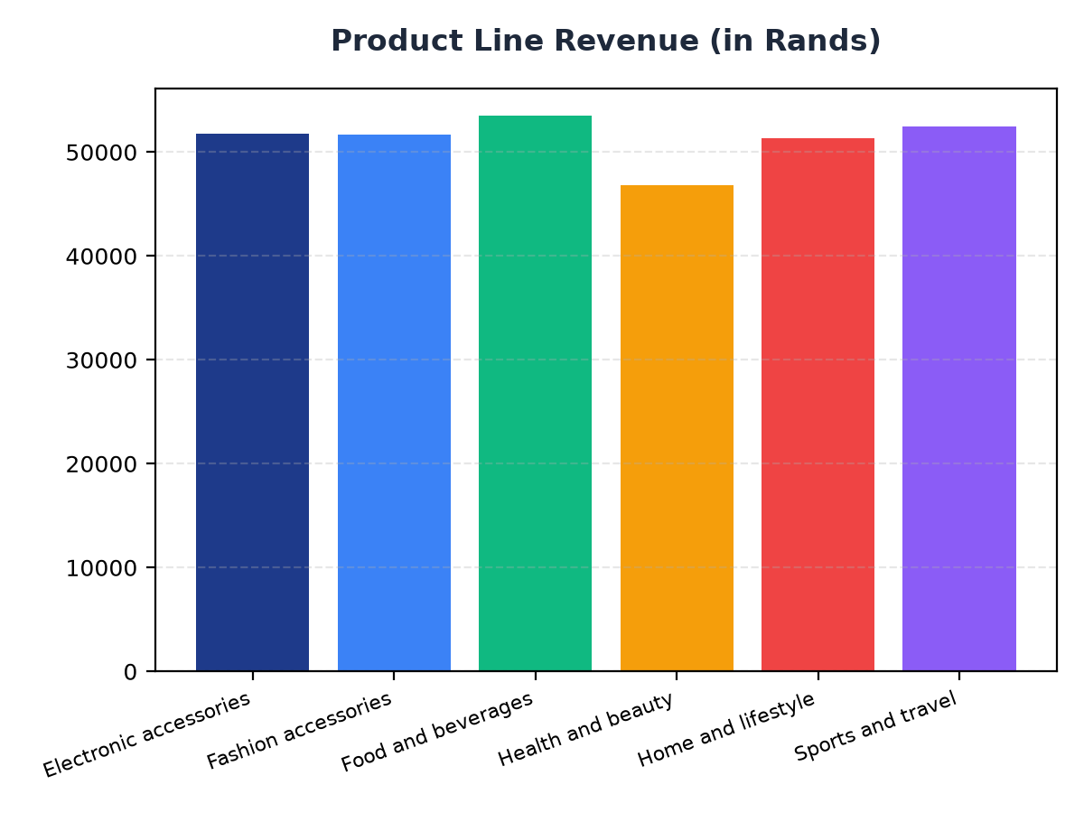
Product Line Revenue Analysis
Food and beverages generated the highest revenue at R53,471.28.
Electronic accessories and Fashion accessories have similar revenue, with R51,750.03 and R51,719.90 respectively.
Strategic recommendation: Increase marketing efforts for Food and beverages to maintain its top position.

Slide 3
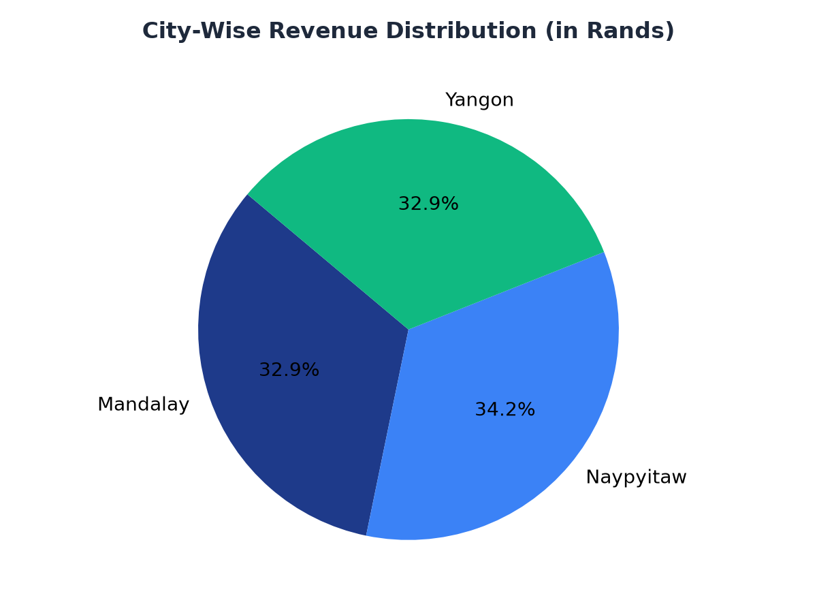
City-Wise Revenue Analysis
Naypyitaw has the highest revenue at R105,303.53, followed closely by Yangon at R101,143.21.
Mandalay has the lowest revenue at R101,140.64, but is still a significant contributor.
Strategic recommendation: Focus on increasing sales in Mandalay to bridge the gap with Naypyitaw and Yangon.

