Slide 1
Supermarket Sales Analysis
Executive Market Analysis & Strategic Recommendations

Slide 2
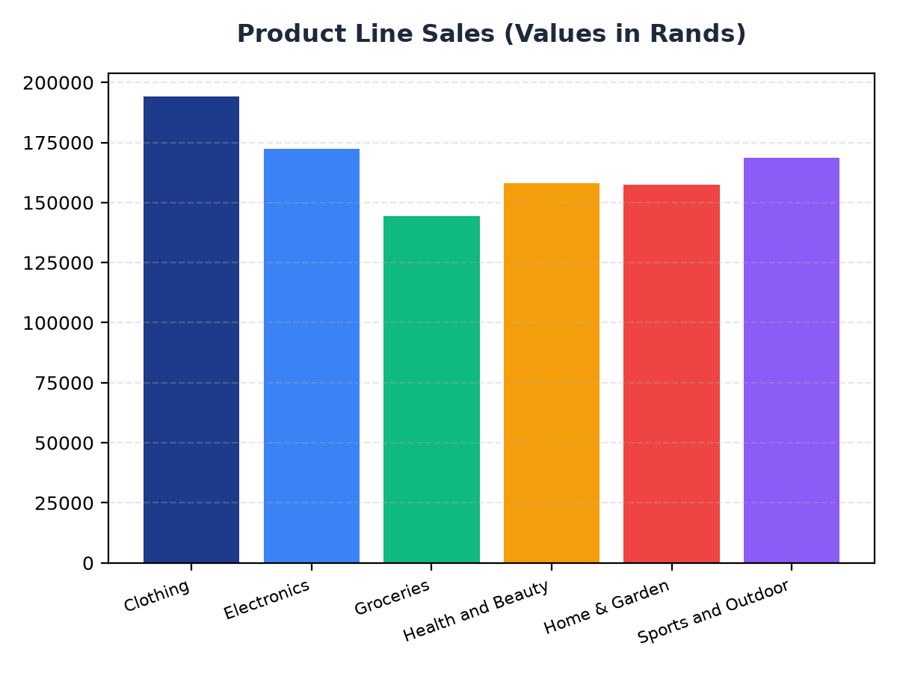
Product Line Sales Performance
The 'Sports and Outdoor' product line generated the highest sales with R168,556.40.
The 'Clothing' product line is the second best performing product line with R194,191.29 in sales.
To improve sales, focus on promoting the 'Sports and Outdoor' and 'Clothing' product lines.

Slide 3
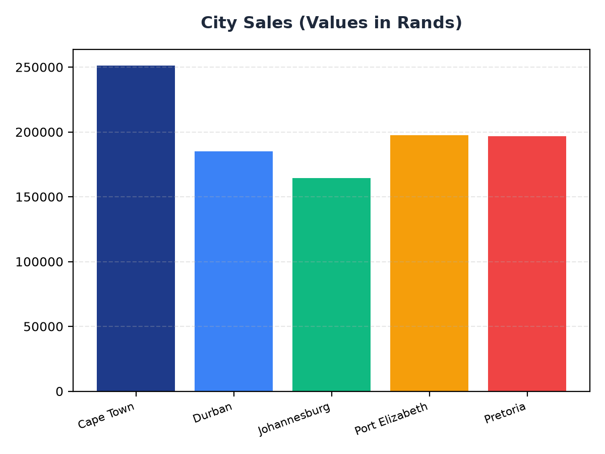
City Sales Performance
Cape Town is the best performing city with R251,197.57 in sales.
Johannesburg is the worst performing city with R164,348.89 in sales.
To improve sales, focus on increasing marketing efforts in Johannesburg and maintaining current strategies in Cape Town.

