Slide 1
Supermarket Sales Analysis
Regional Sales Performance and Product Line Insights

Slide 2
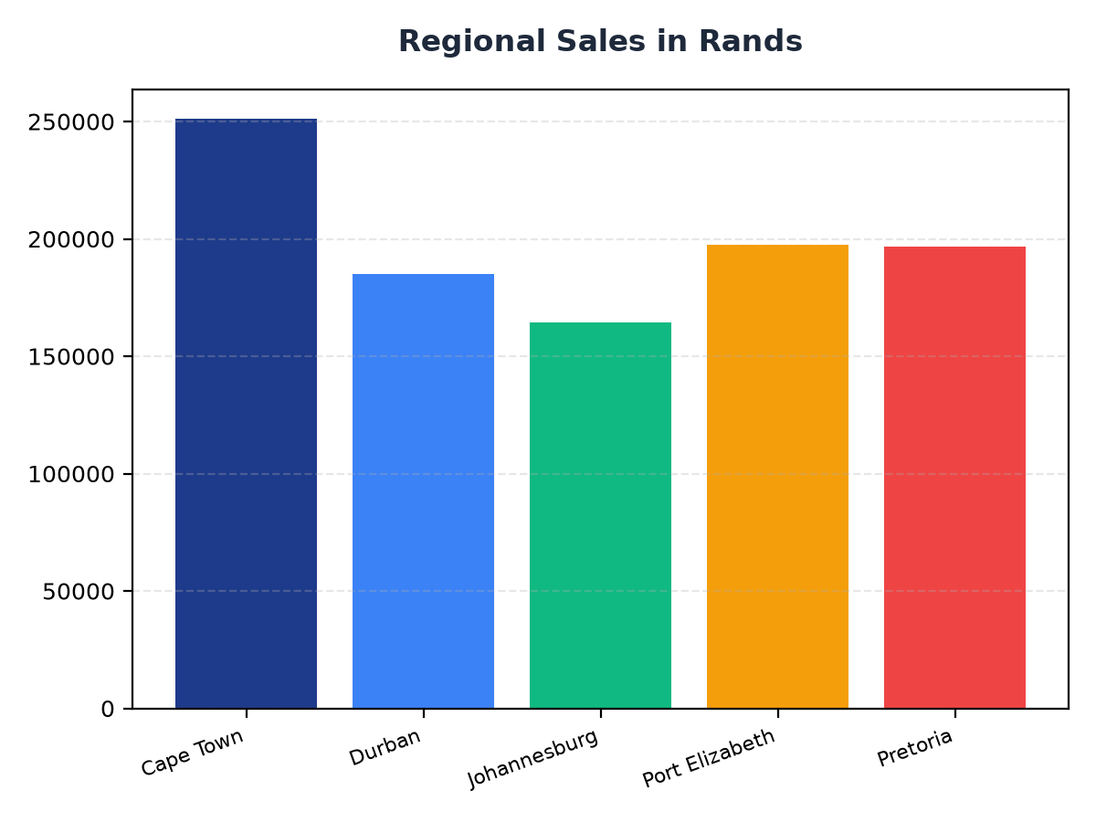
Regional Sales Breakdown
Cape Town accounts for R251,197.57 in sales, which is approximately 25.3% of total revenue
Durban and Johannesburg contribute R184,919.17 and R164,348.89 respectively, totaling around 35.1% of total sales
Port Elizabeth and Pretoria generate R197,538.62 and R196,831.41 in sales, making up around 39.5% of total revenue

Slide 3
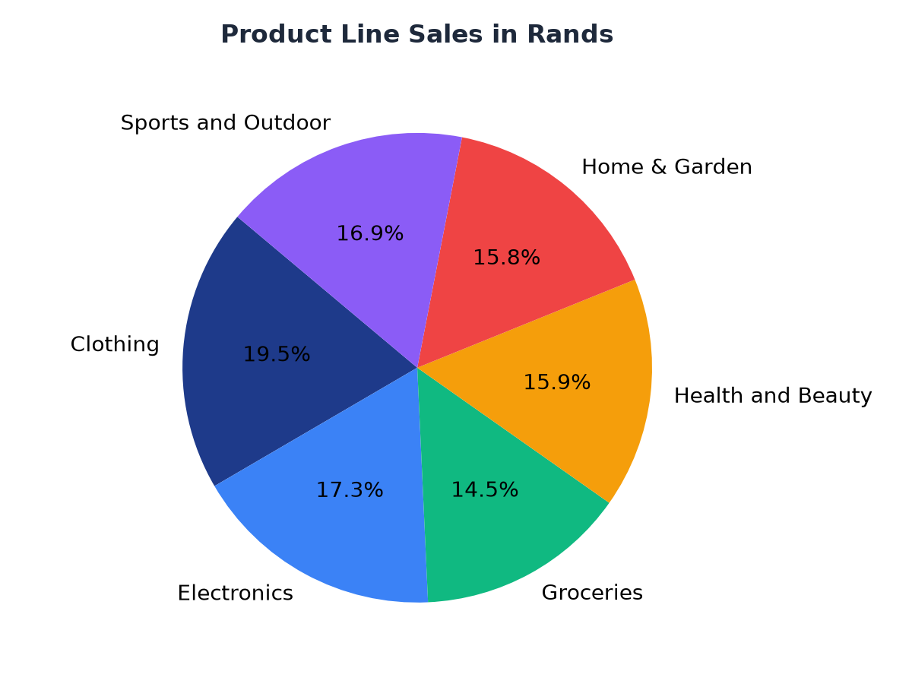
Product Line Sales Analysis
Clothing is the top-selling product line, generating R194,191.29 in revenue
Electronics and Groceries follow closely, with sales of R172,322.58 and R144,326.29 respectively
The remaining product lines, including Health and Beauty, Home & Garden, and Sports and Outdoor, contribute a combined R482,075.82 to total revenue

