Slide 1
South African Supermarket Sales Analysis
Executive Market Analysis & Strategic Recommendations

Slide 2
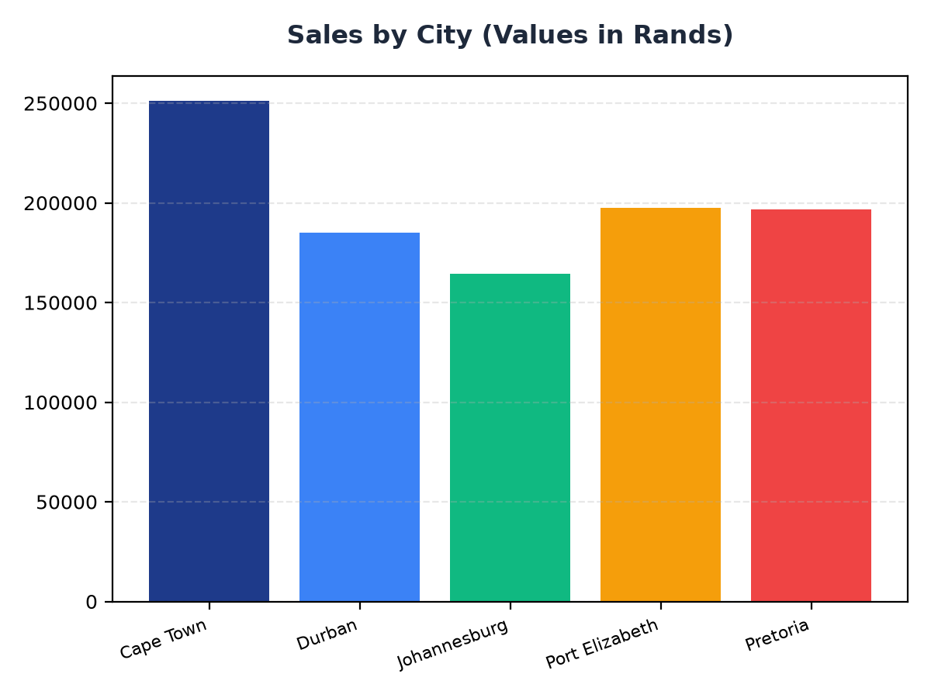
Sales by City
Cape Town has the highest sales at R251,197.57, followed by Port Elizabeth at R197,538.62 and Pretoria at R196,831.41
Durban and Johannesburg have sales of R184,919.17 and R164,348.89 respectively
Targeted business recommendation: Focus on expanding operations in Cape Town and Port Elizabeth to capitalize on high sales

Slide 3
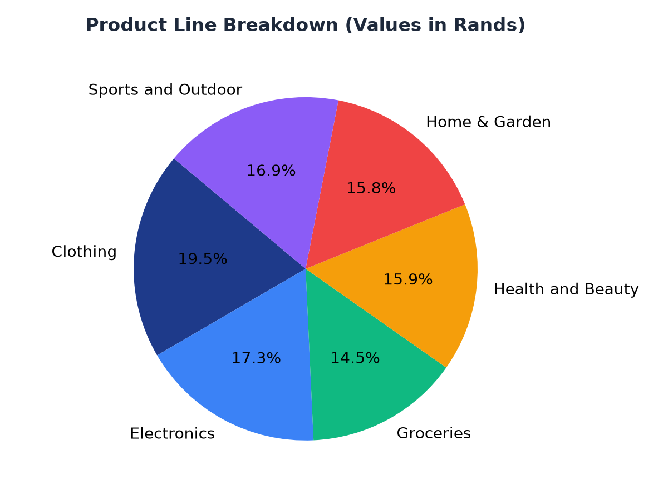
Product Line Breakdown
Clothing is the top-selling product line at R194,191.29, followed by Electronics at R172,322.58 and Groceries at R144,326.29
Health and Beauty, Home & Garden, and Sports and Outdoor have sales of R158,038.67, R157,400.43, and R168,556.40 respectively
Targeted business recommendation: Invest in marketing campaigns to promote Clothing and Electronics product lines

