Slide 1
Supermarket Sales Analysis
Executive Market Analysis & Strategic Recommendations

Slide 2
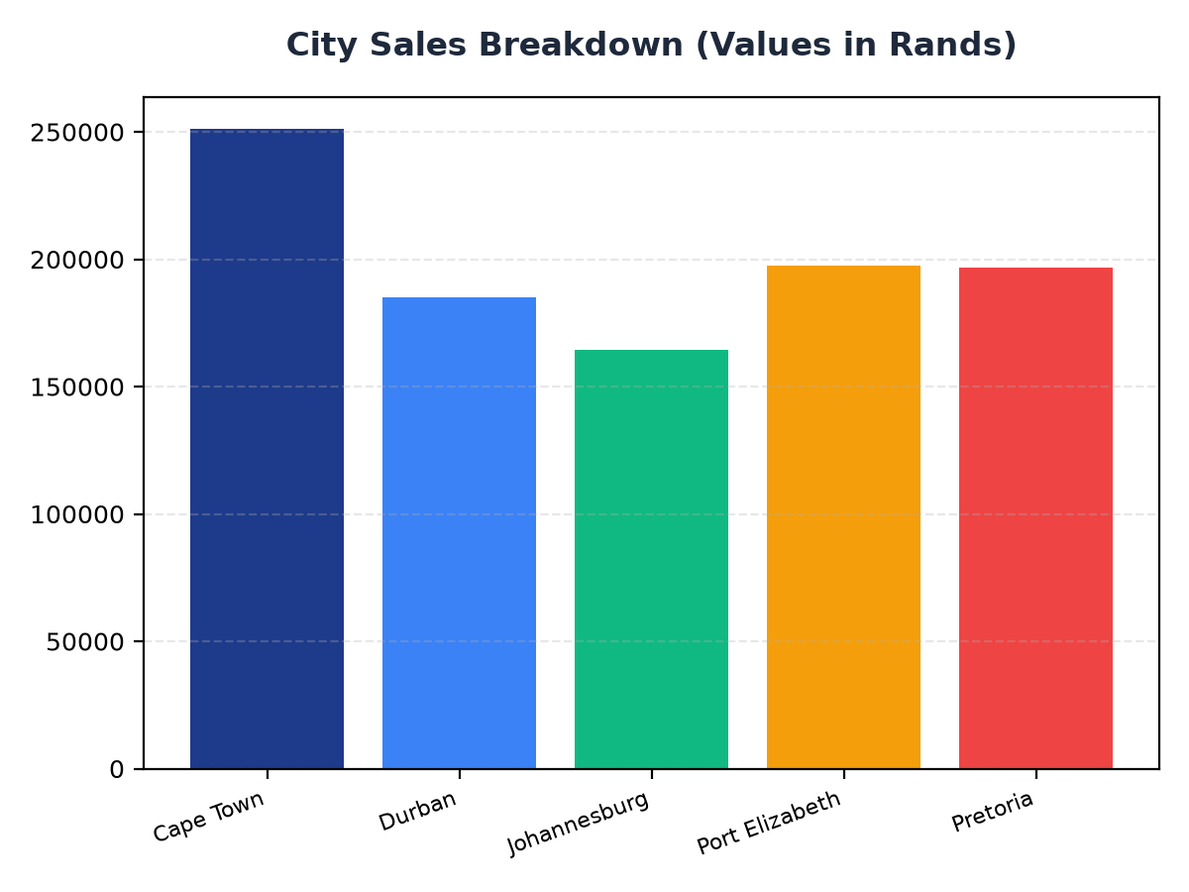
City Sales Breakdown
Cape Town generates the highest sales at R251,197.57, followed by Port Elizabeth and Pretoria at R197,538.62 and R196,831.41 respectively
Johannesburg and Durban have sales of R164,348.89 and R184,919.17 respectively
Targeted marketing efforts should focus on these cities to maximize revenue

Slide 3
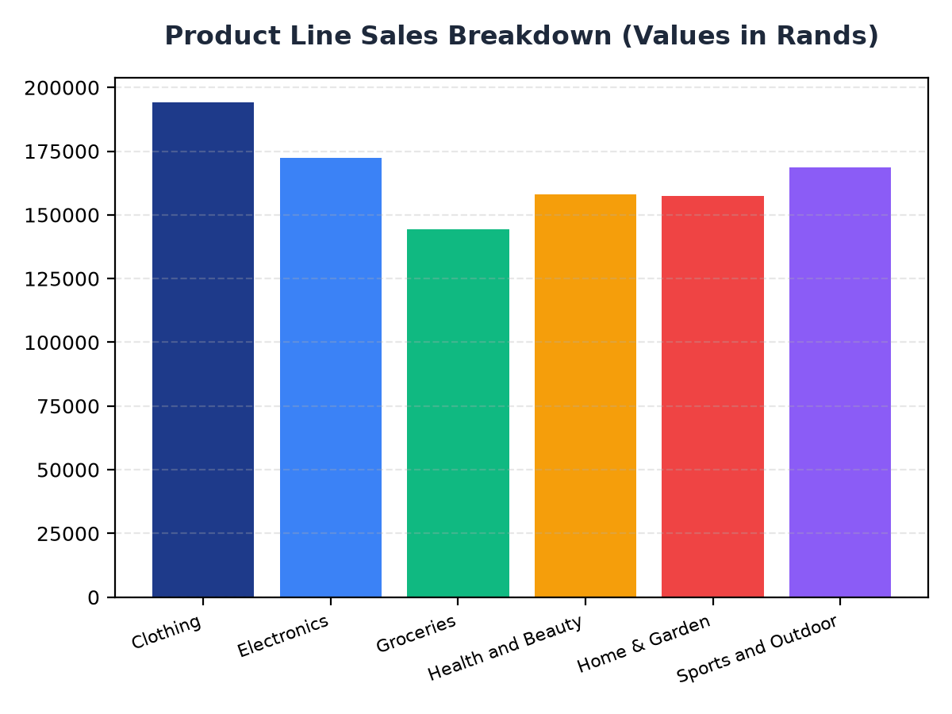
Product Line Sales Breakdown
Clothing is the top performing product line, generating R194,191.29 in sales
Electronics and Sports and Outdoor are also high performing categories, with sales of R172,322.58 and R168,556.40 respectively
Strategic inventory management and targeted promotions should focus on these product lines

