Slide 1
Supermarket Sales Analysis
Executive Market Analysis & Strategic Recommendations

Slide 2
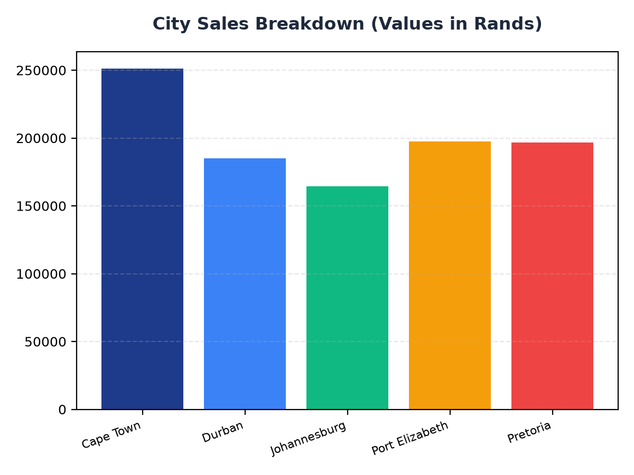
City Sales Breakdown
Cape Town contributes R251,197.57 to total sales, indicating a strong market presence
Durban and Johannesburg follow with R184,919.17 and R164,348.89 respectively, suggesting opportunities for growth
Targeted marketing strategies could enhance sales in Pretoria and Port Elizabeth, which contribute R196,831.41 and R197,538.62 respectively

Slide 3
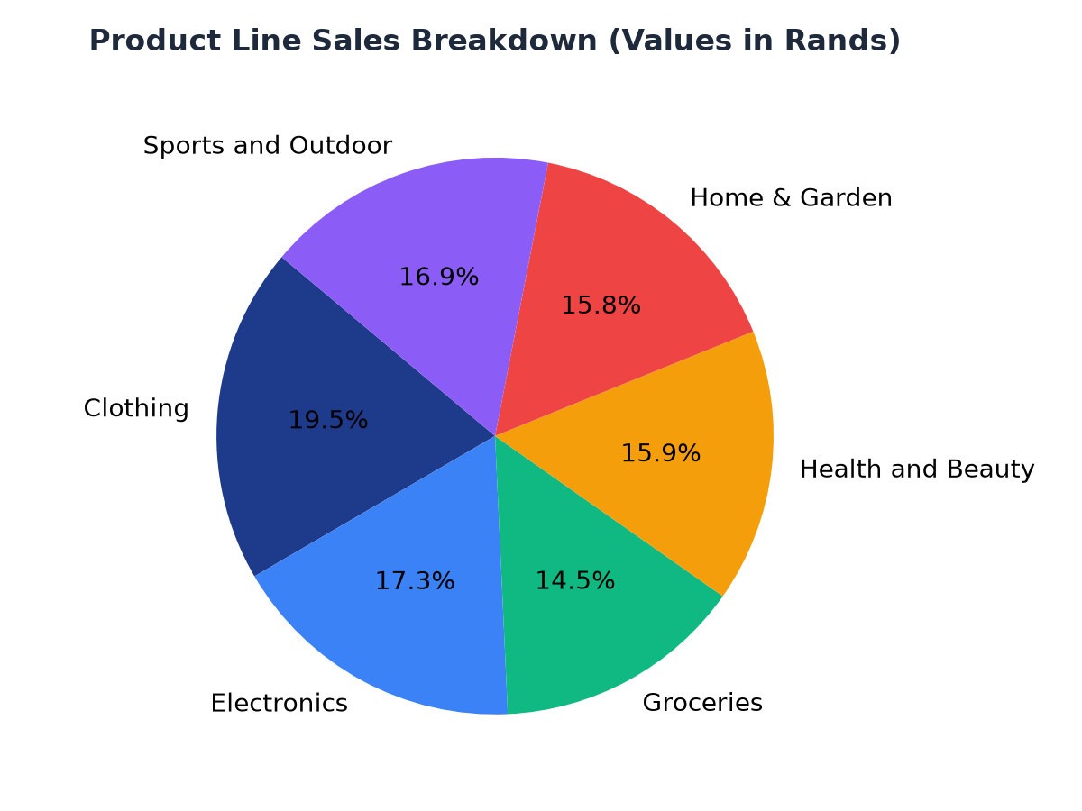
Product Line Sales Analysis
Clothing is the top-selling product line at R194,191.29, indicating a strong demand for apparel
Electronics and Groceries follow with R172,322.58 and R144,326.29 respectively, suggesting a diverse customer base
Strategic inventory management and targeted promotions could enhance sales across all product lines

