Slide 1
South African Supermarket Sales Analysis
Executive Market Analysis & Strategic Recommendations

Slide 2
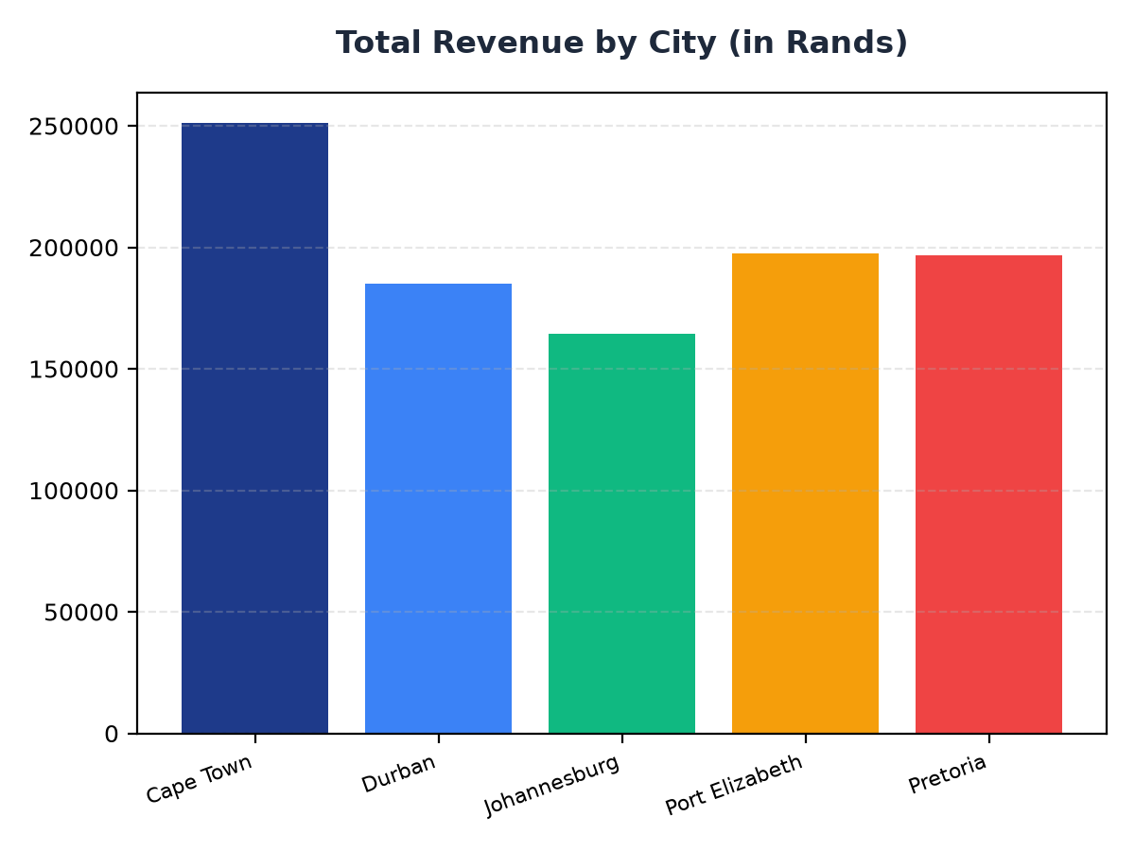
Total Revenue by City
Cape Town generated the highest revenue at R251,197.57
Port Elizabeth and Pretoria have similar revenue at R197,538.62 and R196,831.41 respectively
Johannesburg has the lowest revenue among the top 5 cities at R164,348.89

Slide 3
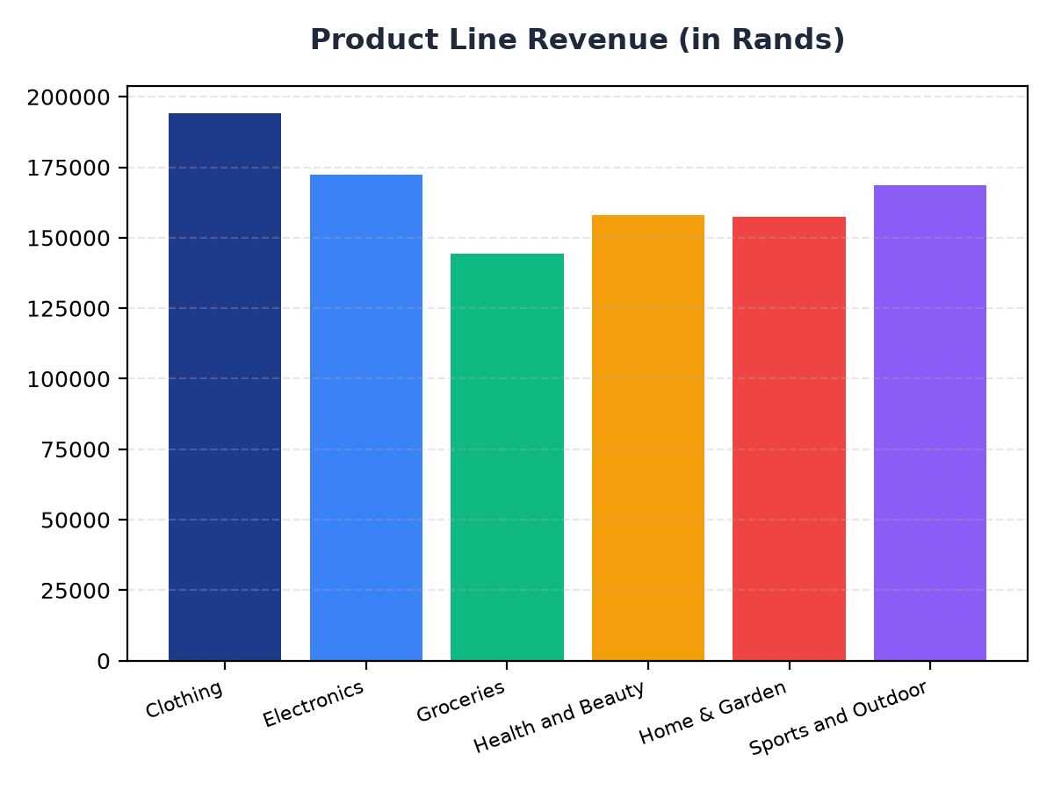
Product Line Revenue
Clothing is the top-selling product line, generating R194,191.29 in revenue
Electronics and Sports and Outdoor product lines have similar revenue at R172,322.58 and R168,556.40 respectively
Groceries have the lowest revenue among the product lines at R144,326.29

