Slide 1
Supermarket Sales Analysis
Executive Market Analysis & Strategic Recommendations

Slide 2
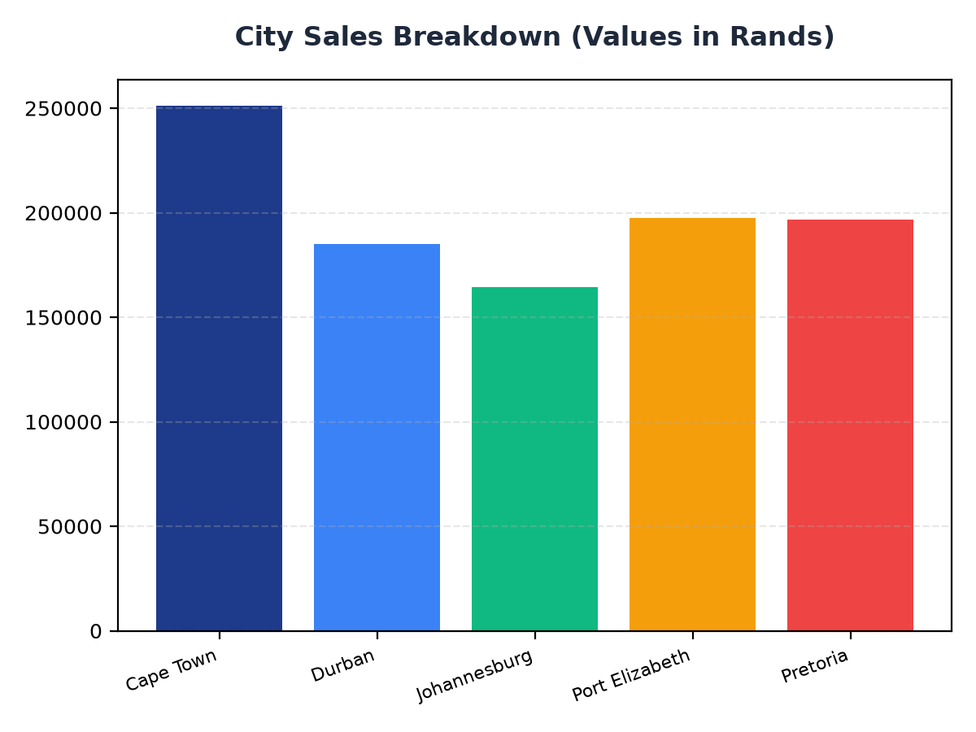
City Sales Breakdown
Cape Town contributes R251,197.57 to total sales, indicating a strong market presence
Durban and Johannesburg follow with R184,919.17 and R164,348.89 respectively, suggesting opportunities for growth
Targeted marketing efforts in these cities could increase overall revenue

Slide 3
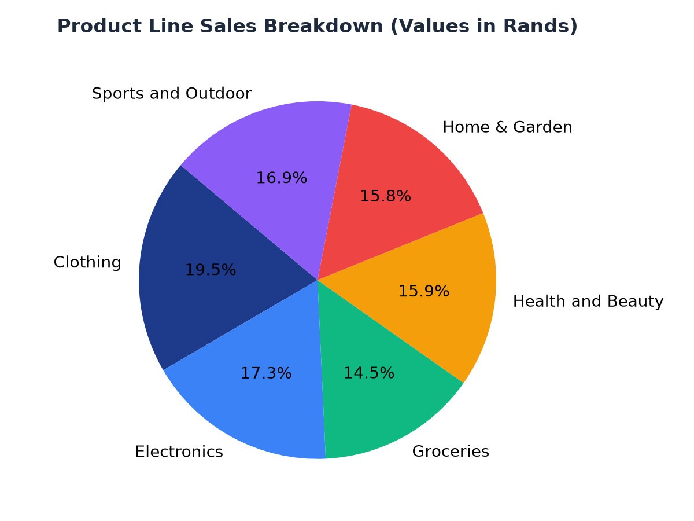
Product Line Sales Analysis
Clothing is the top-selling product line at R194,191.29, indicating a strong demand for apparel
Electronics and Health and Beauty follow with R172,322.58 and R158,038.67 respectively, suggesting a growing interest in these categories
Strategic inventory management and targeted promotions could increase sales in these product lines

