Slide 1
Supermarket Sales Analysis
Executive Market Analysis & Strategic Recommendations

Slide 2
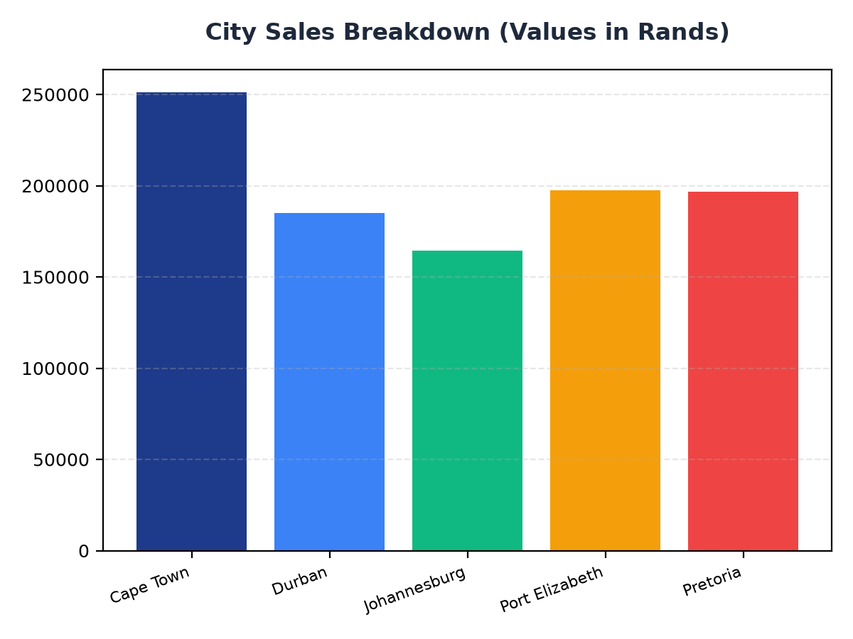
City Sales Breakdown
Cape Town generated the highest sales at R251,197.57
Pretoria and Port Elizabeth have similar sales figures, at R196,831.41 and R197,538.62 respectively
Targeted marketing efforts should focus on increasing sales in Durban and Johannesburg

Slide 3
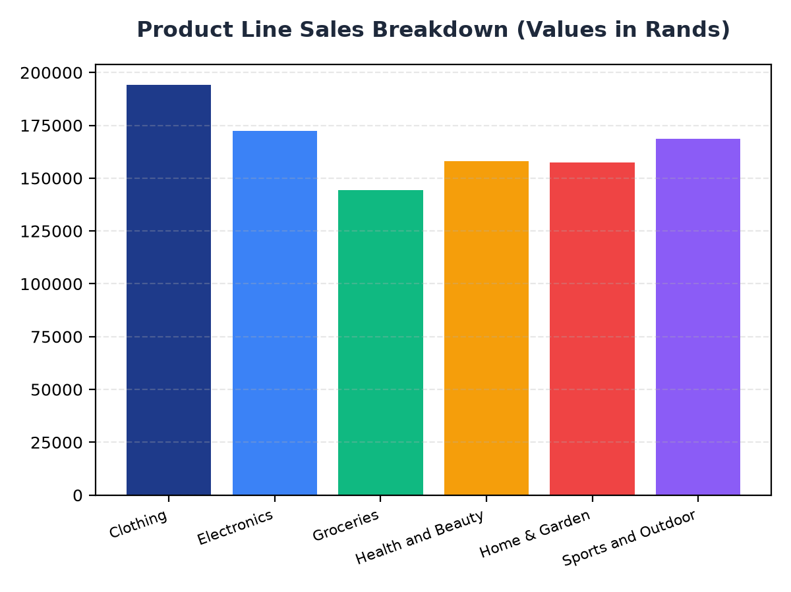
Product Line Sales Breakdown
Clothing is the top-selling product line, generating R194,191.29 in revenue
Electronics and Sports and Outdoor product lines have similar sales figures, at R172,322.58 and R168,556.40 respectively
Strategic pricing and promotion strategies should be implemented to increase sales in the Groceries product line

