Slide 1
Sales Analysis and Market Insights
Executive Sales Report & Strategic Recommendations

Slide 2
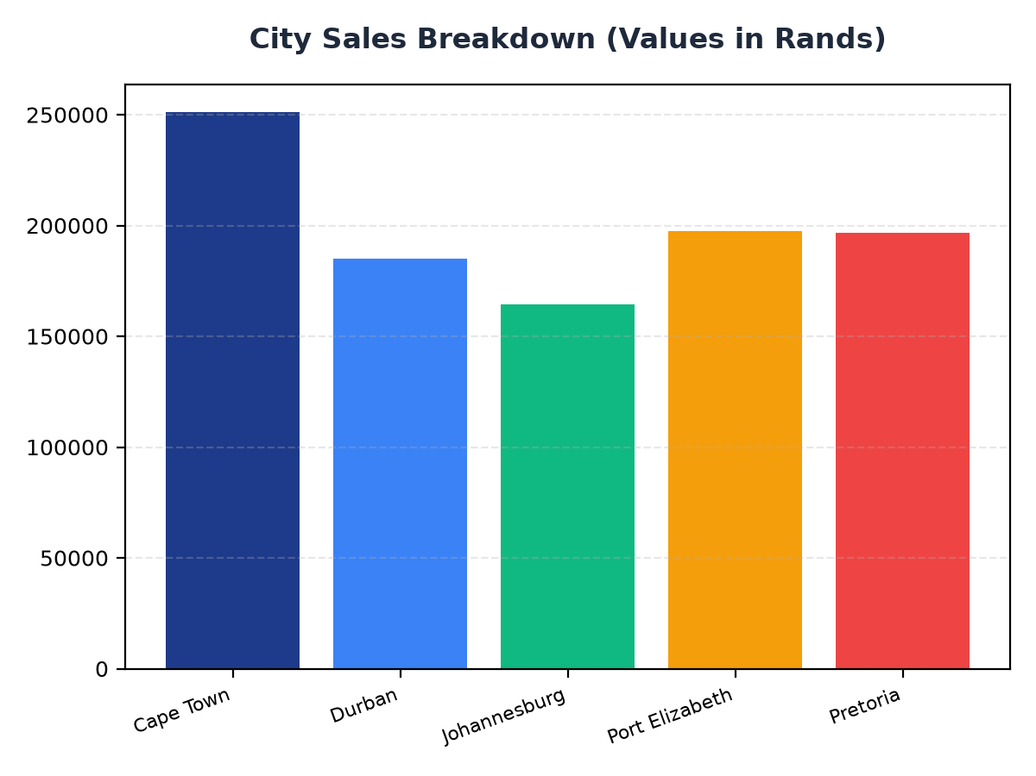
City Sales Breakdown
Cape Town leads in sales with R251,197.57, followed by Port Elizabeth at R197,538.62
Johannesburg and Durban have sales of R164,348.89 and R184,919.17 respectively
Pretoria has the lowest sales among the top cities at R196,831.41

Slide 3
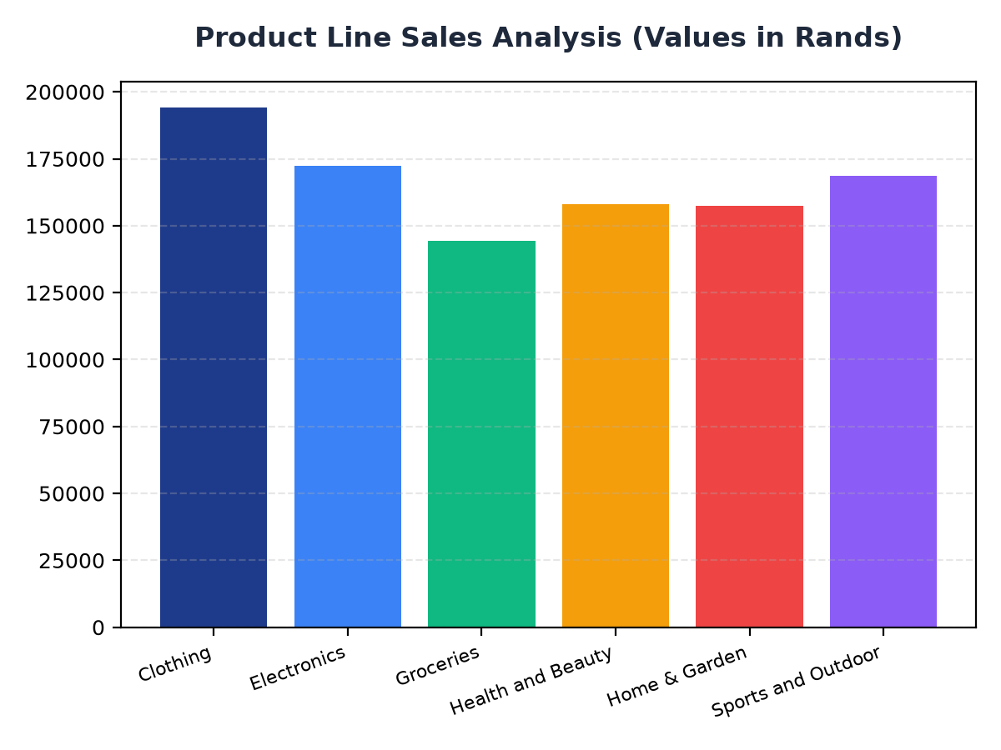
Product Line Sales Analysis
Clothing is the top-selling product line with R194,191.29 in revenue
Electronics and Sports and Outdoor have sales of R172,322.58 and R168,556.40 respectively
Groceries and Health and Beauty have sales of R144,326.29 and R158,038.67 respectively

