Slide 1
Sales Analysis and Market Insights
Executive Summary of Sales Performance

Slide 2
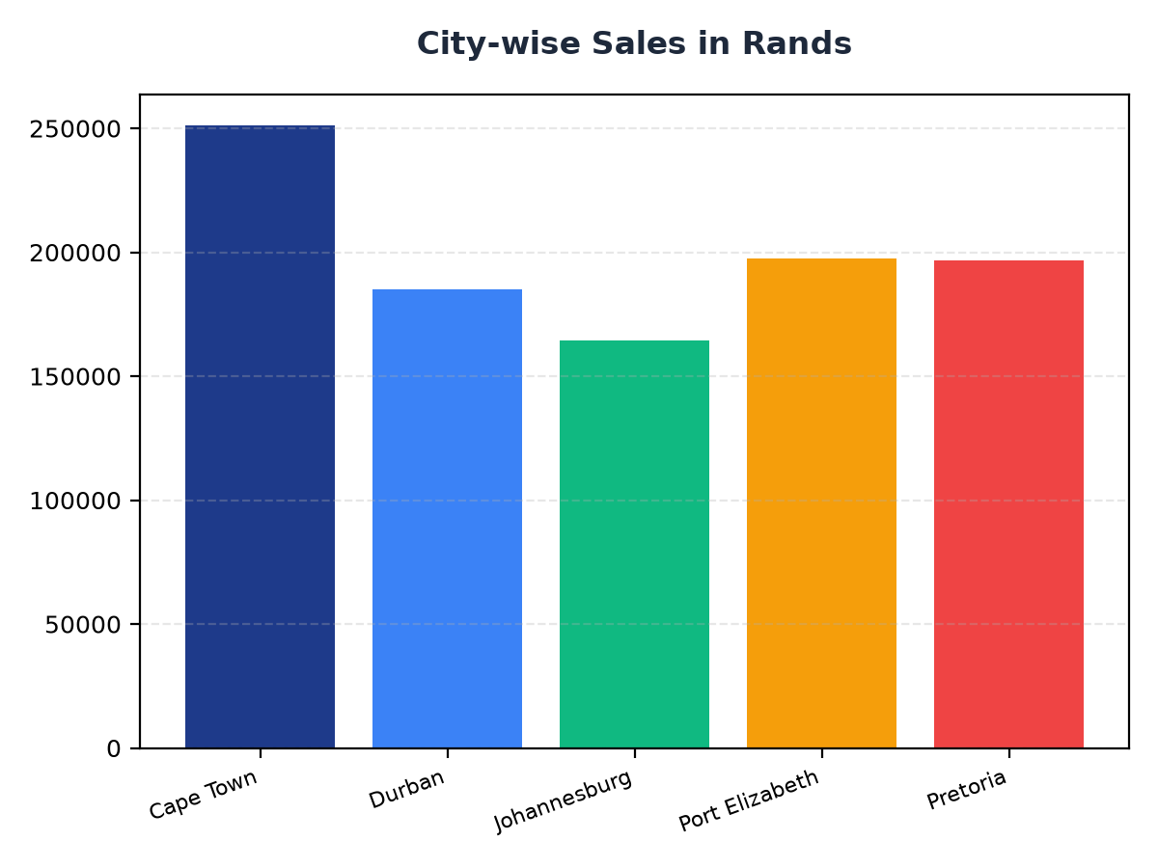
City-wise Sales Breakdown
Cape Town leads with R251,197.57 in sales, indicating a strong market presence.
Durban and Johannesburg follow with R184,919.17 and R164,348.89 respectively, showing potential for growth.
Targeted marketing strategies could enhance sales in Pretoria and Port Elizabeth, which have revenues of R196,831.41 and R197,538.62 respectively.

Slide 3
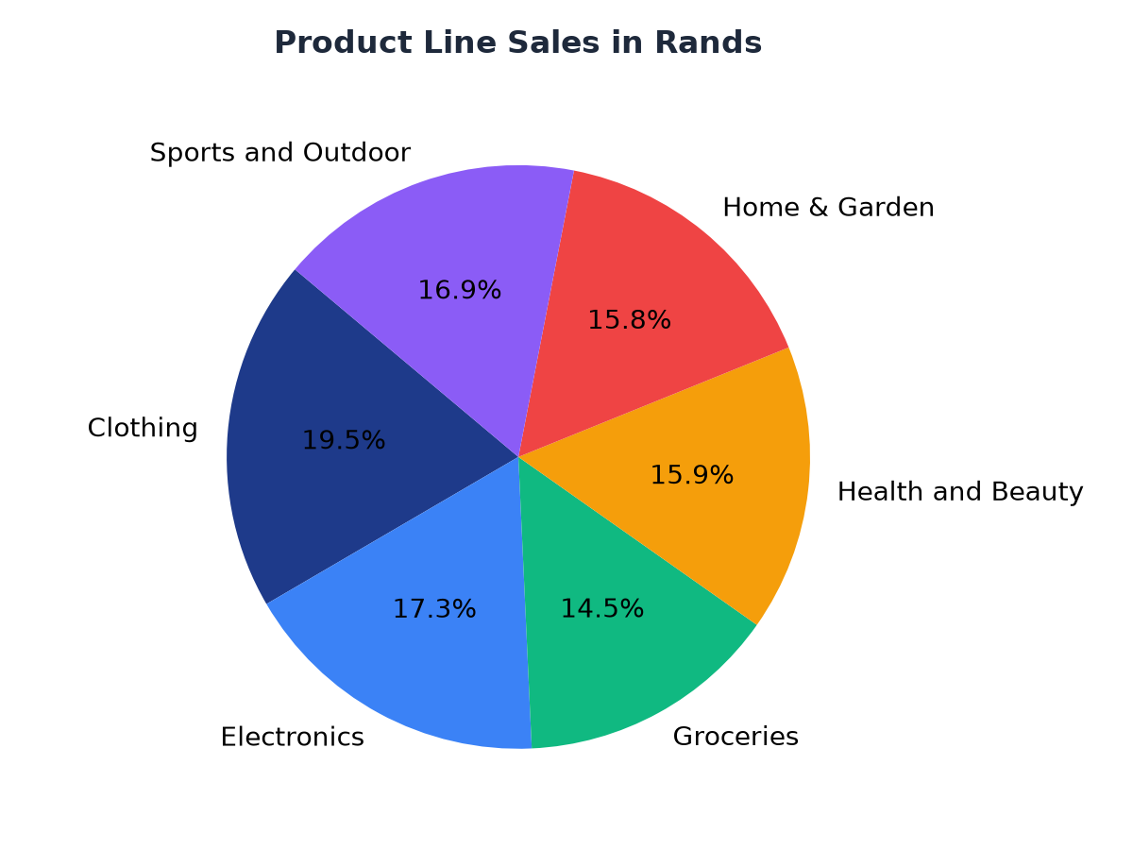
Product Line Sales Analysis
The Clothing product line generates the highest revenue at R194,191.29, indicating strong demand.
Electronics and Health and Beauty follow with R172,322.58 and R158,038.67 respectively, showing a balanced product portfolio.
Strategic pricing and promotion of Groceries, Home & Garden, and Sports and Outdoor could further boost sales.

