Slide 1
Sales Analysis and Insights
Executive Sales Report and Strategic Recommendations

Slide 2
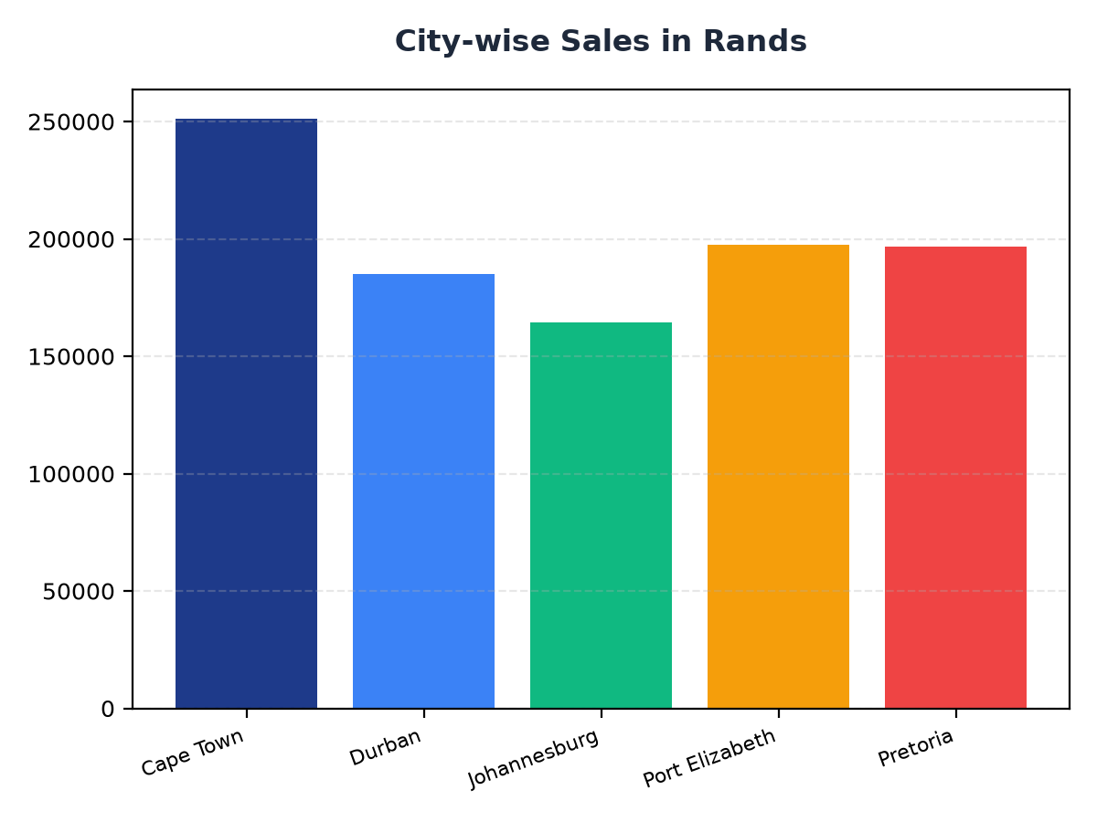
City-wise Sales Breakdown
Cape Town leads with R251,197.57 in sales, followed by Port Elizabeth with R197,538.62.
Johannesburg and Durban contribute R164,348.89 and R184,919.17 respectively to the total revenue.
Pretoria's sales amount to R196,831.41, indicating a strong market presence.

Slide 3
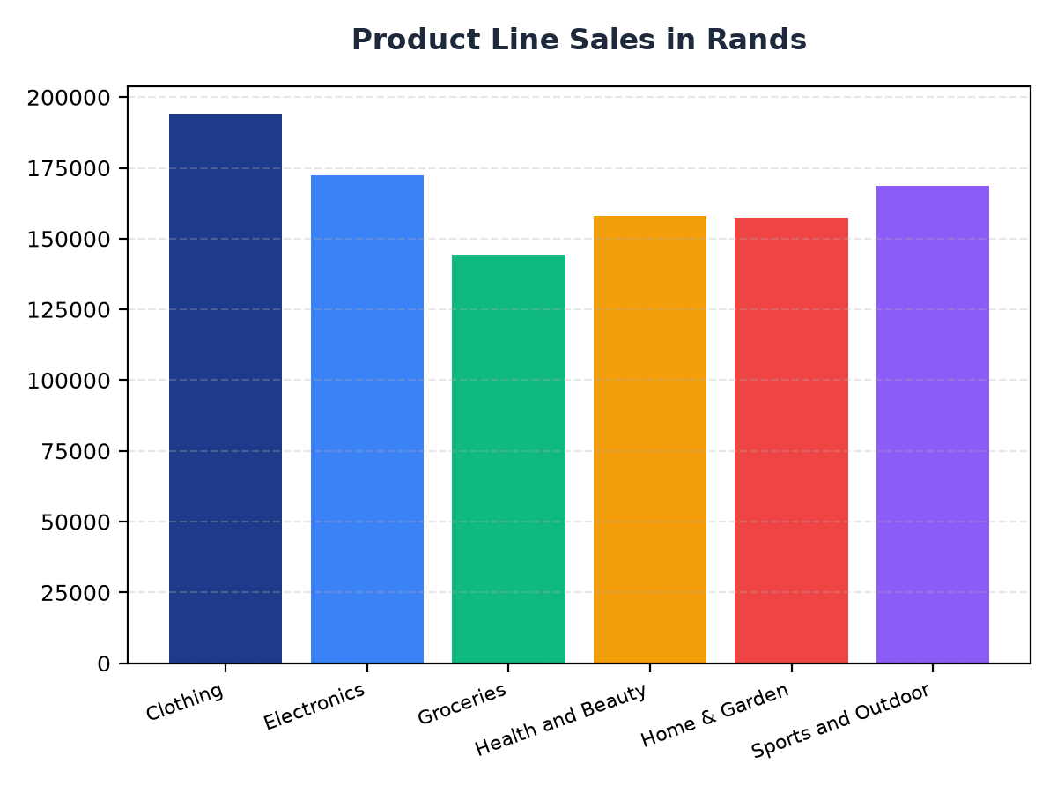
Product Line Sales Analysis
The Clothing product line generates R194,191.29 in sales, making it a significant contributor to total revenue.
Electronics and Health and Beauty product lines contribute R172,322.58 and R158,038.67 respectively to the sales.
Groceries, Home & Garden, and Sports and Outdoor product lines also show notable sales figures.

