Slide 1
Supermarket Sales Analysis
Executive Market Analysis & Strategic Recommendations

Slide 2
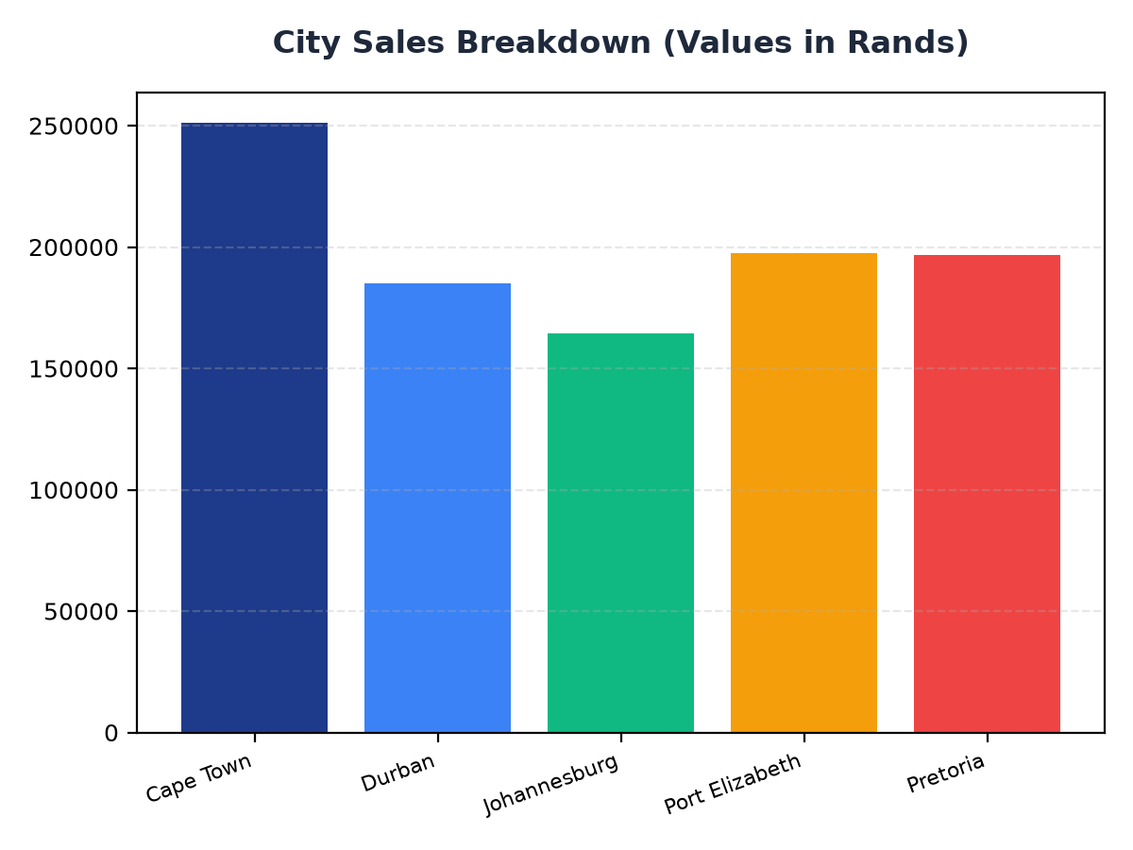
City Sales Breakdown
Cape Town contributes R251,197.57 to total sales, representing the largest city share
Port Elizabeth and Pretoria follow closely, with sales of R197,538.62 and R196,831.41 respectively
Targeted marketing efforts in these cities could further boost sales

Slide 3
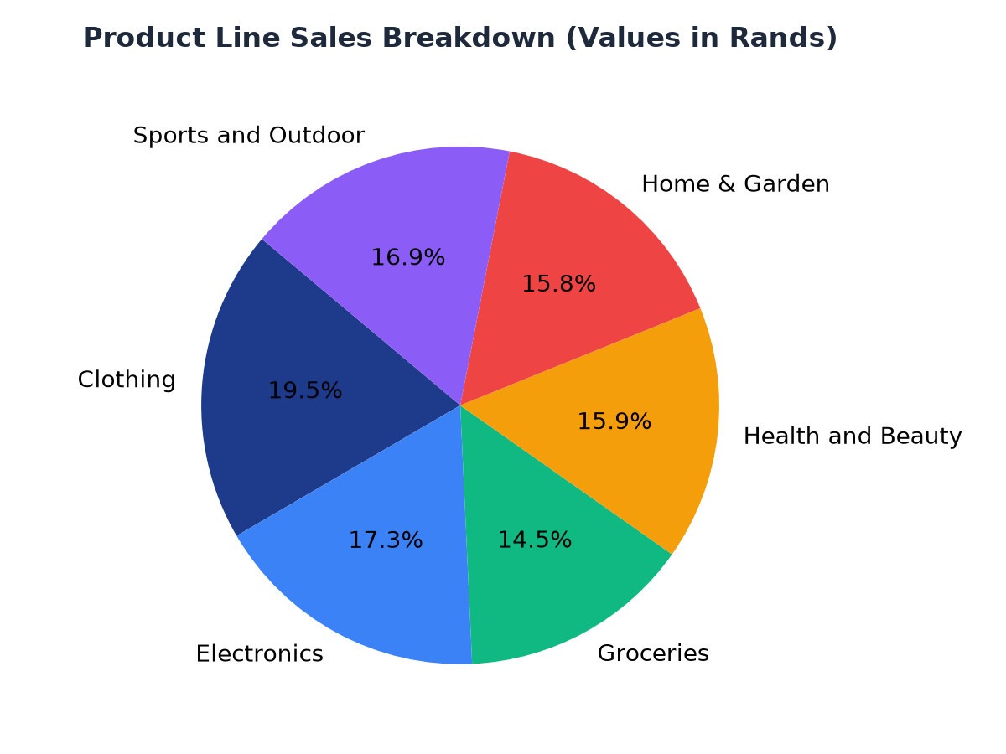
Product Line Sales Analysis
Clothing is the top-selling product line, generating R194,191.29 in revenue
Electronics and Sports and Outdoor product lines also show significant sales, with R172,322.58 and R168,556.40 respectively
Focusing on these product lines could lead to increased overall sales

