Slide 1
Survival Analysis Methods Correcting for Treatment Switching Effects in RCTs: Theory and SAS/R Code (Part II)
ASA short course recap
Wenyi Fan, Biwei Cao

Slide 2
Recap Why Treatment-Switching Is a Problem
Treatment switching is common in oncology trials e.g., progression → crossover to active therapy
Leads to non-compliance and post-randomization confounding
ITT preserves randomization but treatment effect is diluted or biased
One-way Switching
Two-way Switching
Need causal methods to reconstruct a “no-switching” counterfactual

Slide 3
Four Causal Inference Methods
Marginal Structural Model (MSM)
Inverse Probability of Censoring Weighting (IPCW)
Rank Preserving Structure Failure Time (RPFST) Model
Two Stage Estimation (TSE)

Slide 4
Recap Weighting Methods
MSM handles time-dependent confounding
IPCW addresses informative censoring
Both are weighting-based methods (inverse-probability weighting) — create a pseudo-population where treatment & censoring behave “as-if random”
Assumptions:
Method | Key Assumptions
MSM | 1) No unmeasured time-varying confounding 2) Treatment Positivity 3) Correct treatment model 4) Consistency
IPCW | 1) No unmeasured affecting censoring 2) Censoring positivity 3) Correct censoring model 4) Consistency

Slide 5
Rank Preserving Structure Failure Time Model (RPSFTM) Conceptually
Observed survival time
Time before switching
Observed time after switching
Time before switching
Counterfactual time after switching
Survival time attributable to treatment
Counterfactual survival time
Observed survival = Time before switching + Time after switching
Treatment can only affect survival after it begins
For the time after switching, RPSFTM asks a “what if” question:
What if this patient had never switched to the alternative treatment
If treatment is beneficial, survival during the treated period is longer than it would have been
RPSFTM removes this benefit by shortening the post-treatment time
RPSFTM then finds the amount of shortening that makes the two randomized groups align

Slide 6
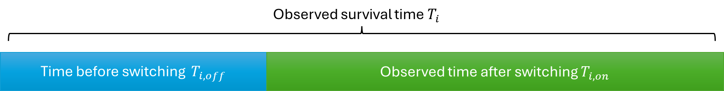
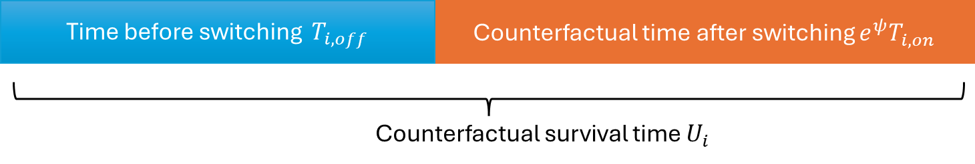
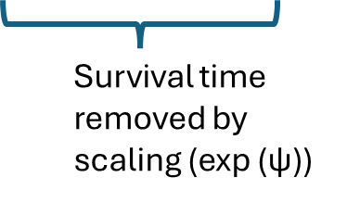
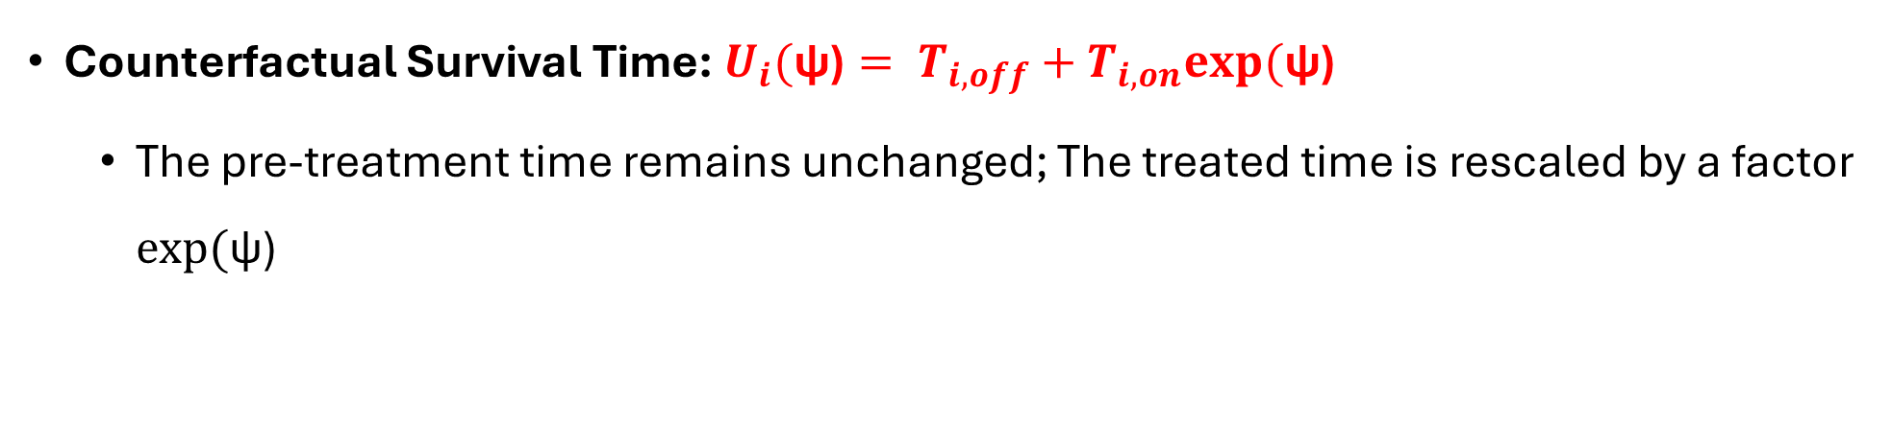
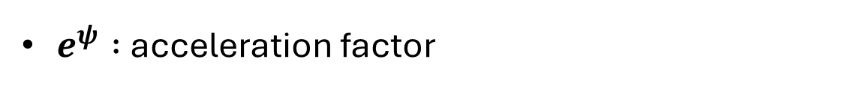
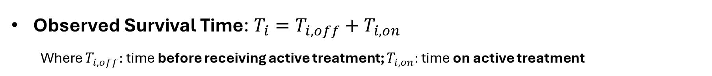
Rank Preserving Structure Failure Time Model (RPSFTM) Mathematical Formulation
Observed Survival Time: ${T_{i}=T}_{i,off}+T_{i,on}$
Where $T_{i,off}:$ time before receiving active treatment; $T_{i,on}:$ time on active treatment
Counterfactual Survival Time: ${U_{i}(\text{ψ}\text{)}= T}_{i,off}+T_{i,on}exp⁡(\text{ψ}\text{)}$
The pre-treatment time remains unchanged; The treated time is rescaled by a factor $exp⁡(\text{ψ}\text{)}$
$e^{ψ} :$acceleration factor

Slide 7

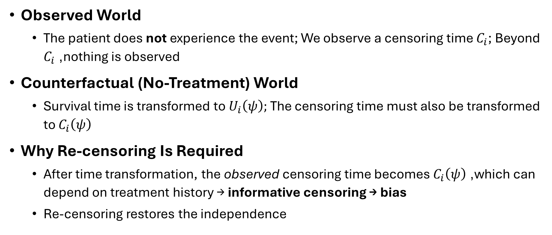
Rank Preserving Structure Failure Time Model (RPSFTM) Re-censoring
Observed World
The patient does not experience the event; We observe a censoring time $C_{i}$; Beyond $C_{i}$, nothing is observed
Counterfactual (No-Treatment) World
Survival time is transformed to $U_{i}\left(ψ\right);$The censoring time must also be transformed to $C_{i}\left(ψ\right)$
Why Re-censoring Is Required
After time transformation, the observed censoring time becomes $C_{i}\left(ψ\right)$, which can depend on treatment history → informative censoring → bias
Re-censoring restores the independence

Slide 8
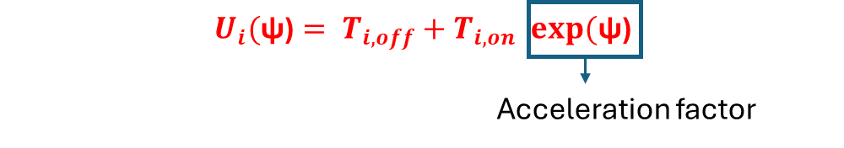
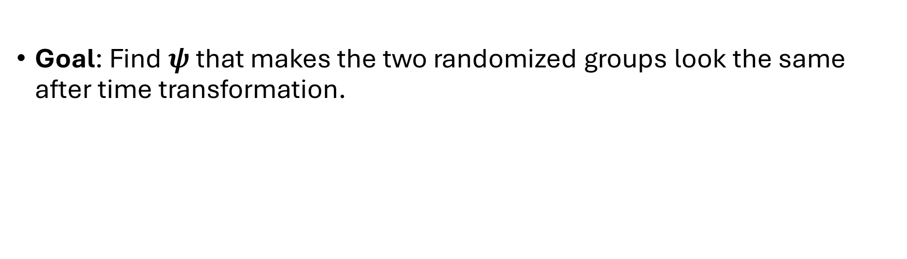

Rank Preserving Structure Failure Time Model (RPSFTM) How Is $ψ$Estimated
Counterfactual survival time:
Goal: Find $ψ$ that makes the two randomized groups look the same after time transformation.

Slide 9
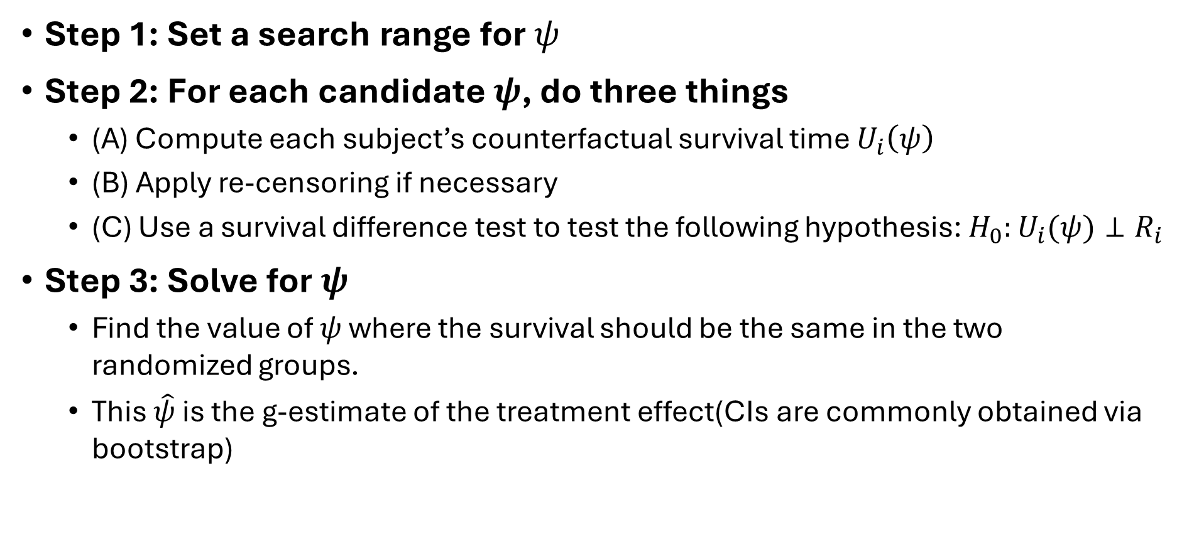

Rank Preserving Structure Failure Time Model (RPSFTM) How Is $ψ$Estimated – G-estimation
Step 1: Set a search range for $ψ$
Step 2: For each candidate $ψ$, do three things
(A) Compute each subject’s counterfactual survival time $U_{i}\left(ψ\right)$
(B) Apply re-censoring if necessary
(C) Use a survival difference test to test the following hypothesis: $H_{0}:U_{i}(ψ)⊥R_{i}$
Step 3: Solve for $ψ$
Find the value of $ψ$ where the survival should be the same in the two randomized groups.
This $\hat{ψ}$ is the g-estimate of the treatment effect(CIs are commonly obtained via bootstrap)

Slide 10
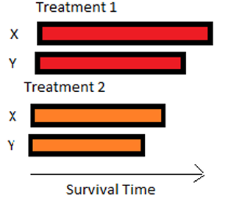
Rank Preserving Structure Failure Time Model (RPSFTM) Assumptions
Randomization ensures the treatment and control arms are comparable at baseline.
In a hypothetical world, the two randomized groups would have the same survival distribution.
Therefore, treatment assignment affects survival only through actual treatment exposure.
If patient X would live longer than patient Y without treatment, then patient X would also live longer than patient Y if both were treated.
Treatment rescales time but does not reverse who survives longer.
Every unit of time on treatment has the same effect for all patients
The treatment effect does not depend on:
when treatment starts,
disease stage at treatment initiation,
whether treatment is received at baseline or after switching
All treated time is rescaled by one common factor, exp⁡(ψ)
Latent survival time is the same in both arms
Rank-preserving assumptions
Constant treatment effect assumption

Slide 11
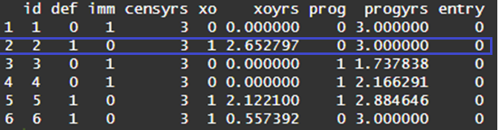
Rank Preserving Structure Failure Time Model (RPSFTM) R Code - rpsftm package
https://cran.r-project.org/web/packages/rpsftm/vignettes/rpsftm_vignette.html
Syntax
rpsftm(formula, data, censor_time, subset, na.action, test=survdiff, low_psi=-1, hi_psi=1, alpha=0.05, treat_modifier=1, autoswitch=TRUE, n_eval_z=100, ...)
Dataset (immdef)
A simulated dataset from White et al. (2002), based on a randomized trial comparing immediate versus deferred zidovudine treatment in asymptomatic HIV-infected participants.
def: indicator for assignment to deferred treatment
imm: indicator for assignment to immediate treatment
censyrs: censoring time
xo: indicator of treatment switching
xoyrs: time from randomization to treatment crossover
prog: indicator of disease progression

Slide 12
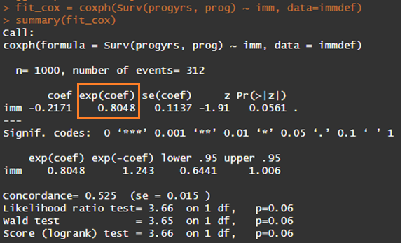
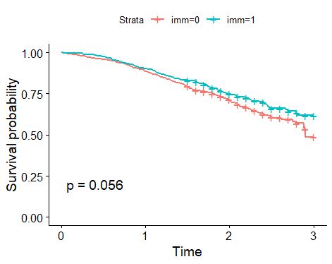
Rank Preserving Structure Failure Time Model (RPSFTM) R Code - ITT analysis
KM_noadj <- survfit(Surv(progyrs, prog) ~ imm, data=immdef)ggsurvplot(KM_noadj,data = immdef,pval = T)

Slide 13
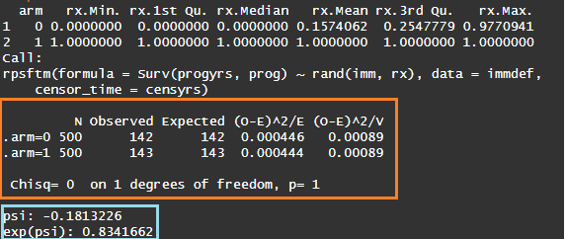

Rank Preserving Structure Failure Time Model (RPSFTM) R Code - RPSFTM
rx <- with(immdef, 1 - xoyrs/progyrs)
rpsftm_fit_lr <- rpsftm(formula = Surv(progyrs, prog) ~ rand(imm, rx), data = immdef, censor_time = censyrs)

Slide 14
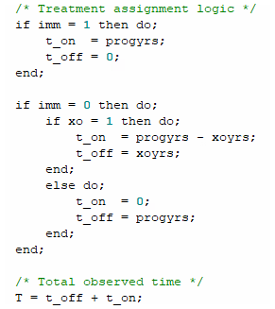
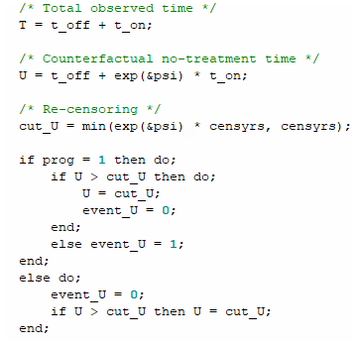
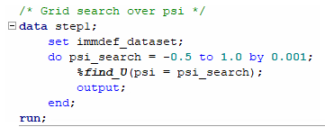
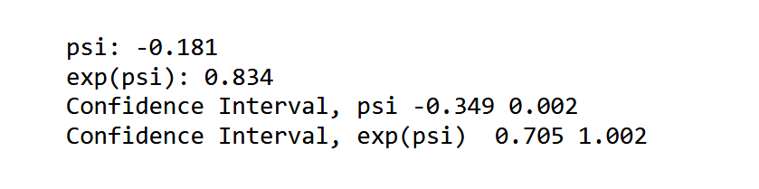


Rank Preserving Structure Failure Time Model (RPSFTM) SAS Code
Key steps
Grid search over ψ
Construct Counterfactual survival time and re-censoring
Identify $\hat{ψ}$ by log-rank test
Split each subject’s follow-up time into time on treatment and time off treatment

Slide 15
Rank Preserving Structure Failure Time Model (RPSFTM) Pros and Cons
Pros
Does not rely on covariate information, thereby relaxing the no unmeasured confounding assumption.
Cons
This method is only suitable for one-way switching.
Remains applicable even with very high levels of treatment switching, including settings where all patients in an arm switch (a scenario where MSM and IPCW may fail).
Increased SE by re-censoring and re-sampling (bootstrap and permutation) on the whole RPSFTM process in computing 95% CI and p-value
Computation resources intensive due to re-sampling on the whole process
G-estimation grid search may end up with multiple roots for$\hat{ψ}$
G-estimation grid search may end up with multiple roots for 𝜓 ̂
“Common treatment effect” assumption is a strong assumption, which may be not true for some oncology trials.

Slide 16
Two Stage Estimation
Notes:
Instead of using “common treatment assumption”, TSE method uses covariate information in the re-scaling.

Slide 17
Two Stage Estimation
It is a re-scaling approach, like the RPSFTM method.
But do not use “common treatment” assumption.
TSE relies on the following 3 assumptions:
No unmeasured confounding (at 1st and 2nd baseline)
OS data follow a parametric distribution
No gap time b/t progression and treatment switch

Slide 18
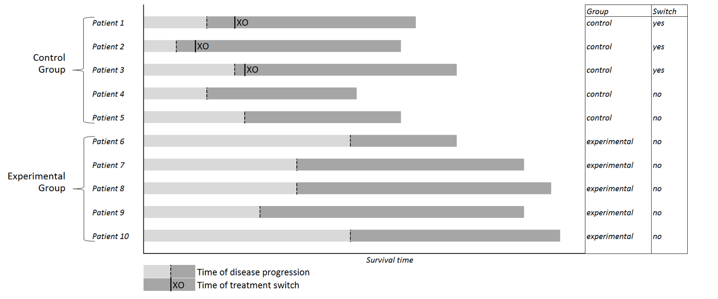
Step 1:
Identify secondary baseline for each patient
XO
XO
XO
XO

Slide 19
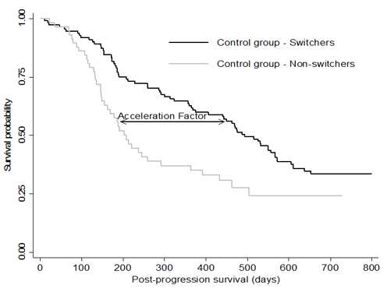
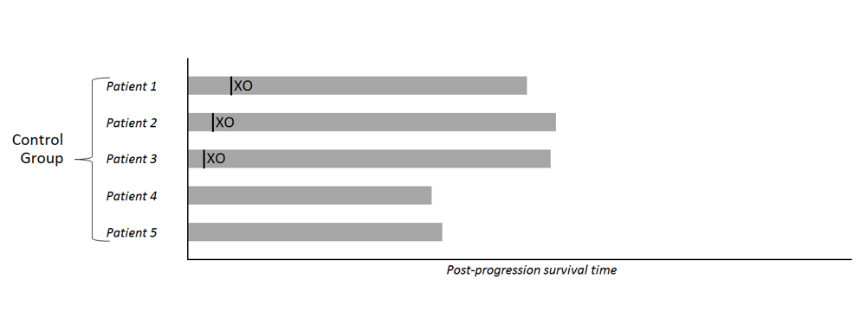
Step 2:
Compare post-secondary baseline survival in control group non-switchers with control group switchers using an AFT model
XO
XO
XO
ᴪ
XO

Slide 20
AFT model
In survival analysis, instead of focusing on the hazard function (like a Cox proportional hazards model), an AFT model looks at the time scale and assumes covariates multiply the survival time.
The model assumes the effect of covariates is to accelerate or decelerate the life course of the event of interest (i.e., make the event happen sooner or later).
Unlike Cox models, AFT models require you to specify a baseline distribution for survival times

Slide 21
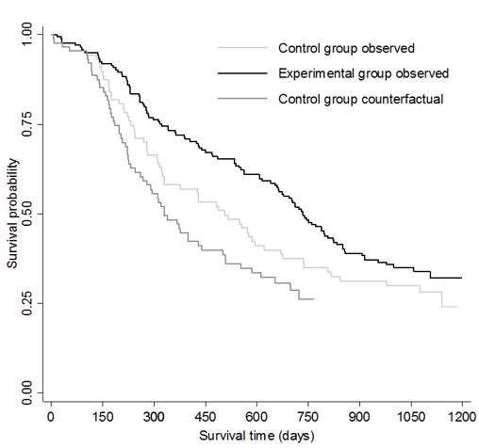
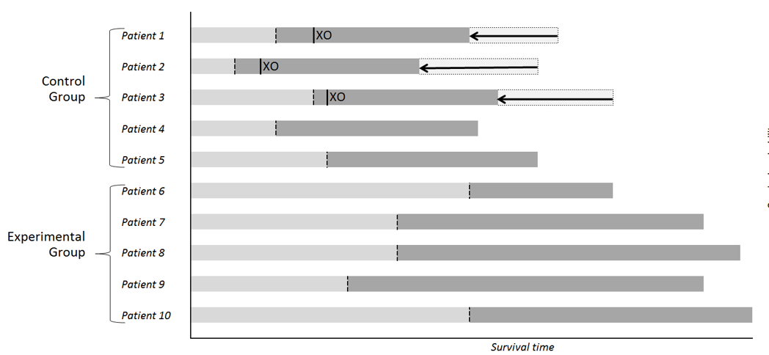
Step 3:
Shrink survival times in switchers according to acceleration factor, and compare to experimental group to obtain hazard ratio adjusted for switching
XO
XO
XO

Slide 22
Accommodating informative censoring
The TSE method involves adjusting censoring times in switchers, but not in non-switchers. This will result in informative censoring if there is an association between switching and prognosis.
Use IPCW Method to accommodate informative censoring.

Slide 23
Limitations
Assumption 1:
No unmeasured confounding (at 1st and 2nd baseline)
It cannot be precisely true, but measures can be taken to make it ‘approximately true’ at the trial design stage.
In the study protocol, devote a section for 1st and 2nd baseline data collection

Slide 24
Limitations
Assumption 2:
OS data follow a parametric distribution
It is not easy to find a parametric distribution which fits observed data perfectly

Slide 25
Limitations
Assumption 3:
No gap time b/t progression and treatment switch
Gap time often exists in most relapsed patients
Negative gap time
Other extreme cases:
Almost all relapsed patients experienced treatment switching, which leads to unreliable ᴪ estimate
Some patients experienced treatment switching without disease progression, estimated ᴪ may not be applicable to this set of patients

Slide 26
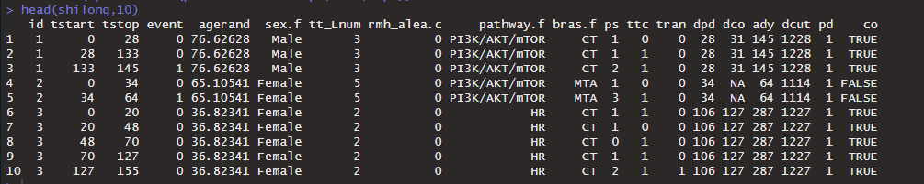
R code
library(trtswitch)
## Bras.f: randomized treatment arm
## Time dependent covariates
# ps The ECOGperformance status
# ttc The presence of concomitant treatments
# tran The use of platelet transfusions
## dpd: relative day of progression
## dco : relative day of treatment switching
## ady: relative day of last news/follow-up
## pd: indicator for progression
## co: indicator for treatment switching

Slide 27
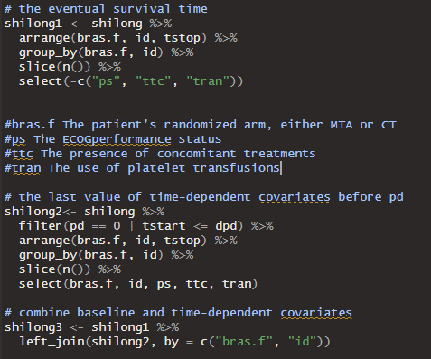
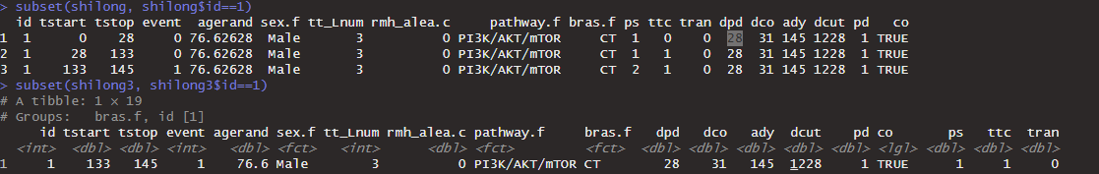

Slide 28
fit1 <- tsesimp(
data = shilong3, id = "id", time = "tstop", event = "event",
treat = "bras.f", censor_time = "dcut",
pd = "pd", pd_time = "dpd",
swtrt = "co", swtrt_time = "dco",
base_cov = c("agerand", "sex.f", "tt_Lnum", "rmh_alea.c", "pathway.f"),
base2_cov = c("agerand", "sex.f", "tt_Lnum", "rmh_alea.c", "pathway.f", "ps", "ttc", "tran"),
aft_dist = "weibull", alpha = 0.05, recensor = TRUE, swtrt_control_only = FALSE, offset = 1, boot = FALSE)

Slide 29
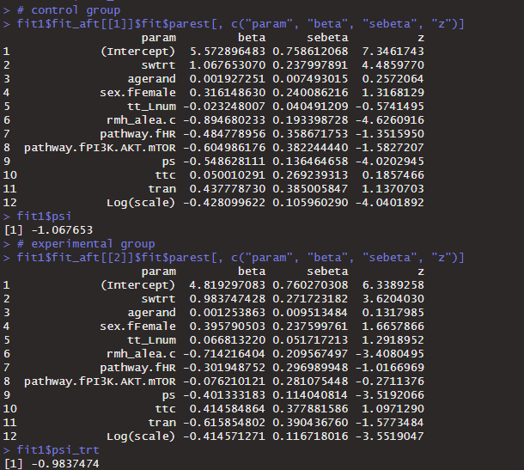

Slide 30
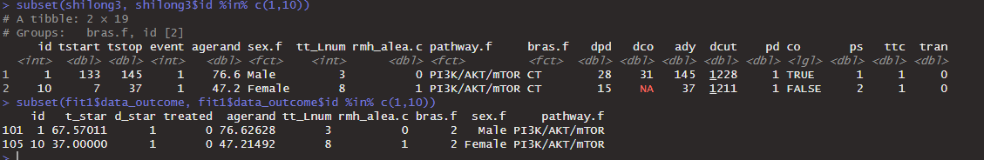

Slide 31
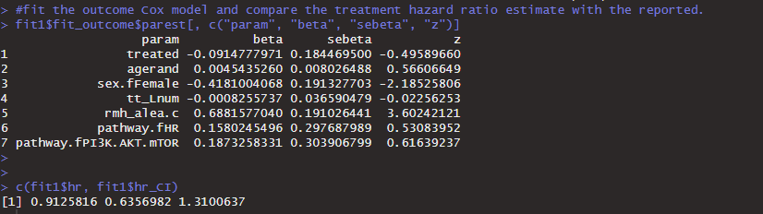

Slide 32
SAS
Data process:
From longitudinal long data format to one record per row for AFT modeling.

Slide 33
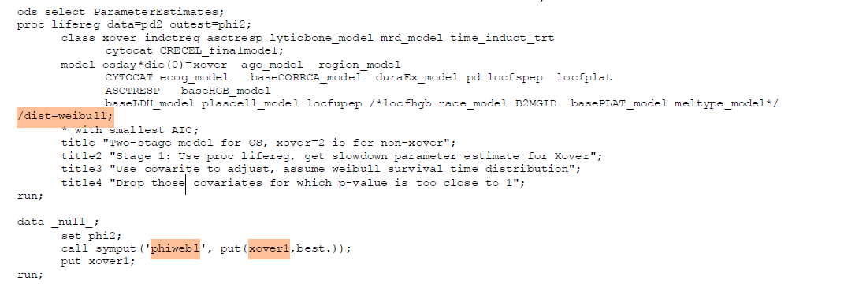
Derive phi
Use AIC/BIC to pick which parametric distribution fits better

Slide 34
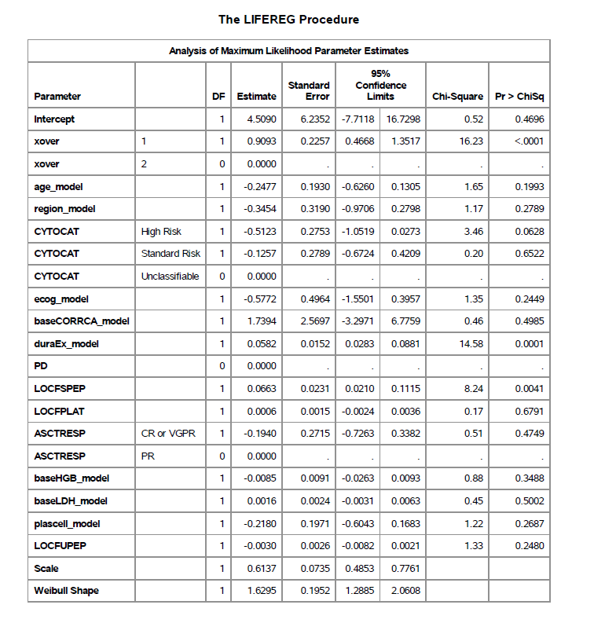

Slide 35
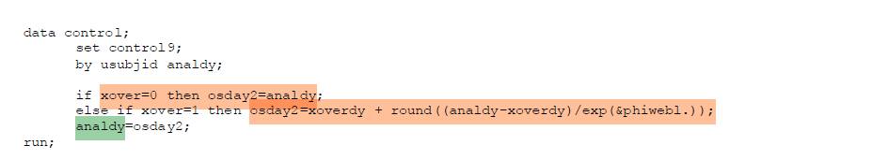
For switchers, after treatment switch, recompute survival time as U = Tc + Ta/exp(phi), phi is from AFT model

Slide 36
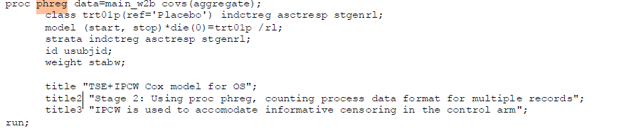

Slide 37
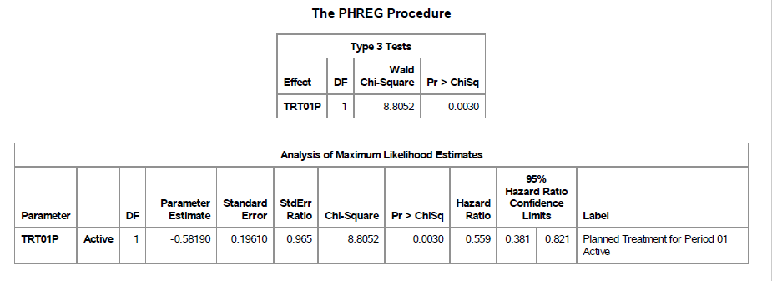

Slide 38
Summary
Treatment switching complicates survival analyses because standard ITT can underestimate effects.
MSM/IPCW re-weights data to adjust for the informative censoring due to switching.
RPSFTM re-scales survival times assuming a constant effect across switchers and non-switchers.
TSE uses an AFT model in two stages to construct adjusted survival times.

Slide 39
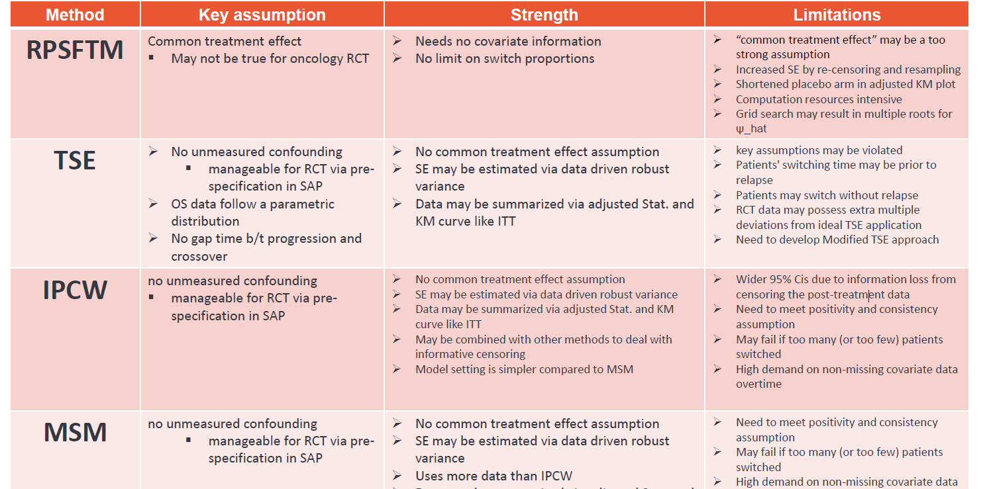

Slide 40
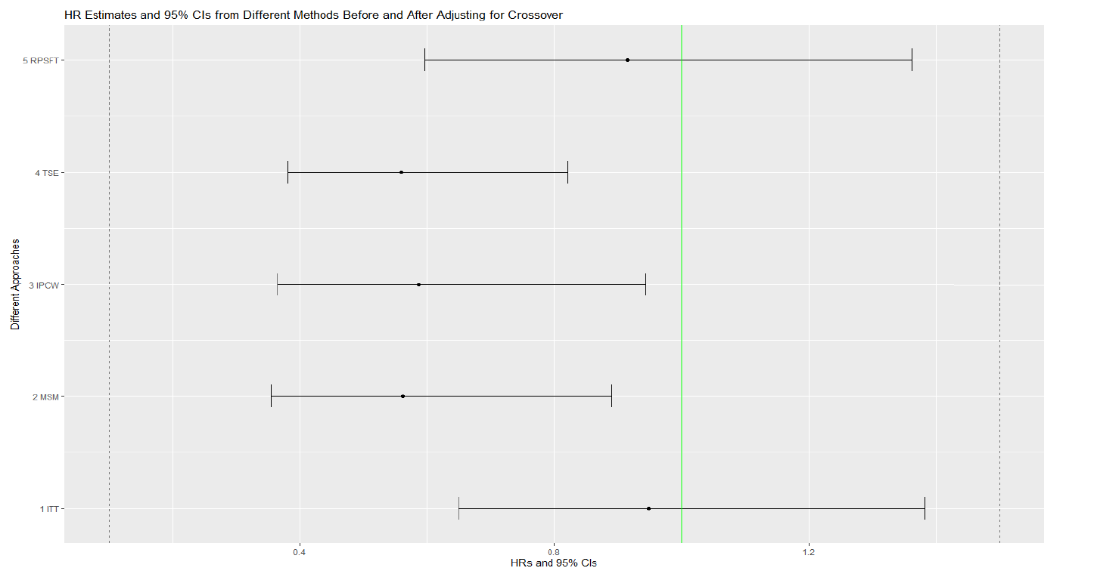

Slide 41
Best practice recommendation
Up front planning
Pre-specify analysis details in the SAP, including a complete list of confounding covariates and variable selection method, etc.
Early engagement with regulatory agencies
Number and percentage of patients with treatment crossover or subsequent therapy need to be summarized by treatment arm
More than one method (better if belonging to different classes) needs to be used to demonstrate the robustness of the causal OS treatment benefit, e.g., TSE and MSM

