Slide 1
Survival Analysis Methods Correcting for Treatment Switching Effects in RCTs: Theory and SAS/R Code (Part I)
ASA short course recap
Biwei Cao, Wenyi Fan

Slide 2
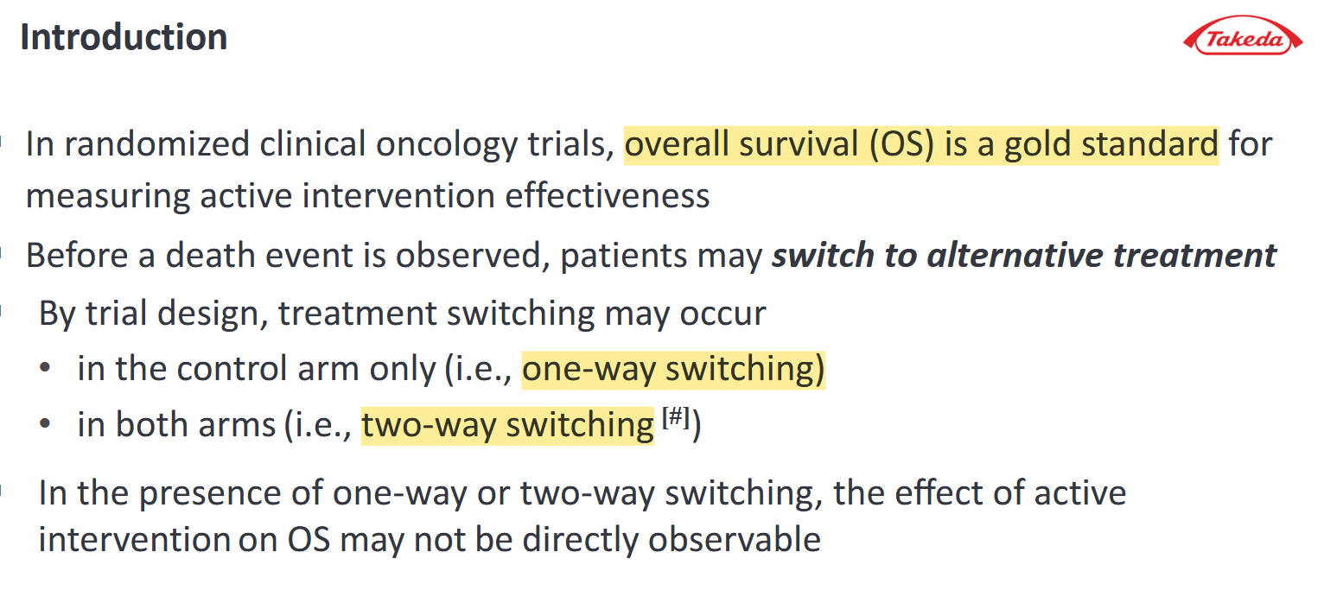

Slide 3
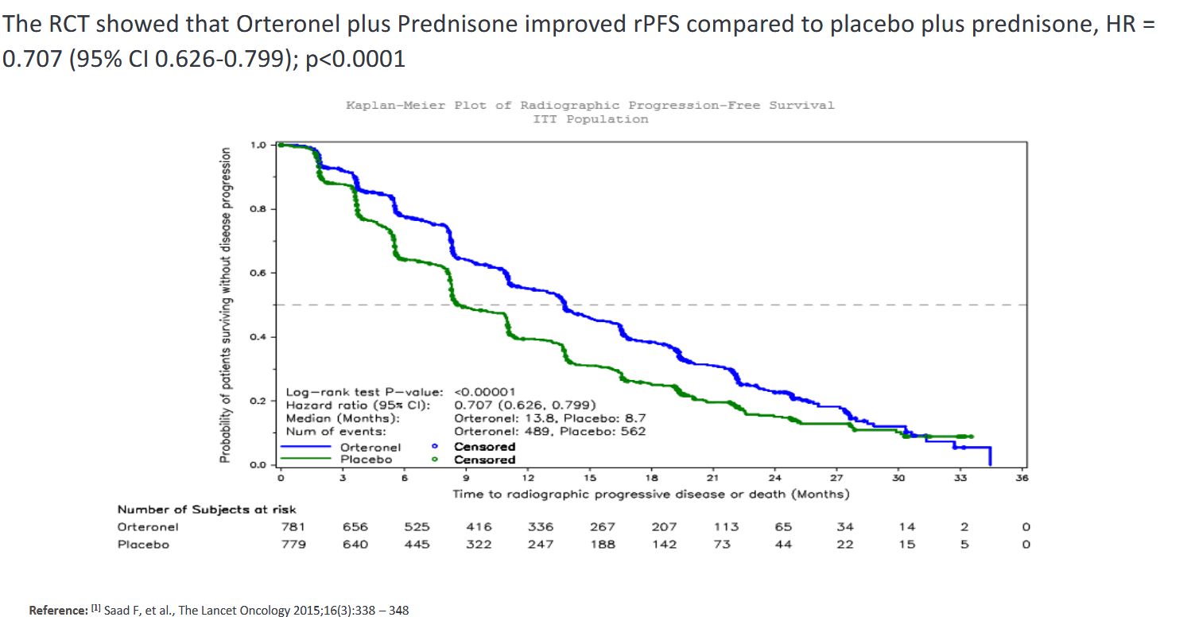

Slide 4
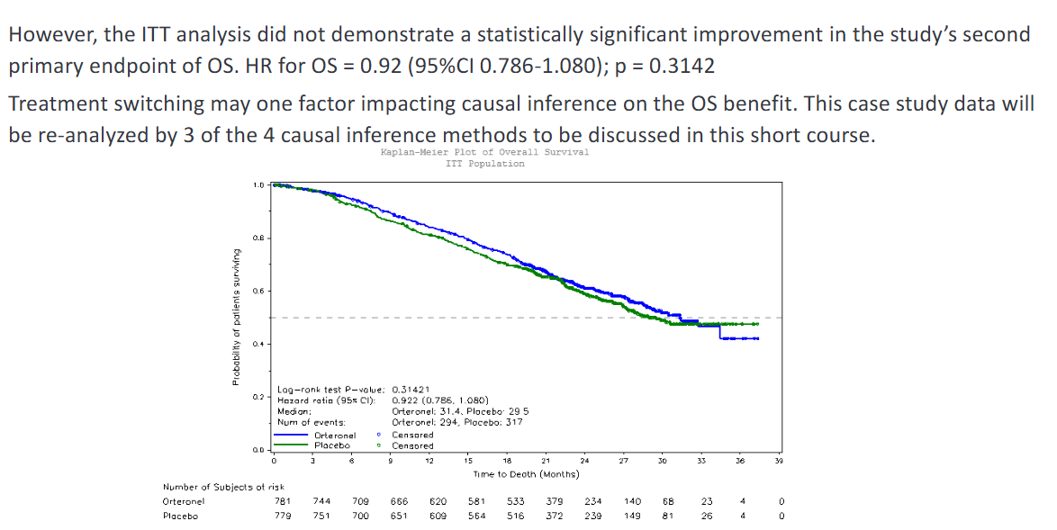

Slide 5
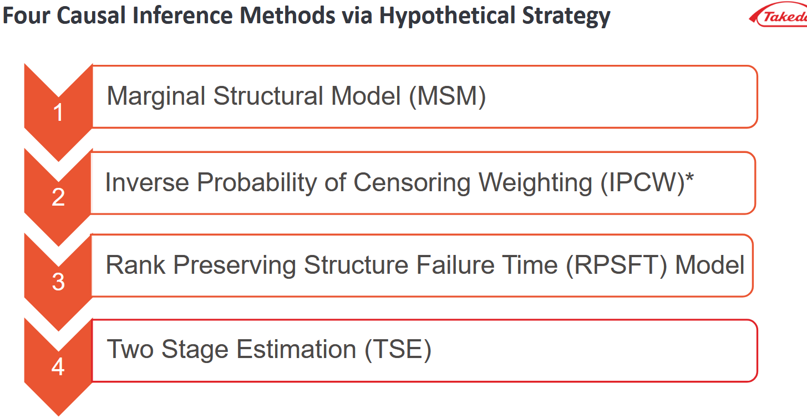

Slide 6
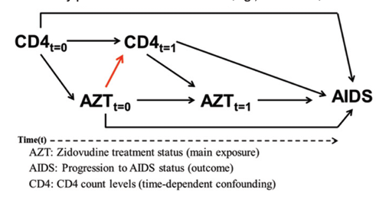
Marginal Structure Model (MSM)
What Was MSM Originally Designed For?
MSMs were originally developed for observational studies where treatment changes over time.
Clinical status evolves over time (e.g., biomarkers, disease severity, symptoms → time-varying covariates)
These time-varying covariates predict survival
Sicker patients are more likely to start or intensify treatment
More stable patients may delay or avoid treatment
These covariates are also affected by prior treatment
Effective treatment improves biomarkers → changes future treatment choices
Ineffective treatment leads to deterioration → also changes future treatment choices
Consequences: Standard Analyses Become Biased
Time-varying confounders lie on the causal pathway → Adjusting for them in a standard time-varying Cox model blocks causal pathways
(Burcu, 2024)

Slide 7
How MSM Works in observational studies Conceptually
MSM Uses Inverse Probability Weights (IPW) to Create a Pseudo-Population
Two major sources of bias:
Time-dependent treatment confounding (Health status is influenced by previous treatment and, in turn, affects future treatment decisions and outcomes.)
Informative censoring (Worsening clinical status might increases the probability of treatment discontinuation, loss to follow-up, or other forms of censoring)
MSM corrects both biases using:
IPTW (Inverse Probability of Treatment Weight) to make treatment “as-if randomized”
(Treatment no longer depends on evolving health status)
IPCW (Inverse Probability of Censoring Weight) to make censoring “as-if random”
(Censoring no longer depends on prognosis → removing censoring bias)
MSM estimates the effects by fitting a model to the weighted Pseudo-Population where confounding has been removed

Slide 8
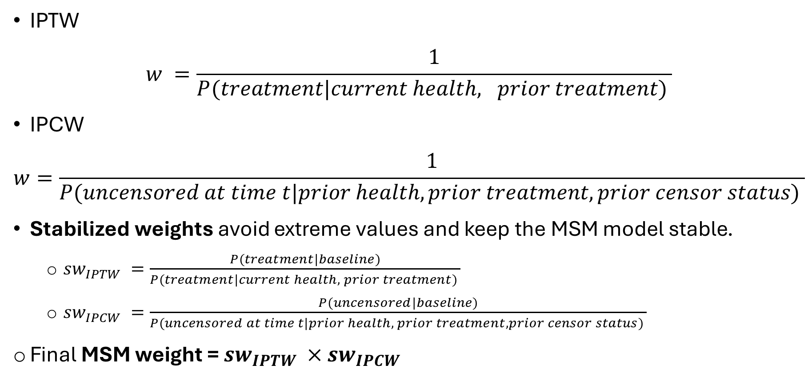
How MSM Works in observational studies IPTW & IPCW
IPTW
$$w =\frac{1}{P(treatment|current health, prior treatment) }$$
IPCW
$$w=\frac{1}{P(uncensored at time t|prior health, prior treatment,prior censor status) }$$
Stabilized weights avoid extreme values and keep the MSM model stable.
$sw_{IPTW} =\frac{P(treatment|baseline)}{P(treatment|current health, prior treatment) }$
$sw_{IPCW} =\frac{P(uncensored|baseline)}{P(uncensored at time t|prior health, prior treatment, prior censor status) }$
$\text{Final} \text{MSM} \text{weight}\text{ = }sw_{IPTW} ×$ $sw_{IPCW}$
Pooled Logistic Model

Slide 9

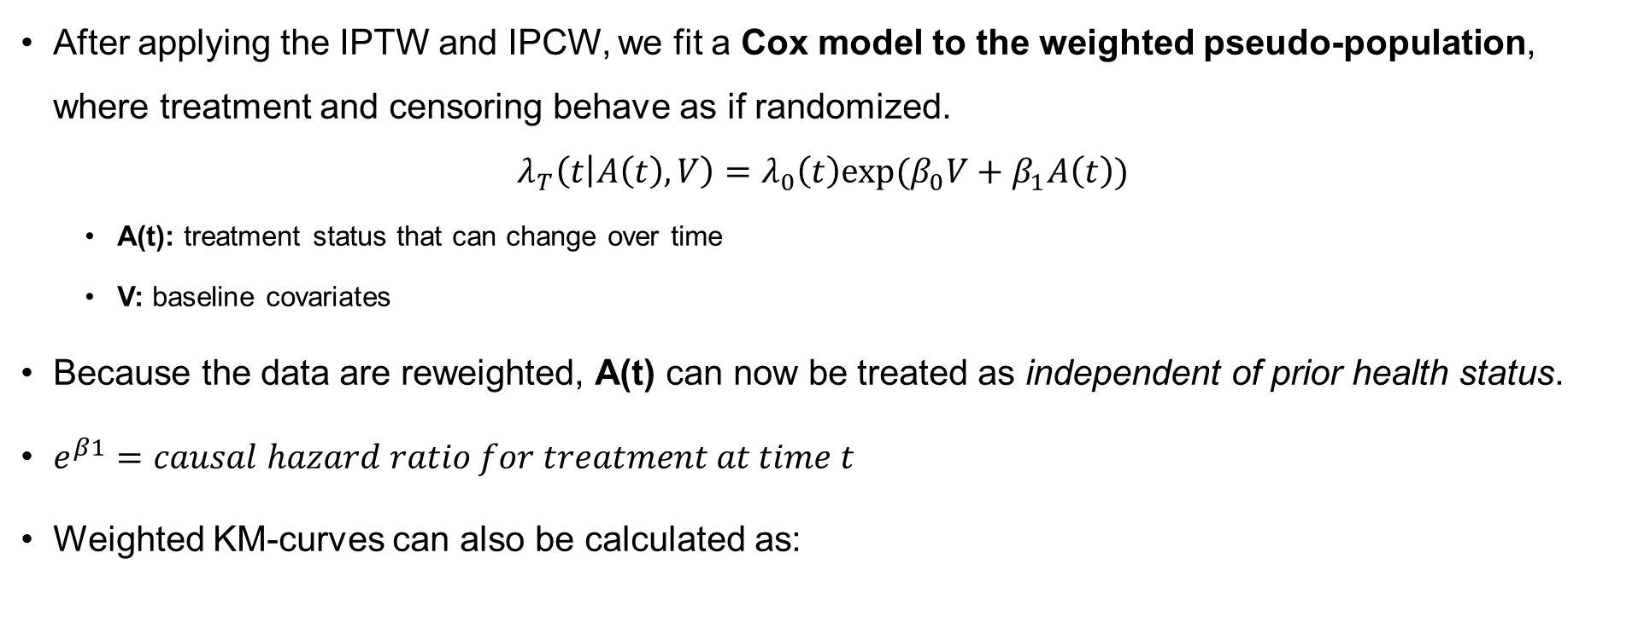
How MSM Works in observational studies Marginal structural Cox model & KM estimates
After applying the IPTW and IPCW, we fit a Cox model to the weighted pseudo-population, where treatment and censoring behave as if randomized.
$$λ_{T}\left(t | A\left(t\right),V\right)=λ_{0}\left(t\right)exp⁡(β_{0}V+β_{1}A\left(t\right))$$
A(t): treatment status that can change over time
V: baseline covariates
Because the data are reweighted, A(t) can now be treated as independent of prior health status.
$e^{β1}=causal hazard ratio for treatment at time t$
Weighted KM-curves can also be calculated as:
(Hernán et al., 2000)
(Xu et al., 2022)

Slide 10
MSM in Observational Studies vs. Treatment-Switching Trials
(Robins et.al., 2000, Xu et.al, 2022)
 | MSM in Observational Studies | MSM in Treatment-Switching Trials
Study objective | Estimate the causal effect of a time-varying exposure | Estimate the joint causal effects of the randomized treatment and switching treatment
Type of confounding | Baseline + time-dependent confounders | Time-dependent confounders arising from treatment switching
Randomization | No | Yes (at baseline)
Role of IPW | Breaks the association between treatment and confounders | Breaks the association between switching and confounders
Key challenge | Confounders affected by prior exposure | Time-dependent confounding due to post-progression switching
Ultimate goal | Estimate the causal exposure effect | Recover the true causal effect of the randomized treatment after correcting for switching

Slide 11

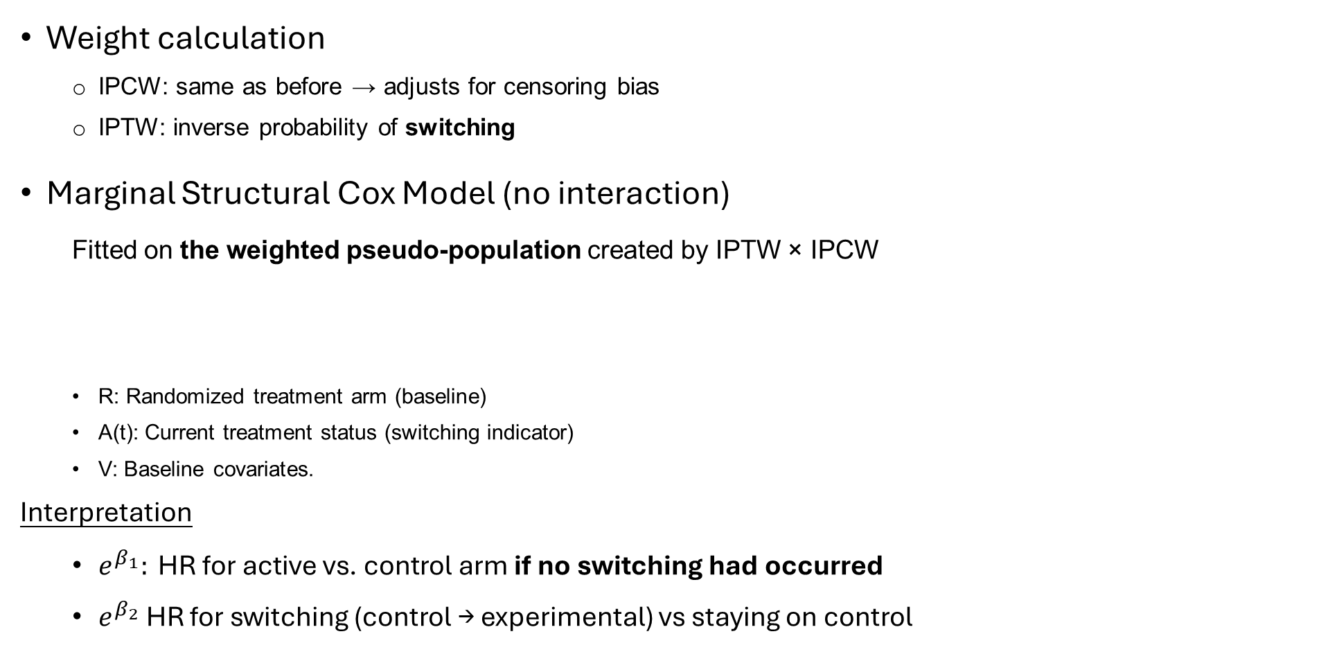
MSM in Two-Way Switching Trials
(Xu et al., 2022)
Weight calculation
IPCW: same as before → adjusts for censoring bias
IPTW: inverse probability of switching
Marginal Structural Cox Model (no interaction)
Fitted on the weighted pseudo-population created by IPTW × IPCW
R: Randomized treatment arm (baseline)
A(t): Current treatment status (switching indicator)
V: Baseline covariates.
Interpretation
$e^{β_{1}}: \text{HR} \text{for} \text{active} \text{vs}\text{. }\text{control} \text{arm} \text{if} \text{no} \text{switching} \text{had} \text{occurred}$
$e^{β_{2}}$HR for switching (control → experimental) vs staying on control

Slide 12
MSM in Two-Way Switching Trials Continue
(Xu et al., 2022)
When There Is Interaction Between R and A(t)
$e^{β_{1}}: \text{HR} \text{for} \text{active} \text{vs}\text{. }\text{control} \text{arm} \text{if} \text{no} \text{switching} \text{had} \text{occurred}$
In real trials, after switching occurs, patients may:
Discontinue the alternative therapy early
Receive multiple or heterogeneous post-progression treatments
Switch to therapies not fully captured in the dataset
→ These complexities make the causal effect of the alternative treatment (β₂) difficult or sometimes impossible to estimate precisely.
However, the randomized treatment effect (β₁) remains valid if the model and weights are correctly specified.

Slide 13
MSM in Two-Way Switching Trials Reducing Bias
(Xu et al., 2022)
No unmeasured confounding
Means: all the variables that influence both treatment decisions (e.g., switching) and outcomes (e.g., survival) are observed and included in the analysis
Cannot be directly tested. In RCTs, reduce by collecting all major prognostic factors at trial-planning stage.
Positivity (non-zero treatment probability)
Means: Each patient must have a positive probability of switching and not switching for any confounder pattern
Structural non-positivity: e.g., only control-arm patients can switch
Random non-positivity: small N, too many weak covariates, or sparse data late in follow-up.

Slide 14
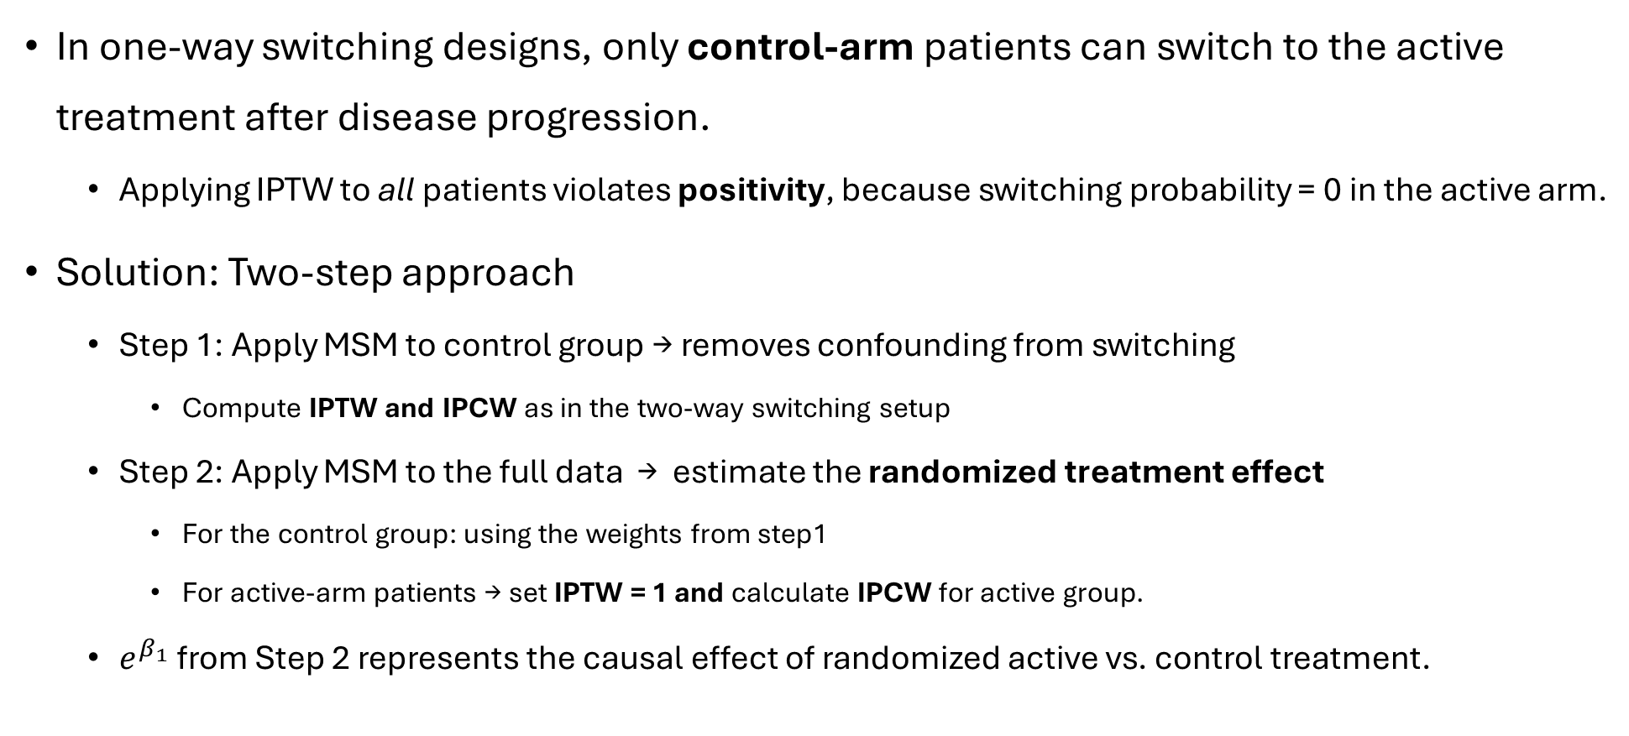
Marginal Structure Model MSM in one-way switching trials
(Xu et al., 2025)
In one-way switching designs, only control-arm patients can switch to the active treatment after disease progression.
Applying IPTW to all patients violates positivity, because switching probability = 0 in the active arm.
Solution: Two-step approach
Step 1: Apply MSM to control group → removes confounding from switching
Compute IPTW and IPCW as in the two-way switching setup
Step 2: Apply MSM to the full data → estimate the randomized treatment effect
For the control group: using the weights from step1
For active-arm patients → set IPTW = 1 and calculate IPCW for active group.
$e^{β_{1}}$from Step 2 represents the causal effect of randomized active vs. control treatment.

Slide 15

Limitations of MSM in Treatment-Switching Trials
(Xu et al., 2025)
Strong positivity requirement for treatment assignment If certain covariate patterns determine treatment (prob = 0 or 1), IPTW cannot be constructed → bias.
Requires Rich, Fully Observed Time-varying Covariates Missing or unmeasured prognostic factors → biased causal inference.
Special complications in RCT switching MSM requires including R × A(t) interaction by default; curves may cross → median survival hard to interpret.

Slide 16
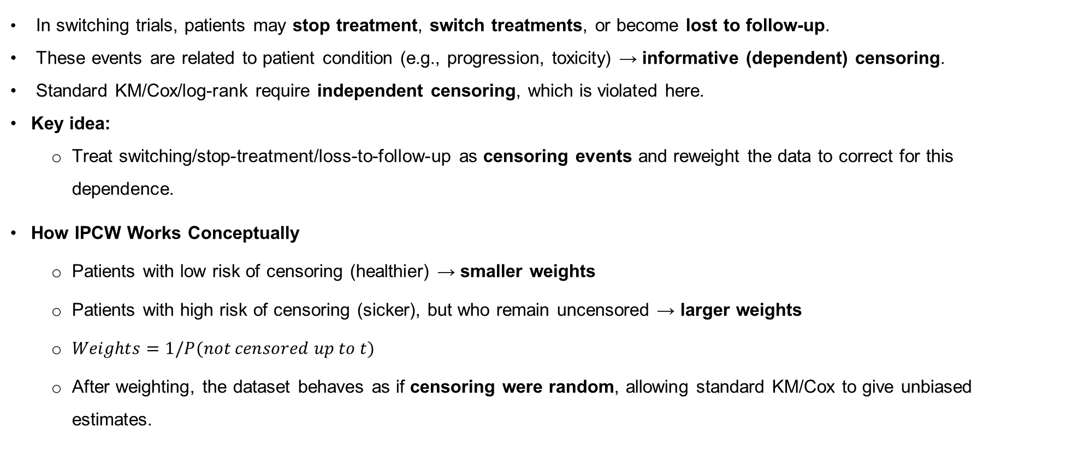
Inverse Probability of Censoring Weighting (IPCW)
(Robins & Finkelstein, 2000)
In switching trials, patients may stop treatment, switch treatments, or become lost to follow-up.
These events are related to patient condition (e.g., progression, toxicity) → informative (dependent) censoring.
Standard KM/Cox/log-rank require independent censoring, which is violated here.
Key idea:
Treat switching/stop-treatment/loss-to-follow-up as censoring events and reweight the data to correct for this dependence.
How IPCW Works Conceptually
Patients with low risk of censoring (healthier) → smaller weights
Patients with high risk of censoring (sicker), but who remain uncensored → larger weights
$Weights=1/P(not censored up to t)$
After weighting, the dataset behaves as if censoring were random, allowing standard KM/Cox to give unbiased estimates.

Slide 17
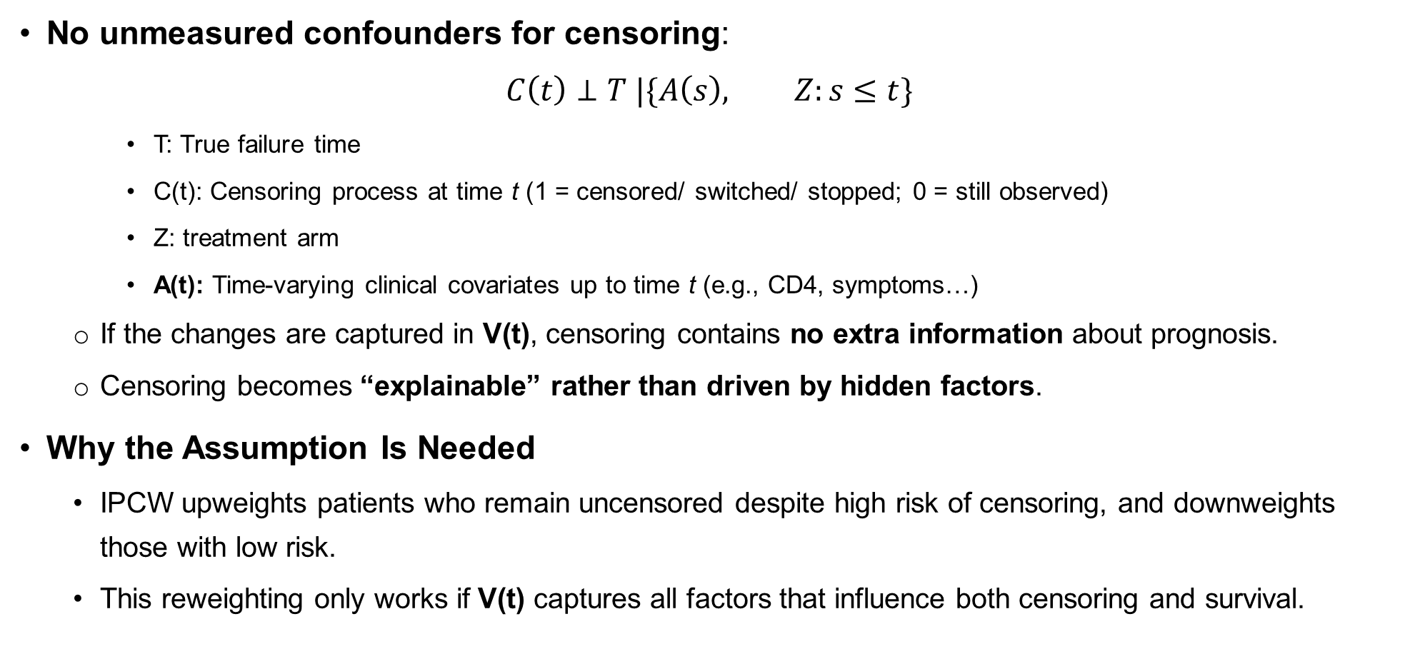
IPCW Assumptions
(Robins & Finkelstein, 2000)
No unmeasured confounders for censoring:
$$C\left(t\right)⊥T |\{A\left(s\right), Z:s≤t\}$$
T: True failure time
C(t): Censoring process at time t (1 = censored/ switched/ stopped; 0 = still observed)
Z: treatment arm
A(t): Time-varying clinical covariates up to time t (e.g., CD4, symptoms…)
If the changes are captured in V(t), censoring contains no extra information about prognosis.
Censoring becomes “explainable” rather than driven by hidden factors.
Why the Assumption Is Needed
IPCW upweights patients who remain uncensored despite high risk of censoring, and downweights those with low risk.
This reweighting only works if V(t) captures all factors that influence both censoring and survival.

Slide 18
IPCW Weight Construction
(Robins & Finkelstein, 2000)
1️⃣Estimate the probability of remaining uncensored:
Using pooled logistic regression to compute the probability of staying uncensored
2️⃣ Compute IPCW = inverse of the probability of staying uncensored
3️⃣ Derive stabilized weights to prevent large variability
After reweighting, the uncensored patients are weighted to represent the full study population that would have been observed if censoring were random, thereby reducing bias from informative censoring

Slide 19

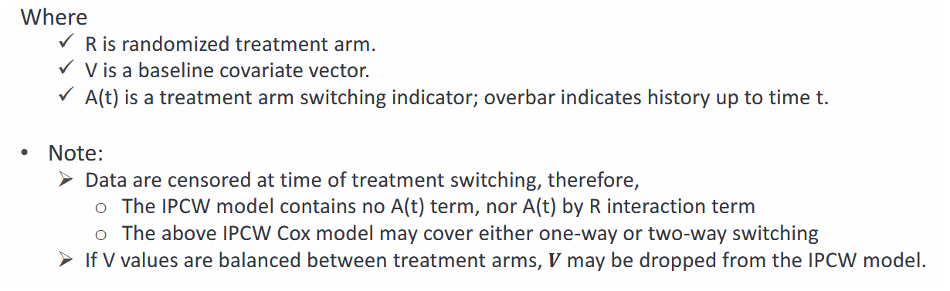
IPCW Modeling and Interpretation
(Robins & Finkelstein, 2000)
Weighted KM and log-rank test:
Weighted Cox

Slide 20
IPCW Key takeways
Accommodating
Accommodating the “No Unmeasured Confounders” Assumption
In RCTs this assumption is not testable.
It may not be perfectly true, but can be made approximately valid through careful trial design and thorough collection of prognostic factors.
Avoiding
Avoiding Positivity Violations
Structural positivity violation: If all patients switch → IPCW cannot be applied.
High switching proportion (>70%) → IPCW cannot be applied.
Very low switching proportion→ IPCW cannot be applied.
Ensuring
Ensuring Correct Model Specification
Follow the modeling guidelines recommended for MSM.
With stabilized weights, do not omit baseline confounders in the extended Cox model if they are imbalanced between randomized groups.

Slide 21
Summary of MSM vs IPCW for Treatment-Switching Trials
(Xu et al., 2022)
 | MSM | IPCW
Goal | Recover causal effect as if no switching, using weights | Same goal; correct bias from informative censoring
How It Works | IPTW × IPCW; reweights treatment and censoring | Treat switching as censoring; weight for follow-up
Treatment Switching | Keep post-switch data | Censor at switching → drop later data
Estimand | Effect of randomized arm and alternative treatment | Effect of staying on randomized arm
Efficiency | Higher (more data retained) | Lower (information loss)
Strengths | Lower bias; higher power; better type I error (when correctly specified) | Simple; intuitive; good when switching patterns are simple
Shared Limitations | Require rich time-varying covariates; sensitive to non-positivity; need correct weight models; extreme weights need truncation
MSM-Specific Limits | Must model treatment + censoring; requires R × A(t) interaction | —
IPCW-Specific Limits | — | Information loss → larger SE; cannot estimate effect of alternative treatment; tends to underestimate effect

Slide 22
Reference
- Burcu, M. (2024). Time-Dependent Confounders: Are They All the Same? ISPOR | International Society for Pharmacoeconomics and Outcomes Research . https://www.ispor.org/publications/journals/value-outcomes-spotlight/abstract/march-april-2016/time-dependent-confounders-are-they-all-the-same
- Hernán, M. Á., Brumback, B., & Robins, J. M. (2000). Marginal Structural Models to Estimate the Causal Effect of Zidovudine on the Survival of HIV-Positive Men. Epidemiology, 11(5), 561–570. https://doi.org/10.1097/00001648-200009000-00012
- Robins, J. M., & Finkelstein, D. M. (2000). Correcting for Noncompliance and Dependent Censoring in an AIDS Clinical Trial with Inverse Probability of Censoring Weighted (IPCW) Log-Rank Tests. Biometrics, 56(3), 779–788. https://doi.org/10.1111/j.0006-341x.2000.00779.x
- Robins, J. M., Hernán, M. Á., & Brumback, B. (2000). Marginal Structural Models and Causal Inference in Epidemiology. Epidemiology, 11(5), 550–560. https://doi.org/10.1097/00001648-200009000-00011
- Xu, J., Bay, C., Wang, B., Liu, G., & Li, C. (2025). Application of marginal structural models for causal inference on the treatment effect for overall survival in randomized controlled trials with control arm patients switching to active intervention after disease progression. Journal of Biopharmaceutical Statistics, 1–18. https://doi.org/10.1080/10543406.2025.2547591
- Xu, J., Liu, G., & Wang, B. (2022). Bias and Type I error Control in Correcting Treatment Effect for Treatment Switching Using Marginal Structural Models in Phase III Oncology Trials. Journal of Biopharmaceutical Statistics, 32(6), 897–914. https://doi.org/10.1080/10543406.2022.2058524

