Slide 1
QuickSnack
Order fast. Snack smart.
MOGA SAMUEL PAUL

Slide 2
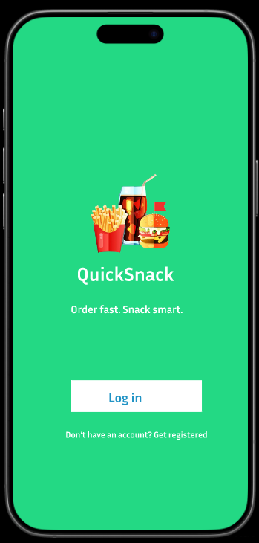
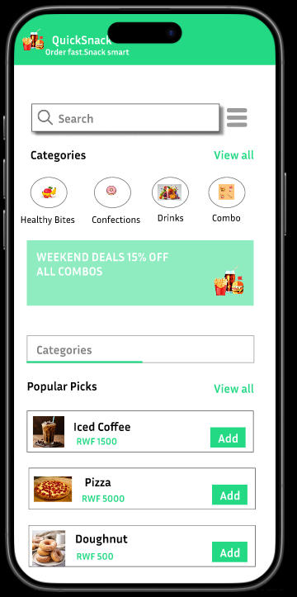
Project overview
The product:
QuickSnack lets students and staff order snacks quickly from the cafeteria, with pre-ordering cashless payments for a fast, convenient experience.
Preview of selected polished designs.
Project duration:
17 OCTOBER – 19 OCTOBER

Slide 3
Project overview
The problem:
Long cafeteria queues and manual ordering waste time and cause delays for students and staff.
The goal:
Design an app ‘’QuickSnack’’ which streamlines ordering to save time and improve convenience on campus.

Slide 4
Project overview
My role:
UX designer, UX researcher, UI Designer.
Responsibilities:
Plan the app’s structure and flow, study users to identify needs and test usability, and create the visual look to ensure it’s attractive, consistent, and user-friendly.

Slide 5
User research: summary
We conducted interviews with students and staff to understand snack ordering habits . We initially assumed users preferred in-person cash orders . Research showed pre-ordering and digital payments were highly desired.This insight shaped QuickSnack to focus on speed and convenience.

Slide 6
User research: pain points
1
2
3
Limited Payment Options
Unclear Menu Availability
Long Queues
Waiting in line takes up too much time and disrupts students’ and staff schedules.
Limited payment options
make it hard for students to complete purchases.
Not knowing what’s available beforehand causes indecision, wasted time, and missed orders.

Slide 7
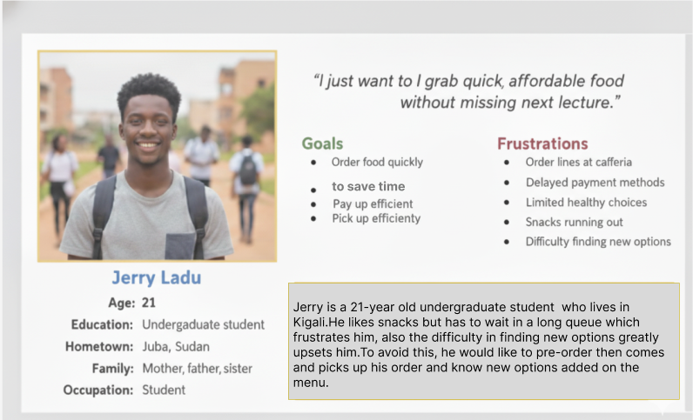
Persona:JERRY LADU
Problem statement:
Jerry is an undergraduate student who needs a convient way to order food because long queues lead to delays hence missing lectures and meals sometimes.

Slide 8
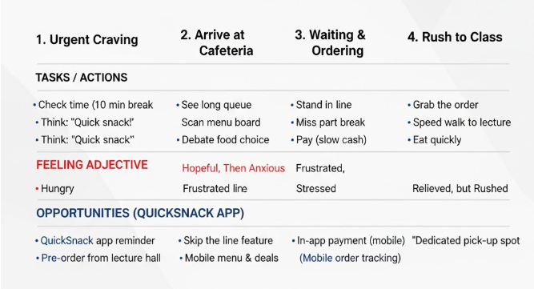
User journey map
Jerry‘s user journey helped solve his problem. The QuickSnack app addresses this by offering pre-ordering with real-time updates to ensure efficiency and student satisfaction.
Image of user journey map

Slide 9
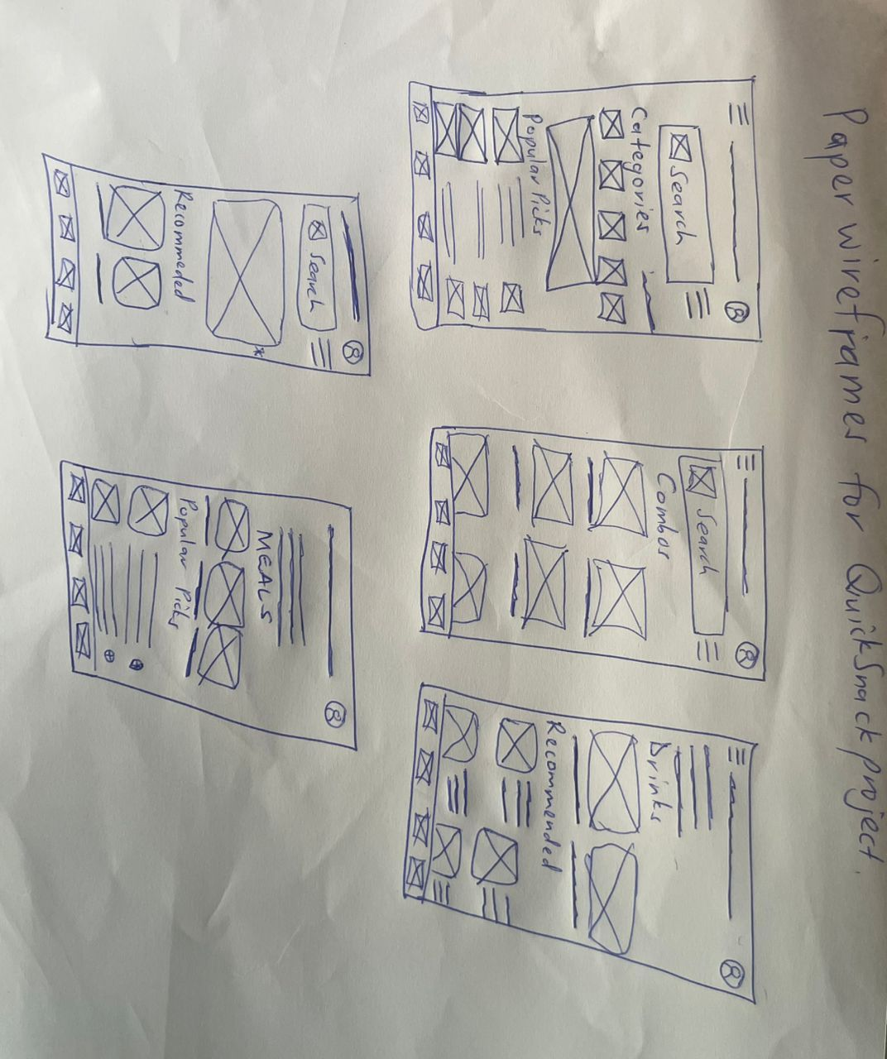
Paper wireframes
Each Screen of the app on paper ensured that the elements that made to digital wireframes would be well suited to address user pain points. For home screen, I prioritize easy and quick ordering process to help users.
Image of paper wireframes including five different versions of the same screen and one image of the new, refined version

Slide 10
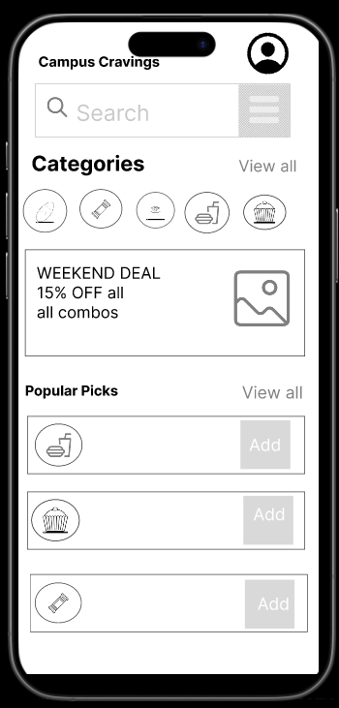
Digital wireframes
User can choose their favorite meal from here.
Proceeding towards digital wireframes i want to ensure the findings and feedbacks from the user research were covered.
The Add Button makes it faster to order meals.

Slide 11
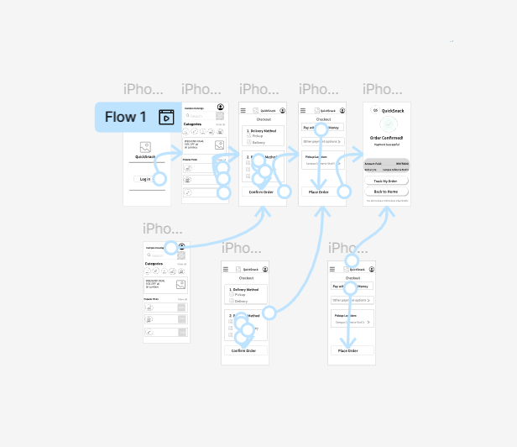
Low-fidelity prototype
The low-ﬁdelity prototype connected to the primary ﬂow of the app.
Screenshot of prototype with connections or prototype GIF
View Prototype :Low fidelity (QuickSnack App)

Slide 12
Usability study: findings
To ensure the QuickSnack app met the needs of the busy student persona, two rounds of usability testing focused on enabling orders and payments in under two minutes. Initial friction points, such as Mobile Money selection and combo customization, were successfully addressed through design changes that led to a highly efficient and positive user experience.
Round 1 findings
Round 2 findings
1
Inefficient Combo Customization
1
MoMo Integration Success
2
Lack of Vendor Clarity
2
Faster Ordering
3
Confusion on Payment Flow
3
Clear Pickup Instructions

Slide 13
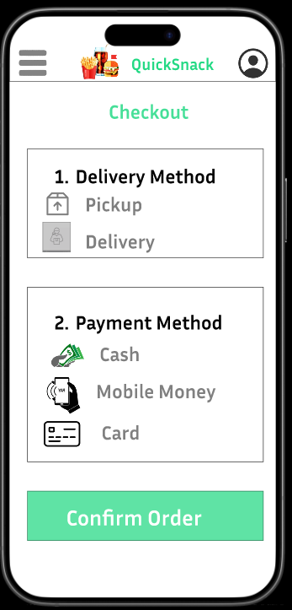
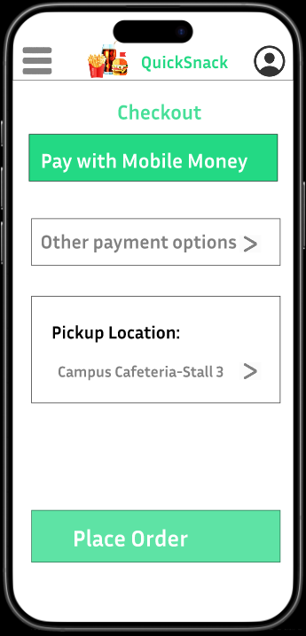
Mockups
Before the usability study the main ﬂow was user have to complete the scheduling by selecting payment method and delivery option to get into the snack home page.
After the usability study I added the pickup options to the starting of checkout process to avoid the confusions faced by the users to get into the snack home page.
Before usability study
After usability study
Image of selected screen before usability study
Image of selected screen after usability study

Slide 14
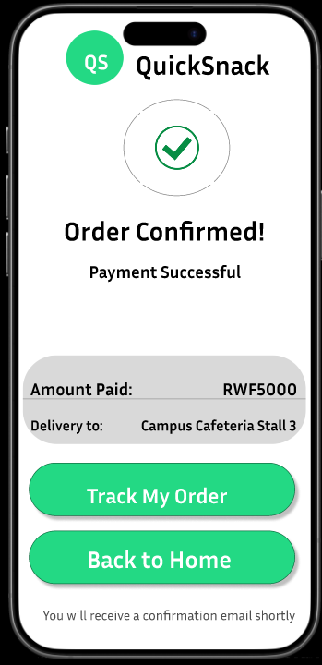
Mockups
Main mockup screen for display
Main mockup screen for display
Main mockup screen for display
Main mockup screen for display

Slide 15
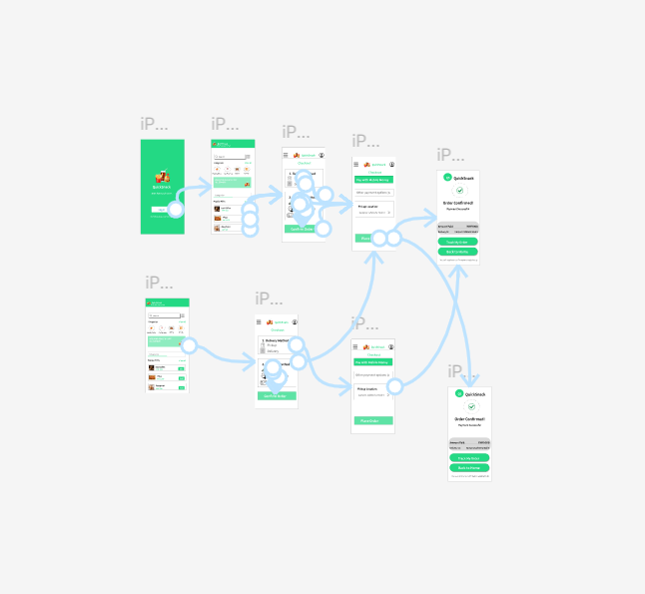
High-fidelity prototype
The ﬁnal high ﬁdelity prototype presented with a main user ﬂow contains adding snacks, payment method, delivery and the tracking process.
View Propotype: High Fidelity (QuickSnack App)
Screenshot of prototype with connections or prototype GIF

Slide 16
Accessibility considerations
1
2
3
High-contrast colors for readability.
Descriptive images for visual guidance
Clear icons for navigation and menu recognition.

Slide 17
Takeaways
Impact:
The design of QuickSnack made ordering snacks faster and more convenient for students and staff. One study participant said, “It saves me so much time between classes—I don’t have to wait in line anymore!”
What I learned:
I learned the importance of user research, design, and feedback in creating a user-friendly app while improving my problem-solving skills.

Slide 18
Next steps
1
2
Expand research to include family users and large group ordering features.
Conduct a final usability round to confirm all issues are resolved.

Slide 19
Insert a few sentences summarizing the next steps you would take with this project and why. Feel free to organize next steps in a bullet point list.
Let’s connect!
Thank you all! for your time, reviewing my work on “QuickSnack”,If you’d like my work and want to see more get in touch:
Email: mogapaul54@gmail.com

Slide 20
Thank you!

