Slide 1
Course Name: Data Mining and Foundation of AI 6CC555
Student Number: 100610788

Slide 2
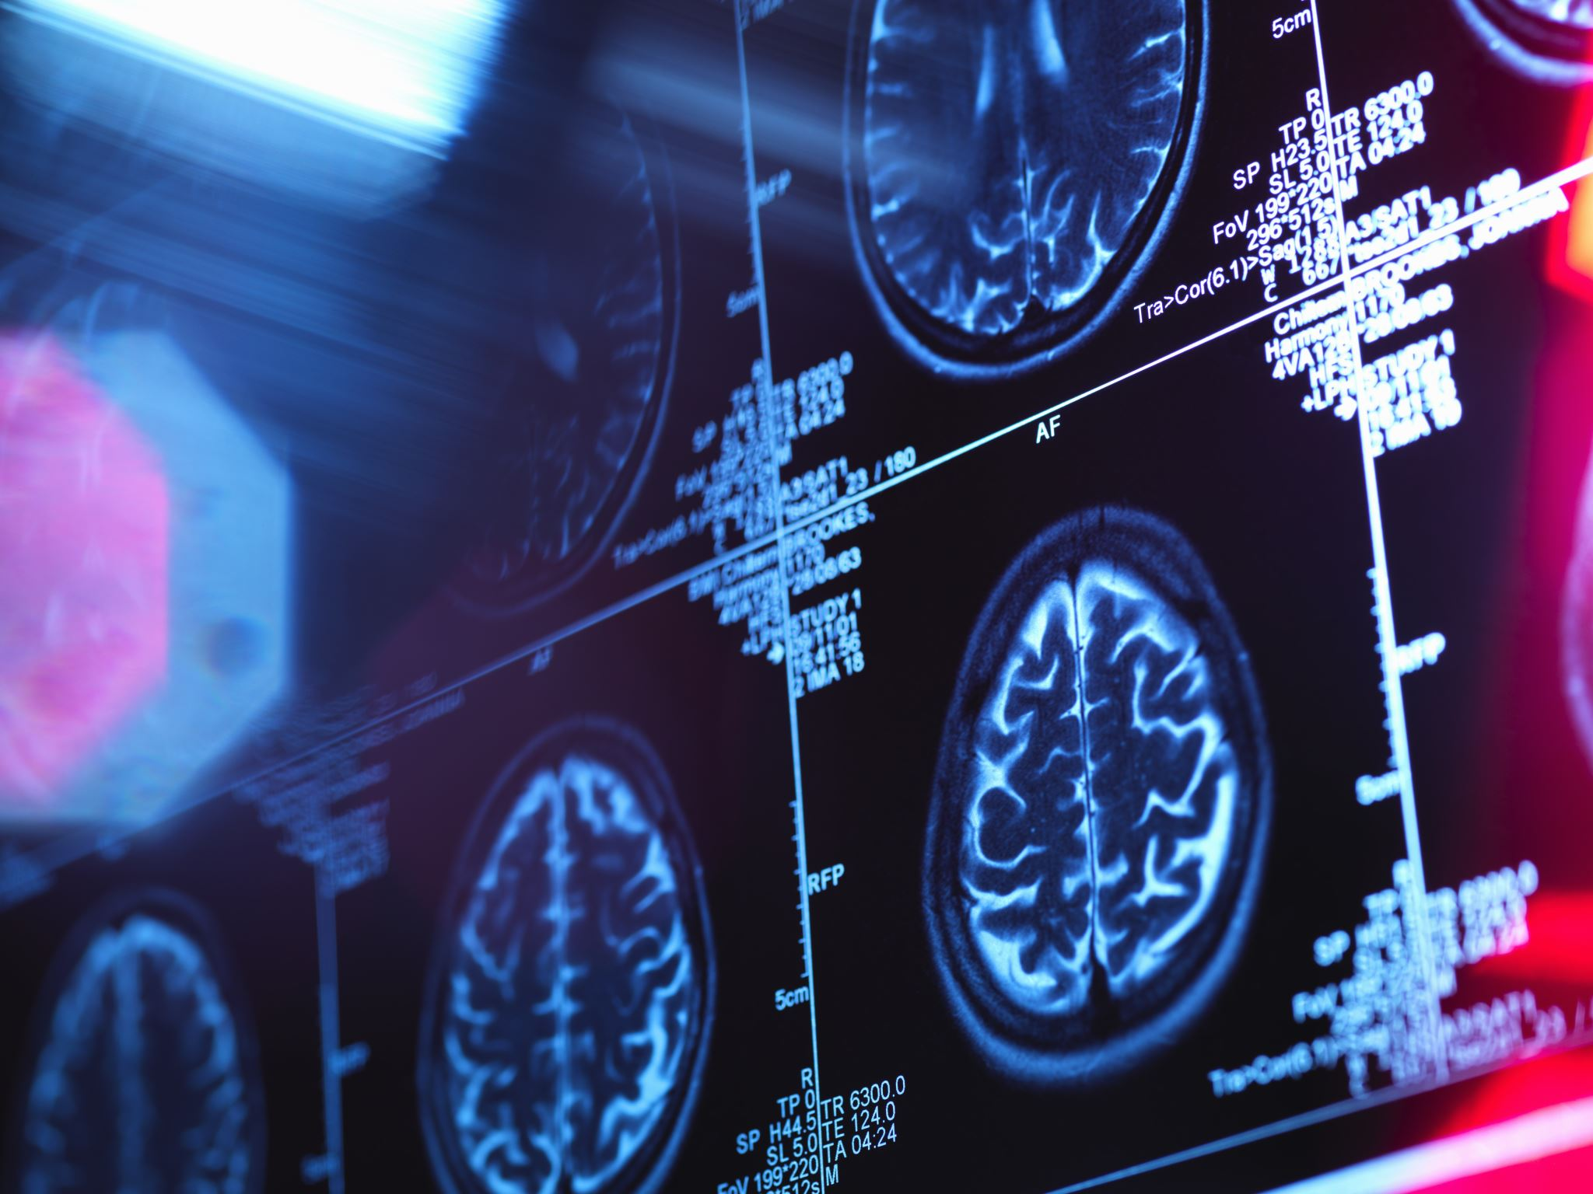
Analysis of Chest X-Ray Images Using Machine Learning
A detailed walkthrough of data processing, model building, and evaluation

Slide 3
Objective: Develop a model to differentiate between normal and pneumonia conditions in chest X-rays. Importance: Quick and accurate diagnosis can significantly improve patient outcomes by enabling timely treatment.
Data Source:
Acquired a dataset of chest X-ray images from Kaggle, which includes labeled images categorized as 'Normal' and 'Pneumonia’. https://www.kaggle.com/datasets/paultimothymooney/chest-xray-pneumonia
Volume and Variety: The dataset consists of thousands of X-ray images, providing a robust basis for training a diagnostic model.

Slide 4
Data Preparation:
Data Cleaning: Checked images for any corruption or unusual file sizes that could affect model training.
Preprocessing:
Resizing: Standardized all images to a uniform size to ensure consistency in input data.
Normalization: Scaled pixel values to the [0, 1] range to facilitate faster convergence during model training.

Slide 5

Model Building:
Architecture Overview: Utilizes a Convolutional Neural Network (CNN) which includes layers such as convolutional layers, activation functions (ReLU), pooling layers, and dense layers for classification.
Architecture Details: The CNN has a significant number of parameters (2,507,618), all of which are trainable.
Data Split: Data is split into training and testing sets with a certain proportion to validate the model performance accurately.

Slide 6

Training the Model:
The model is trained using CPU and GPU with no observed difference in results.
The model is trained over several (30) epochs with batches of images to optimize the loss function.
Data augmentation techniques like rotations and shifts are used to improve model robustness.
The model and its training history are saved to avoid retraining and to facilitate easy reuse.

Slide 7

Exploratory Data Analysis (EDA)
Visualization: Used image viewing tools to inspect sample X-ray images for understanding typical characteristics and variations.
Analysis: Assessed the distribution of classes to ensure a balanced dataset, minimizing bias in the model’s performance.

Slide 8

Implementation of Advanced Techniques:
Using LIME for Local Interpretability: LIME framework interprets and explains the predictions of an image-based machine learning model. The explanation aims to make the model's decision-making process transparent by identifying which parts of the input image influence the model's predictions.
Grad-CAM Visualization:
Heatmap visualizations are used to highlight areas relevant for diagnosis in the X-rays, focusing particularly on the lung fields which are crucial for diagnosing pneumonia.

Slide 9
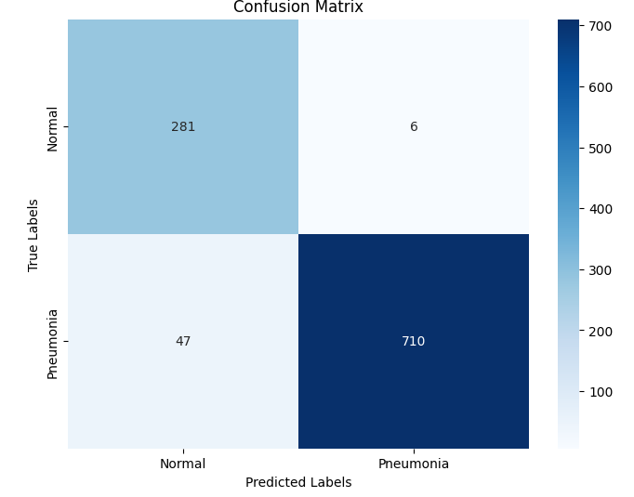
Evaluations of Solution:
Confusion Matrix:
The confusion matrix suggests the model has a strong predictive ability, with a high number of true positives and true negatives and relatively low false positives and false negatives.

Slide 10
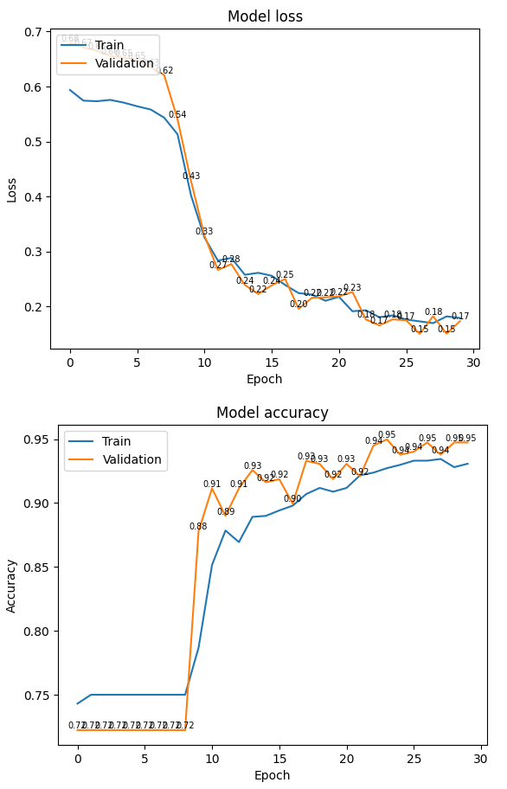
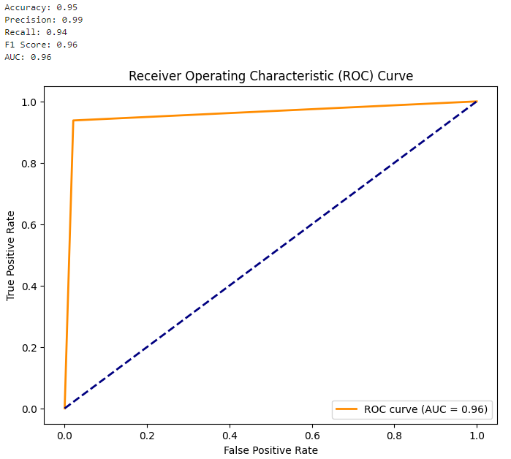
Evaluations of Solution:
Model Performance:
Loss and accuracy graphs show model learning effectively, with training loss decreasing more sharply than validation, indicating quick learning and potential overfitting after initial epochs.

Slide 11
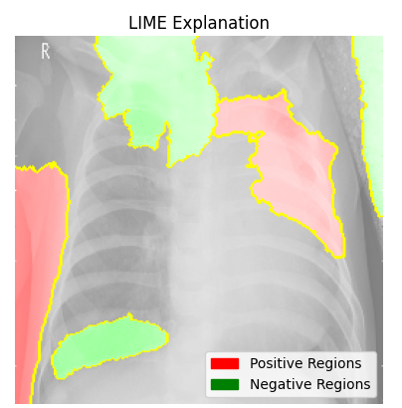
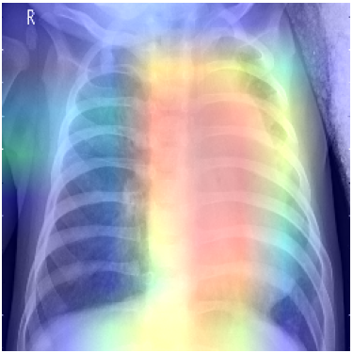
Evaluations of Solution:
Grad-CAM Output
Model Insights:
Heatmaps show the model focusing on the lung fields, validating the model's effectiveness in recognizing patterns associated with pneumonia.

Slide 12
Conclusion
Achievements and Observations:
Developed a robust CNN model with high accuracy and interpretability in diagnosing pneumonia from X-rays.
The model's effectiveness is supported by advanced visualization techniques that confirm focus on relevant anatomical areas.

