Slide 1
Digital Prescription Record Analyser
~ Moghith M

Slide 2
ABSTRACT
The Digital Prescription Record Analyser is a Python-based application designed to simplify the handling and analysis of prescription records. It reads data from CSV files, cleans and processes the information, and stores it into a MySQL database. The system allows healthcare administrators and analysts to gain insights into common medications, track monthly trends of diseases and patients, detect duplicate records,identify the most prescribed drugs, Patients with Common Disease and Patient Count per Disease.Additionally, it provides visualization through charts for better interpretation. This tool helps improve decision-making in healthcare data management by offering a streamlined and automated solution for prescription analysis.

Slide 3
OBJECTIVE
To read and clean data from CSV files effectively.
To store cleaned data securely into a MySQL database.
To detect and remove duplicate prescription entries.
To identify the most commonly prescribed medications.
To identify Patient Count per Disease
To identify Patients with Common Disease
To generate monthly reports on disease trends and patient statistics.
To visualize data using graphs for better understanding and decision-making.
To provide a console-based user interface for ease of use.

Slide 4
TECHNOLOGIES USED
Python – Core programming language
Pandas – For data manipulation and analysis
MySQL – To store and retrieve cleaned data
MySQL-Connector-Python – For database connectivity
Matplotlib – For visualizing data insights
CSV – Input file format for prescription records
NumPy – For numerical operations

Slide 5
FUNCTIONALITIES
Load and clean prescription data
Remove duplicates and empty rows
Insert cleaned data into MySQL
View most prescribed medicines
View most common diseases
Generate monthly patient reports
Show Patient Count per Disease")
View most affected disease
Show monthly disease frequency
Show Patients with Common Disease

Slide 6
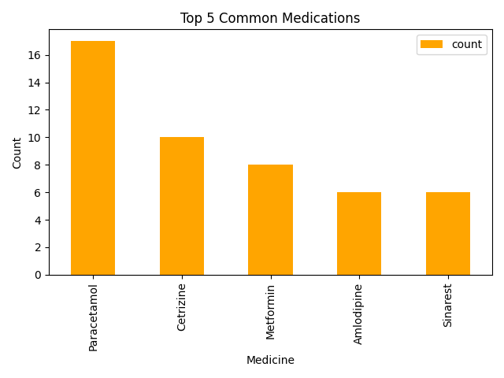
OUTPUT

Slide 7
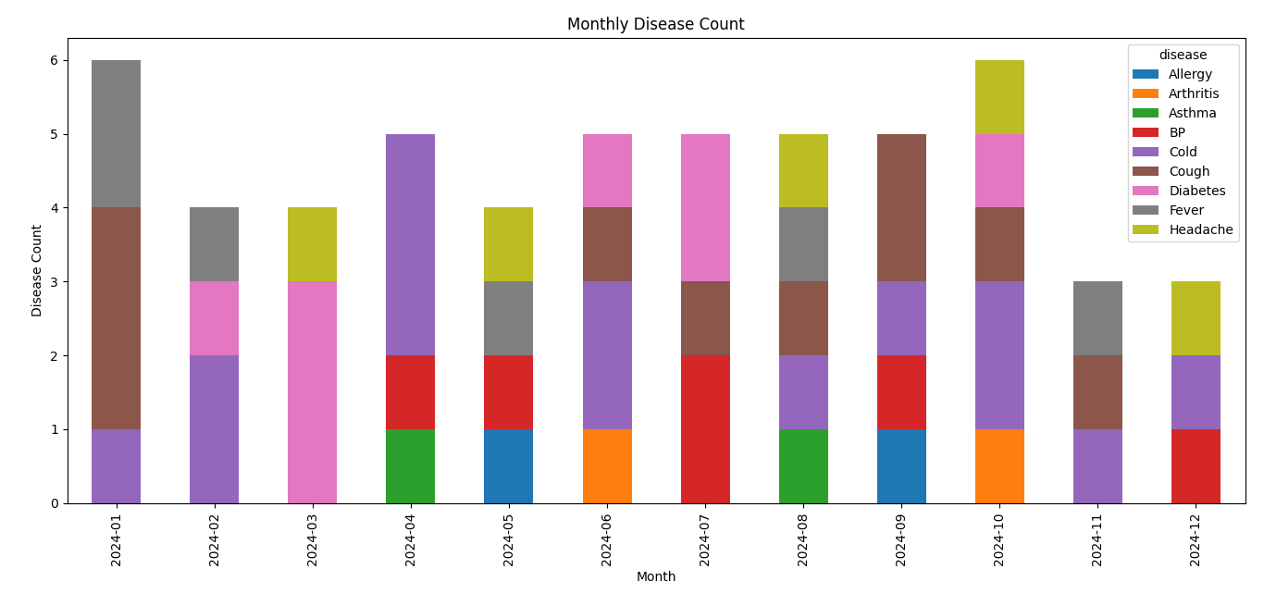
OUTPUT

Slide 8
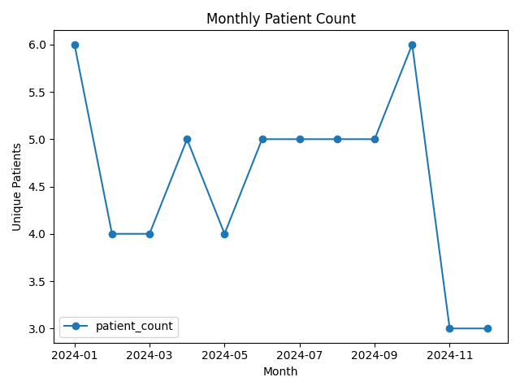
OUTPUT

Slide 9
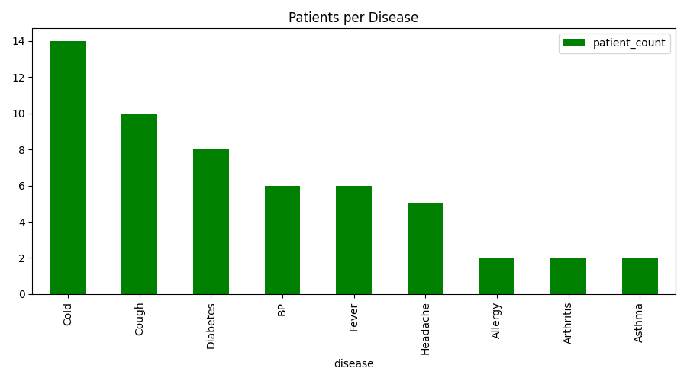
OUTPUT

Slide 10
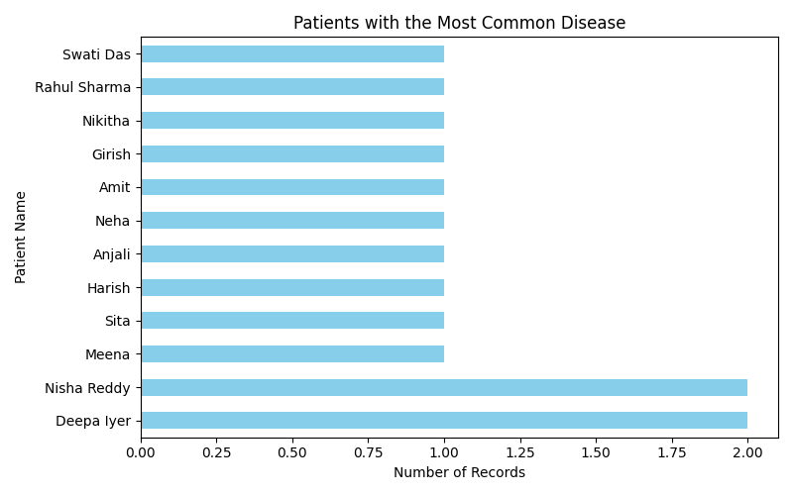
OUTPUT

Slide 11
Thank You !

