Slide 1
Failed Banking Transaction Analysis
~ Moghith M

Slide 2
ABSTRACT
The Failed Banking Transaction Analysis project aims to identify and analyze failed transactions from large volumes of banking data using big data tools. Leveraging PySpark on Google Cloud Dataproc, raw transactional data from Google Cloud Storage is cleaned, validated, and merged into a unified dataset. Failed transactions are filtered and stored in a Cloud SQL database to enable efficient querying. The processed data is further analyzed and visualized using BigQuery, providing insights into failure patterns based on payment mode, city, and branch. This system enables banks to enhance operational reliability and improve customer satisfaction through data-driven insights.

Slide 3
OBJECTIVE
Ingest transactional data from various CSV files stored in Google Cloud Storage.
Clean and standardize data by handling nulls, blanks, invalid values, and duplicates using PySpark.
Format and validate key fields such as dates, payment modes, and transaction statuses.
Filter and isolate failed transactions for targeted analysis.
Store the processed data securely in a Cloud SQL instance.
Enable future querying, visualization, and reporting via BigQuery integration.
Support business insights and decision-making with accurate failure trend analysis.

Slide 4
TECHNOLOGIES USED
Python – Used for scripting, cleaning data, and creating the initial CSV files.
Pandas – Utilized within Python for data exploration and preliminary cleaning.
PySpark– For scalable data processing and deep cleaning on large datasets.
Google Cloud Storage (GCS) – Storage location for raw and cleaned data files.
Google Cloud Dataproc – To run PySpark jobs on a managed single-node cluster.
Google Cloud SQL (MySQL) – Stores filtered failed transaction records for querying.
BigQuery – Handles SQL-based analysis and serves as a backend for visual reporting.
Looker – A BI tool integrated with BigQuery to create insightful dashboards.

Slide 5
FUNCTIONALITIES
Uploaded CSVs to GCS
Created CSV files using Python
Cleaned data using PySpark and Pandas
Merged all CSVs into one file
Removed null, blank, and duplicate records
Formatted and validated data fields
Filtered failed transactions
Stored results in Cloud SQL (MySQL)
Analyzed data using BigQuery
Visualized insights with Looker

Slide 6
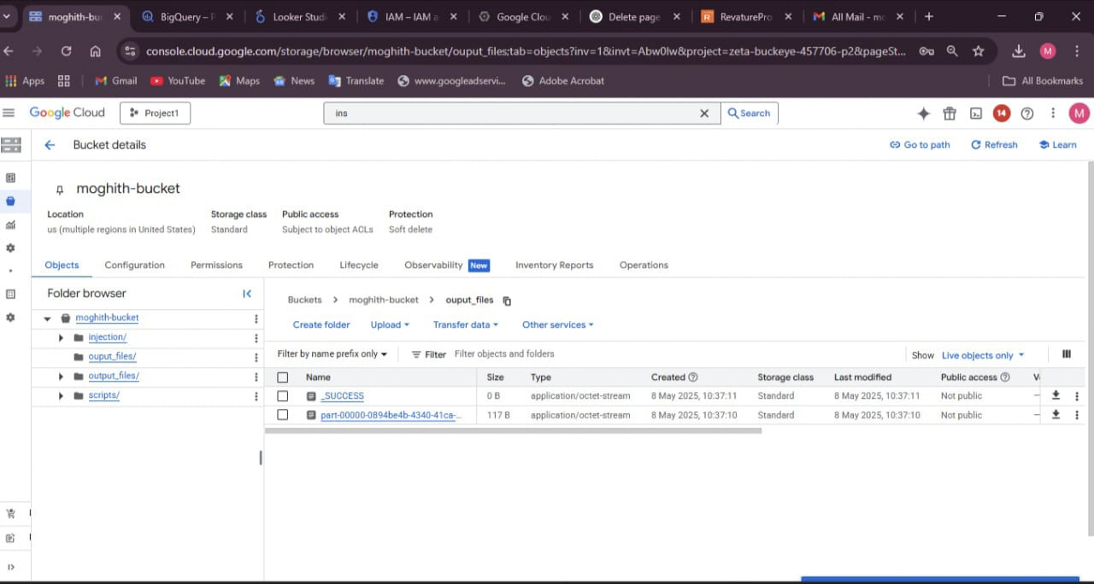
RESULT SNAPSHOTS

Slide 7
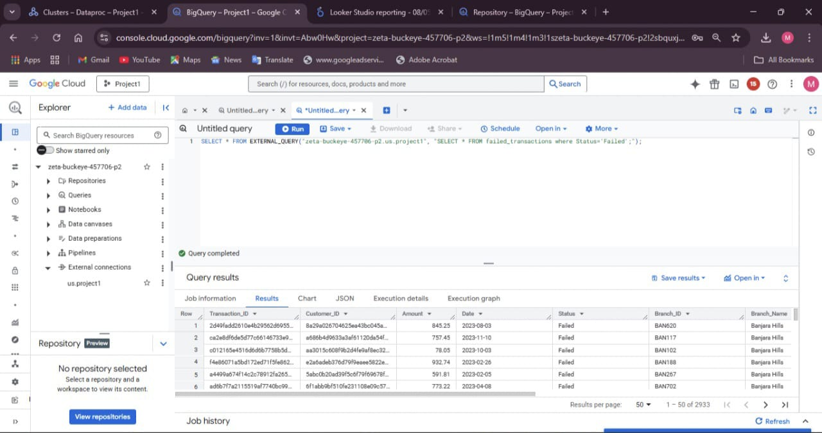
RESULT SNAPSHOTS

Slide 8
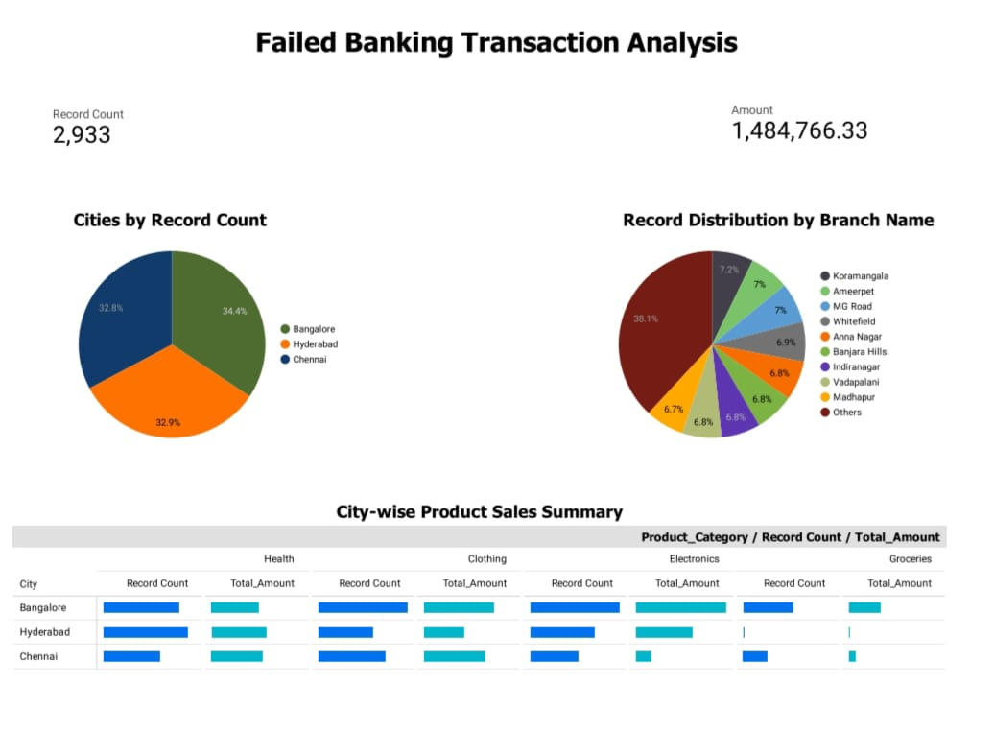
FAILED TRANSACTION INSIGHTS

Slide 9
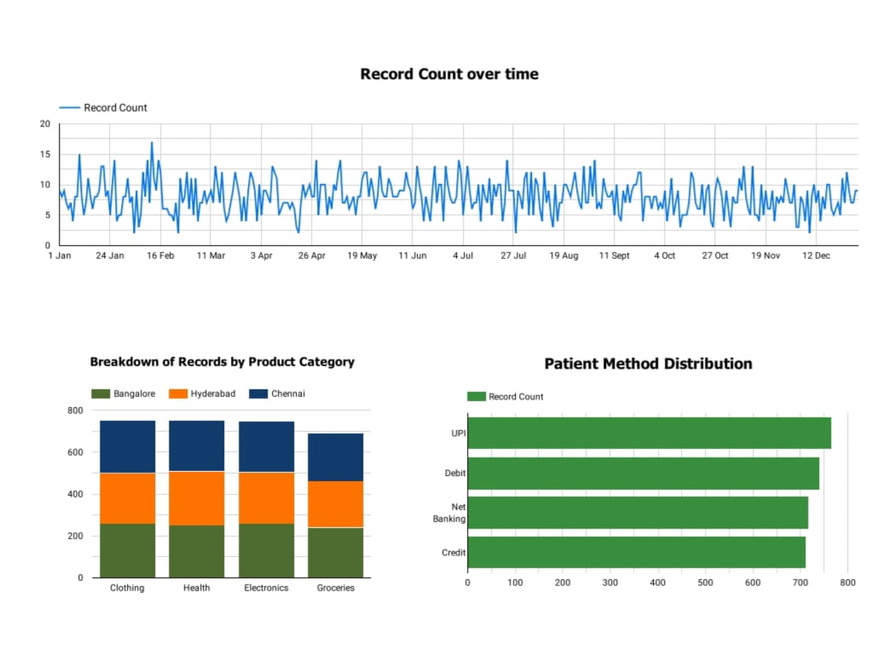
FAILED TRANSACTION INSIGHTS

Slide 10
Thank You

