Slide 1
ELECTVIZ – EXPLORING ELECTIONS THROUGH VISUAL INTELLIGENCE
INFOSYS SPRINGBOARD INTERNSHIP 6.0 || MILESTONE – 3 ||
PROJECT PRESENTATION
PROJECT MENTOR – SUNDAR.J
Presented By:
Amit Sanap
Dhinesh kannan
Mogithaa S D
Mounika Kodumuru
Mounika Mogalapalli

Slide 2
Milestone – 3
(Data Visualization)

Slide 3

What is Data Visualization?
Data Visualization is the process of representing data in graphical or visual format such as charts, graphs, maps, and dashboards to make information easy to understand.
Instead of reading numbers in tables, we use visuals to quickly identify patterns, trends, and insights.

Slide 4

Objective of the Milestone
To analyze party-wise, constituency-wise, and
historical election data
To identify trends in voting patterns over time
To compare party performance across constituencies
To create interactive dashboards for better decision-making

Slide 5
Dataset Overview
Party-wise Data Contains information about different political parties and their total votes or performance in elections
and helps compare the performance of parties and identify leading or dominant parties.
Constituency Data Includes election results for each constituency and the parties contesting in those areas.
It helps analyze regional performance and identify strong or weak constituencies for parties.
Time / Historical Data Contains election data from different years or time periods.It helps analyze trends
and changes in party performance over time.

Slide 6
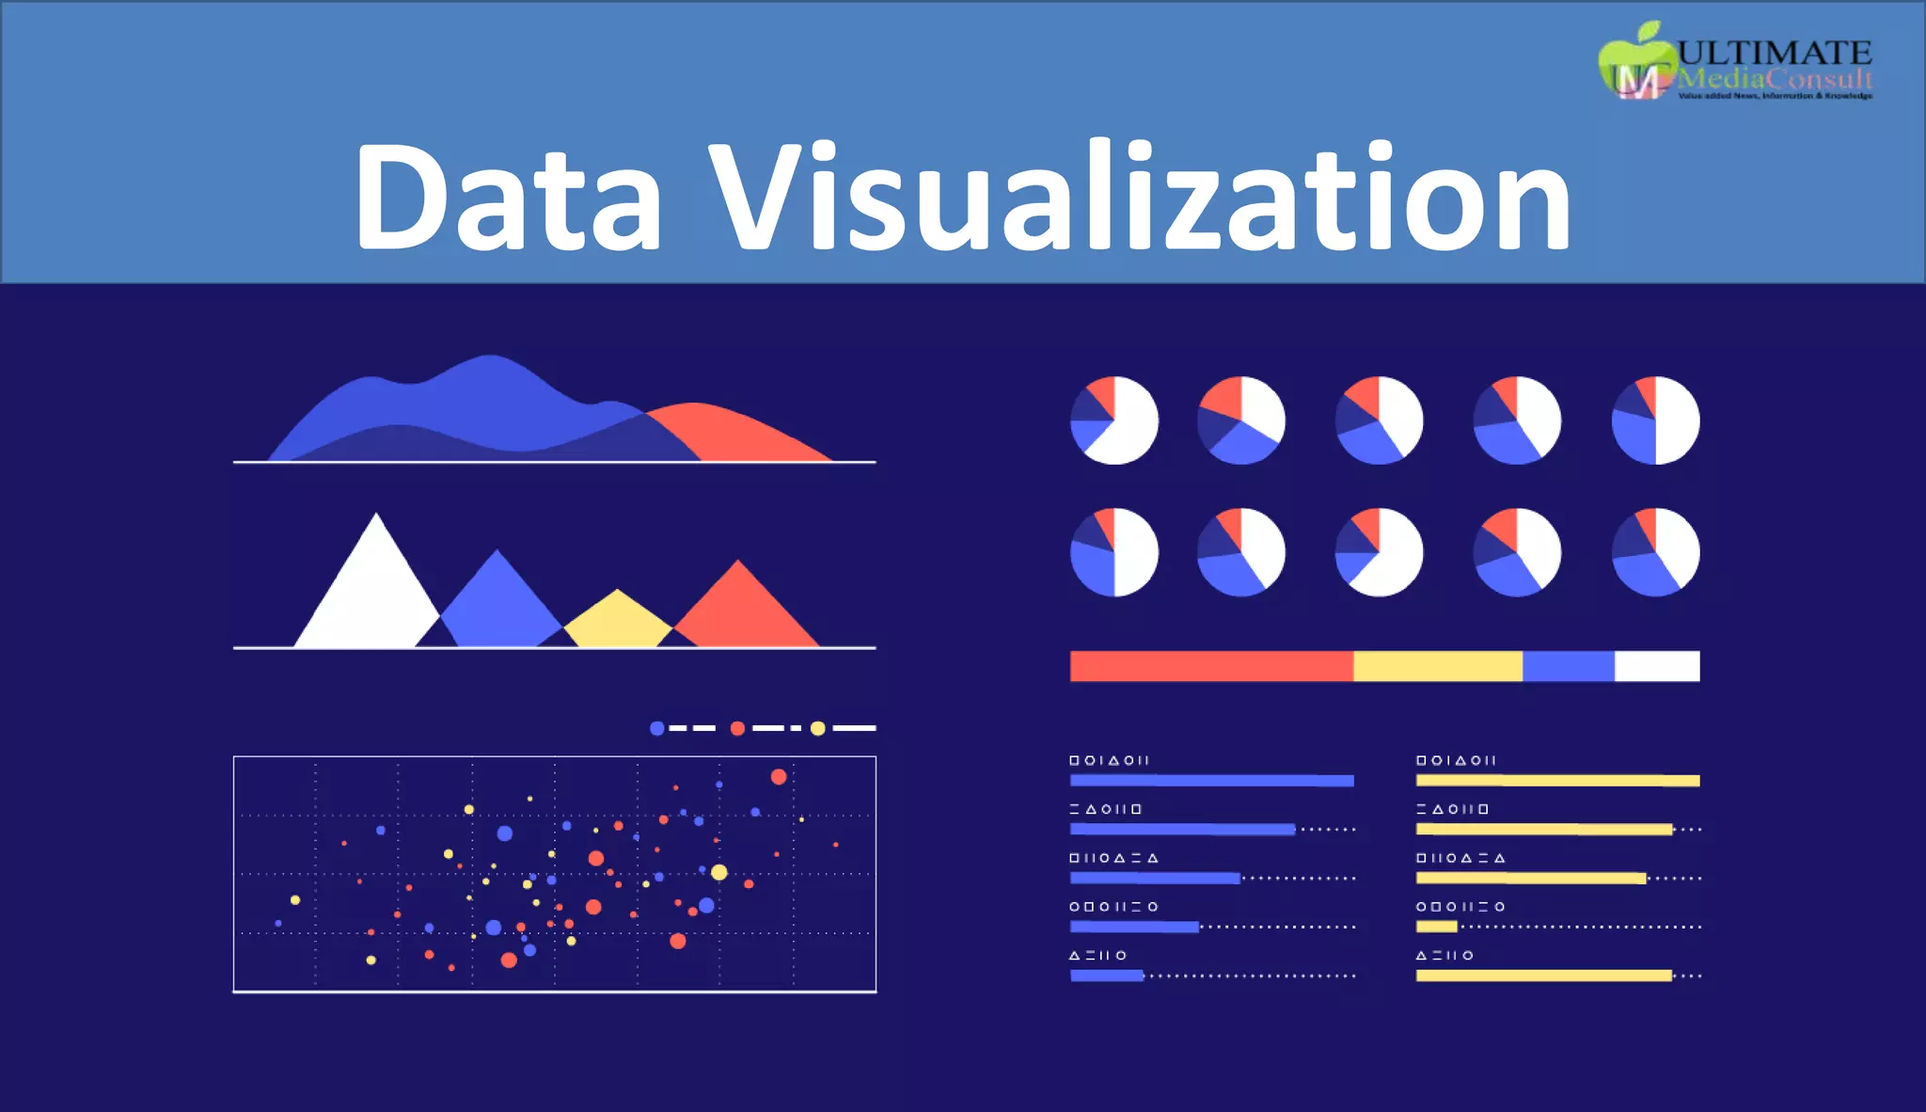
Data Visualization Techniques Used
In this milestone, we used:
📊 Bar Chart
📈 Line Chart
🔵 Bubble Chart
🔥 Heat Map
🎛 Slicers (Filters)

Slide 7
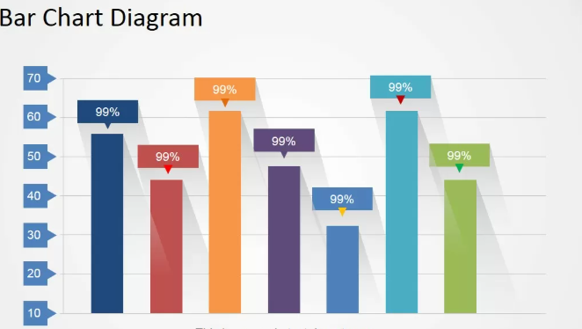
Bar Chart – Party-wise & Constituency Comparison
Compare vote count of different parties
Identify winning party in each constituency
Analyze performance differences

Slide 8
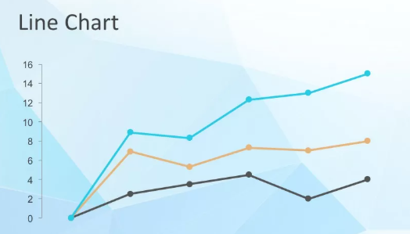
Line Chart – Time & Historical Trend Analysis
Show changes in party performance over years
Analyze historical growth or decline
Identify long-term voting patterns

Slide 9
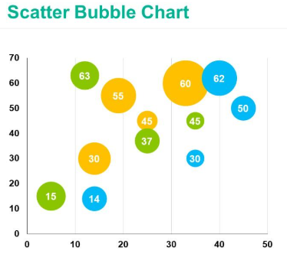
Bubble Chart – Multi-Dimensional Analysis
It Show relationship between:
Vote count
Vote percentage
Constituency
Bubble size represents vote strength

Slide 10
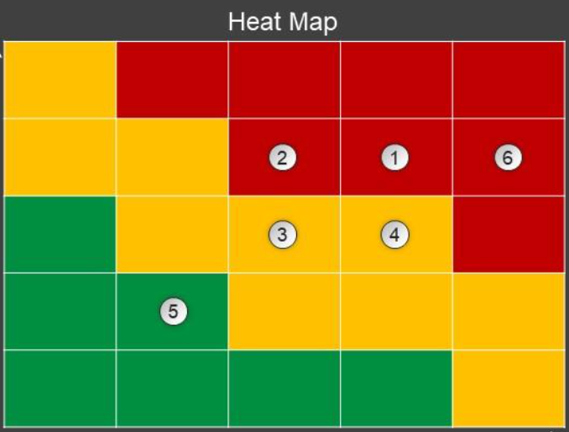
Heat Map – Intensity & Regional Performance
Identify strong and weak constituencies
Show performance intensity using color variations
Detect voting concentration patterns

Slide 11

Slicers – Interactive Filtering
Filter by:
Year
Party
Constituency
Enable dynamic analysis

Slide 12
Thank You!!

