Slide 1
Implementing Ensemble Methods and Neural Networks to predict Glass Transition Temperature:
Sunny Kaushik (IMT2021007)
Rohit Mogli (IMT2021535)

Slide 2
Background
Works done by Armeli et. al provided a ground where we can improve upon the features, and the models.
Models used by authors of the reviewing paper were mainly the Extra Trees which are basically the extremely randomized trees.
The major novelty introduced is in the feature vector where we're considering the branching in the compounds.
The authors of the paper neglected the sulfur atom, but the dependency of glass transition temperature on molecular mass have a very strong correlation.
Importance: The molecular mass is showing a strong correlation with the Tg as presented in the correlation map with a value of 0.76

Slide 3
Machine Learning Models:
Extra Trees model: An ensemble learning technique that constructs a multitude of decision trees at training time and outputs the average prediction of the individual trees, using random thresholds for splitting decisions to increase model randomness and decrease overfit.
Linear Regression: A statistical method that models the relationship between a dependent variable and one or more independent variables by fitting a linear equation to observed data, commonly used for predicting outcomes.
Random Forest: An ensemble method that builds multiple decision trees during training and predicts by averaging the predictions of the individual trees, effectively reducing overfitting and improving accuracy.
Gradient Boosting: A powerful machine learning technique that builds models incrementally in the form of an ensemble of weak prediction models, typically decision trees, optimizing a differentiable loss function.
Xtreme Gradient Boosting: An optimized distributed gradient boosting library designed to be highly efficient, flexible, and portable, implementing machine learning algorithms under the Gradient Boosting framework.

Slide 4
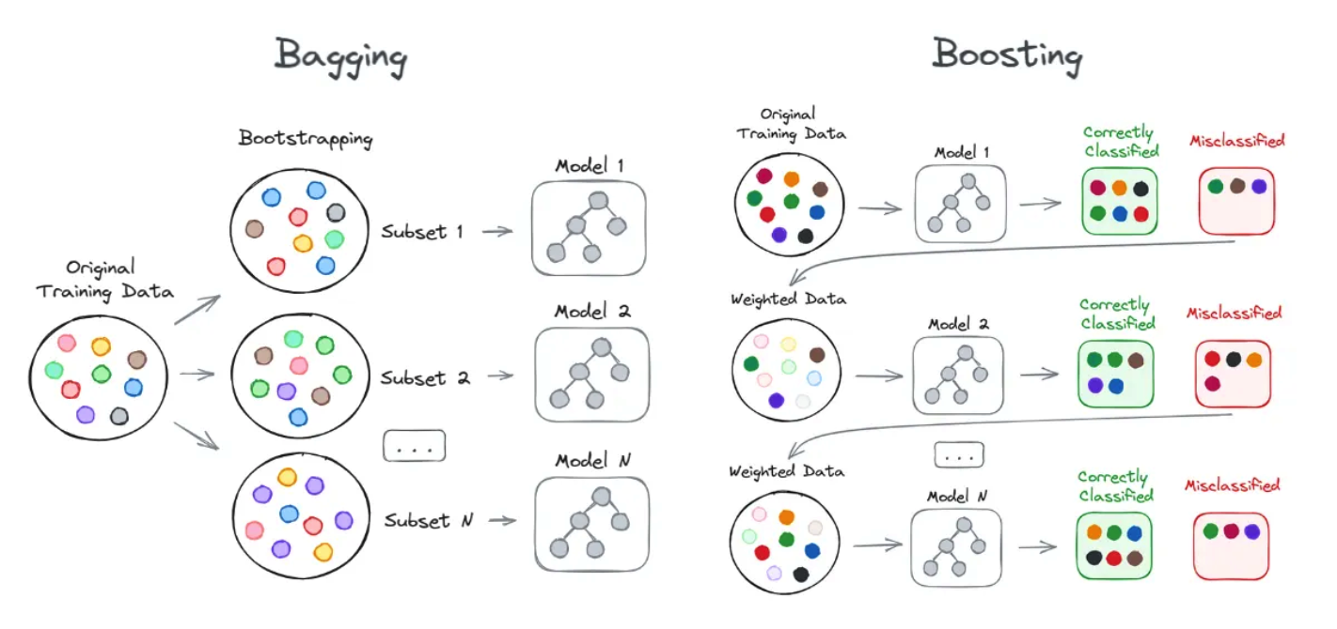
Bagging and Boosting Methods:

Slide 5
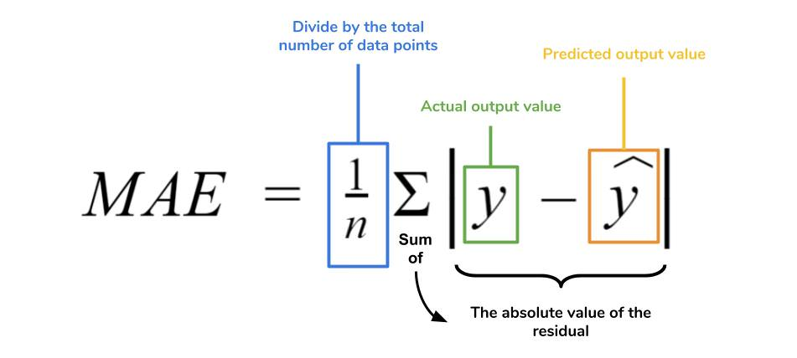
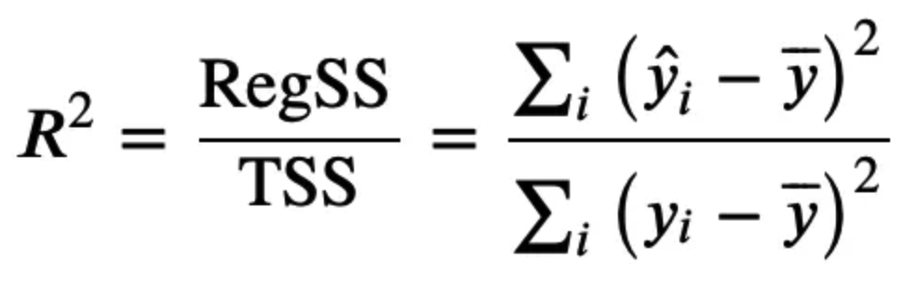
Evaluation Metrics:
Mean Absolute Error
R2 Score

Slide 6
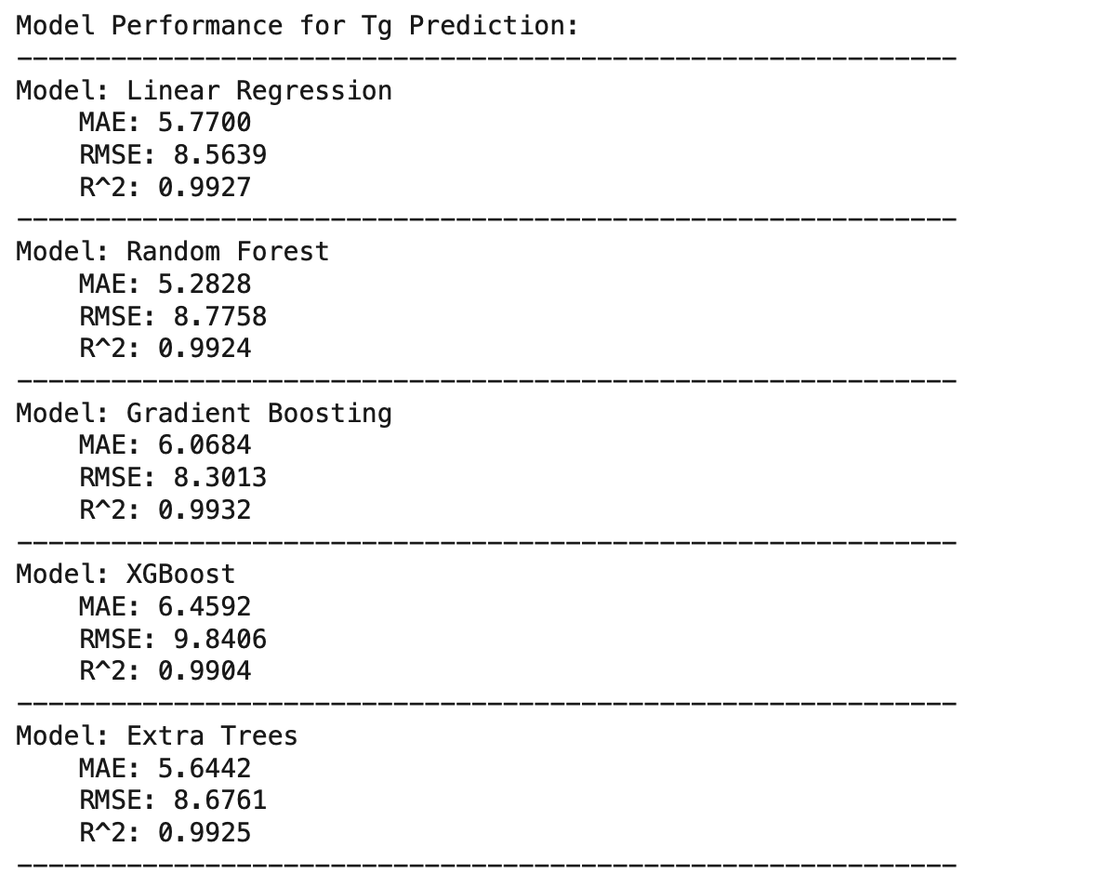
Results from Implemented Models:

Slide 7
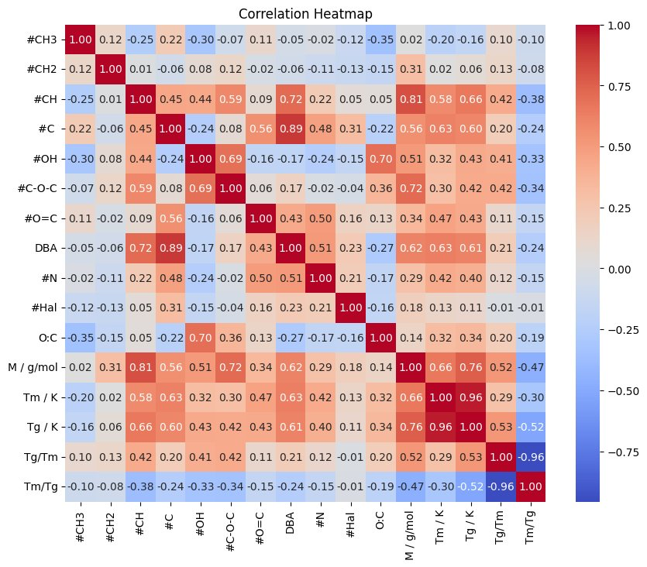
Novelty Introduced
We have introduced the new features in the dataset, namely the number of sulfur atoms and the number of branching.
Branching in Compounds: Branching refers to the presence of side chains or substituents attached to the main carbon backbone of organic molecules, affecting the molecule's physical properties and reactivity by altering its shape and molecular interactions.
Importance of including the sulfur atoms: From the correlation map, the molecular mass and the Tg are highly correlated with a value of 0.76.
ACS Omega 2023, 8, 13, 12298–12309
Publication Date:March 22, 2023

Slide 8
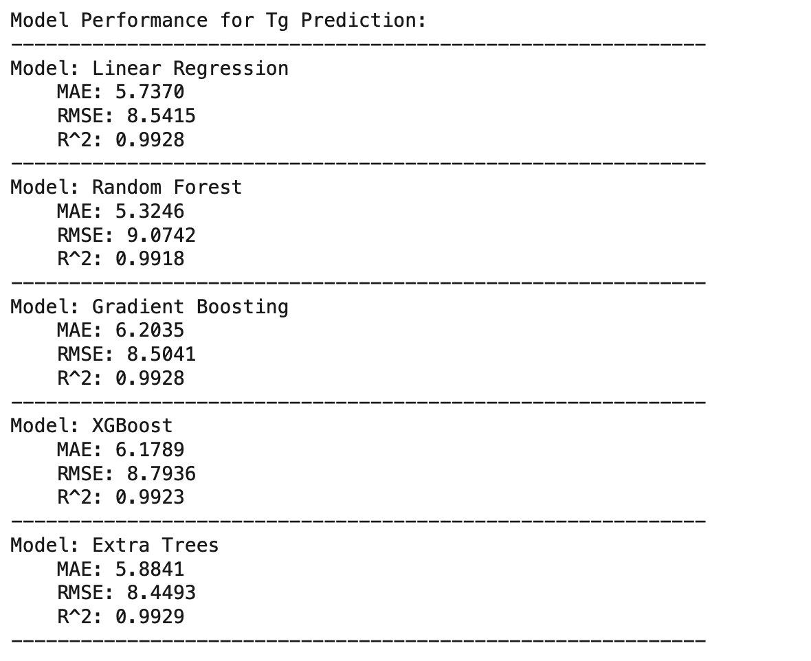
Results after Idea implementation-1:

Slide 9
Best Results after Idea implementation:
To the conventional method of splitting the dataset : test = 80% and train = 20%, increased the training data to 90%, the reason being the smaller dataset availability.
The Idea implemented covered majorly the following points:
1. Inclusion of the feature of number of Sulphur Atoms
2. Inclusion of the Branching feature as the number of branches present in the compound
Importance of addition of the above two features: The sulfur atoms are considered as the one of the heaviest element in the organic compounds and the branching feature influences the Glass Transition temperature captured in the accuracy.

Slide 10
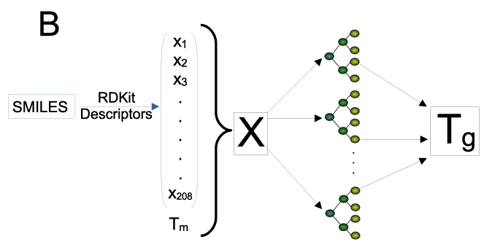
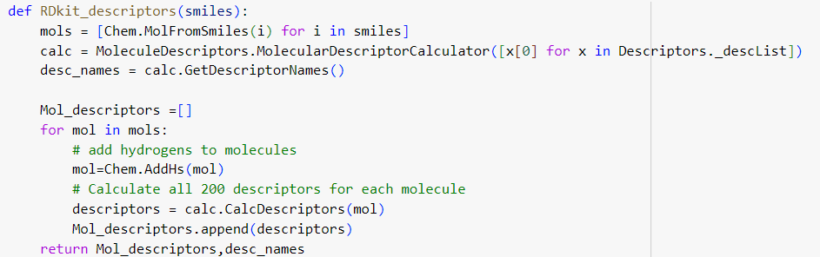
Generating Descriptors from SMILES Representation:
Smiles representation is used for generating 200 RDKit descriptors
RDKit is a software toolkit widely used for cheminformatics
RDKit allows users to work with chemical structures in various formats, including SMILES, SDF, and Mol files.
Descriptors are numerical representations of chemical compounds that encode various structural, topological, electronic, and physicochemical properties.
Topological descriptors include number of atoms, number of bonds and molecular weights
Functional group count descriptors include number of hydrogen bonds, number of aromatic rings etc.
Stereochemistry descriptors include number of chiral centers, and chirality indices

Slide 11
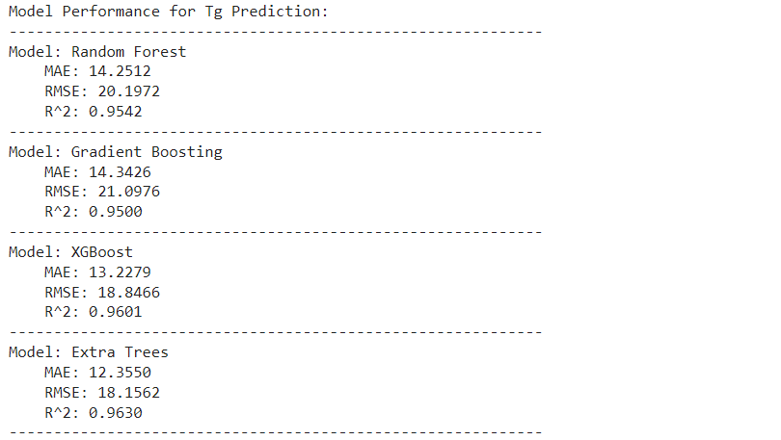
Results after Idea implementation-2:(using smiles)

Slide 12
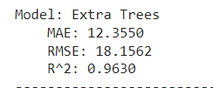
Best Results after Idea implementation:
The best result for implementing the SMILES representation idea was achieved using the extra trees model.
The Idea implemented covered majorly the following points:
1. Inclusion of the feature of number of 200 RDKit descriptors
2. Inclusion of the multiple features which are not present in functional group idea implementation
Importance of addition of the above features: The inclusion of multiple features reduces the model's accuracy because some of these features may not be relevant for predicting the glass transition temperature, negatively impacting the model's performance.

Slide 13
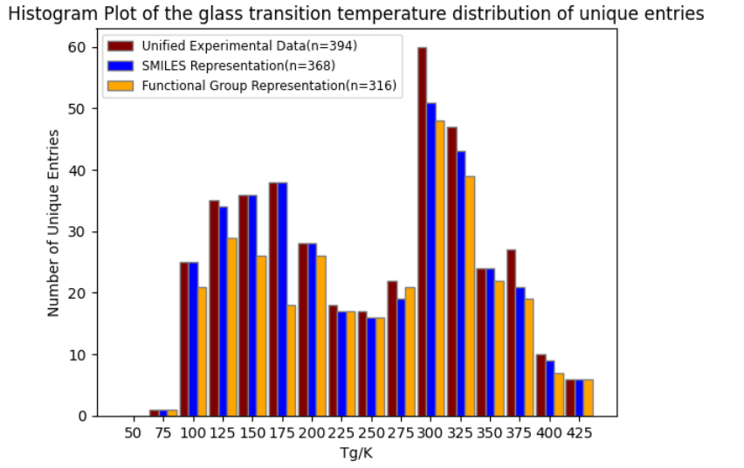
Data reduction histogram plot:
Ambiguities cause originally distinct molecules to be represented by the same feature vector.
Consequently, these distinct molecules are treated as the same substance in the model.
Some constitutional isomers (molecules with the same formula but different arrangements) have minor differences in their glass transition temperatures.
Example1: 2-pentanol (Tg = 140 K) vs. 3-pentanol (Tg = 143 K).
Example2: sucrose (Tg = 334 K) vs. trehalose (Tg = 385 K).
Figure visualizes the effect of data reduction due to feature representation.

Slide 14

Alternative models:
Boyer−Beaman rule
The rule suggests that the solubility of an organic compound in water is inversely proportional to its melting point
compounds with lower melting points tend to have higher solubility in water, while compounds with higher melting points are generally less soluble.
Tm = melting point and g is a constant, whose value was found to be approximately 0.7
Shiraiwa et al
This approach uses molecular properties such as molar mass and atomic oxygen-to-carbon ratio to provide insights into the behavior of organic aerosols in the atmosphere
M = molar mass and O/C = atomic oxygen-to-carbon ratio of organic compounds
A,B,C,D, and E are fixed parameters:
A=−21.57 K,B=1.51 Kmol g−1,C=1.7×10−3 Kmol2 g−2 ,D=131.4 K, and E=−0.25 Kmolg−1

Slide 15
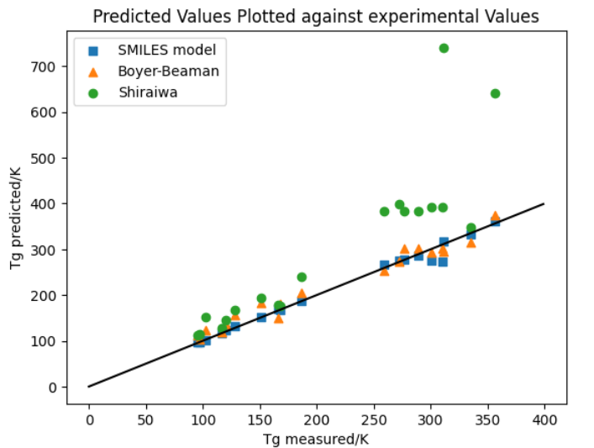
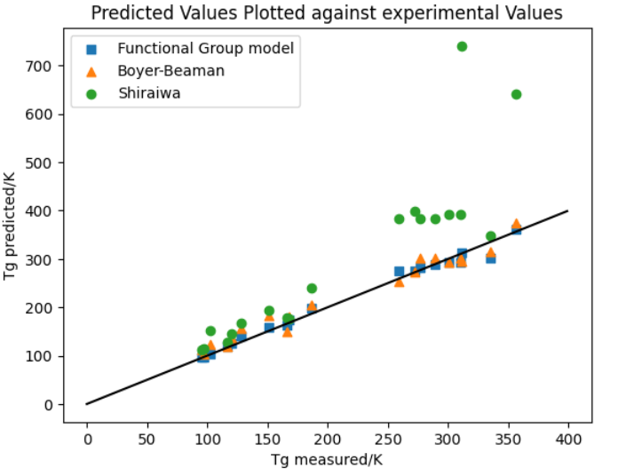
Comparison of models:
The predictions of the SMILES model (square) and the Functional Group model (square) are compared with those of the Boyer-Beaman model (triangle) and the Shiraiwa model (circle).
A straight line indicates that points close to the line represent predicted values that are close to the measured values, demonstrating the accuracy of the scattered points.
Figures shows the Tg values predicted with the Functional Group Mode (FGM) and SMILE Mode(SM) versus the experimental Tg data. The line of unity (solid black line) represents a perfect prediction

Slide 16
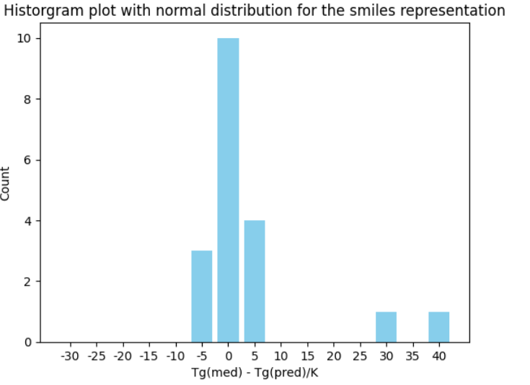
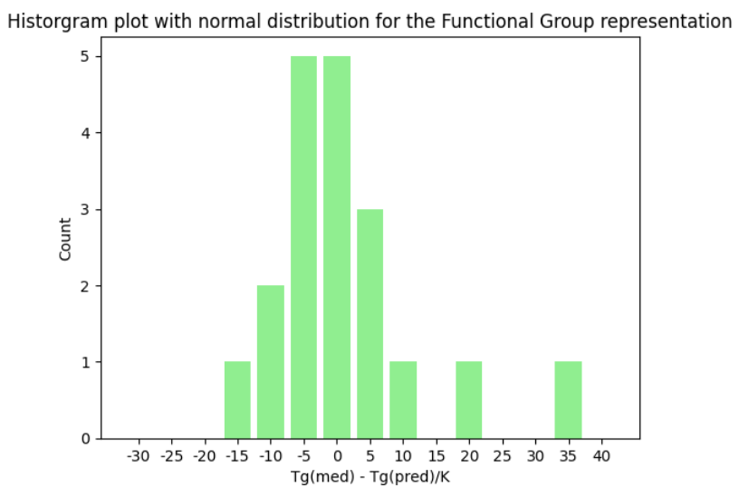
Histogram plot of variation from median:
Figures show the deviation of the individual glass transition temperature values Tg from their median value Tg(med) is depicted.
The data obeys a normal distribution centered around the zero value
Since we have taken only 20 samples from the dataset to plot the histogram, the plot appears somewhat distorted.

Slide 17
Future Work and Conclusion :
The Boyer-Beamen relation of Tg/Tm = 0.7 influences the glass transition temperature significantly.
The accuracy is presented by the models used by Armeli et. Al in the paper is already crossing the accuracy mark of 99%
Some of the exceptions persists in the prediction.
The paper Structure – Glass transition temperature relationship for non-polymeric molecules: The concept of internal plasticizing effect published in the year 2024 suggests experimental setups helps predict the glas temperature more accurately without relying on the melting temperature.

Slide 18
Results from Neural Network Model

