Slide 1

Machine-Learning-Based Prediction of the Glass Transition Temperature of Organic Compounds
Sunny Kaushik(IMT2021007)
Rohit Mogli(IMT2021503)

Slide 2
Background and Problem Statement
T is defined as the temperature at which the viscosity of a substance reaches a value of about 10^12 Pa-s.
The random forest algorithm consists of multiple individual decision trees and is, therefore, an ensemble method. Such an ensemble of trees is more powerful than a single decision tree, because of the uncorrelatedness of the different trees.
The extra trees algorithm relies on the same concept as the random forest, but has two major differences. First, the subsets are created without replacement and, second, instead of searching for the best split by maximizing the variance reduction, only a few random splits are considered and the best one among those is chosen. Generally, the random forest and extra trees algorithm are believed to perform equally well, but extra trees seems to outperform random forest when noisy features are present.

Slide 3
Literature Review
In 2014, Alzghoul et al. published a study in which machine learning algorithms (mainly support vector machines and neural networks) were used to predict the glass transition temperature of organic molecular compounds. One limitation of their work is that only a rather small data set of 71 druglike substances (mostly functionalized heterocycles) was considered. Thus, their model is only applicable to this specific group of substances, which lacks the representation of more common and simple molecules.
Tao et al. investigated the performance of over 70 different machine learning models on a polymer Tg data set and observed that a random forest algorithm performed best.
A long-known and simple, but surprisingly reliable, method is the Boyer−Beaman that formulates a proportional relationship between the glass transition temper- ature Tg and the melting temperature Tm of a substance. Further studies have elaborated that the Tg/Tm ratio is ∼0.7 for a large variety of substances.

Slide 4
Dataset and Methodology
all experimental input data are provided in form of the Bielefeld Molecular Organic Glasses (BIMOG) database.
The extremely randomized trees (extra trees) procedure was chosen for this purpose. Two approaches using different sets of input variables were followed. The first one uses the number of selected functional groups present in the compound, while the second one generates descriptors from a SMILES (Simplified Molecular Input Line Entry System) string.
The results show that the predictions of both approaches show a similar mean absolute error of about 12−13 K, with the SMILES-based predictions performing slightly better.
The majority of the data used here was taken from a data set collected by Koop et al.8 In that study, a total of 596 Tg values of various substances were analyzed, of which about 480 originate from organic molecular compounds, and these were used in the current study.
They are using the median of the dataset

Slide 5
Machine Learning Models

Slide 6
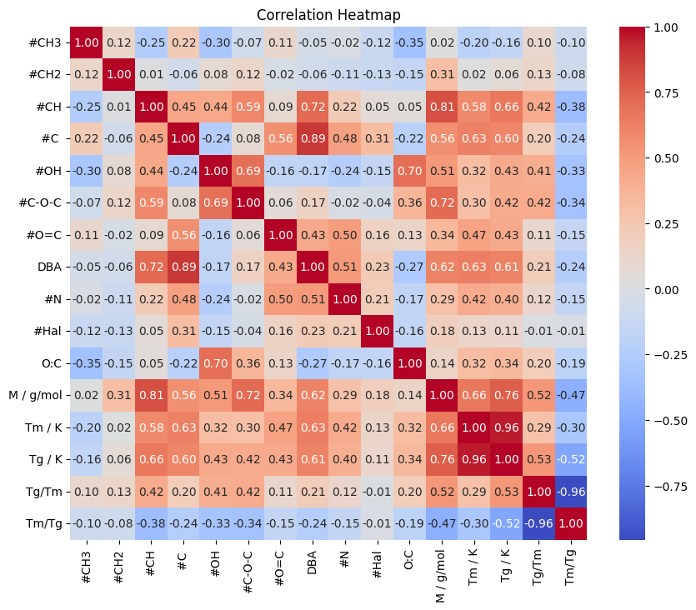
Correlation Matrix
Highly correlated with Tm with coefficient 0.96
Highly correlated with M/g/mol with coefficient 0.76
In functional groups, highly correlated with number of CH bonds with coefficient 0.66
Along with #C with coefficient 0.60 and DBA with coefficient 0.61

Slide 7
Future Works
The molecular compounds in our data set consist primarily of C−, H−, O−, N−, and halogen atoms. There are very few compounds with sulfur atoms, but they are so under- represented in the data set that we do not recommend to use the model for such compounds.
The same is true for relatively large molecules (>600 g mol−1): While there are some compounds in the data set with larger molar mass, there are too few to justify a generalization
One problem that arose at the early data assessment stage was that quite often multiple experimental Tg data are available for the same substance, originating from different literature sources, methods or experimental conditions, e.g., cooling and heating rate.

Slide 8
SMILES (Simplified Molecular Input Line Entry System)
It is a way of representing the structure of a molecule in a text-based format. It's used in computational chemistry and bioinformatics to encode molecular structures for easy storage, searching, and manipulation by computers.
Rules for SMILES representation:
Atoms are represented by their elemental symbols
Single, double, triple, and aromatic bonds are represented by the symbols -, =, #
Branches are specified by enclosing them in parentheses, and can be nested or stacked
Cyclic structures are represented by breaking one bond in each ring
Chiral atoms are represented by ‘@’ or ‘@@’
Configuration around double bonds is specified by the characters / and \ (Cis and Trans isomers)

Slide 9
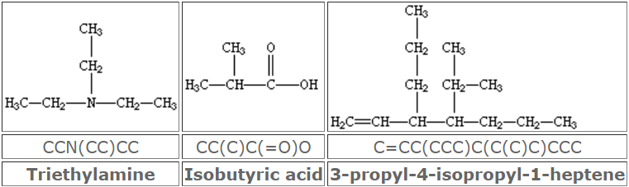
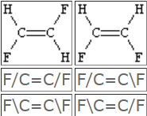
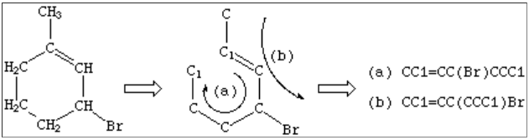
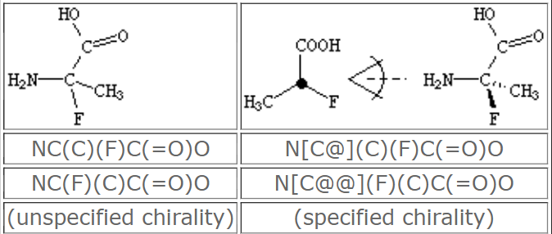
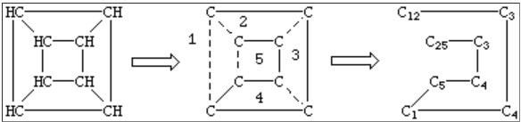
Examples of SMILES

Slide 10
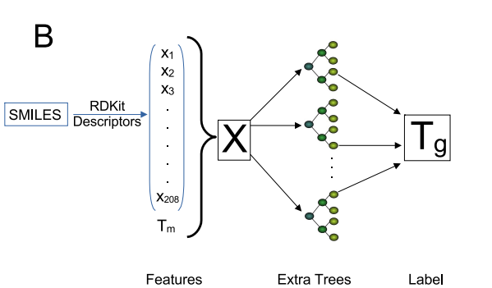
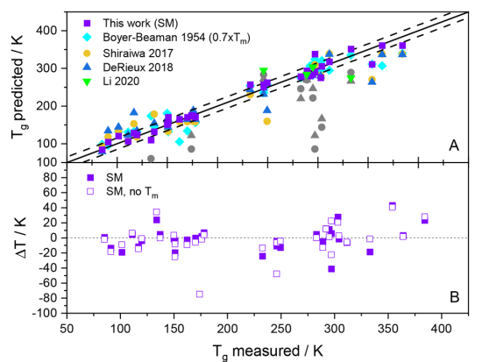
SMILES Based Approach using ML models
The RDKit package in Python, along with the DeepChem package, is employed to handle SMILES strings.
The RDKitDescriptors featurizer is used to transform SMILES strings into a 208-bit vector representing various molecular properties and structural information
The SMILES Mode ML model, especially with the inclusion of melting point (Tm) as a feature, demonstrates superior performance in predicting Tg values compared to other methods.

Slide 11
Effect of branching on the glass transition temperature
Branching can have a significant effect on the glass transition temperature (Tg) of a polymer or organic compound
Increasing branching tends to lower the glass transition temperature, while decreasing branching or linearizing the structure tends to raise it
This effect arises from the influence of branching on the molecular packing and mobility within the material.
Due to the disrupted packing and increased free volume, these interactions become weaker in branched molecules.
Hydrogen bonds and van der Waals forces play a key role in determining glass transition temperature.
Molecule having strong hydrogen bond or any branching which can increase the bonding strength of the molecule then glass transition temperature also increases

Slide 12

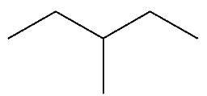
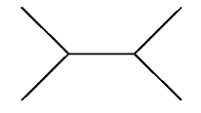
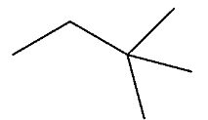
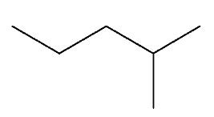
Testing on isomers of hexane
Molecular formula | Molecular structure | Melting point Tm (K) | Glass transition temperature Tg(K)
n – hexane |  | 177.83 | 90.49
2 – methyl pentane |  | 120.1 | 140.42,77
3 – methyl pentane |  | 336 | 136.99,76
2,3 – dimethyl butane |  | 331 | 90.36
2,2 – dimethyl butane |  | 173 | 78.13

Slide 13
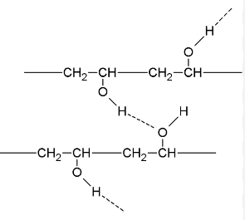
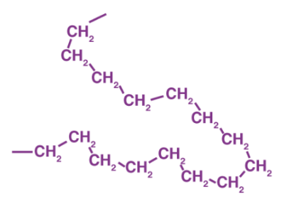
Hydrogen bond effect on glass transition temperature
- Polyvinyl alcohol Tg = 348.15 – 358.15
- Polyethylene Tg = 148.15

