Slide 1
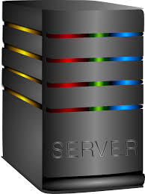
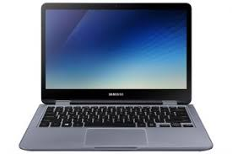
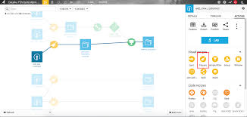
Data scientist laptop
* interface to analyze and prepare data and train models
* interface to manage API
Dataiku server
Dataiku
API deployer
Dataiku API NODES

