Slide 1
Sales Analysis
Team Name: Group 3
Date: April 2025

Slide 2
Team Members
Mohammad Kordy
Ahmad Ramadan
Mohammad Osama
Sanaa Ahmad

Slide 3
Introduction
Objective: Analyze sales performance, customer insights, and profitability.
Scope: Data cleaning, DAX calculations, and identifying top sales trends.
Audience: Management and stakeholders.

Slide 4
Data Overview
Source: Superstore Sales Dataset (CSV)
Data Cleaning Process:
Standardized date formats
Corrected inconsistent category names
Key Fields: Order ID, Product Category, Sales, Profit, Customer Segment

Slide 5
Power BI Process
Data Cleaning: Used Power Query to transform and prepare raw data for analysis.
DAX Functions: Implemented measures and calculated columns to derive meaningful insights.
Data Modeling: Established relationships between tables to ensure accurate data context.
Data Visualization: Created clear and impactful charts and visuals to communicate trends.
Report Creation: Designed structured reports using the most suitable visuals to highlight key findings.
Dashboard Creation: Built interactive dashboards showcasing KPIs and the most critical data from the reports.

Slide 6
Technical Steps & Data Processing
1. Adding Gender using AI
Utilized AI-based name classification to predict customer gender.
2. Calculating Duration with a Function
Used M formula --- Duration.Days([Shipdate] - [Orderdate]) “to calculate shipping duration.”
3. Customer Satisfaction Stratification
Applied conditional formatting to categorize satisfaction levels:
Added a new column: "Gender" with values 'Male' and 'Female’.
Ensured the column datatype was formatted as an integer.
0-2: Satisfied
3-5: Neutral
6-7: Dissatisfied

Slide 7
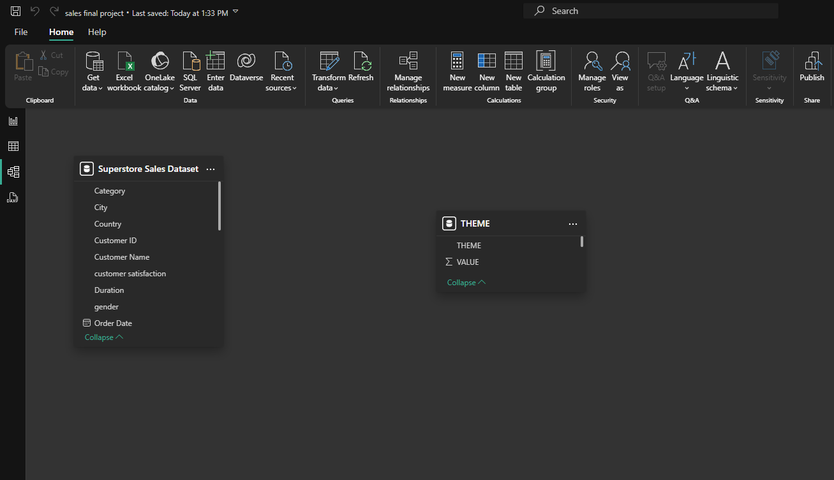
Data Modeling

Slide 8
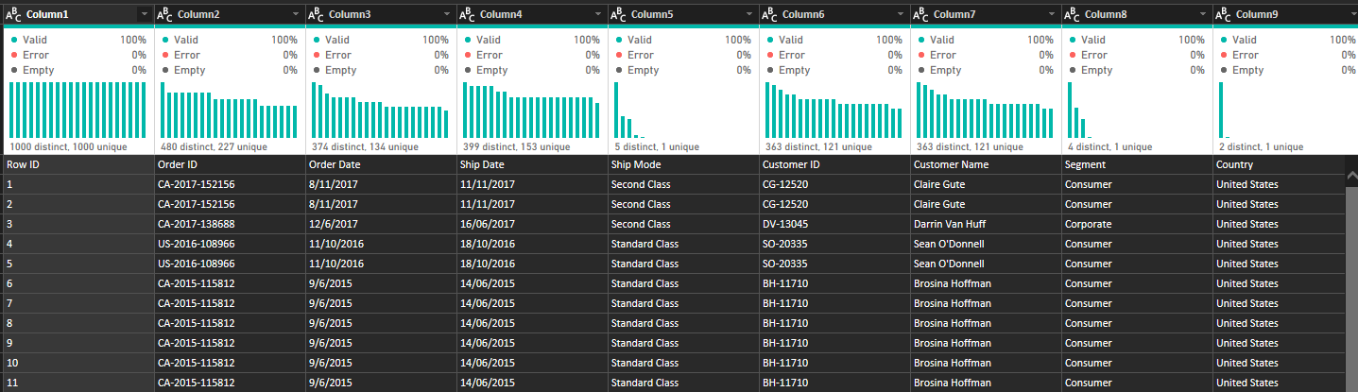
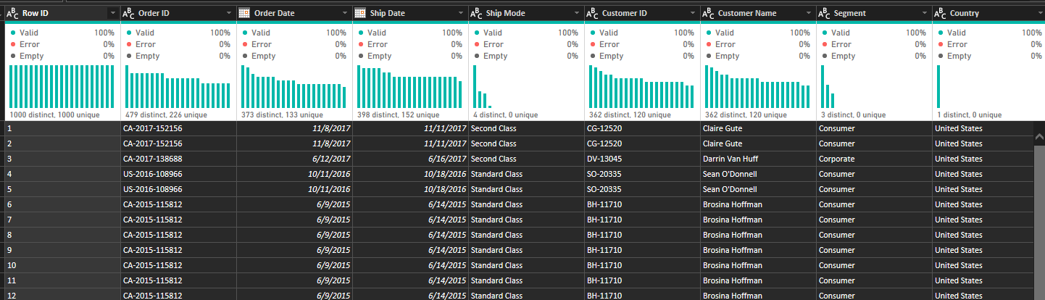
Data Cleaning & Transformation in Power Query
Before Cleaning
After Cleaning

Slide 9
Data Cleaning & Transformation in Power Query
1. Insert New Column: Gender
Applied AI-based name classification to derive gender.
2. Insert New Column: Returned
Created a new column to flag returned orders. “Modifying the source Data”
3. Standardized Date Format
Adjusted Regional Settings to "English (United Kingdom)".
Transformed date fields to ensure correct formatting.

Slide 10
Data Cleaning & Transformation in Power Query
4. Data Type Transformation
Converted date fields to Date type for consistency.
5. Duration Calculation
Used M formula --- Duration.Days([Shipdate] - [Orderdate]) “to calculate shipping duration.”
6. Conditional Column for Customer Satisfaction
Used "Add Column > Conditional Column" to categorize satisfaction levels.

Slide 11

DAX Implementation
For a professional presentation we created two modes Dark and Light Mode for each component
A table created for both modes dark and light
DAX Formulas:

Slide 12
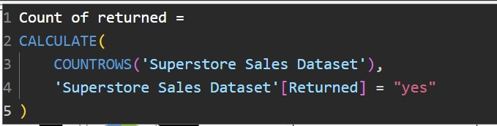
DAX Implementation
To gain deeper insights into customer loyalty, a DAX measure was created to count the total number of orders per customer.
DAX Formula: Counting Orders per Customer
DAX Formula: Counting of return.

Slide 13
DAX Implementation
DAX Formula: Summing Total Sales.
DAX Formula: Calculating male.
DAX Formula: Calculating female.

Slide 14
Key Insights & Findings
Top Performing Products: Identified best-selling items and categories.
Customer Trends: Analyzed purchase patterns by segment.
Profitability Analysis: Compared profit margins across different regions.

Slide 15
Navigation and Dark Mode
Empowering Users with Advanced Features: Navigation and Dark Mode for Seamless Accessibility and Comfort

Slide 16
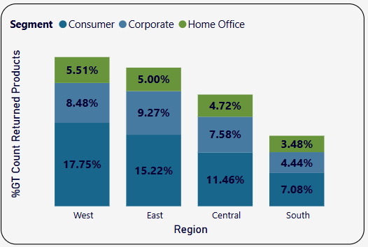
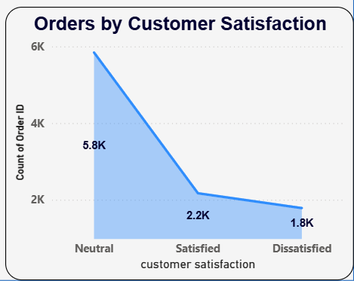
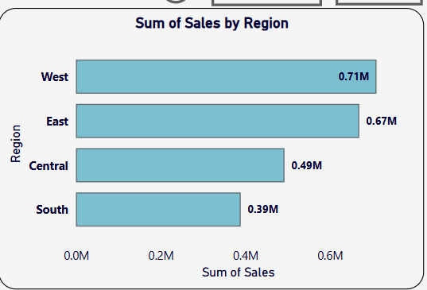
Power BI Visuals
🔹 Returned Products by Region & Segment
The West and East regions have the highest percentage of returned products.
The Consumer segment accounts for the majority of returns across all regions.
South region shows the lowest return rates overall.
🔹 Orders by Customer Satisfaction
Most orders come from Neutral customers (5.8K), followed by Satisfied (2.2K), and Dissatisfied (1.8K).
Indicates a need to improve satisfaction to increase repeat purchases.
🔹 Sales by Region
The West region leads in sales (0.71M), followed by East (0.67M).
South has the lowest sales (0.39M), suggesting a potential area for growth strategies.

Slide 17
Best Sales Performance
Top 3 Performing Regions: [West, East, Central]
Highest Revenue-Generating Category: [Office supplies]
Seasonal Trends: Identified peak sales periods.

Slide 18

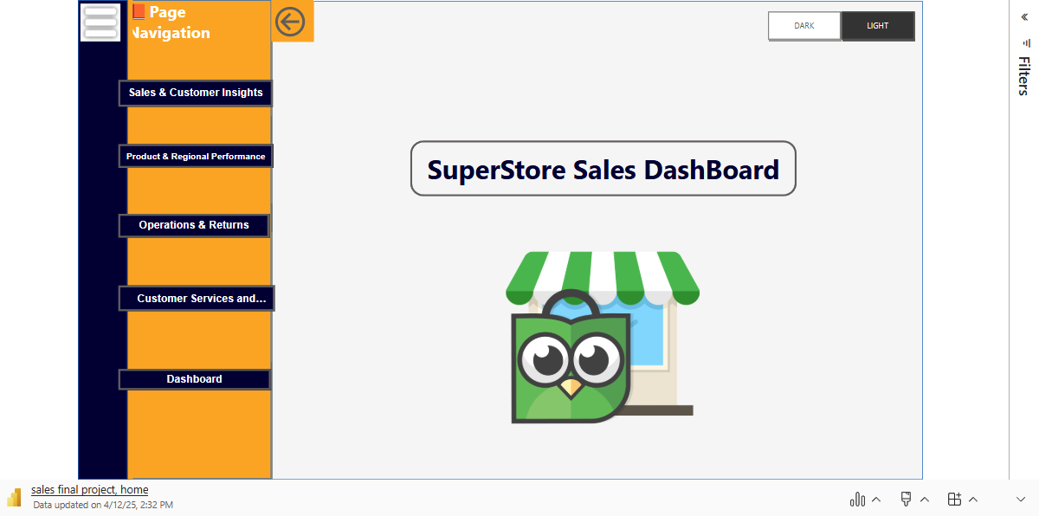
Microsoft Power BI

Slide 19
Recommendations
Focus on high-margin products to maximize profitability.
Improve marketing strategies for underperforming regions.
Enhance customer targeting using segmentation insights.

Slide 20
Thank you

