Slide 1
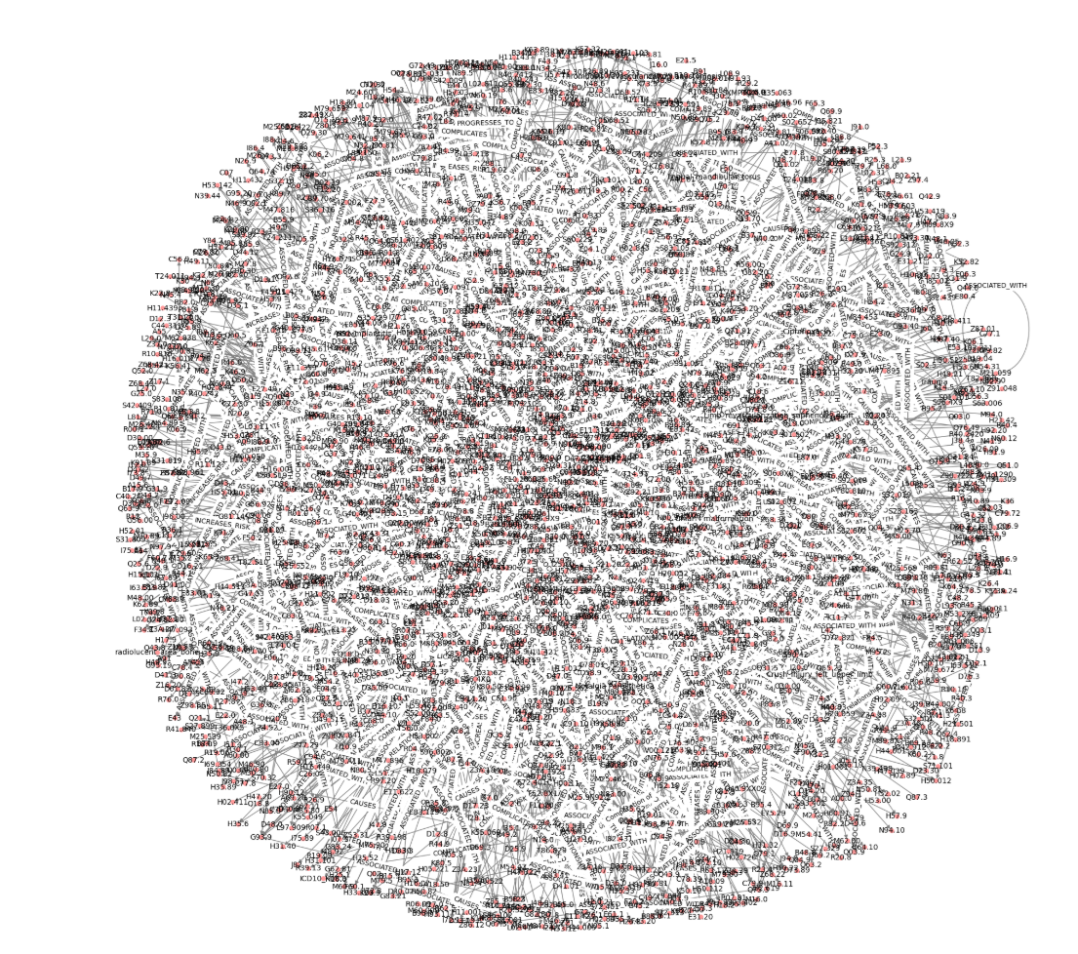
CodiEsp 1000 Clinical Cases Knowledge Graph

Slide 2
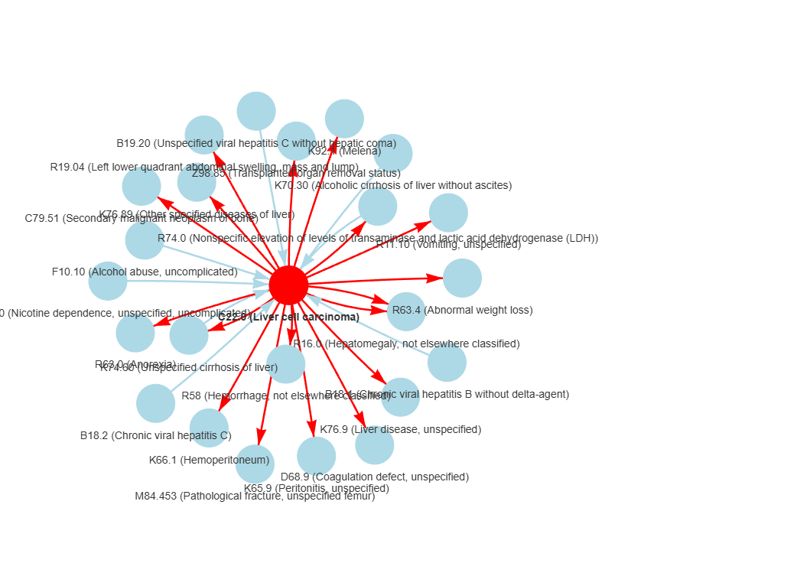
ICD-10 Code: C22.0 – Liver Cell Carcinoma

Slide 3
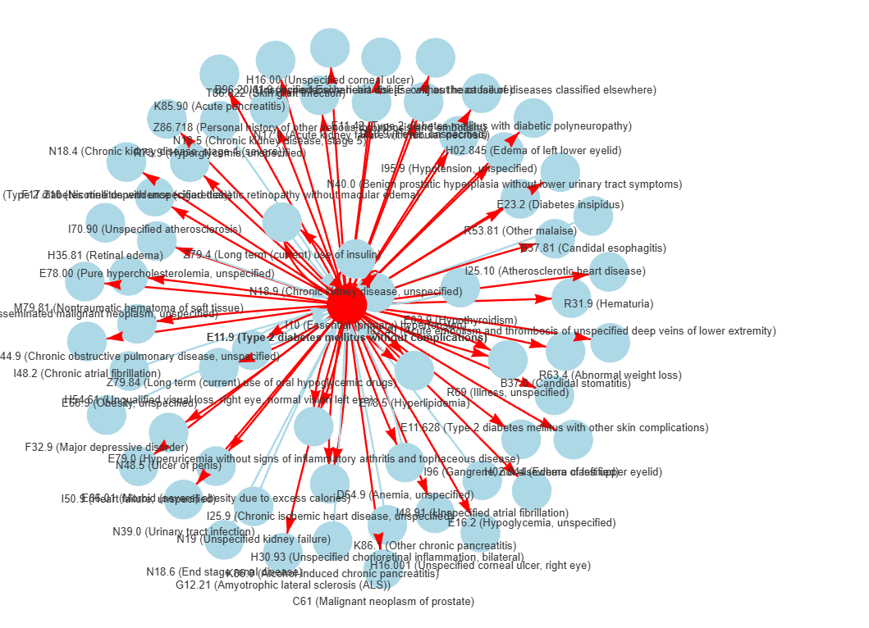
ICD-10 Code: E11.9 – Type 2 diabetes mellitus without complications

Slide 4
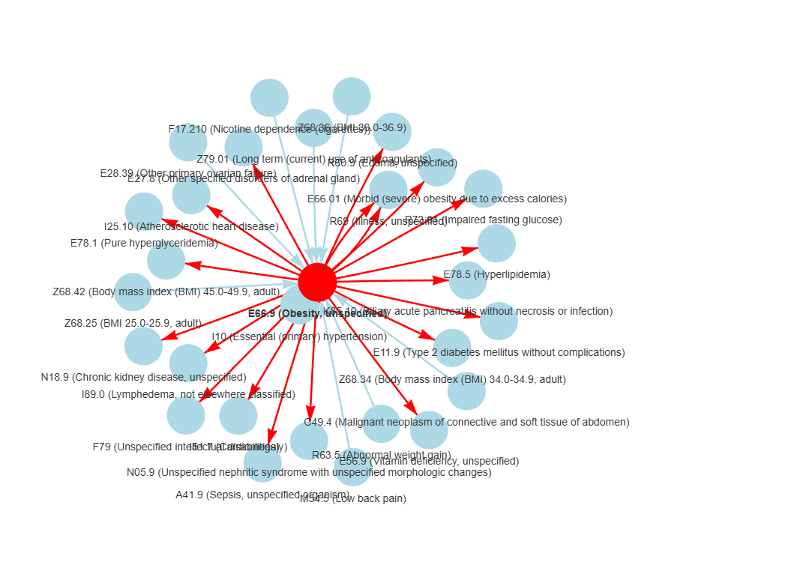
ICD-10 Code: E66.9 - Obesity, unspecified

Slide 5
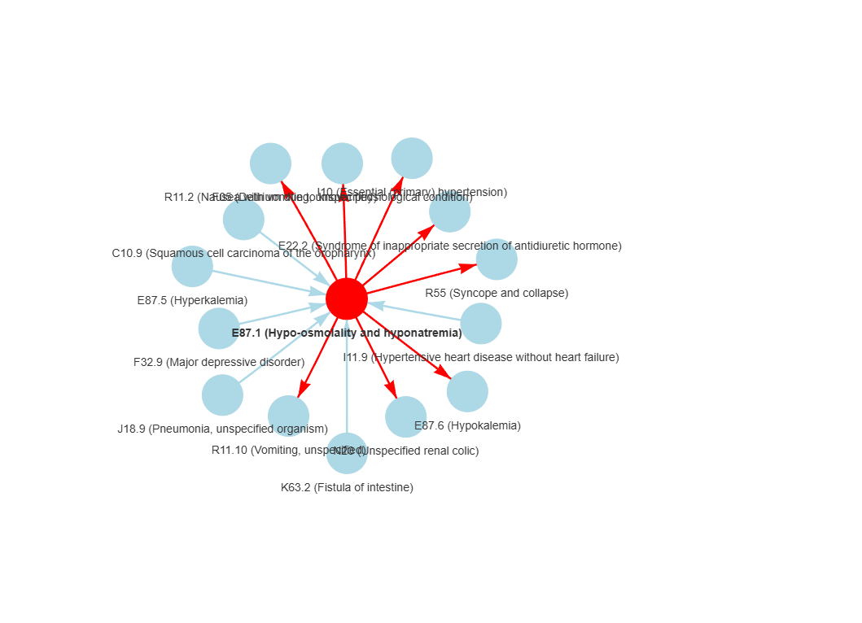
ICD-10 Code: E87.1 – Hypo-osmolality and hyponatremia

Slide 6
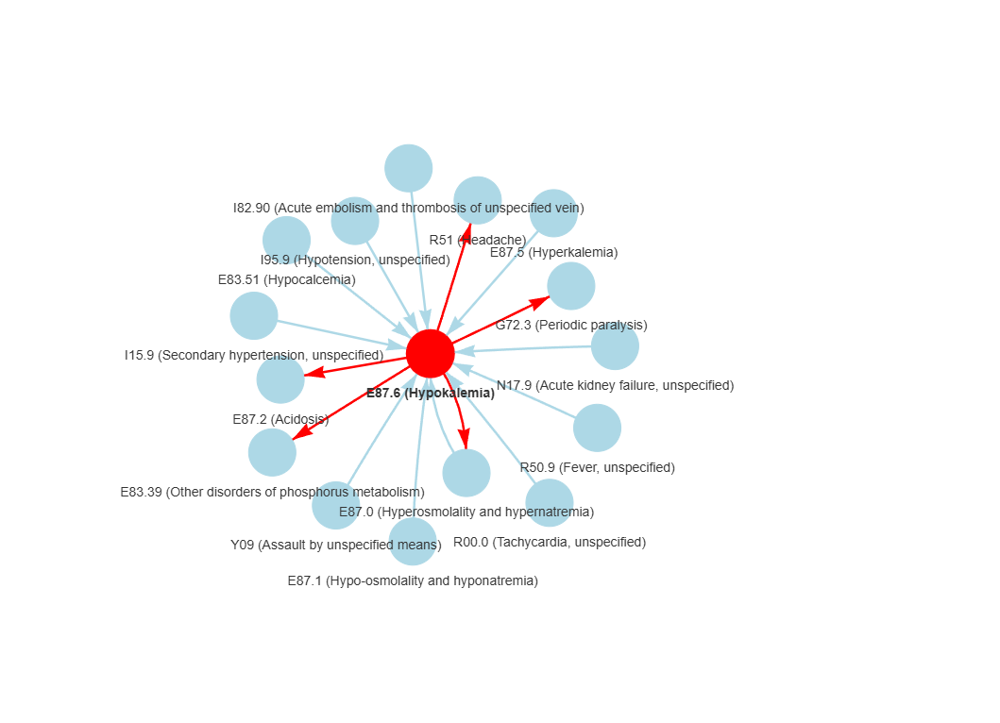
ICD-10 Code: E87.6 - Hypokalemia

Slide 7
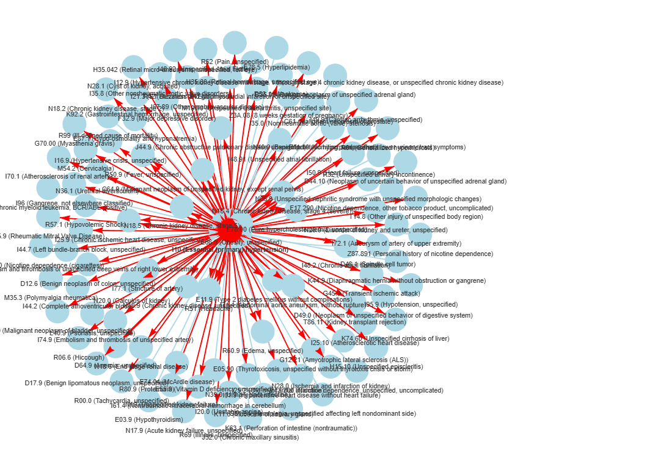
ICD-10 Code: I10 - Essential (primary) hypertension

Slide 8
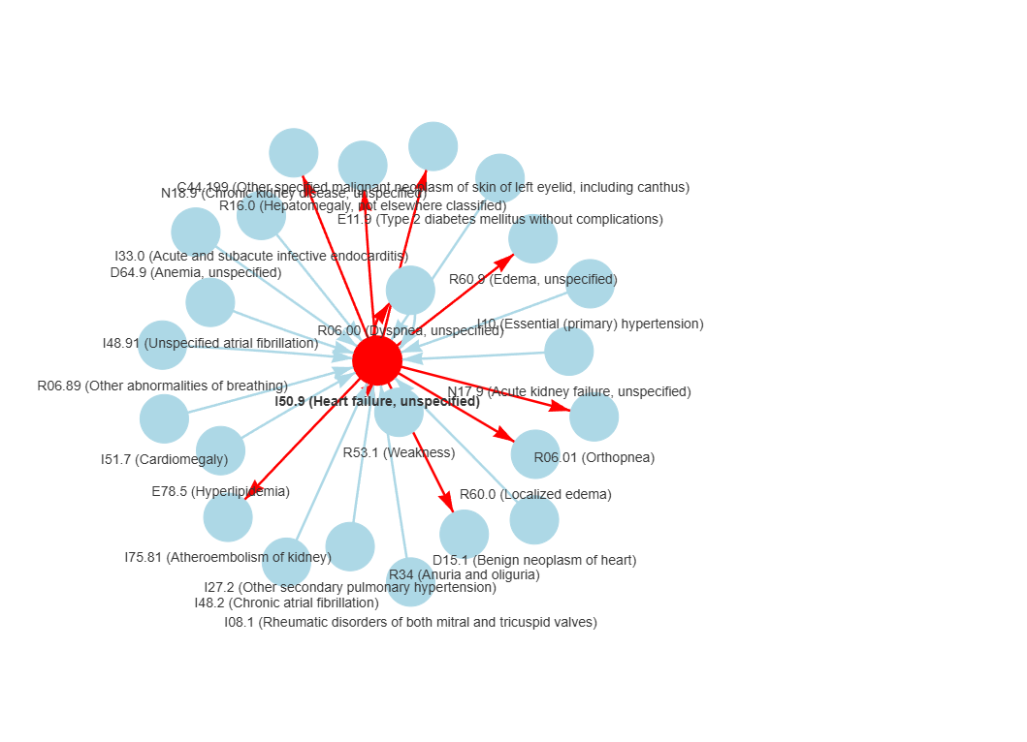
ICD-10 Code: I50.9 - Heart failure, unspecified

Slide 9
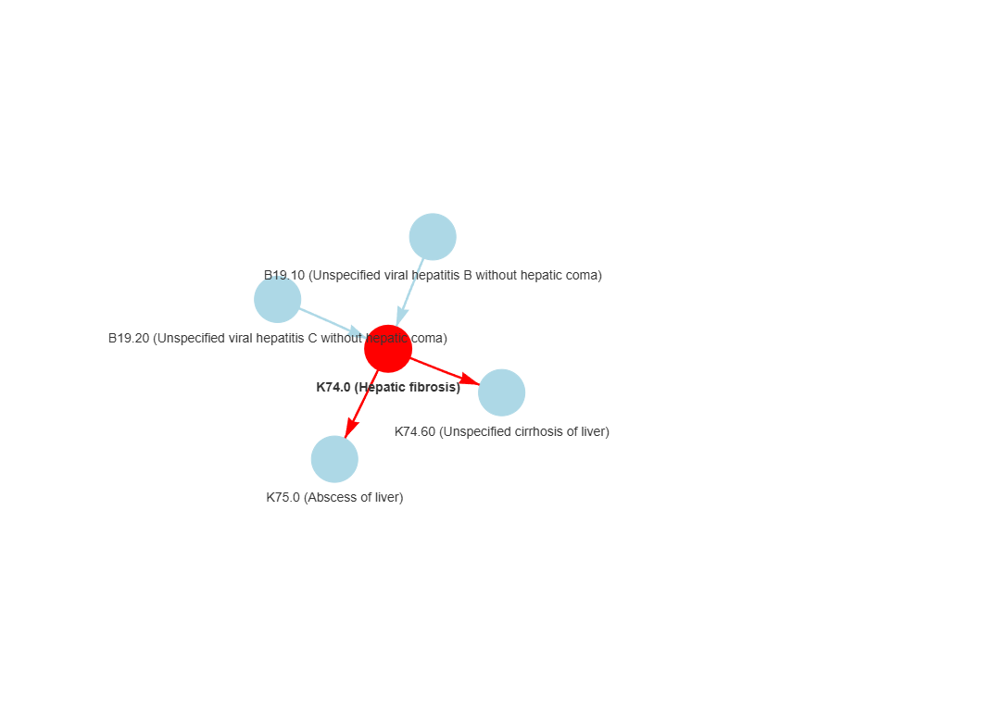
ICD-10 Code: K74.0 - Hepatic fibrosis

Slide 10
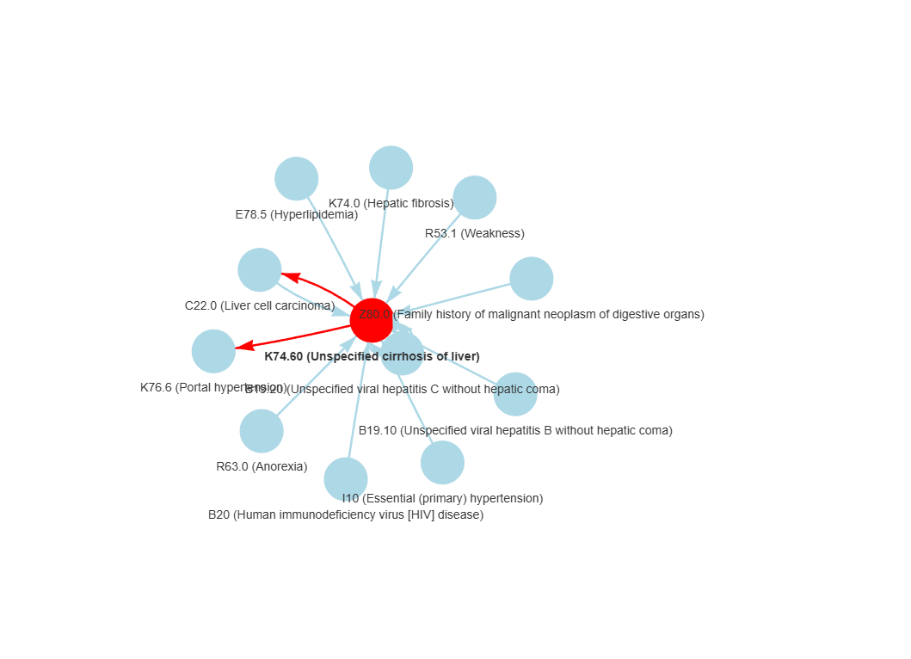
ICD-10 Code: K74.60 - Unspecified cirrhosis of liver

Slide 11
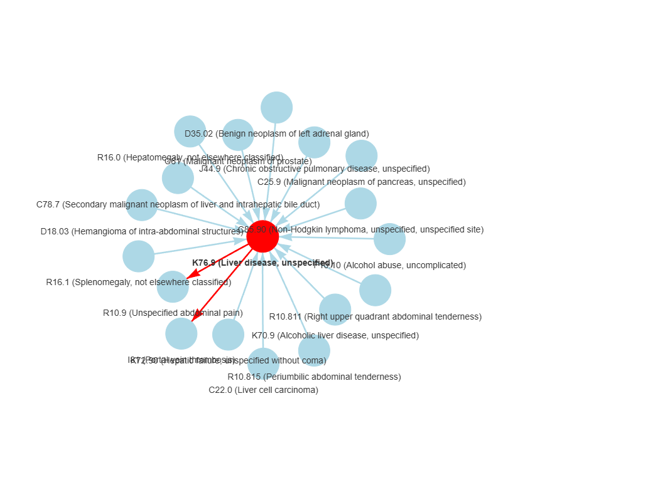
ICD-10 Code: K76.9 - Liver disease, unspecified

Slide 12
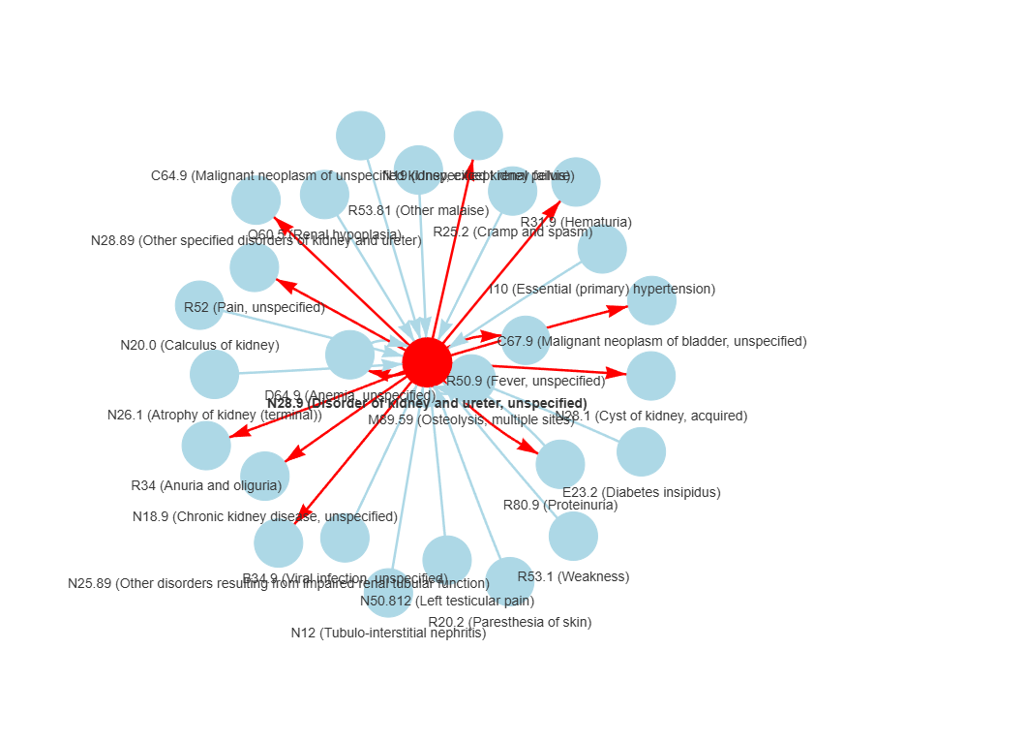
ICD-10 Code: N28.9 - Disorder of kidney and ureter, unspecified

Slide 13
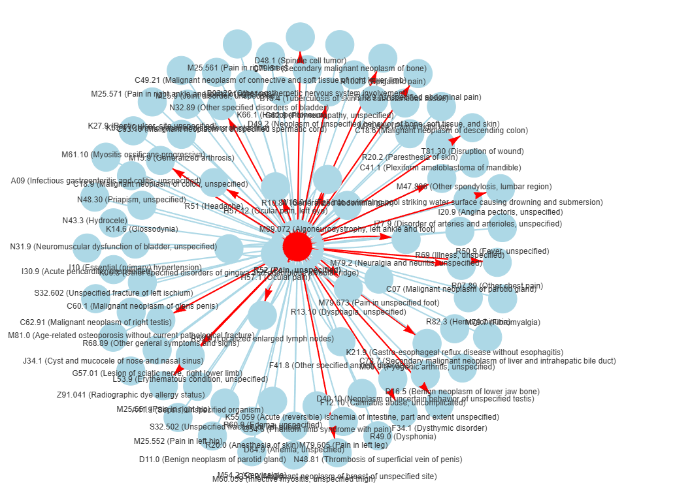
ICD-10 Code: R52 - Pain, unspecified

Slide 14
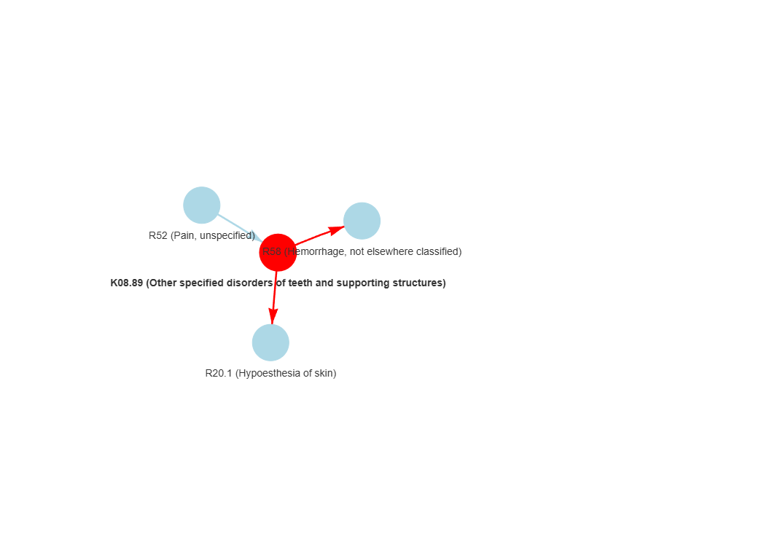
ICD-10 Code: K08.89 - Other specified disorders of teeth and supporting structures

