Slide 1

Agile Methodology
10 H
maintenance
Sprint
10-12 Weeks
Collecting and analyzing project requirements
Design and development
Testing and merging
Finished
Work

Slide 2

Scrum Process Diagram
10 H
maintenance
Sprint
6-9 Weeks
Collecting and analyzing project requirements
Design and development
Testing and merging
Finished
Work

Slide 3


.com
75,000+
Eye-Catching Preformatted Editable Templates.
Download and save hours of work!
Easy to use
Fully customizable
Cutting edge designs
30% OFF
Your Annual Membership Plan
CODE: ANNUAL30
Visit PoweredTemplate.com
Notes:
You can safely remove this slide. This slide was provided by PoweredTemplate.com – You can download more templates, shapes and diagrams for presentations from https://poweredtemplate.com

Slide 4
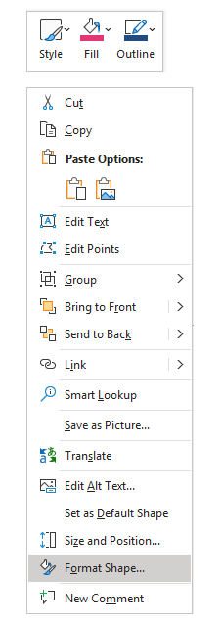
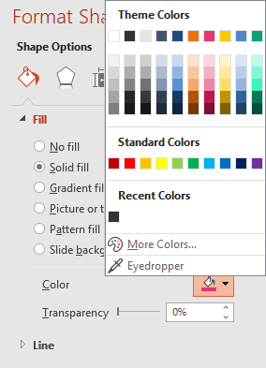

Change Shape Colors
The presentation template has been made in PowerPoint itself, and you can edit the color of any component in this graphics. To change the color, just right click the object to highlight it, and then follow the instructions. In case on any questions please visit our Help Center.
Right click on the object you want to change the color of.
Choose Format Shape in drop down menu.
Choose "Fill" in the Format Shape box then "Solid" or "Gradient" depending on the appearance of the object. Click on a new color.
Notes:
You can safely remove this slide. This slide was provided by PoweredTemplate.com – You can download more templates, shapes and diagrams for presentations from https://poweredtemplate.com

Slide 5
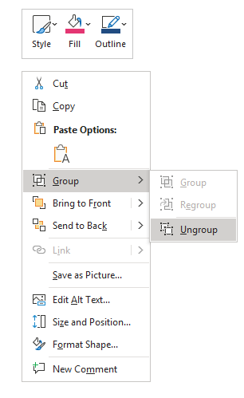

Edit Shapes
You may edit the shapes in your own: remove, resize, rotate, and copy to a new slide. In case on any questions please visit our Help Center.
Right click on the object you want to modify.
Choose Group -> Ungroup in drop down menu.
Click on any objects and shapes to start working with it.
When you finish, select all objects you want to group and choose Group -> Group in the menu.
Notes:
You can safely remove this slide. This slide was provided by PoweredTemplate.com – You can download more templates, shapes and diagrams for presentations from https://poweredtemplate.com

Slide 6
Man
Remember you must attribute!*
Creating content takes a lot of time and effort, but all we need from you is only an attribution link.
In order to use the content or a part of it, you must attribute it to PoweredTemplate.com, so we will be able to continue creating new free graphic resources every day.
Insert the attribution line in the credits section of your presentation. If it’s not possible, place it wherever it's visible on a web page, close to where you’re using the resource.
For example: This presentation has been designed using resources from PoweredTemplate.com
Don’t want to credit the author? Go Premium and use over 75,000 templates with no attribution!
* This only applies if you downloaded this content as an unsubscribed (free) user.
Notes:
You can safely remove this slide. This slide was provided by PoweredTemplate.com – You can download more templates, shapes and diagrams for presentations from https://poweredtemplate.com

