Slide 1
Reactjs Demo
By Trip Compton

Slide 2
What is react?
React is an open source Javascript library used for building web applications
Developed by a software engineer at Facebook and first deployed in Facebook’s news feed in 2011
Used for single-page applications, but routing can be added
Only deals with the view of an application, unlike other frameworks such as Angular

Slide 3
Why use react?
Gives developers the ability to work with an easier virtual browser that is more user friendly
If you know Javascript, there is not that much to learn if you want to use React
Higher performance through the use of a virtual DOM stored in memory that compares differences and applies them instead of re-rendering the entire page
Allows the use of reusable Components

Slide 4
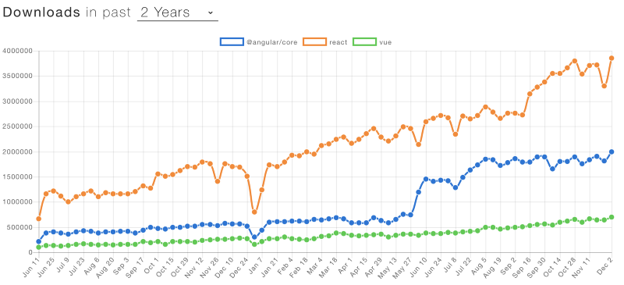
React compared to other front-end frameworks
# of downloads using NPM up to December 2018

Slide 5
Major Concepts
JSX – A syntax extension to Javascript used throughout React applications to produce React elements. Also provides protection against injection attacks by escaping values before rendering.
Example:
const name = ‘John Doe’;
const element = <h1>Hello, {name}</h1>;
Components – similar to Javascript functions, allow developers to break up the UI into reusable pieces.
Props – or Properties, are inputs accepted by a component

