Slide 1
Support Vector Machines
Mohammed Almelabi

Slide 2
Support Vector Machine
Support Vector Machine is one of the most popular machine learning algorithms. It is primarily a classier method that performs classification tasks by constructing hyperplanes in a multidimensional space that separates cases of different class labels. SVM supports both regression and classification tasks and can handle multiple continuous and categorical variables
Example: One class is linearly separable from the others like if we only had two features like Height and Hair length of an individual, we’d first plot these two variables in two dimensional space where each point has two co-ordinates

Slide 3
Support Vector Machine
What is Hyperplane?
It is an N-dimensional space.
1-D Hyperplane is a single point
2-D Hyperplane is a line
3-D Hyperplane is a flat plane

Slide 4
Why we talk about hyperplane?
The main idea behind SVM is to use Hyperplane to create a separation between classes.
Points will fall on one side of the separting hyperplane, which we can use to assign a class.

Slide 5
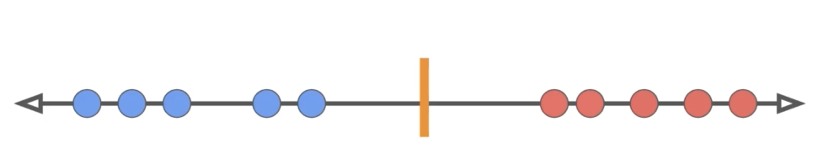
Line

Slide 6
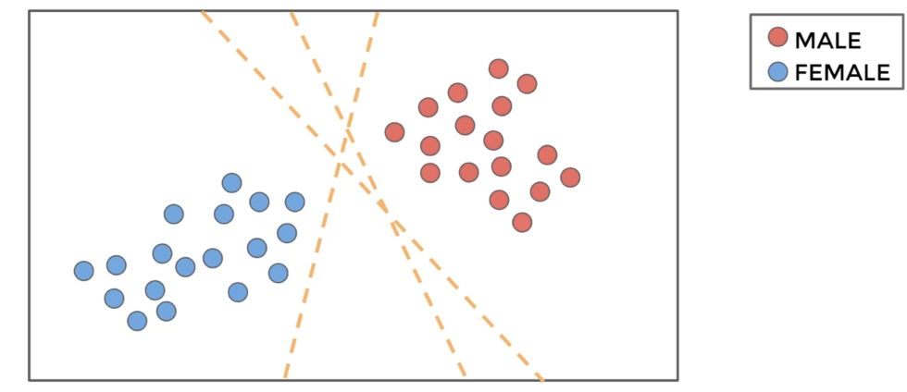

Slide 7
Maximum Margin Classifier
We can think of MMC as a classifier that used to maximize the margin between classes.

Slide 8
