Slide 1
Mobile-Web Device Attacks
Talhi Chaima && Dehli Nesrine

Slide 2
Table of contents
01
02
03
04
05
06
Introduction
Definition & Types
Targets & Stages
Impacts & Testing
Detection & Prevention
Case Studies & Conclu

Slide 3
Introduction
01
In our interconnected world, where digital devices are indispensable, they are vulnerable to exploitation by malicious actors aiming for personal gain or disruption, encompassing both mobile and web device attacks.

Slide 4
Mobile Device Attacks

Slide 5
Definition & Types
02
1
Definition :
What is a Mobile Device Attack?
• Mobile attacks refer to malicious attempts to gain unauthorized access to data stored on smartphones, tablets, and other mobile internet-connected devices.
• Attackers use various techniques to exploit mobile operating systems, apps, and networks.

Slide 6
Why are Mobile Devices Vulnerable to Attack?
Mobile devices are vulnerable to attack due to their portability, constant connectivity, and the vast amount of personal and sensitive data they store. Attackers can exploit vulnerabilities through apps, networks, and operating systems to gain unauthorized access to devices and data.

Slide 7
2
Types of Mobile Device Attacks
Phishing attacks Smishing
Fraudulent messages sent via SMS to trick users into revealing sensitive information or installing malicious apps.
Bluetooth Attacks
Bluejacking
Sending unsolicited messages to Bluetooth-enabled devices
Bluesnarfing
Unauthorized access to a device's data through Bluetooth.
Malware Attacks
Spyware
collecting personal information without consent.
Ransomware
encrypting files and demanding payment for decryption.

Slide 8
Targets & Stages
03
1
Attack Targets :
Mobile device attacks can target various components within the digital ecosystem,Here's an overview of attack targets concerning mobile device attacks :

Slide 9
Network Communications:
Mobile device attacks can intercept and manipulate network communications. Attackers may exploit insecure Wi-Fi networks, launch man-in-the-middle attacks, or eavesdrop on data transmission to steal sensitive information.
Operating Systems:
Attackers exploit vulnerabilities in mobile operating systems, such as iOS4 and Android, to gain unauthorized access, install malware, or execute malicious

Slide 10
User Data :
Personal information stored on mobile devices, including contacts, messages, photos, and login credentials, can be targeted for theft or unauthorized access.
SMS and Messaging Services :
Attackers can exploit vulnerabilities in SMS and messaging services to conduct phishing attacks, distribute malware, or intercept sensitive information.

Slide 11
Targets & Stages
03
2
Attack Stages :
Mobile – Web device attacks typically consist of several stages, often following a well-defined sequence. Here are the common attack stages :

Slide 12
Reconnaissance :
Delivery :
Exploitation :
attackers collect data about potential targets , including mobile,web devices, operating systems, and apps used, through passive or active means
attackers transmit the malicious payload to the target device through various vectors such as malicious apps, email attachments, SMS messages, or compromised websites.
attackers capitalize on vulnerabilities in the device's operating system, app software, or hardware components to gain unauthorized access.
Installation :
Data theft or manipulation :
Spread or Propagation:
After successful exploitation, the attacker installs the malicious software or code on the target device. This could be in the form of malware, spyware, or a backdoor that allows remote control of the device.
attackers gain unauthorized access to sensitive data on the device (personal inforamtion , login credentials ..),and may manipulate it or inject malicious code to further their objectives.
Some mobile-web device attacks involve spreading to other devices, either within the same network or via infected files or links sent to contacts in the victim's address book. This can lead to a wider attack surface.

Slide 13
Impacts & Testing
04
1
Impacts of Attacks:
Web-Mobile device attacks can disrupt normal operations by compromising the functionality and availability of the targeted devices. This can result in loss of productivity, downtime, and interruption of critical services.
:

Slide 14
Operational Disruptions :
financial losses :
Web-Mobile device attacks can disrupt normal operations by compromising the functionality and availability of the targeted devices. This can result in loss of productivity, downtime, and interruption of critical services.
Web-Mobile device attacks can result in significant financial losses through a variety of means. Individuals may experience unauthorized transactions, identity theft, or fraudulent use of their banking and payment information.
Damaged Reputation :
Legal Responses :
A successful Web-mobile device attack can damage the reputation of individuals and organizations. Breaches of personal or sensitive data can erode trust and confidence in individuals or businesses, leading to a loss of customers, clients, or partners.
Organizations may face legal and regulatory consequences, including fines and lawsuits, when personal or sensitive data is compromised, potentially affecting their legal standing and financial stability.

Slide 15
Impacts & Testing
04
2
Exemple of Mobile Attack :
Smishing
Here’s how the attack goes :

Slide 16
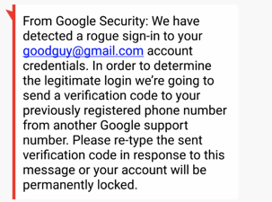
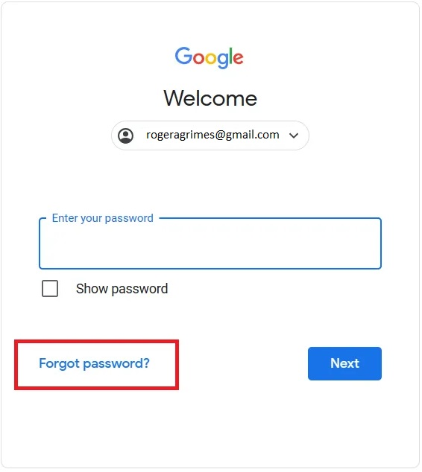
1. Attacker sends a fake text message, posing as Gmail support
2. Initiates a login attempt, pretending
not to know the password

Slide 17
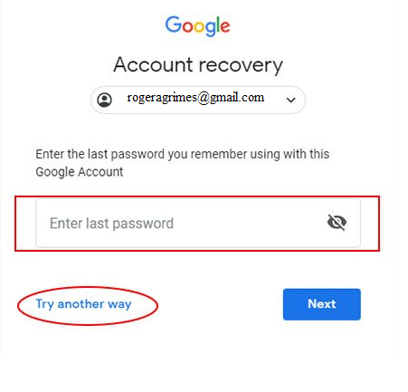
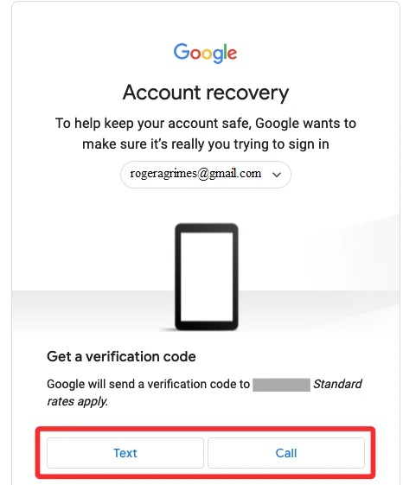
3. Requests an SMS recovery code from the legitimate service

Slide 18

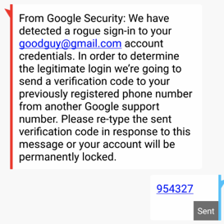
4. Gmail sends the recovery code to the victim's registered phone.
5. Trick user into sending back the recovery code
6. Attacker uses the code to take
control of the user's account.

Slide 19

Detection & Prevention
1
Detection Techniques :
Mobile App Security Scanning
Network Security
Behavioral Analysis
Device Authentication and Access Controls

Slide 20
2
Prevention Strategies :
Strong
Authentication
Device Encryption
Remote Wiping
and Tracking
Secure Backup

Slide 21
Case Studies
06
Pegasus using WhatsApp (2019) :
Background:
In May 2019, WhatsApp, a popular messaging application with over 1.5 billion users worldwide, reported a security breach that allowed attackers to remotely install spyware on users' devices. The exploit, attributed to the Israeli-based NSO Group, targeted a vulnerability in WhatsApp's voice calling feature.

Slide 22
Attack :
Targets :
The Pegasus spyware allowed attackers to gain complete access to a user's device by exploiting a vulnerability in the WhatsApp call function.
Targets of Pegasus attacks could include journalists, activists, political dissidents, and individuals of interest to governments or other entities.
Impact :
Responses :
The real impact of Pegasus using WhatsApp or any other means lies in its potential for surveillance and espionage. The unauthorized access to personal information and communication can have serious implications for privacy, freedom of expression, and human rights.
WhatsApp released security patches to address vulnerabilities and affected parties typically launch investigations to confirm the claims and may pursue legal action against those responsible.

Slide 23
Web Device Attacks

Slide 24
Definition & Types
02
1
Definition:
Web device attacks are a rising concern in our digital world. Malicious actions target devices like computers,IoT devices..
to compromise their security. These attacks can lead to data breaches, unauthorized access, and financial loss. It's important to be aware of these risks and safeguard our devices against such threats.

Slide 25
Definition & Types
02
2
Types of Attack :
Web-based attacks can target various components of a web application or the underlying devices and infrastructure. Here are some common types of web-based attacks:

Slide 26
Man-in-the-Middle (MitM)
Cross-Site Scripting (XSS)
Distributed Denial of Service
attack takes place when an unauthorized individual intercepts and modifies the communication between a user and a web server. This enables the attacker to secretly listen in on the conversation, manipulate the transmitted data, or pose as one of the parties involved.
XSS attacks occur when an attacker injects malicious scripts into web pages viewed by users. These scripts can be used to steal sensitive information, control user sessions, or deface websites.
attack occurs when a large volume of traffic is directed towards a web server or network resources, overwhelming their capacity and causing the targeted system to become slow or unresponsive. As a result, legitimate users are unable to access the services provided by the system.

Slide 27
Web device attacks Targets
03
Databases
Cloud Services
Web Applications
Web Servers
Web Browsers

Slide 28
Impacts & Testing
04
2
Testing of Attack :
we have a video also about the attack man in the middle :

Slide 29
Detection & Prevention
1
Detection Techniques :
There are several detection techniques that can be employed to identify web device attacks like :

Slide 30
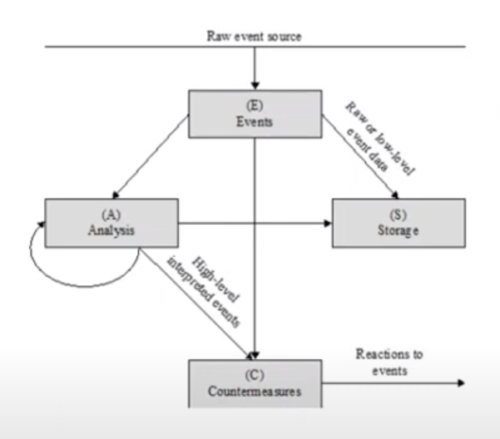
intrusion Detection Systems (IDS) :
IDS monitors network traffic and system logs for suspicious activity, such as known attack patterns or abnormal behavior.

Slide 31
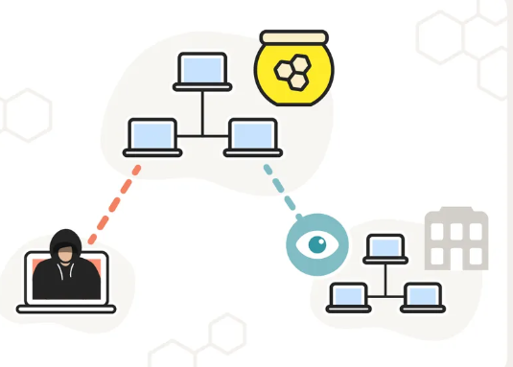
Honeypots :
Deploy decoy systems to attract attackers and study their methods.Helps in understanding attack techniques and improving overall security posture.

Slide 32
2
Prevention Solutions :
web application firewalls WAFs
Regular Patching and Updates
act as a protective layer between web applications and users
for web app and servers
Secure Coding Practices
User Authentication and Authorization
Following secure coding guidelines and best practices
like multi-factor authentication (MFA)

Slide 33
Case Studies & Conclu
06
1
Case Studies :
Here's an example of a web-based device attack, the response to the attack, and measures taken to counter it:

Slide 34
The Equifax Data Breach (2017):
Attack:
Impact:
Attackers exploited a vulnerability in Apache Struts, a popular web application framework, to gain unauthorized access to Equifax's web application.
Personal and sensitive information, including names, dates of birth,and credit card details, were compromised in the breach. This attack had a significant impact on privacy and eroded trust in Equifax, causing reputational damage.*145 M cutomers*
Response:
Protection Measures:
Equifax discovered the breach and took immediate action to investigate and contain the incident. They engaged a cybersecurity firm for forensic analysis and notified law enforcement authorities.
In the aftermath of the attack, Equifax implemented measures to enhance security and protect data. They strengthened patch management, improved identity verification processes, and ensured the protection of sensitive information.

Slide 35
Conclusion
Both mobile and web devices are vulnerable to many different attacks. They can be at risk of various online dangers that could harm user privacy, security, and data.

Slide 36
Thanks!
Do you have any questions?

