Slide 1
Identifying optimum locations for starting a Restaurant in Toronto, Ontario in Canada
Mohab O. Hassan
Coursera
Applied Data Science Capstone

Slide 2
Problem
Identifying the optimum location(s) for starting a new restaurant in Toronto, Ontario in Canada.
Proposed Solution
Finding:
A location with a minimum competition means a location where the number of restaurants is low with respect to the number of people or the current population living there.
A location with a weak competition means a location where there are some restaurants, but their quality or rating is low.

Slide 3
Data Sources
Data type | Source
Postal Codes, Boroughs and Neighbourhoods in Canada | Wikipedia
Postal Codes, and geographical locations in Toronto, Ontario | Coursera (CognitiveClass.ai)
The population in each Neighbourhood in Canada in 2016 | Canada Stats
The geographical boundaries for each Neighbourhood in Toronto, Ontario | Canada Stats
Venues' IDs, names, locations, distances from the corresponding Neighbourhood centre location, postal codes and categories type | Foursquare API
Restaurants' ratings, likes, checkins, price tier and tips | Foursquare API

Slide 4
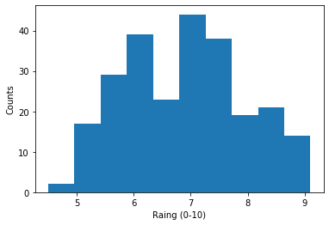
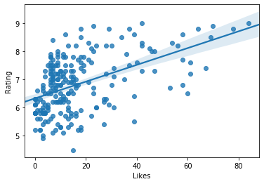
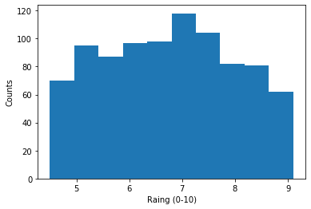
Data Cleaning
More than 50% of the rating values of the restaurants are missing!
Trying to get the missing rating values using the Like Counts in SLR.
Weak correlation (~0.5) between Rating and Like Counts.
Assuming uniform random distribution for missing values
Distribution of the available Ratings in the restaurants
Single Linear Regression between the Like Count and Rating
Distribution of Rating after using a uniform random distribution.

Slide 5
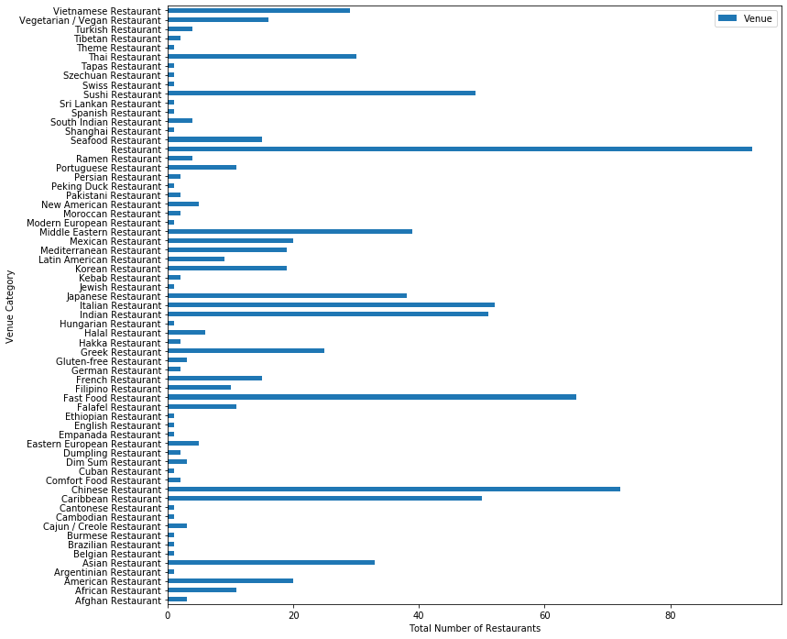
Exploratory Data Analysis
Total number of restaurants for each cuisine.
The largest count belongs to generic restaurants (without a specific cuisine).
Not possible to do analysis based on cuisine.
Largest count

Slide 6
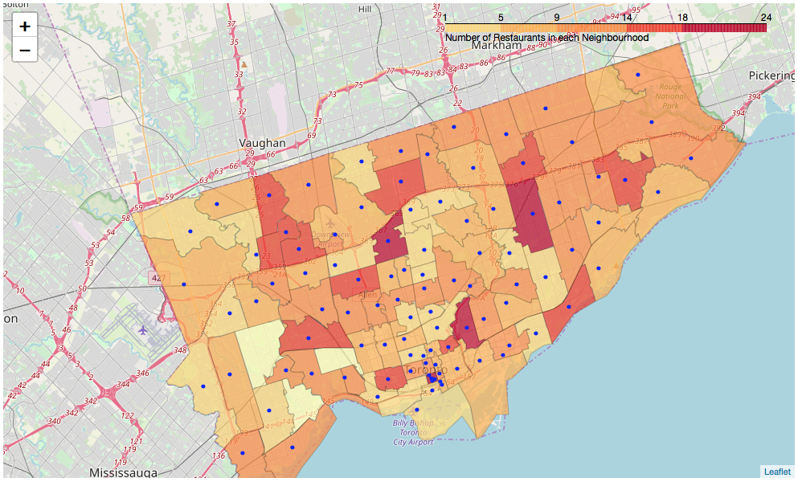
Exploratory Data Analysis
Number of restaurants in each neighbourhood
Large density of restaurants in the Toronto Downtown compared to the borders of Toronto.

Slide 7
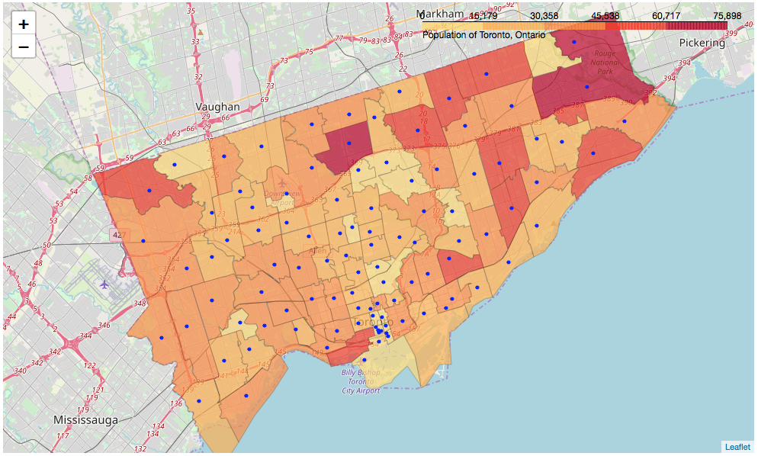
Exploratory Data Analysis
Population in each neighbourhood
Large population centers near the borders of Toronto.
Many small neighbourhoods near Toronto Downtown with relatively smaller populations.

Slide 8
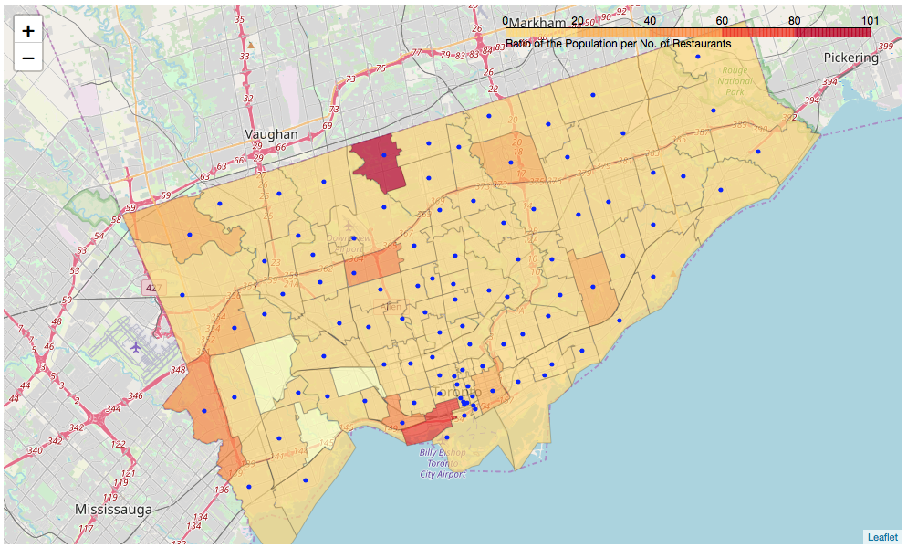
Results and Discussion
Lack of restaurants in some neighbourhoods
The ratio between the population and number of restaurants in each neighbourhood.
Willowdale West in North York has only 1 restaurant and a population greater than 40,000.

Slide 9
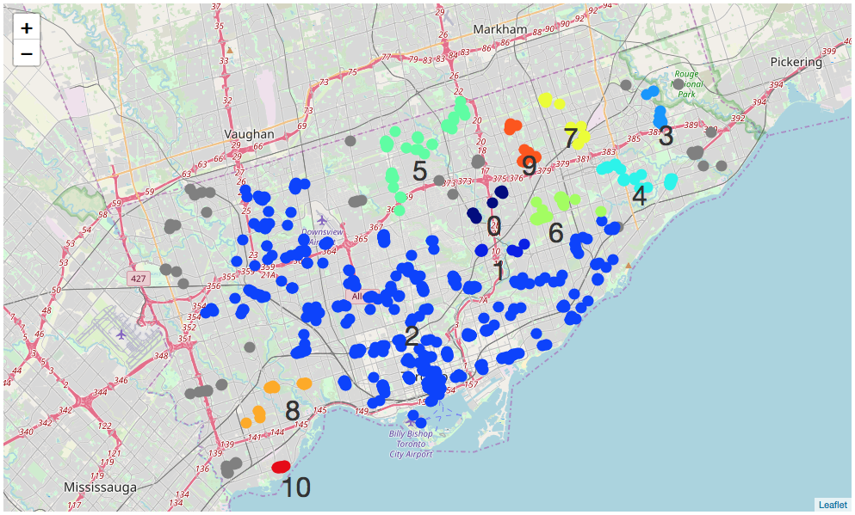
Results and Discussion
Clustering the restaurants based on their location
A large cluster (#2) in the middle of Toronto but smaller ones near the borders and the north east area.

Slide 10
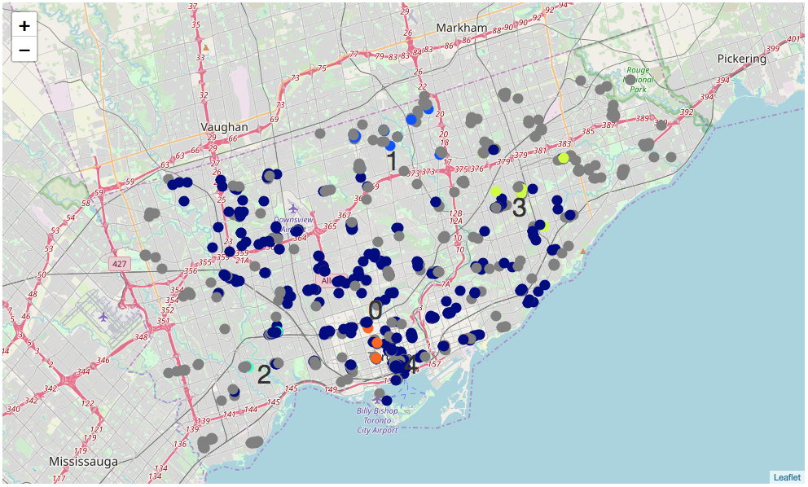
Results and Discussion
Clustering the restaurants based on their location and their rating, like count, tip count and price tier
A large cluster (#0) in the middle of Toronto sharing the same features.
Table in the next slide showing the features of each cluster.

Slide 11
Results and Discussion
Cluster #4 is located near the Toronto Downtown area and has very competitive features such as high rating, like count, tip count and low price.
Cluster #3 is located near the Scarborough Centre area and has weak competitive features such as low rating, like count and tip count. This could potentially be a good place to have a new restaurant.
Cluster # | Avg Rating | Avg Like Count | Avg Tip Count | Avg Price Tier
0 | 6.83 | 1.51 | 1.03 | 2.0
1 | 6.49 | 1.4 | 0.53 | 2.0
2 | 7.42 | 0.0 | 0.0 | 2.0
3 | 5.12 | 0.6 | 0.3 | 2.0
4 | 6.92 | 1.9 | 1.2 | 1.0

Slide 12
Conclusions
Different datasets from Foursquare and Canada Statistics were explored to identify optimum locations to start a new restaurant.
The optimum locations were defined as either those that have very low number of restaurants compared to their population, or those that have some restaurants, but they are of low quality/unpopular.
The results suggested that Willowdale West in North York has relatively a very few restaurants compared to its population. Also, the restaurants located near Scarborough Centre area have relatively low ratings and are less liked by their visitors.

