Slide 1
Optimization Techniques
Project 7th Temes :
Mohab Mohamed 221002016
Yousef Abdallah 221002152

Slide 2
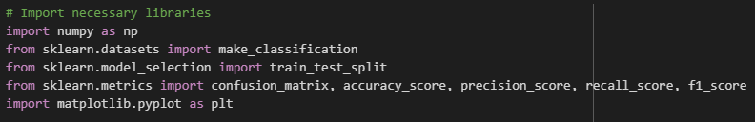
Libraries

Slide 3
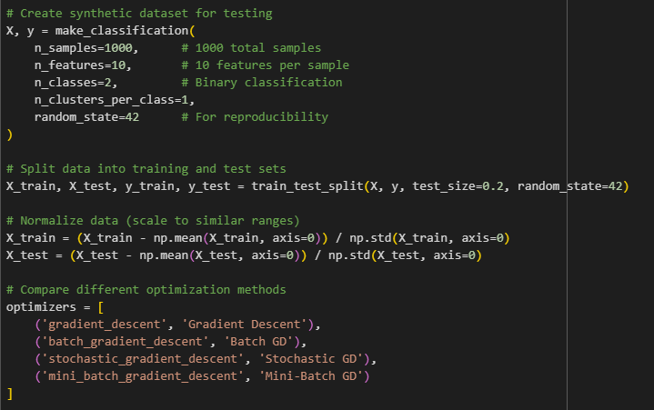
Main

Slide 4
Class LogisticRegression
__init__()
_sigmoid()
_compute_loss()
Fit()
_gradient_descent()
_batch_gradient_descent()
_stochastic_gradient_descent()
_mini_batch_gradient_descent()
Predict()
Evaluate()

Slide 5
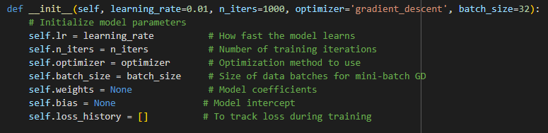
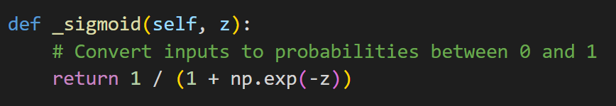
__init__() _sigmoid()

Slide 6
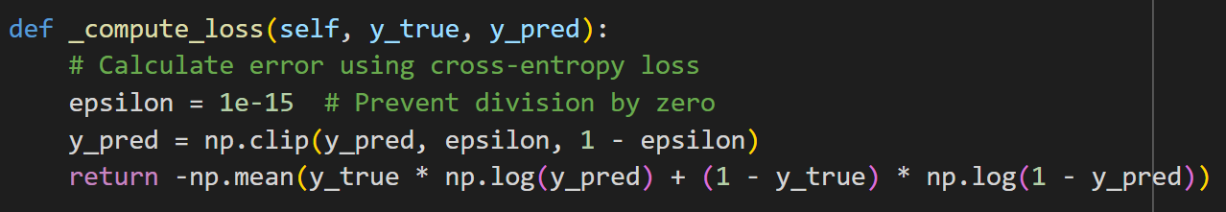
_compute_loss()

Slide 7
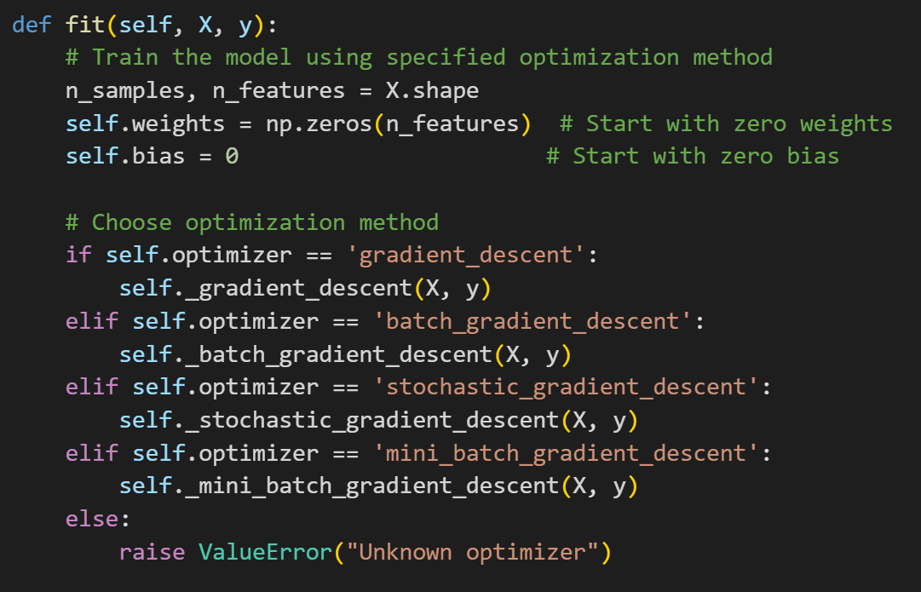
fit()

Slide 8
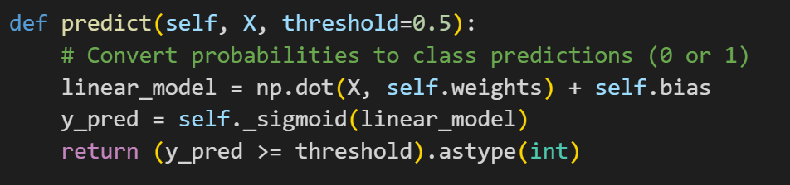
Predict()

Slide 9
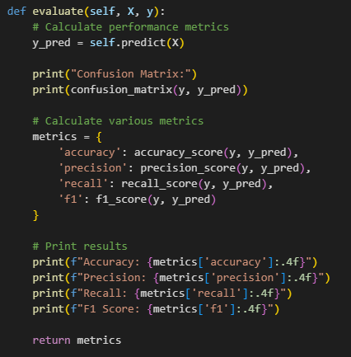
Evaluate()

Slide 10
OPTIMIZERS

Slide 11
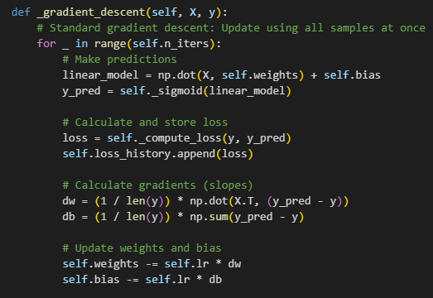

_gradient_descent()
_batch_gradient_descent()

Slide 12
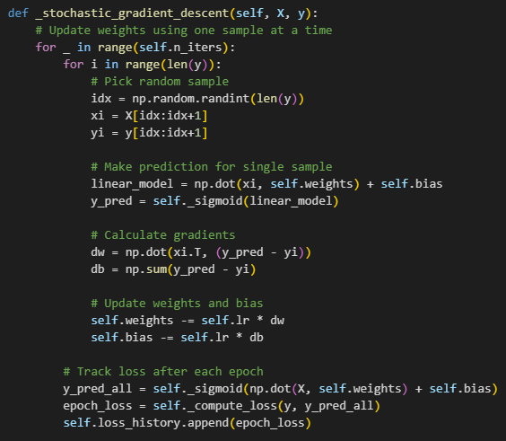
_stochastic_gradient_descent()

Slide 13
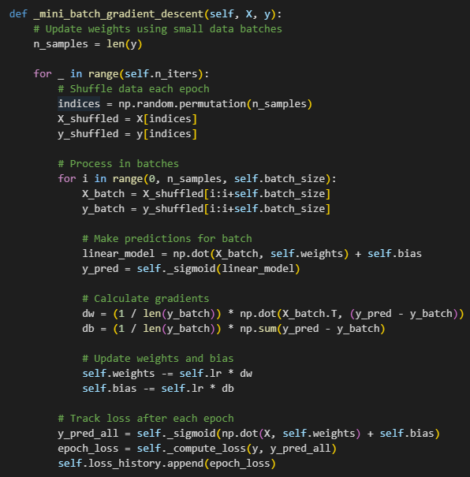
_mini_batch_gradient_descent()

Slide 14
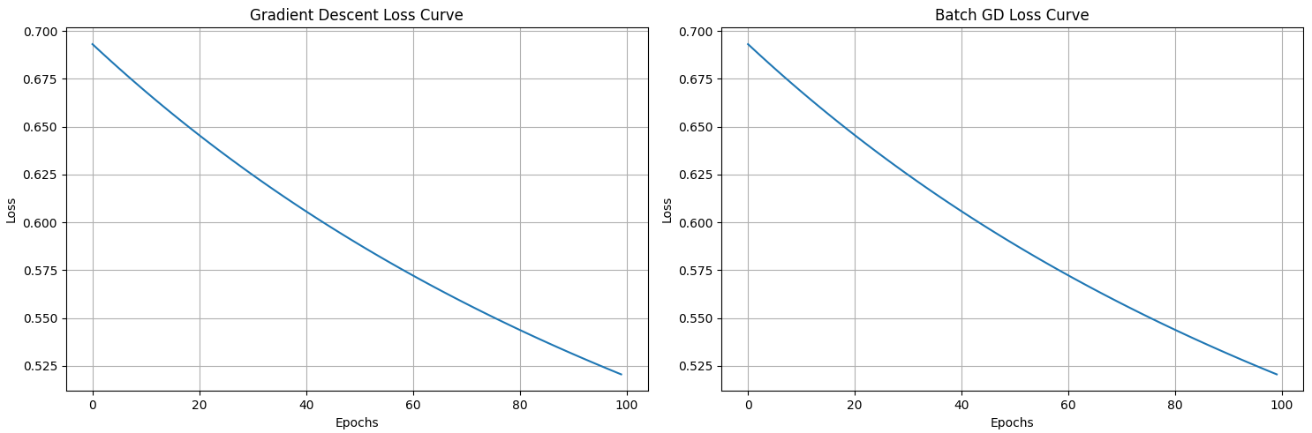
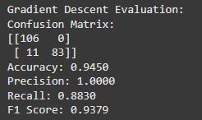
Output

Slide 15
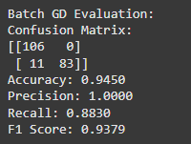
Output

Slide 16
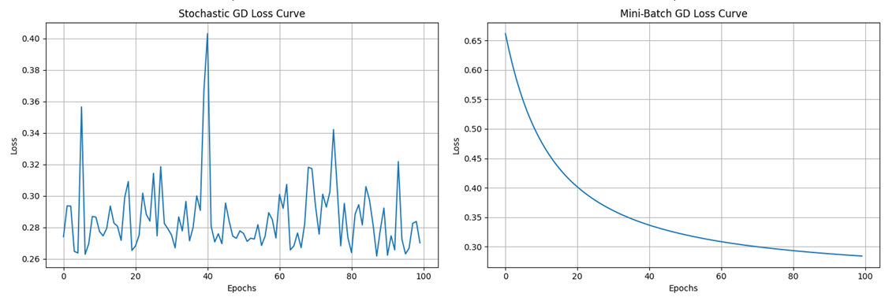
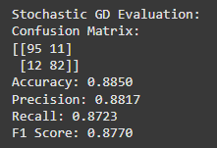
Output

Slide 17
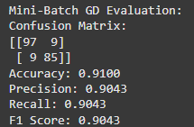
Output

Slide 18
Thank you

