Slide 1
chest-xray-pneumonia
Images Segmentation
Mohab Mohamed , 221002016
Yousef Abdallah , 221002152
Eng Hady Yaser

Slide 2
Why Use Chest X-ray Pneumonia in AI
- Pneumonia is a serious lung infection, often diagnosed with chest X-rays.
- Early and accurate detection is crucial to save lives.
- AI can help radiologists by automating and improving diagnosis accuracy.
- The chest X-ray pneumonia dataset provides real-world images for training AI models.

Slide 3
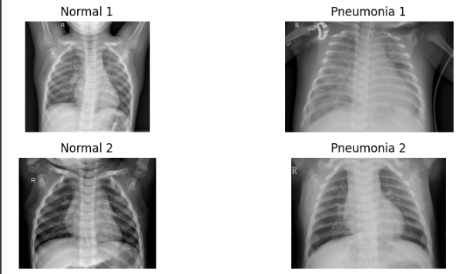

Slide 4
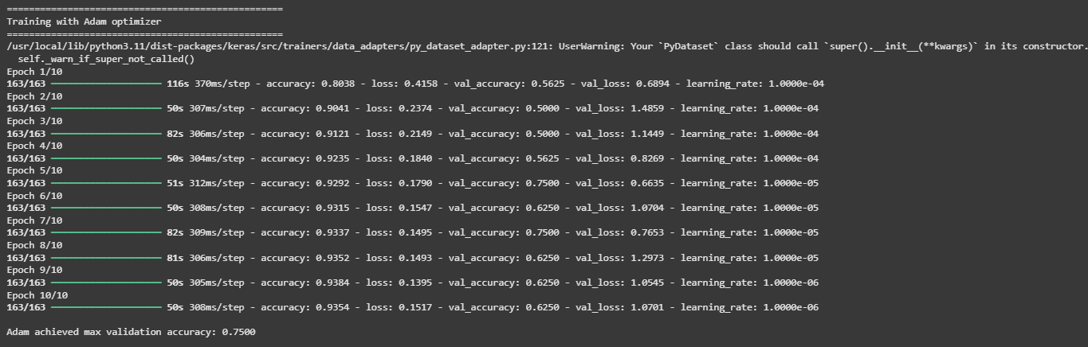
Model 1

Slide 5
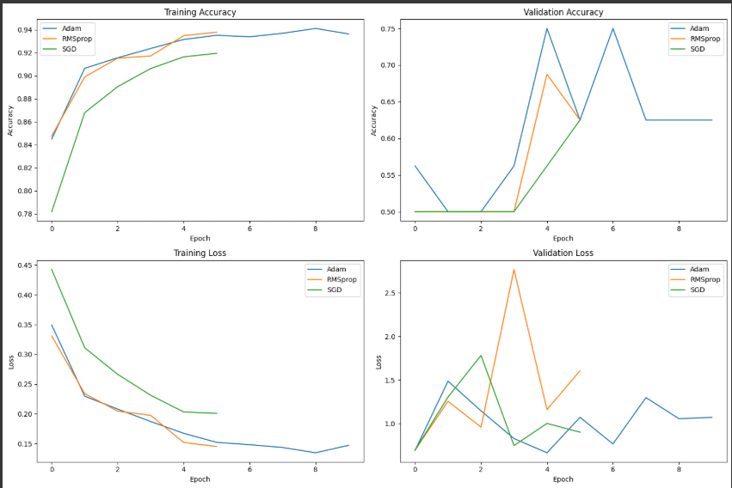

Slide 6
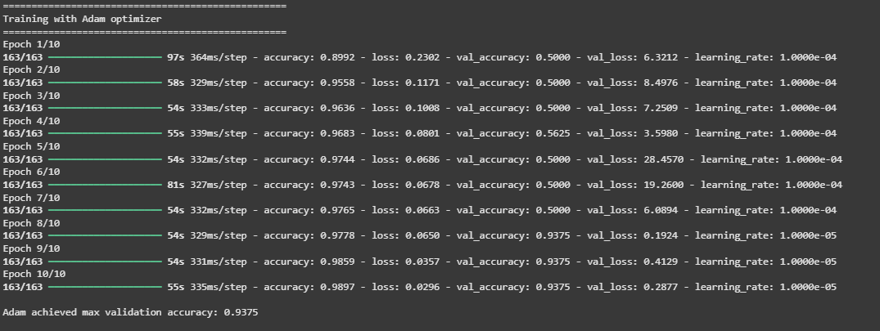
Model 2

Slide 7
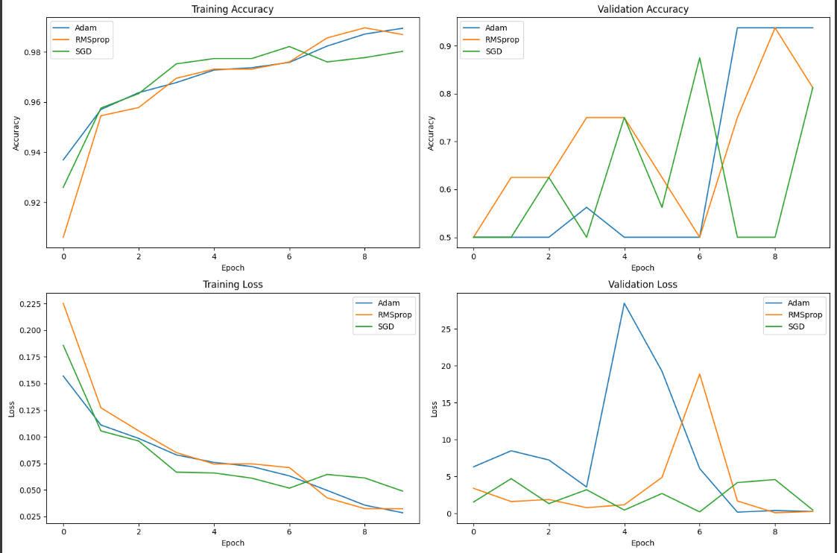

Slide 8
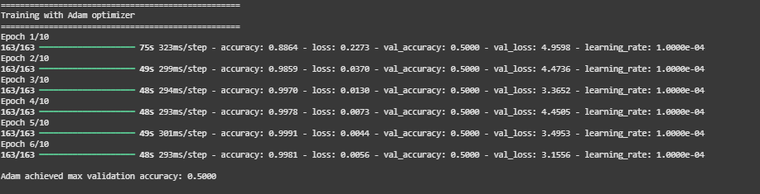
Model 3

Slide 9
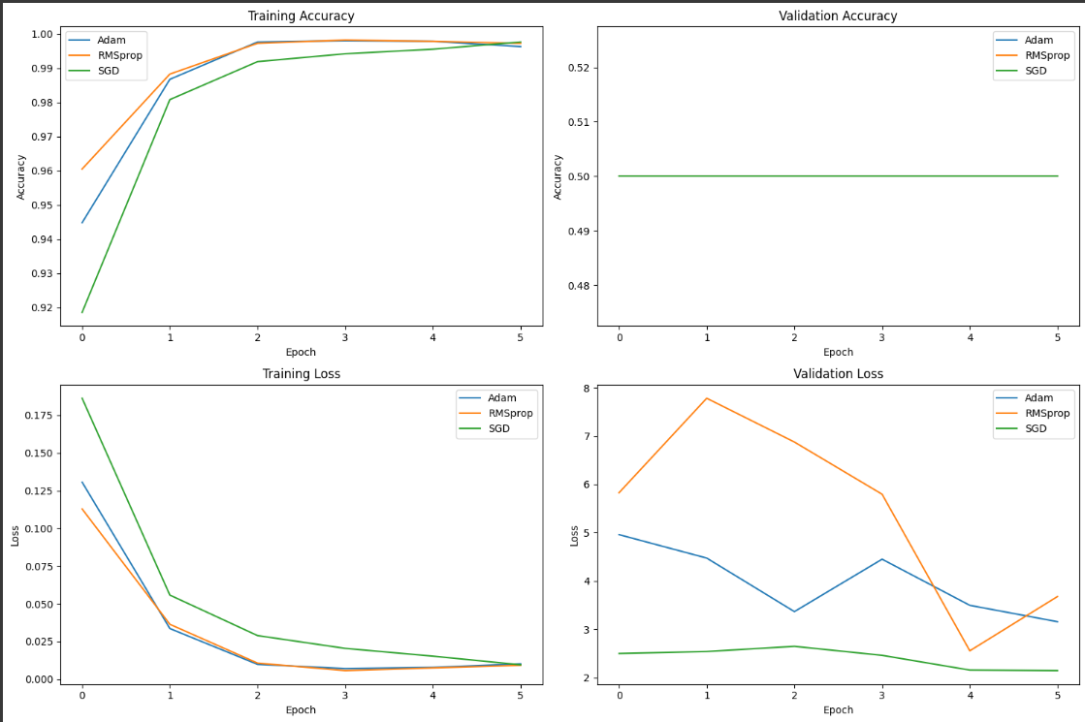

Slide 10
