Slide 1
Battery Calculations and selection

Slide 2
Objectives
1- understanding of battery function
2-key strategy of calculations
3- parameters of calculations
4- selecting different types of batteries
5- comparing between different alternatives

Slide 3
Function of battery
1-Guarantee a minimal autonomy according to the testing requirements
in our case the sun will always shine so there is no autonomy
Days
2-Act as a buffer to supply power when the power sources
are unable to meet the demand from the motors and to level current peaks
In this case the power source is the photovoltaic

Slide 4
Key strategy in battery calculation
To ensure a robust system the battery must be qualified to ensure continuous power supply for the load in case of shortage
So we are going to observe the system load curve with the pv power generation curve and choose the worst case scenario
Worst case :
Choosing the minimum power coming from the independent source in our system which is the photo voltaic and calculating the power needed to be covered from another independent power source ”battery in this case” is the key of calculation

Slide 5
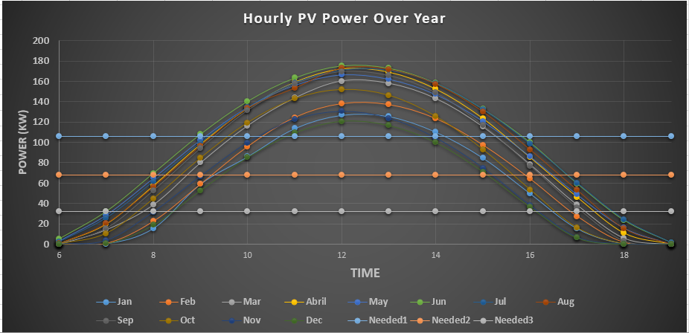
PV curve through out the year
We can observe that the lowest curve of the PV is in December
where the maximum gain is 120 KW and the most time interval the PV cannot meet the load demand (9H) per day
So this this the month we are going to choose as to calculate the battery demands

Slide 6



Battery calculations
1-series:
2-Parallel

Slide 7
Battery calculations
Before we calculate the number of batteries we must know some important parameters
1- Output voltage = load voltage = 220 volt
2-load energy WH = ( load KW) * (hours of operation)
= 102 KW * 9 = 918 KWH
3 - Type of battery chosen : dependent on that
The battery voltage
The battery AH
The price

Slide 8
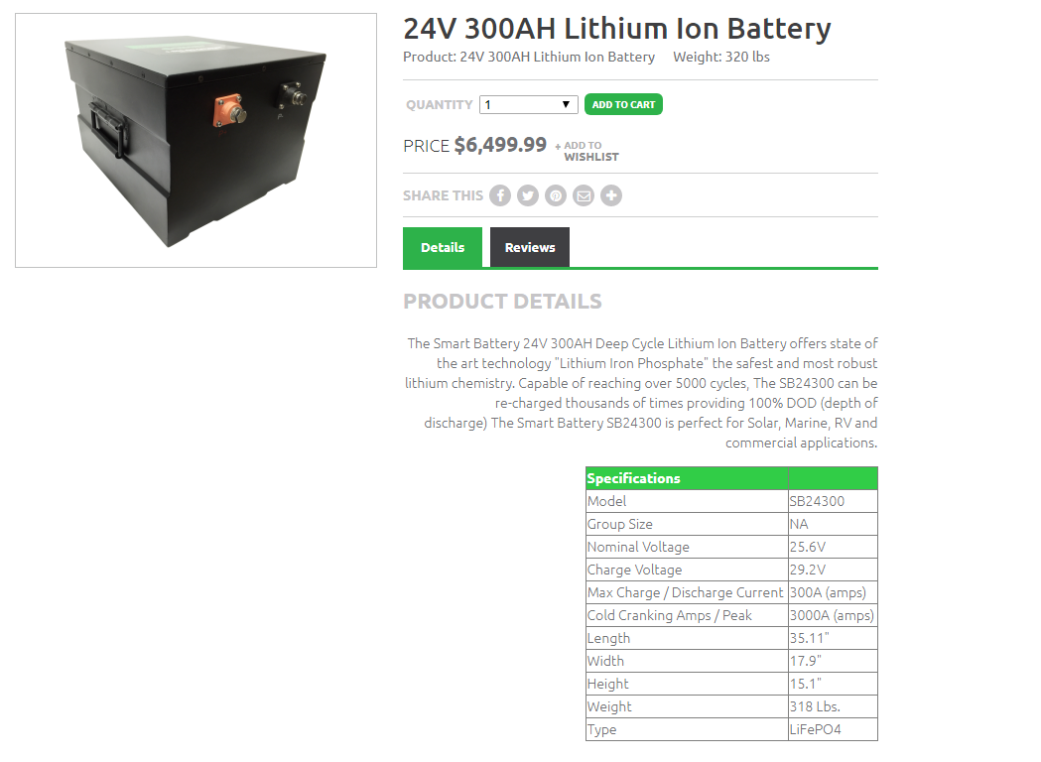
Lithium ion battery
Case 1 (DOD 100%)
Batteries in Series: 10
Batteries in parallel :14
Total number of batteries: 140
Weight :20.2 tons
No. of cycles= 100
Price: 910000$
Case 2 (DOD 8o %)
Batteries in Series: 10
Batteries in parallel :18
Total number of batteries: 180
Weight :26.2 tons
No. of cycles= 200
Price: 1170000$

Slide 9
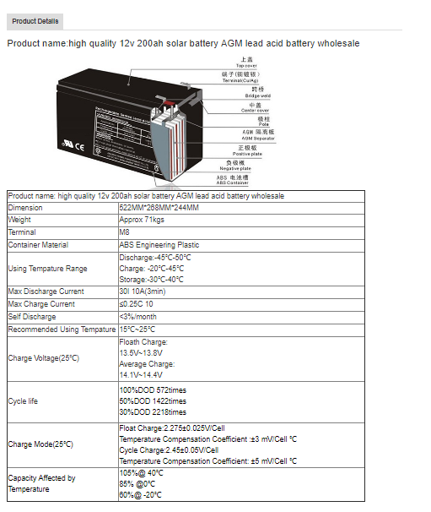
Lead acid battery (AGM)
Case 1 (DOD 100%)
Batteries in Series: 19
Batteries in parallel :21
Total number of batteries: 399
Weight :28.2 tons
No. of cycles= 572
Price: 24000$
Case 2 (DOD 5o %)
Batteries in Series: 19
Batteries in parallel :26
Total number of batteries: 494
Weight : 35 tons
No. of cycles= 1422
Price: 29640$

Slide 10
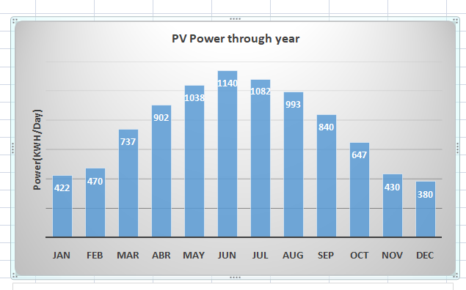
Calculating the amount of charge and discharge
To ensure that the battery would be sustainable for operation for the next days we must make sure our batteries gets to SOC 100% again “Definition of cycle”
Of course we are going to see the power gained by the pv and see if it going to be sufficient for our batteries – which is a load now.
In December the pv gain is the least in Cairo 380 kwh , so by simple mathematics the load demand is 918 kwh in 9 hours so we got 3 hours left from the day these hours the charger controller will redirect the energy
from the pv to the load “solar priority “ and the left energy will be charging the battery
since load demand is 303kwh for 3 hours the left is 74kwh to charge the battery (8% of total capacity)
Therefore we will need about 12 days to charge the batteries again
So the it’s abvious the battery would never be able to sustain the load

Slide 11
PV-Battery –Fuel Cell system
Constant Parameters
Period of operation | Load demand
6-11 | 510KWH
11-2 | 306KWH
2-6 | 408

Slide 12
Senario 1 battery night charging
Period of operation | Load demand (KWH) | Fuel Cell KWH | Battery KWH | PV KWH
6-11 | 510 | - | 510 | -
11-2 | 306 | - | - | 306
2-6 | 408 | - | 408 | -

Slide 13
Senario 2 the 3 way distribution
Fuel cell power 100kw
Mass of hydrogen =36.15 kg/day
Tank capacity = 690 liter
In this case batteries number will decrease dramatically and the extra kwh will be used to produce hydrogen for the next days
Period of operation | Load demand (KWH) | Fuel Cell KWH | Battery KWH | PV KWH
6-11 | 510 | 500 | 10 | -
11-2 | 306 | - | - | 306
2-6 | 408 | 400 | 8 | -

Slide 14
Senario 3 the Fuel cell muscle power
Fuel cell power 85kw
Mass of hydrogen =30.73 kg/day
Tank capacity = 700 liter
DOD of battery = 9%/day
Period of operation | Load demand (KWH) | Fuel Cell KWH | Battery KWH | PV KWH
6-11 | 510 | 425 | 85 | -
11-2 | 306 | - | - | 306
2-6 | 408 | 340 | 68 | -

