Slide 1


MCP
Model Context Protocol

Slide 2
What is MCP?
MCP (Model Context Protocol) is an open-source standard for connecting AI applications to external systems.
Using MCP, AI applications like Claude or ChatGPT can connect to data sources (e.g. local files, databases), tools (e.g. search engines, calculators) and workflows (e.g. specialized prompts)—enabling them to access key information and perform tasks.
Think of MCP like a USB-C port for AI applications. Just as USB-C provides a standardized way to connect electronic devices, MCP provides a standardized way to connect AI applications to external systems.

Slide 3
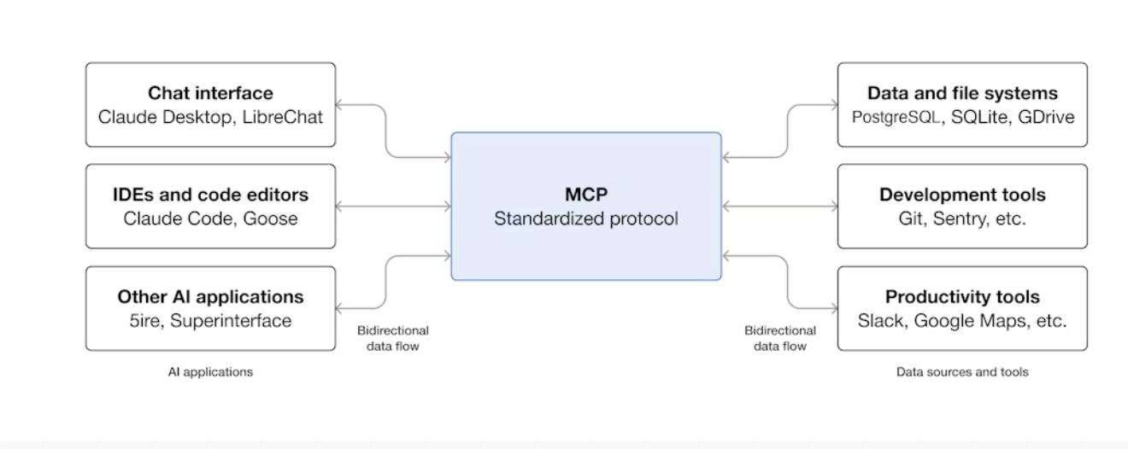
Architectural Flow

Slide 4
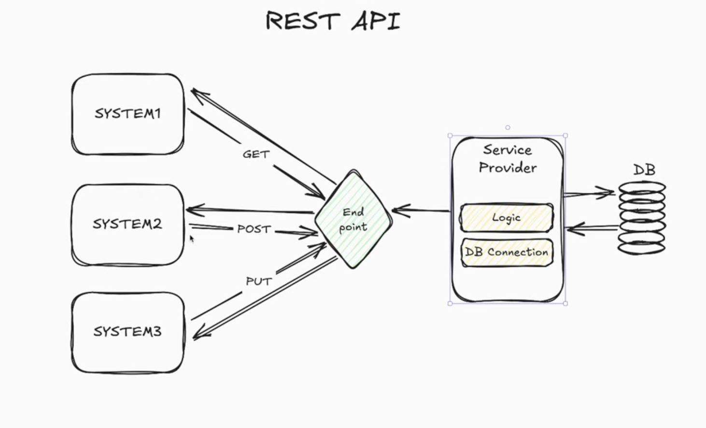

Slide 5
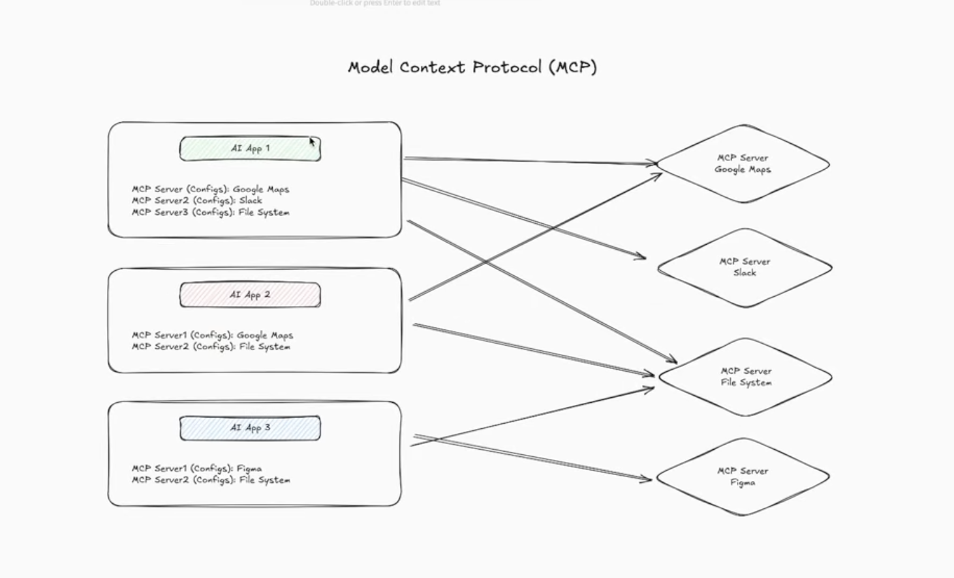

Slide 6
MCP vs APIs
MCP is the next generation of APIs because it changes the fundamental abstraction:
Instead of humans writing code to integrate with APIs, AI models can integrate with services directly through a safe, standardized protocol.
Google Maps Server Demo
Google Maps Server

Slide 7
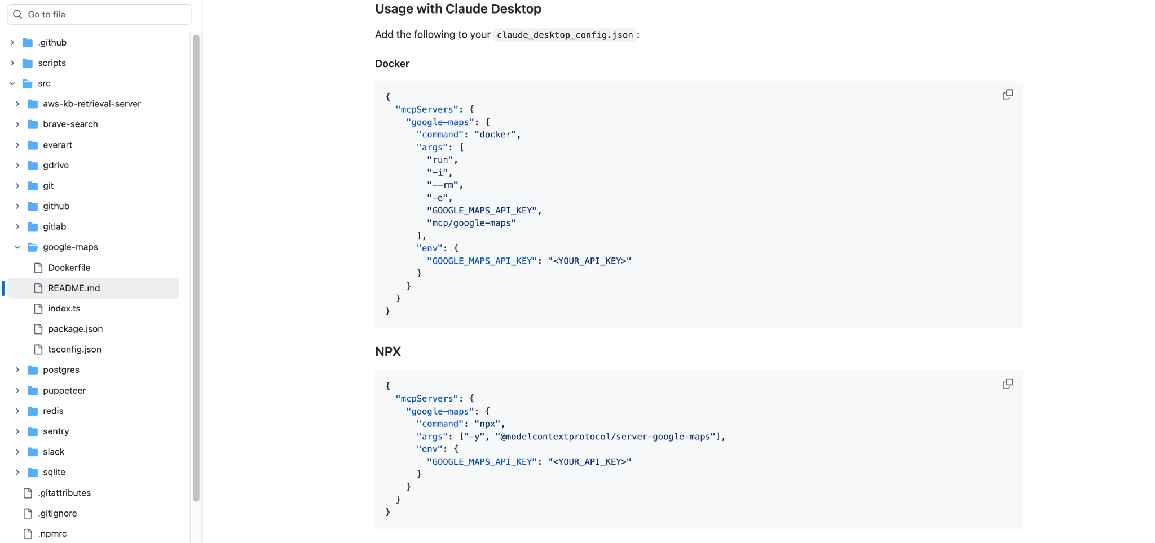

Slide 8
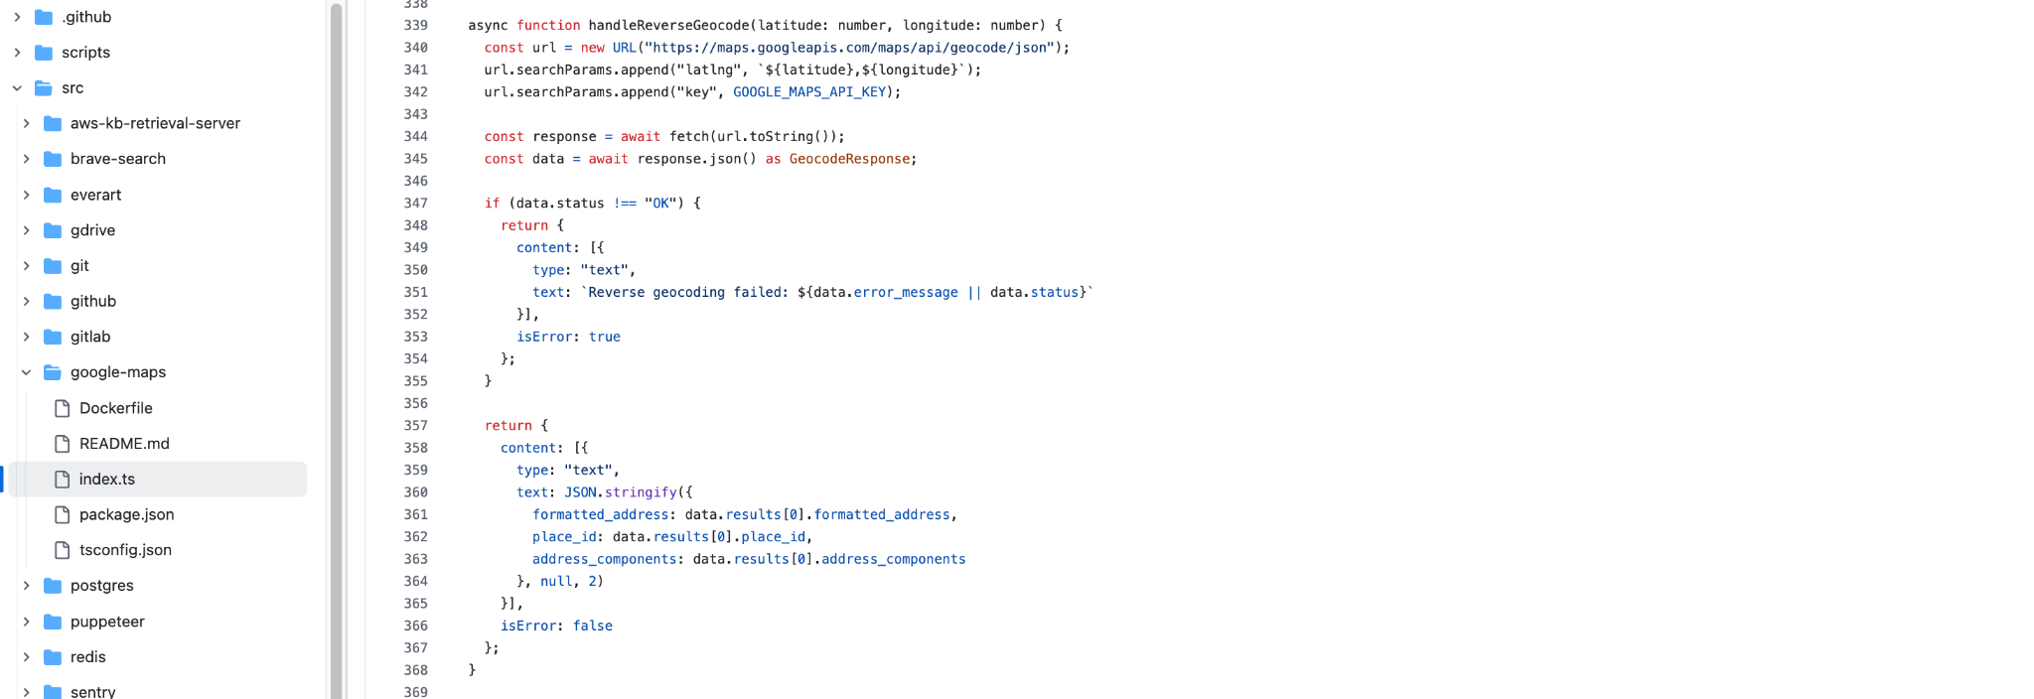

Slide 9
Why MCP Matters
For developers: It makes building and connecting AI apps much easier and faster.
For AI apps/agents: It gives them a big toolbox of data and services they can use to work better.
For end-users: It leads to smarter AI that can safely use your data and perform tasks for you when needed.

Slide 10
Core Architecture

Slide 11






The Three Core Components
The Host
The Client
The Server
The AI application (e.g., chat interface, IDE). Manages the user, the AI model, and security.
The middleware library *inside* the Host. Manages server connections and translates data.
The external tool or data source (e.g., GitHub, database). Exposes capabilities via the MCP API.

Slide 12
The Host (AI Application)
Owner of the User: The Host is the user-facing application that the user trusts and interacts with.
Owner of the AI Model: The Host manages the LLM, including its context window and when to trigger tool use.
Owner of Security: The Host is the primary security gatekeeper. It decides *which* servers to connect to and *which* capabilities to expose to the AI.

Slide 13
The Client
Connection Manager: Establishes and maintains connections to one or more MCP Servers (local or remote).
Context Translator: Converts structured JSON data from servers into natural language text for the LLM's context window.
Request Dispatcher: When the AI decides to call a tool, the Client routes the request to the correct server.

Slide 14
The Server
Exposes Capabilities: The Server's job is to implement the MCP API to expose its specific functionalities.
Fulfills the Contract: It doesn't know *which* Host or AI is calling it. It only knows how to speak the MCP language.
Implements Business Logic: This is where your actual tool logic lives (e.g., the code that *actually* calls the GitHub API).

Slide 15
Server Capabilities

Slide 16






The Three Capability Types
Tools
Resources
Prompts
Model-driven functions for *taking action* (e.g., github/create-issue, db/insert). The AI decides when to call these.
Read-only data for *providing context* (e.g., file/read, db/schema).
User-driven, pre-defined prompts

Slide 17


Tools
Tools enable AI models to perform actions. Each tool defines a specific operation with typed inputs and outputs. The model requests tool execution based on context.
How Tools Work
Tools are schema-defined interfaces that LLMs can invoke. MCP uses JSON Schema for validation. Each tool performs a single operation with clearly defined inputs and outputs. Tools may require user consent prior to execution, helping to ensure users maintain control over actions taken by a model.
tools/list
tools/call
The Client calls this endpoint first. The Server returns a JSON of all available tools, their descriptions, and their JSON Schema parameters.
After the AI chooses a tool, the Client calls this endpoint with the tool_id and a JSON object of parameters. The Server executes the logic and returns the result.

Slide 18
Resources
Resources provide structured access to information that the AI application can retrieve and provide to models as context.
How Resources Work
Resources expose data from files, APIs, databases, or any other source that an AI needs to understand context. Applications can access this information directly and decide how to use it - whether that’s selecting relevant portions, searching with embeddings, or passing it all to the model.
resources/list
resources/read
Similar to tools, this endpoint returns a list of available data resources (e.g., list of files in a directory, tables in a database).
The Client (or Host) calls this to fetch the *content* of a specific resource (e.g., the text of main.py). This content is then injected into the AI's context.

Slide 19


Prompts
Prompts provide reusable templates. They allow MCP server authors to provide parameterized prompts for a domain, or showcase how to best use the MCP server.
How Prompts Work
Prompts are structured templates that define expected inputs and interaction patterns. They are user-controlled, requiring explicit invocation rather than automatic triggering. Prompts can be context-aware, referencing available resources and tools to create comprehensive workflows. Similar to resources, prompts support parameter completion to help users discover valid argument values.
Its purpose is to discover available prompts and it return array of prompt descriptors
prompts/list
prompts/get
Its purpose is to retrieve prompt details and it return full prompt definition with arguments

Slide 20
Client

Slide 21


Client
MCP clients are instantiated by host applications to communicate with particular MCP servers. The host application, like Claude.ai or an IDE, manages the overall user experience and coordinates multiple clients. Each client handles one direct communication with one server.
Understanding the distinction is important: the host is the application users interact with, while clients are the protocol-level components that enable server connections.
Connection Management
Capability Aggregation
The Client queries *all* connected servers (tools/list, resources/list) and merges their capabilities into a single, unified inventory for the Host to consume.
The Client is responsible for the full lifecycle of connecting to servers, whether over stdio (for local) or HTTP (for remote).

Slide 22
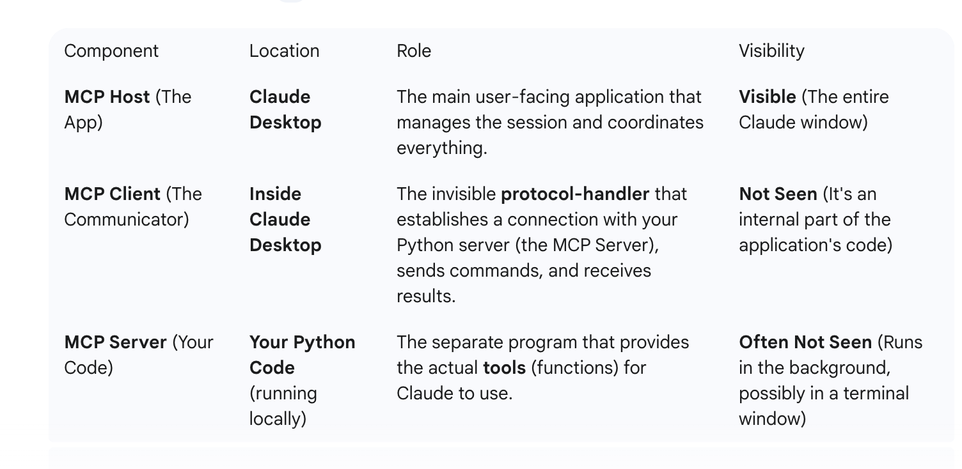

Slide 23
Developing: Building a Server (Python)

Slide 24
Building a Server: Overview
An MCP Server is, at its core, a simple web server`.
It must implement the standard MCP API endpoints (mcp/info, tools/list, tools/call, etc.).
This is made *much* easier by using the official SDKs, such as mcp-sdk-python.
The SDK provides a library like FastMCP (built on FastAPI) that handles the protocol for you.

Slide 25
Python SDK: FastMCP
The Model Context Protocol allows applications to provide context for LLMs in a standardized way, separating the concerns of providing context from the actual LLM interaction. This Python SDK implements the full MCP specification, making it easy to:
Build MCP clients that can connect to any MCP server
Create MCP servers that expose resources, prompts and tools
Use standard transports like stdio, SSE, and Streamable HTTP
Handle all MCP protocol messages and lifecycle events
Python SDK

Slide 26


Python SDK: FastMCP
FastMCP
How it Works
The mcp-sdk-python library includes FastMCP, which is built on the popular FastAPI framework.
You simply define a function, add a decorator like @mcp.tool(), and the SDK automatically:
It provides Python decorators that automatically turn your functions into MCP-compliant tools and resources.
•
Generates the JSON Schema for parameters.
•
Publishes the tool in the tools/list endpoint.
•
Routes tools/call requests to your function.

Slide 27
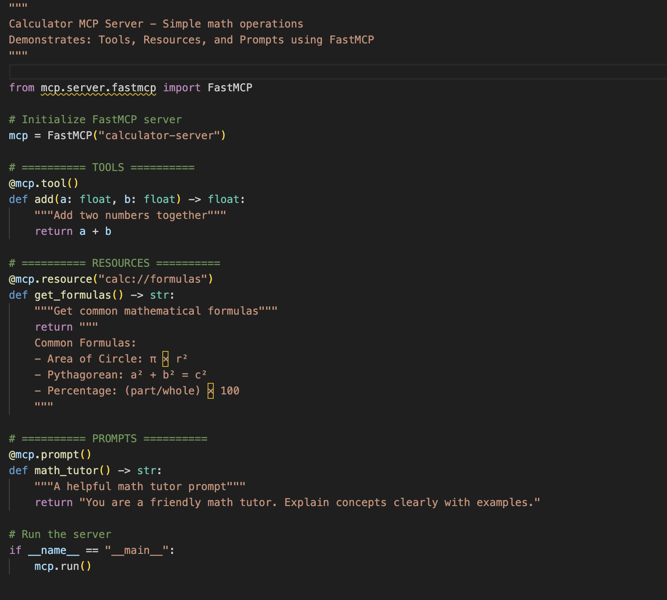

Slide 28
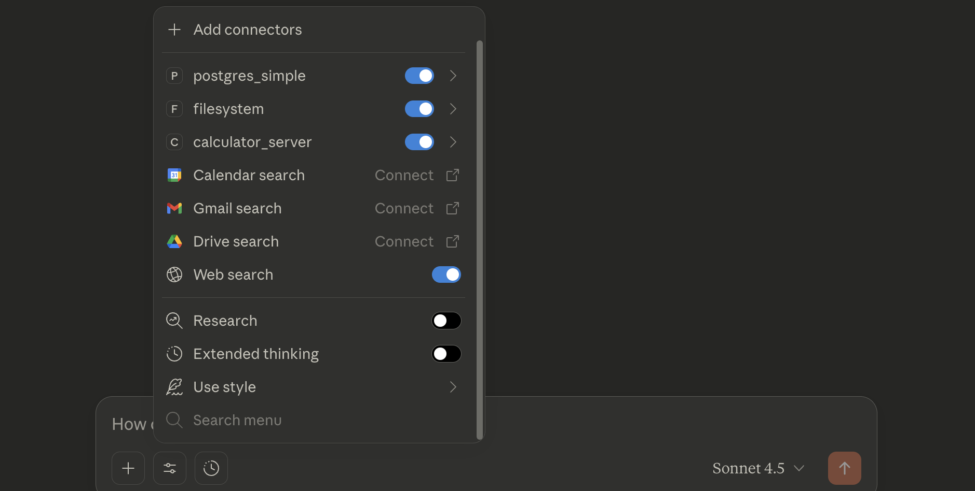
How to use Server
Add server to the configuration file, in case of claude desktop use “claude_desktop_config.json”
Restart claude desktop

Slide 29
Developing: Building a Client (Python)

Slide 30
Building a client
Create Anthropic api key: https://console.anthropic.com/settings/keys
Buy credits to be able to use your api key
Run client.py file after choosing path of your server file

Slide 31
Developer Experience

Slide 32
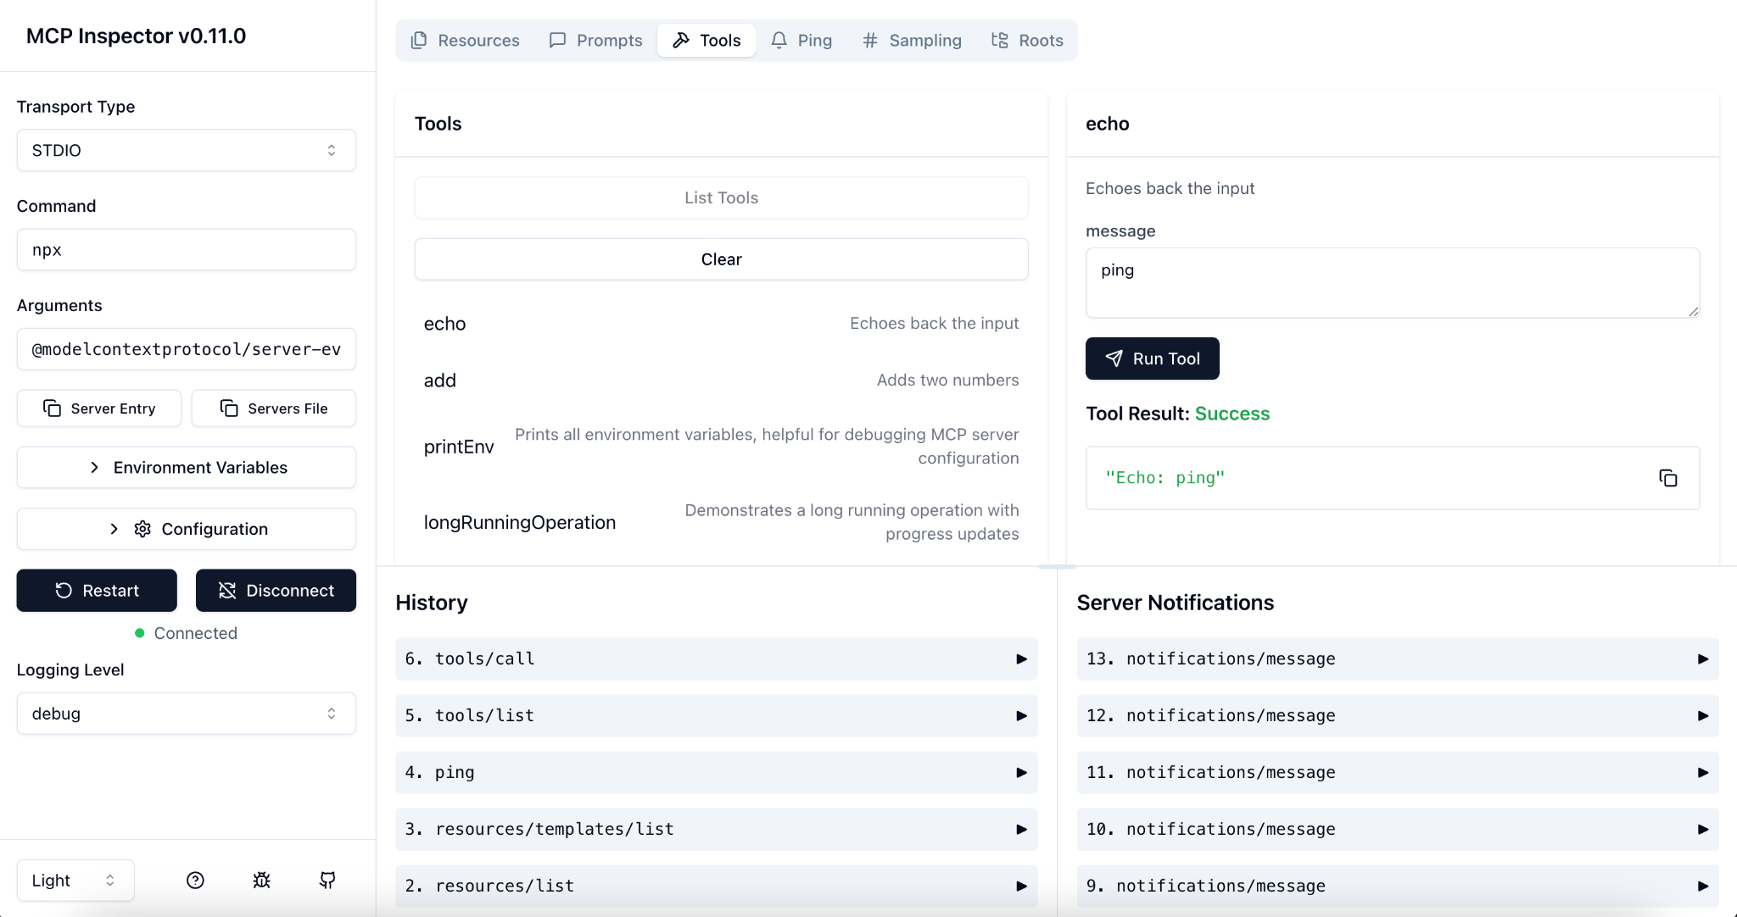

Tools: The MCP Inspector
What is it?
The MCP Inspector is a graphical developer tool for debugging MCP connections.
It acts as a "Host" application, allowing you to connect to any local or remote server and test its capabilities manually.
Why use it?
•
See the raw JSON requests and responses.
•
Manually call tools and check their results.
Debug your server *before* integrating it into a complex AI application.
•
How to use it?
Run: % npx @modelcontextprotocol/inspector python <server_path_file>
Remotely servers example: npx @modelcontextprotocol/inspector npx -y @modelcontextprotocol/server-filesystem ~
MCP Inspector

Slide 33
Practical Tutorial: Connecting to Claude Desktop (db_server example)

Slide 34
Questions?
Thank You.

