Slide 1
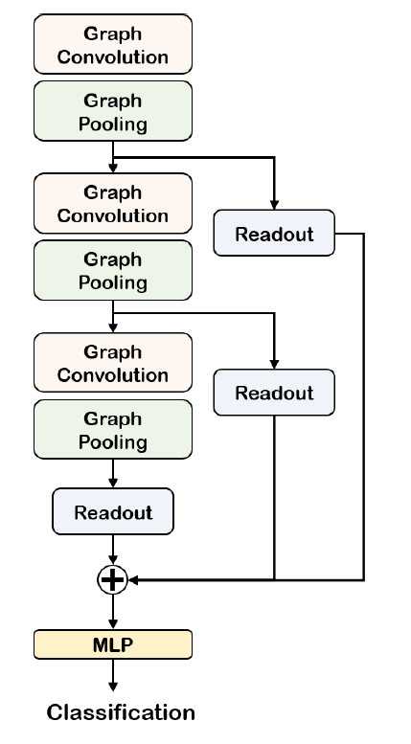
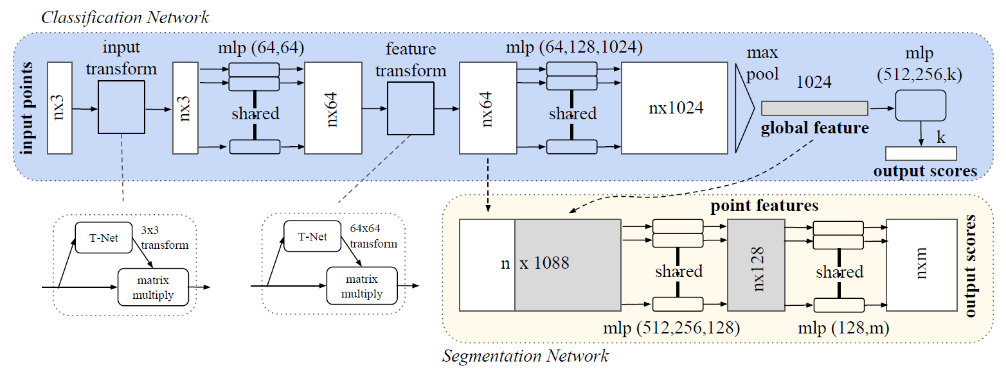
feature engineering
pre-processing
raw point cloud
64
64
nx10
nx10
Linear & BN

Slide 2
nx32
nx10
nx10
1D Conv & BN
feature vector for each node
feature engineering
Edge list and primary graph structure (6-nearest-neighbors)
pre-processing
raw point cloud

