Slide 1



Real-Time Digital Courier Management System for End-to-End Logistics and Delivery Scheduling
TEAM MEMBERS:
Keerthana M - 23CDR073
Mohaideen Abdul Kathar S - 23CDR092
PROJECT GUIDE
Dr. M. N. Kavitha

Slide 2

In today's fast-paced world, people often struggle to find time to physically send parcels through courier services. There is a lack of trust in traditional systems due to frequent delivery delays, incorrect delivery addresses, and even lost packages.
Moreover, sending parcels with human guides is expensive and inefficient. These issues create hesitation among users and reduce the reliability of courier services.
Hence, there is a need for a smart, real-time solution that enhances user experience, ensures delivery accuracy, and provides end-to-end transparency in logistics

Slide 3
Objectives
To develop a real-time digital courier management system that streamlines parcel delivery through a web-based platform, enabling users to register, request deliveries, track parcel status, and ensure accurate, timely, and transparent logistics using modern technologies like Python (Flask), MySQL, HTML, CSS, and JavaScript.
‹#›

Slide 4
Software Tools used
Frontend: HTML, CSS, JavaScript
Backend: Python (Flask Framework)
Database: MySQL
Development Tools: Visual Studio Code, XAMPP (for MySQL), Postman (API Testing)
‹#›

Slide 5
Existing Solution
Manual parcel booking and processing
Limited or delayed tracking information
Lack of real-time updates and transparency
Expensive human-guided delivery options
Frequent errors in address handling and parcel loss
Poor coordination between admin, employee, and customer
Low customer trust and satisfaction

Slide 6
Implementation Details
The system is developed as a web application using Flask (Python) for the backend, managing user authentication, admin controls, and API routes.
The frontend is built using HTML, CSS, and JavaScript for interactive user experience. MySQL handles structured data storage such as user details, parcel info, and delivery logs.
Users register/login, submit parcel requests, and view delivery status. Admins verify requests and assign employees (incharge) for delivery. Employees log in to view assigned tasks and update delivery progress.
All updates trigger real-time status changes and notifications to customers, admins, and delivery agents, ensuring a seamless courier management experience.
‹#›

Slide 7
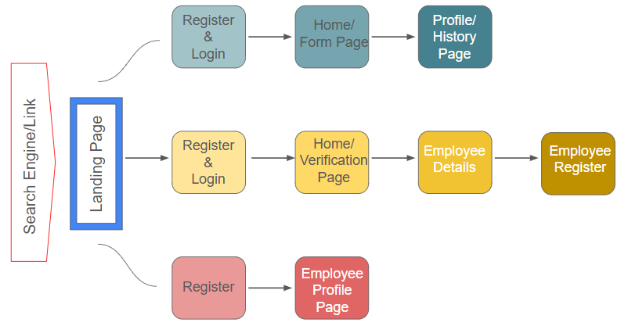
Website Architecture

Slide 8
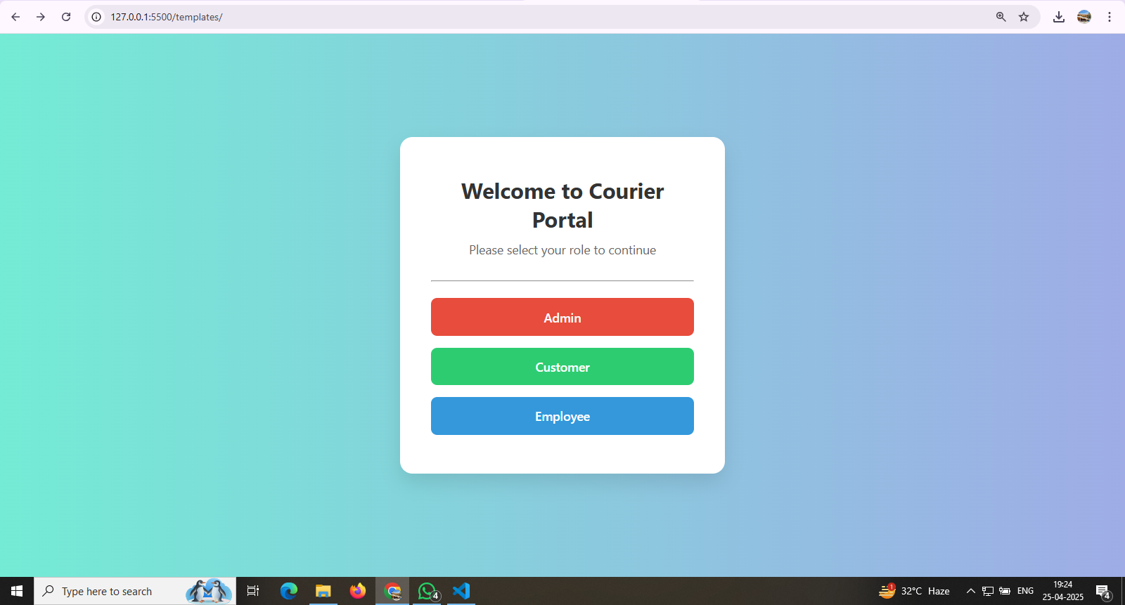

Slide 9
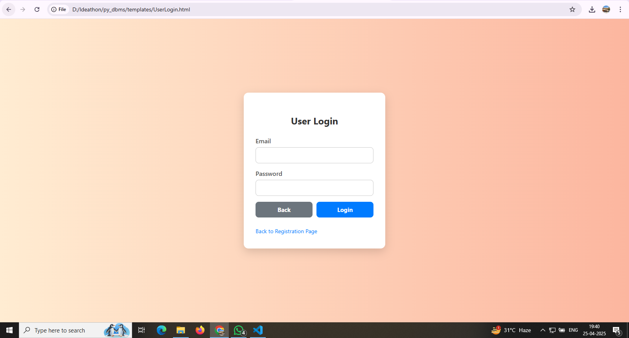

Slide 10
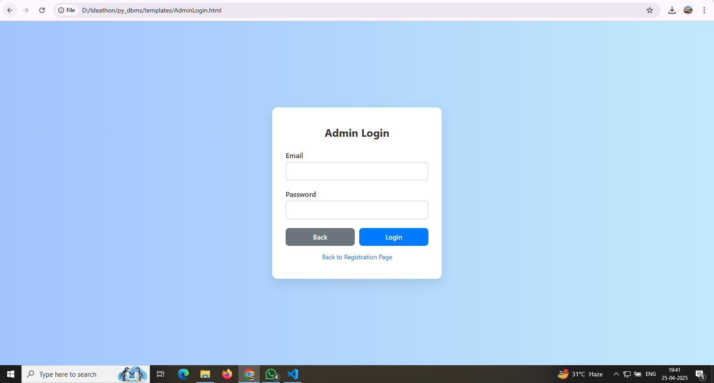

Slide 11
Thank you!

