Slide 1



Real-Time Digital Courier Management System for End-to-End Logistics and Delivery Scheduling
REVIEW-3
TEAM MEMBERS:
Keerthana M - 23CDR073
Mohaideen Abdul Kathar S - 23CDR092
PROJECT GUIDE
Dr. M. N. Kavitha

Slide 2

In today's fast-paced world, people often struggle to find time to physically send parcels through courier services. There is a lack of trust in traditional systems due to frequent delivery delays, incorrect delivery addresses, and even lost packages.
Moreover, sending parcels with human guides is expensive and inefficient. These issues create hesitation among users and reduce the reliability of courier services.
Hence, there is a need for a smart, real-time solution that enhances user experience, ensures delivery accuracy, and provides end-to-end transparency in logistics

Slide 3
Objectives
To develop a real-time digital courier management system that streamlines parcel delivery through a web-based platform, enabling users to register, request deliveries, track parcel status, and ensure accurate, timely, and transparent logistics using modern technologies like Python (Flask), MySQL, HTML, CSS, and JavaScript.
‹#›

Slide 4
Software Tools used
Frontend: HTML, CSS, JavaScript
Backend: Python (Flask Framework)
Database: MySQL
Development Tools: Visual Studio Code, XAMPP (for MySQL), Postman (API Testing)
‹#›

Slide 5
Why This Tech Stack
💻 Frontend: HTML, CSS, JavaScript
HTML – Standard language to structure web content.
CSS – For styling the user interface and making it visually appealing.
JavaScript – Adds interactivity (form validation, alerts, dynamic UI updates).
⚙️ Backend: Python (Flask Framework)
Python – Simple, clean syntax; beginner-friendly and powerful.
Flask – Lightweight and flexible; perfect for small to medium-sized web apps.
Easy to learn and quick to set up REST APIs.
Integrates well with MySQL and frontend frameworks.

Slide 6
Why This Tech Stack
🗃️ Database: MySQL
Widely Used – Industry standard for relational databases.
Reliable & Scalable – Can handle growing data securely.
XAMPP Integration – Easy to set up a local MySQL environment.
🧰 Development Tools
Visual Studio Code – Lightweight yet powerful code editor with smart IntelliSense.
XAMPP – Convenient package to run Apache and MySQL locally.
Postman – Handy tool to test APIs during development.

Slide 7
Existing Solution
Manual parcel booking and processing
Limited or delayed tracking information
Lack of real-time updates and transparency
Expensive human-guided delivery options
Frequent errors in address handling and parcel loss
Poor coordination between admin, employee, and customer
Low customer trust and satisfaction

Slide 8
Why It’s Useful for Customer
🔐 Secure – Customer data is safely stored and protected from unauthorized access.
🧭 Easy to Navigate – Clean layout and intuitive flow make it simple for anyone to use.
📍 Location Tracker – Helps customers auto-fill or validate location-based info for faster registration or service access.
💻 Platform Independent – Works smoothly on any device with a browser (Windows, Mac, Linux, etc.).
🌐 Web-Based Convenience – No need to install anything; just access via browser anytime, anywhere.

Slide 9
Implementation Details
The system is developed as a web application using Flask (Python) for the backend, managing user authentication, admin controls, and API routes.
The frontend is built using HTML, CSS, and JavaScript for interactive user experience. MySQL handles structured data storage such as user details, parcel info, and delivery logs.
Users register/login, submit parcel requests, and view delivery status. Admins verify requests and assign employees (incharge) for delivery. Employees log in to view assigned tasks and update delivery progress.
All updates trigger real-time status changes and notifications to customers, admins, and delivery agents, ensuring a seamless courier management experience.
‹#›

Slide 10
Types of Modules
Customer Registration & Login module
Customer Dashboard & Profile
Admin Registration & Login module
Admin Dashboard with Histories
Dashboard for adding the Employees
Employee Login Module
Employee Dashboard with Histories

Slide 11
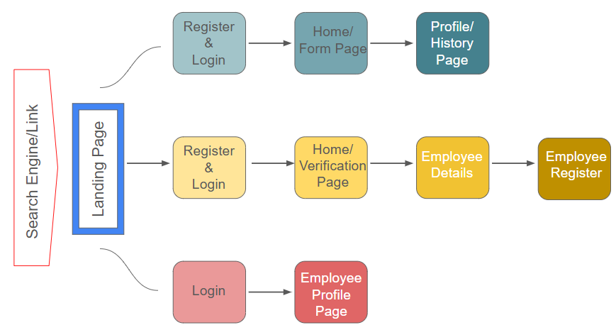
Website Architecture

Slide 12
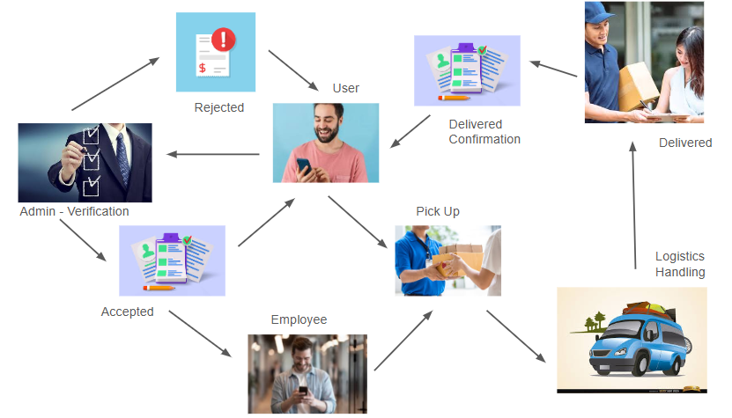
Workflow

Slide 13
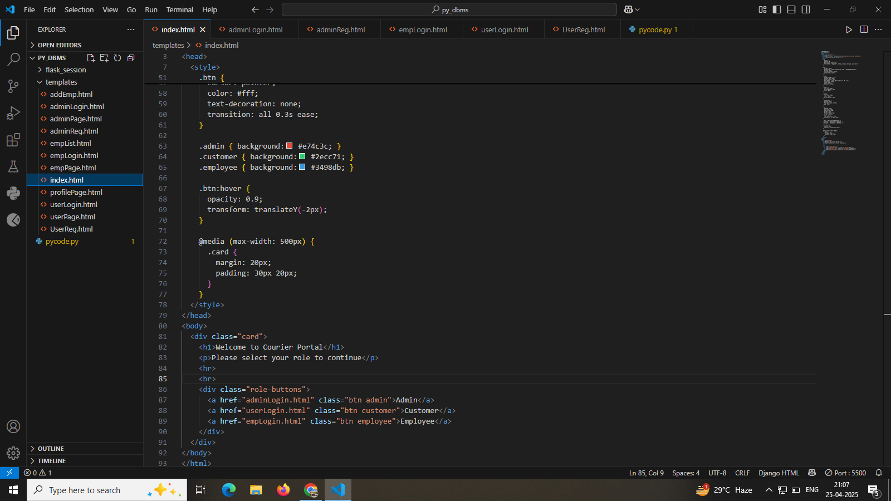

Slide 14
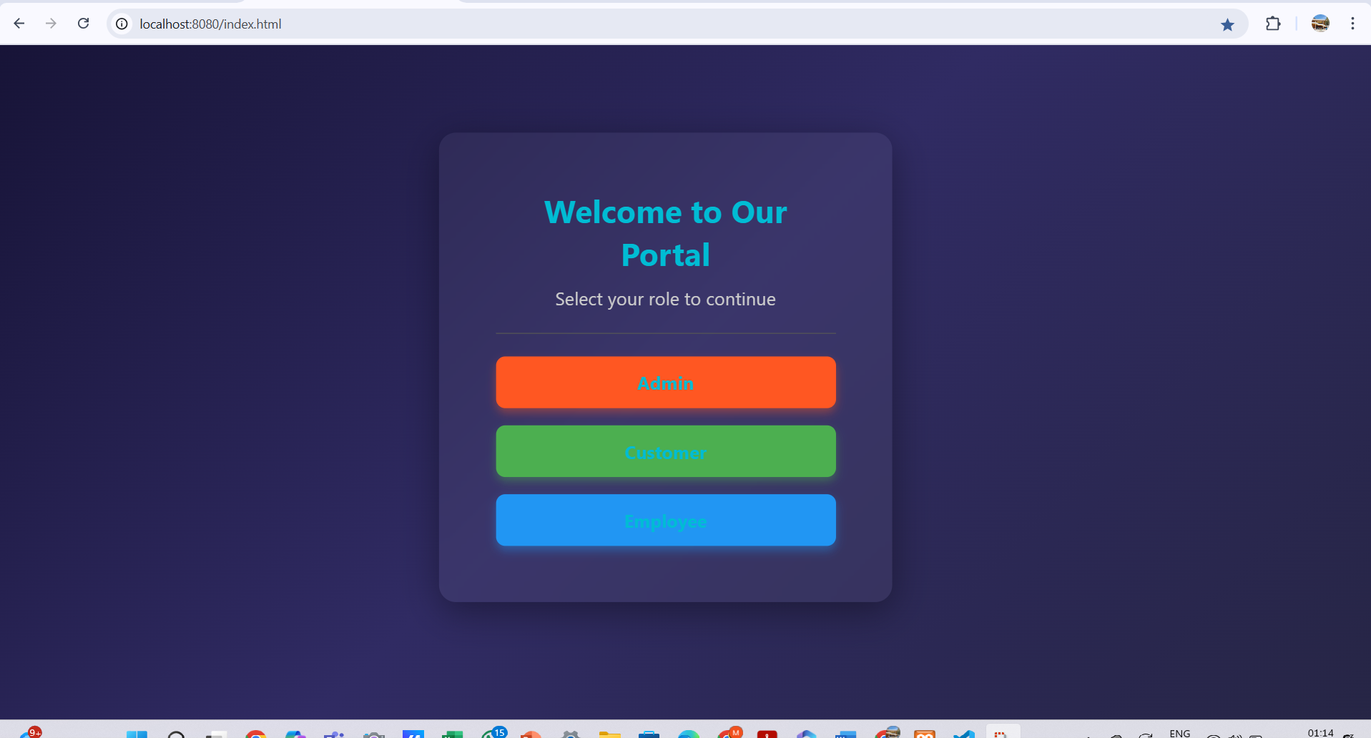

Slide 15
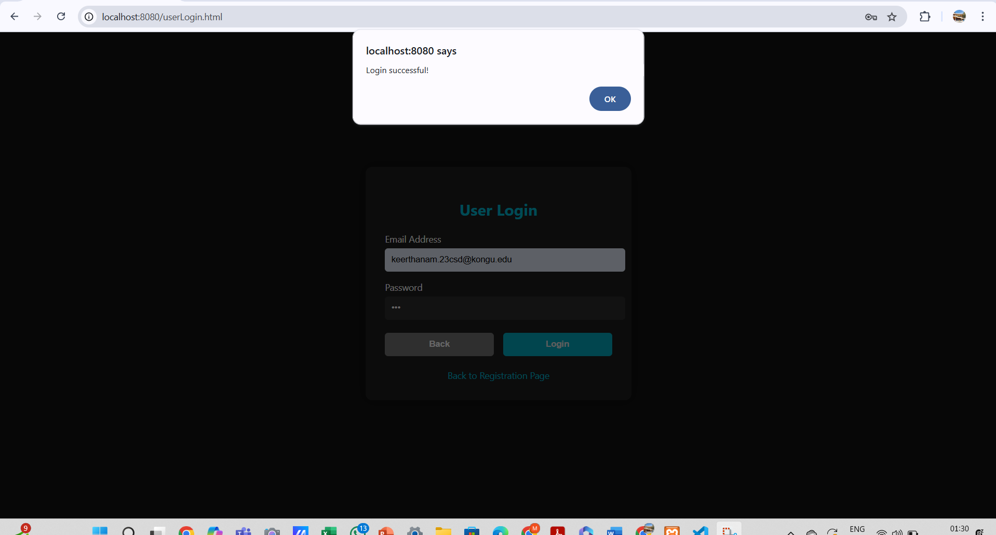

Slide 16
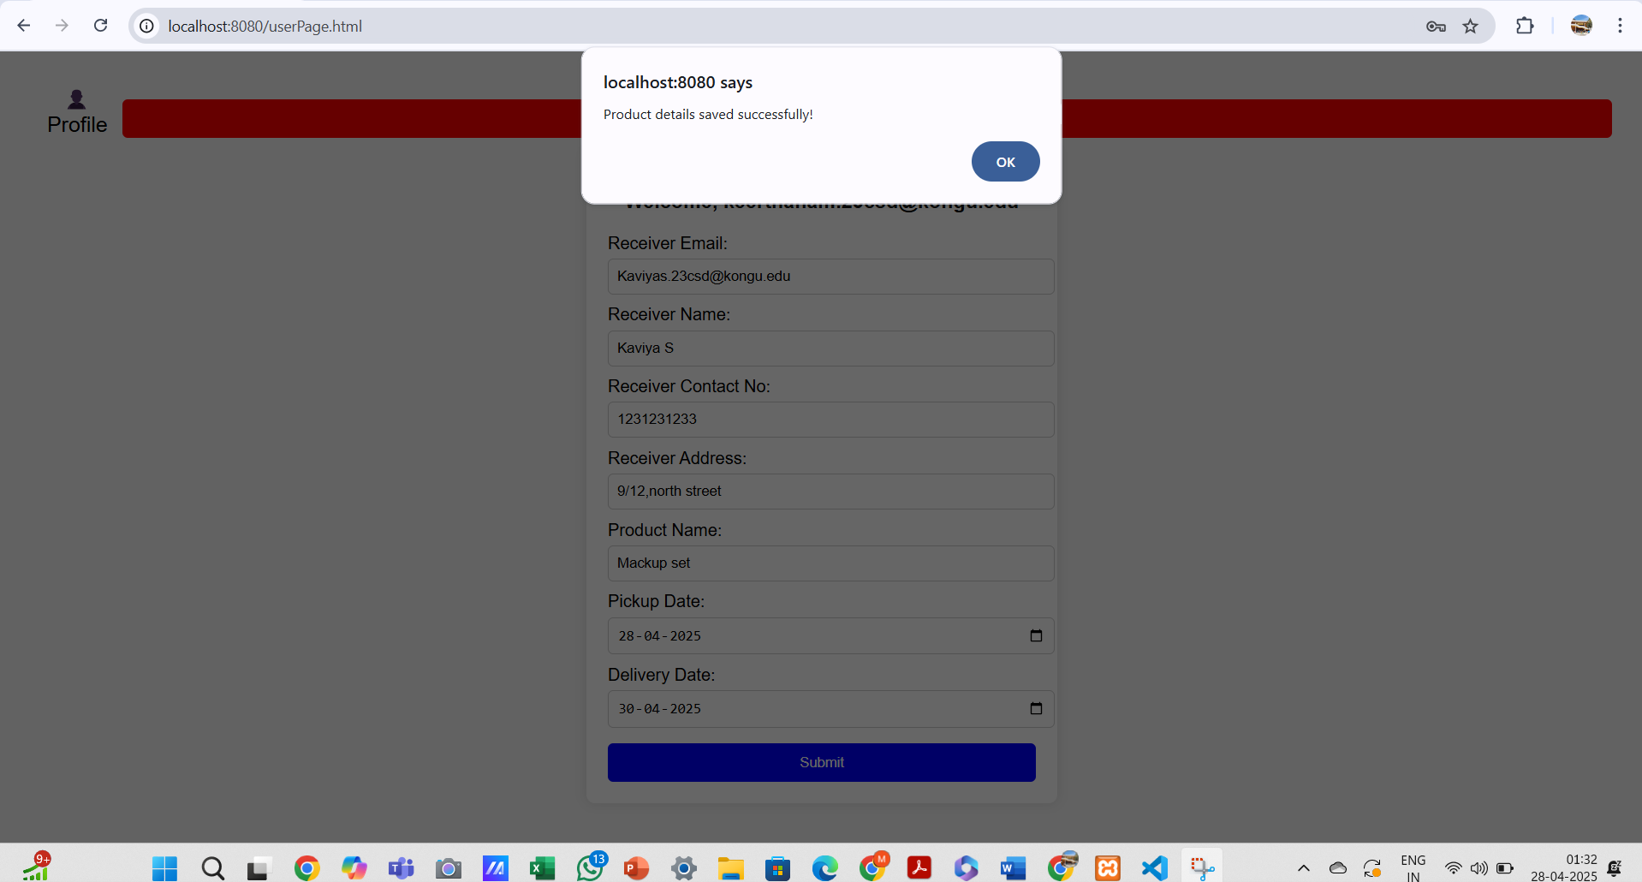

Slide 17
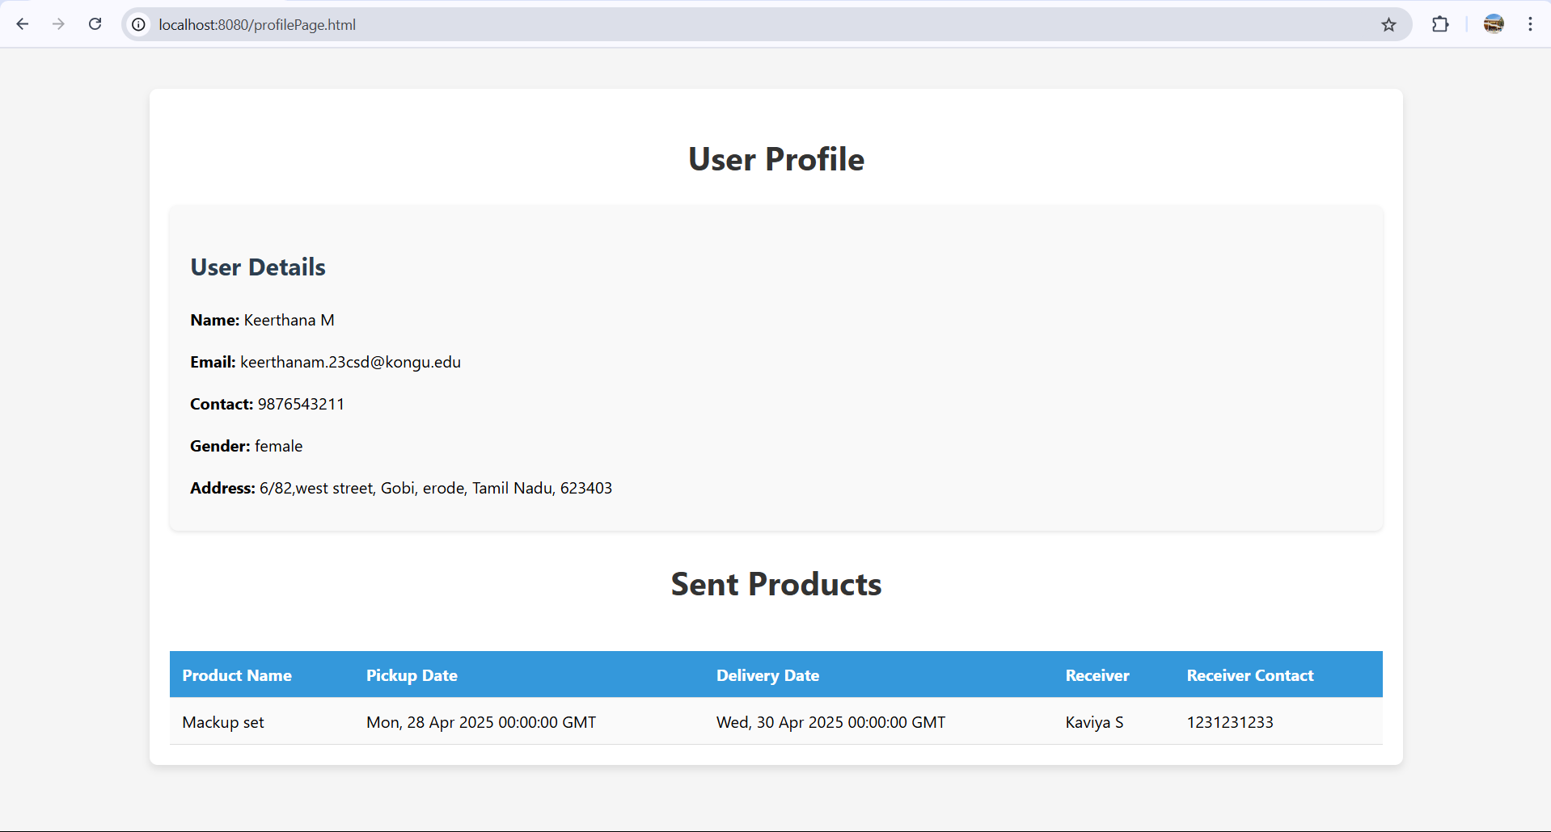

Slide 18
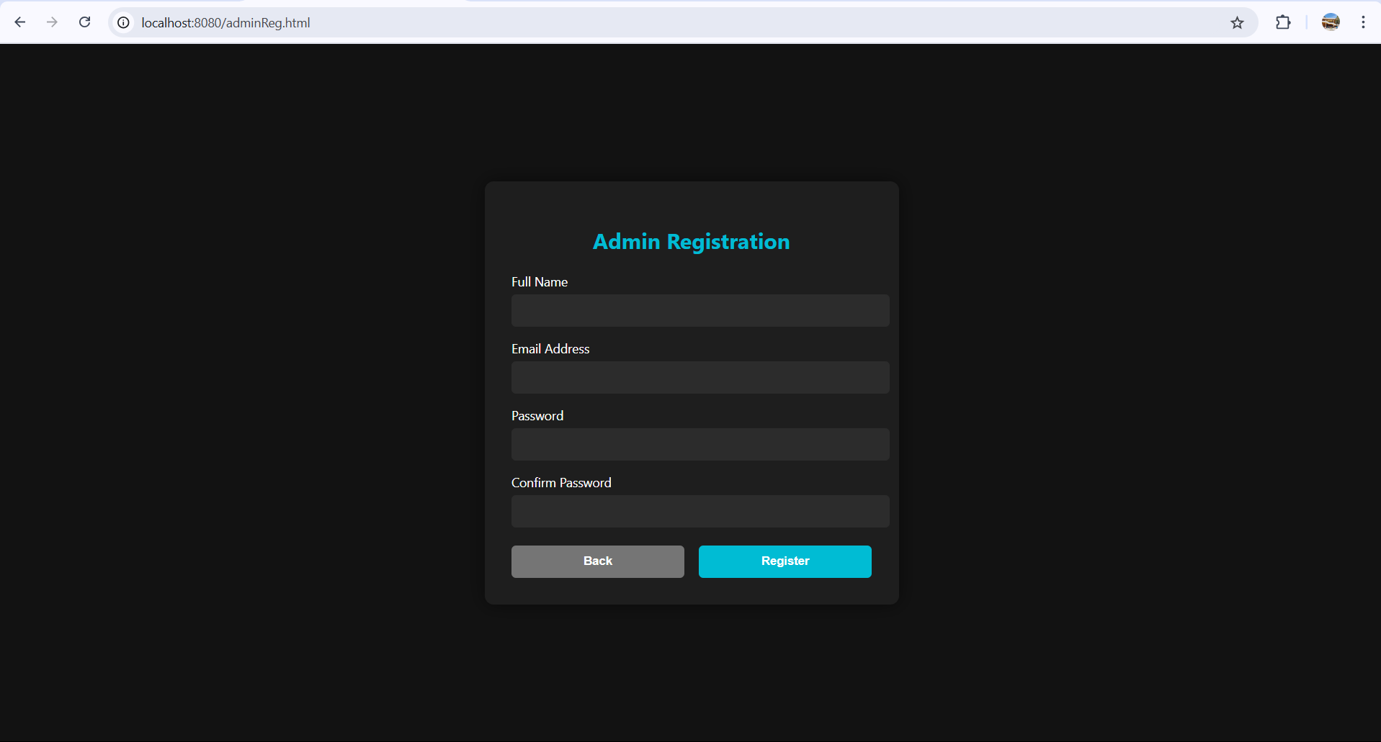

Slide 19
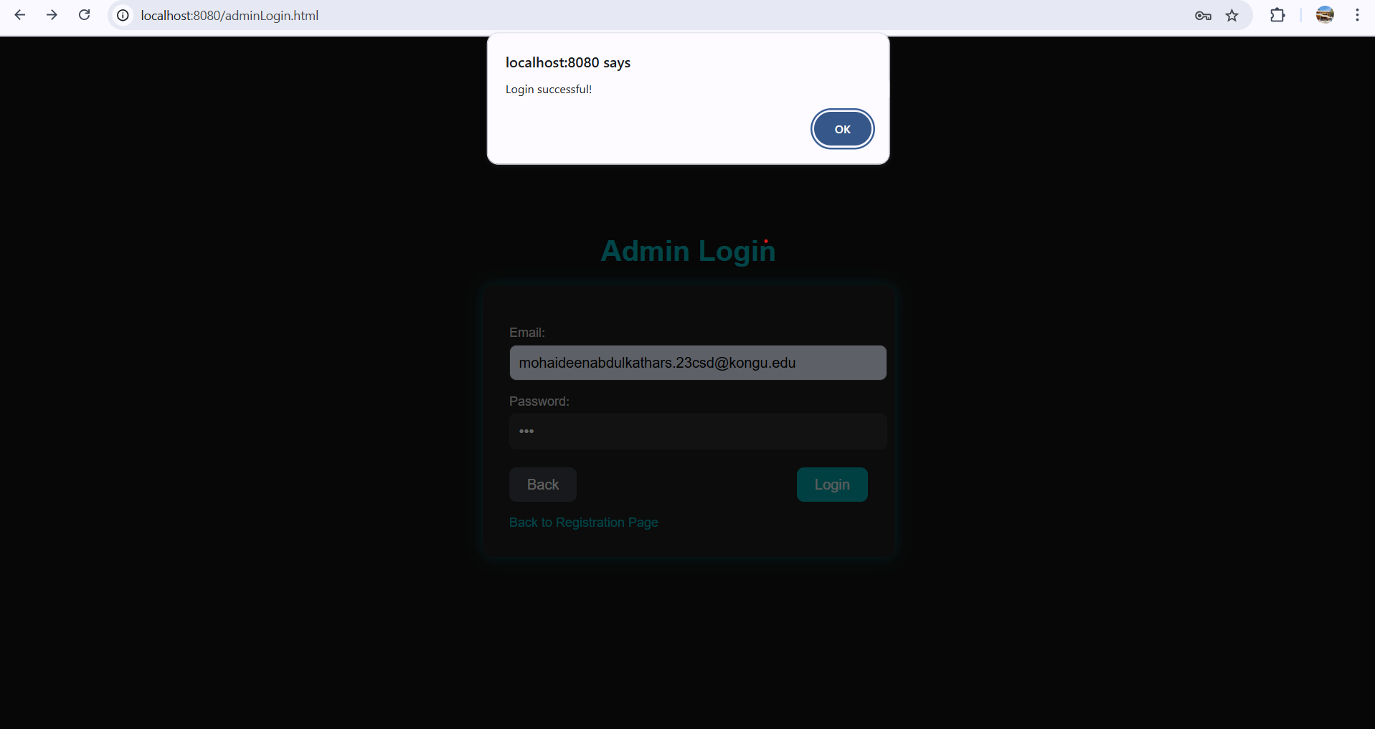

Slide 20
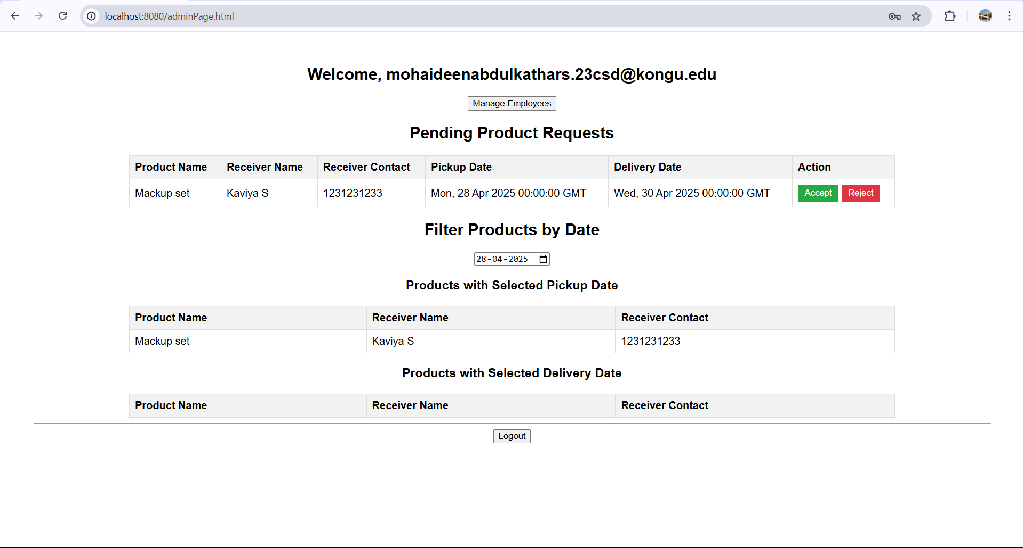

Slide 21
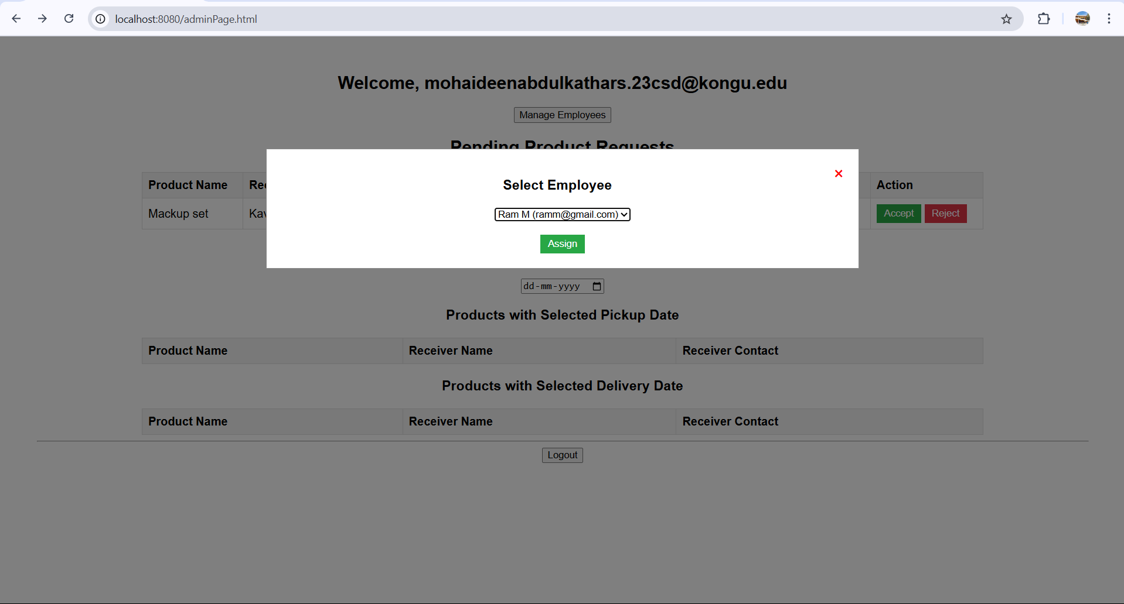

Slide 22
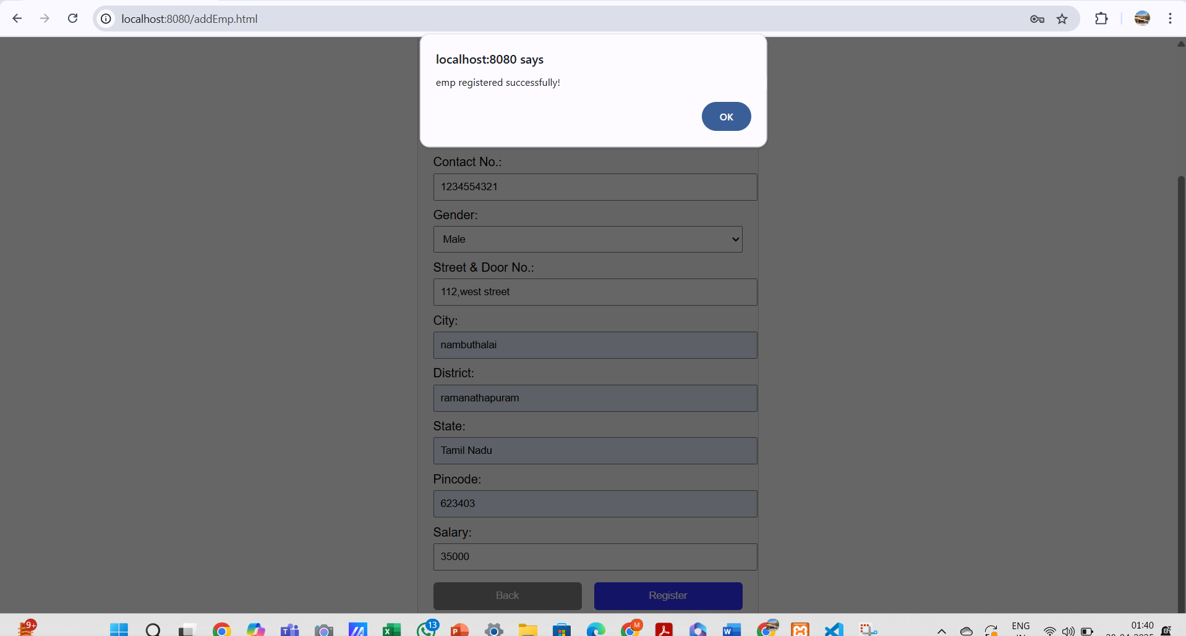

Slide 23
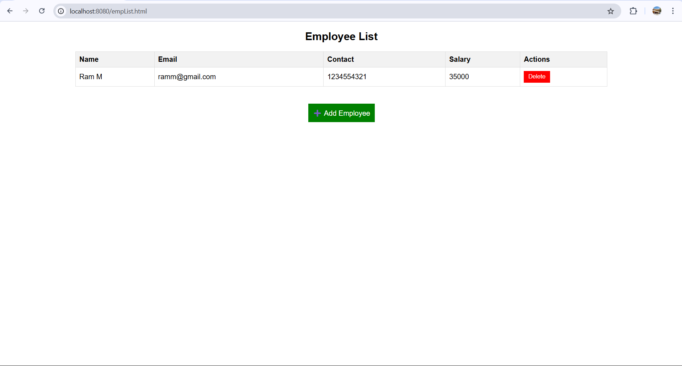

Slide 24
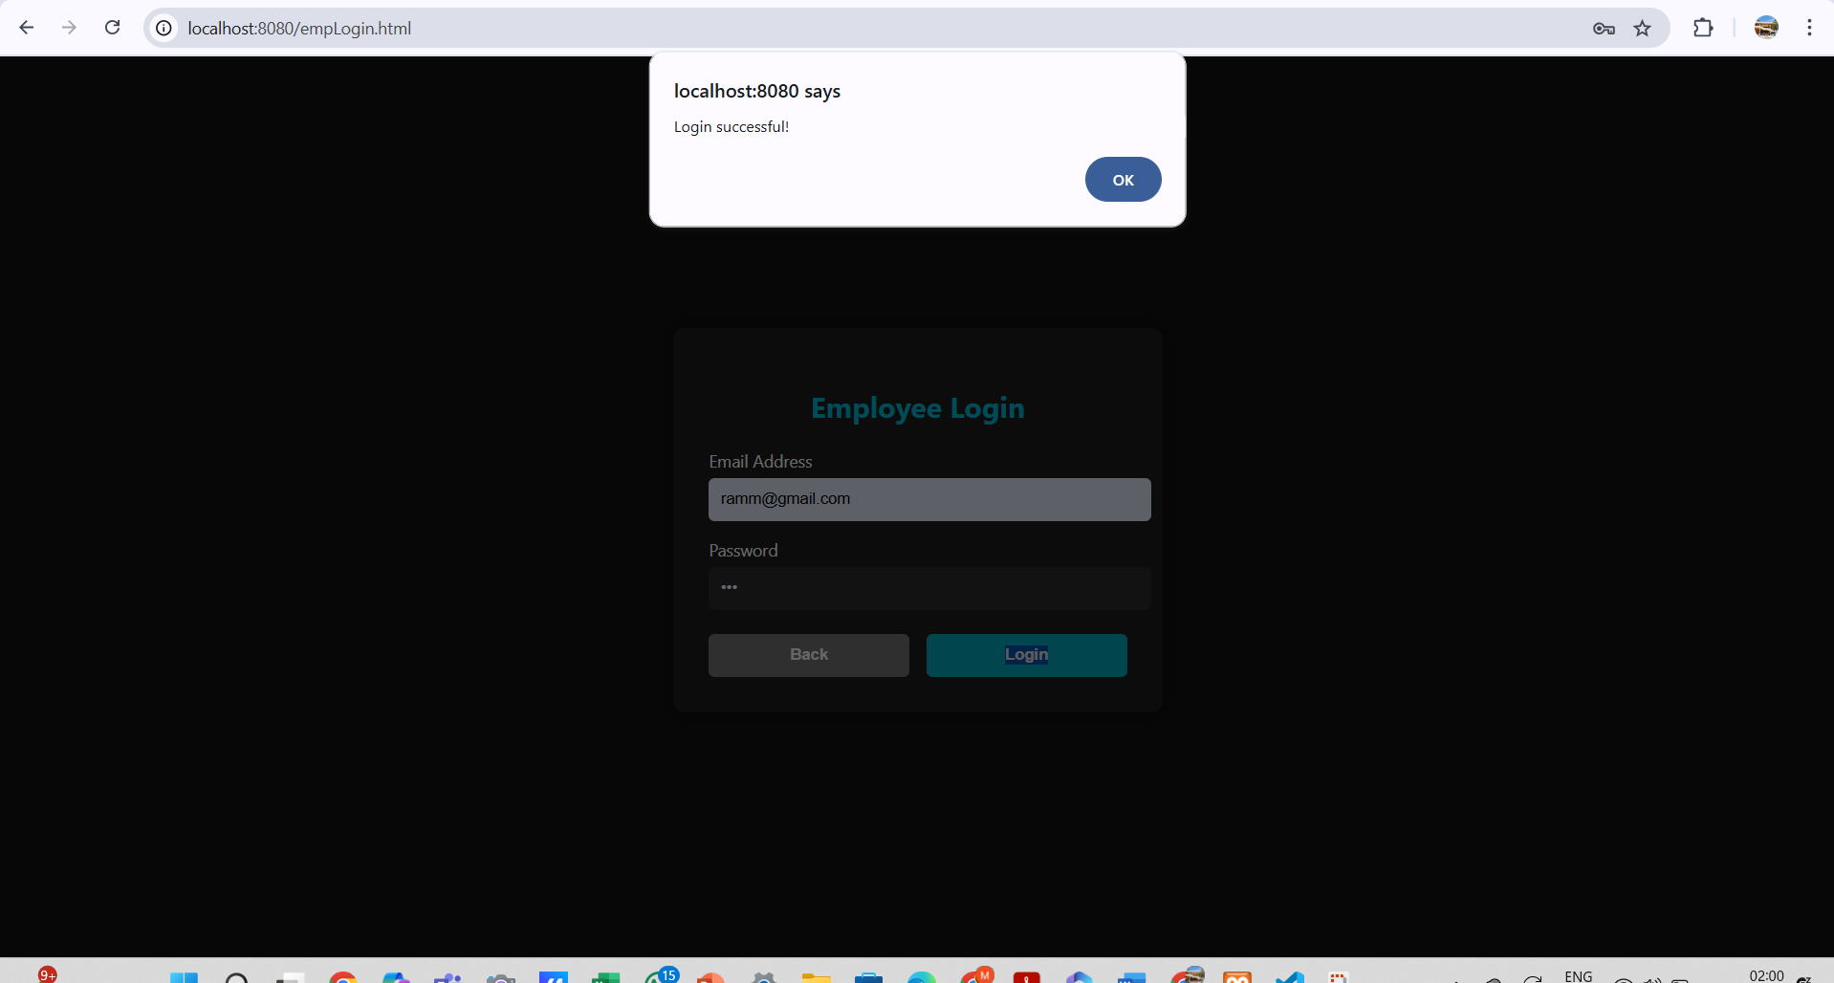

Slide 25
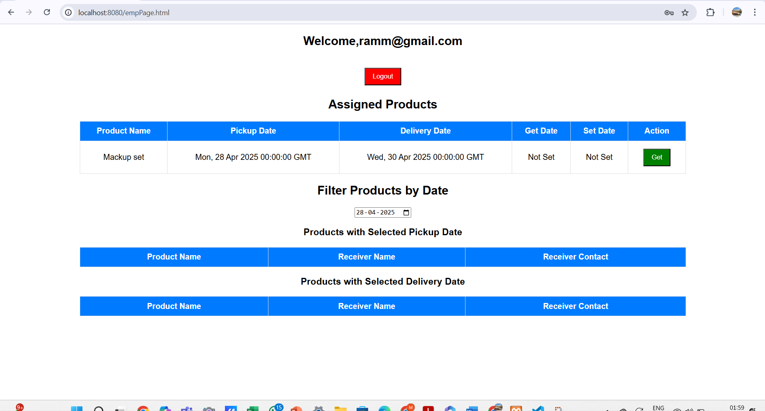

Slide 26
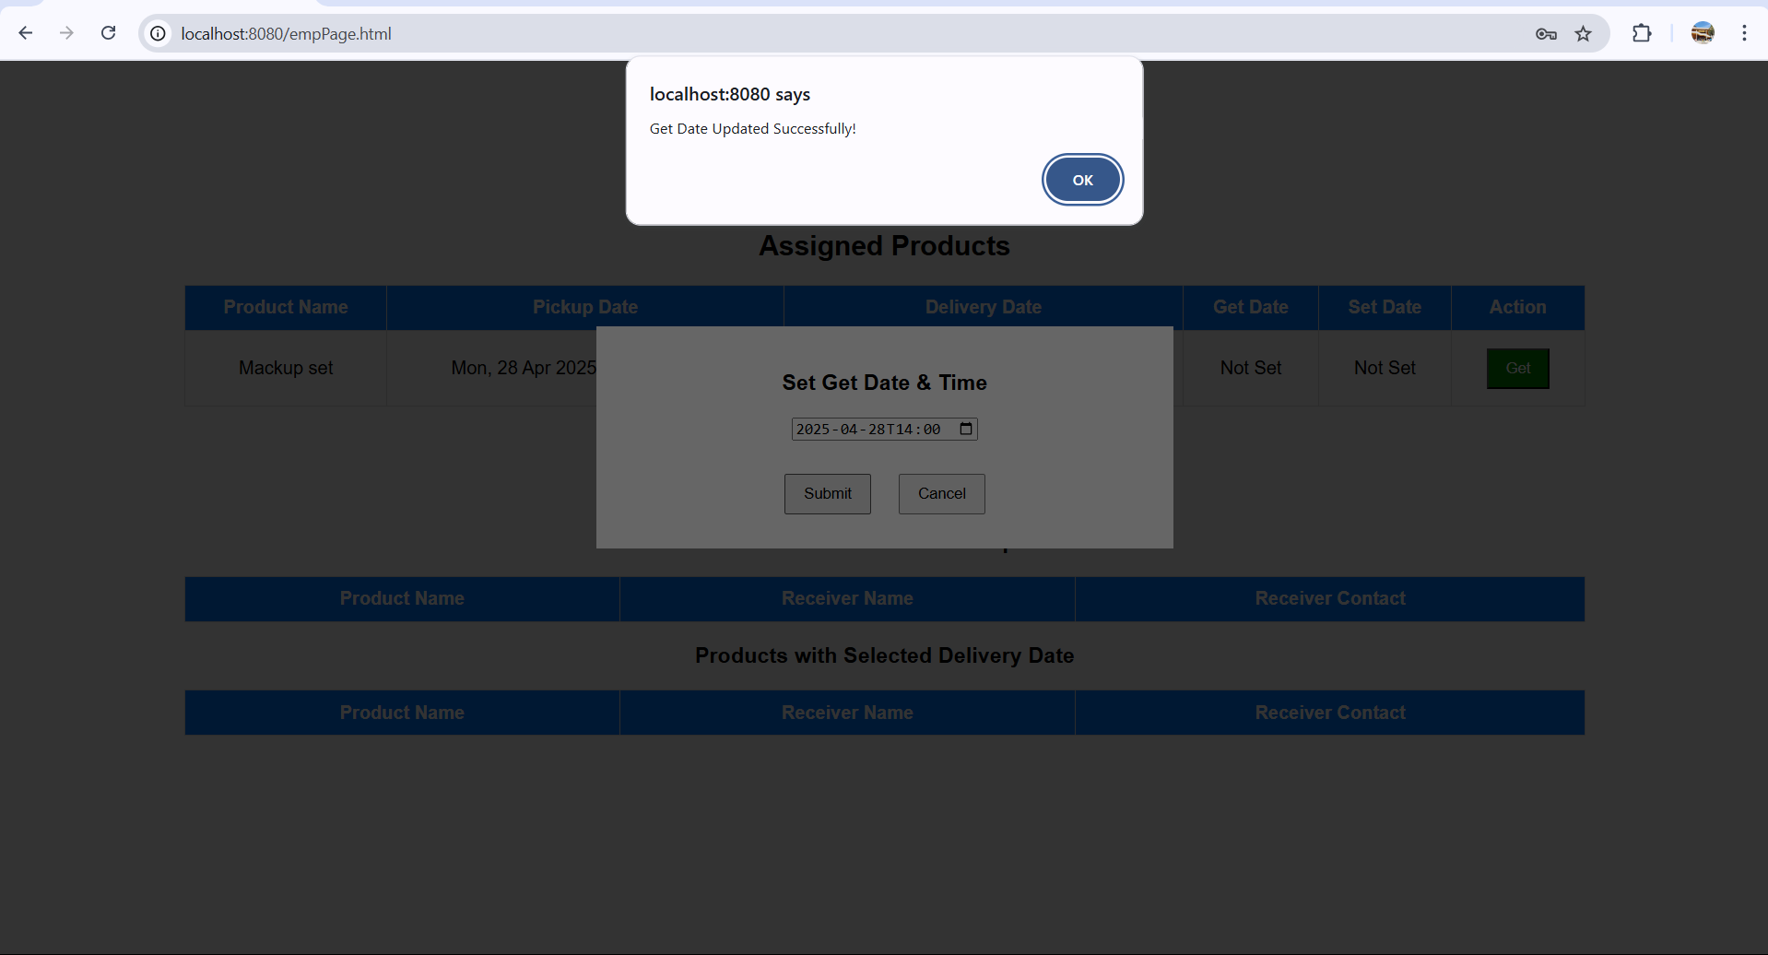

Slide 27
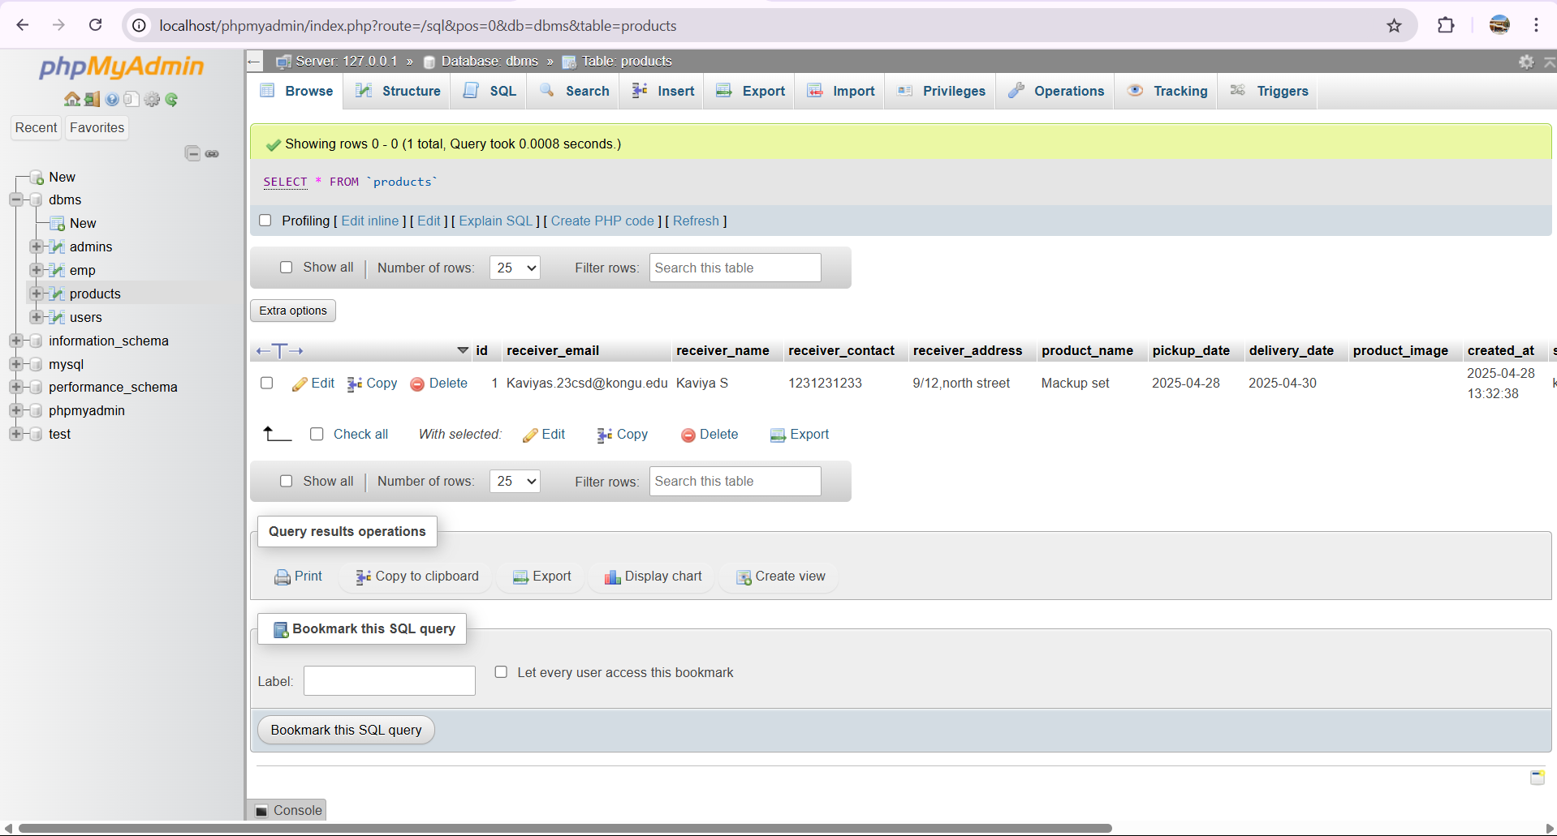

Slide 28
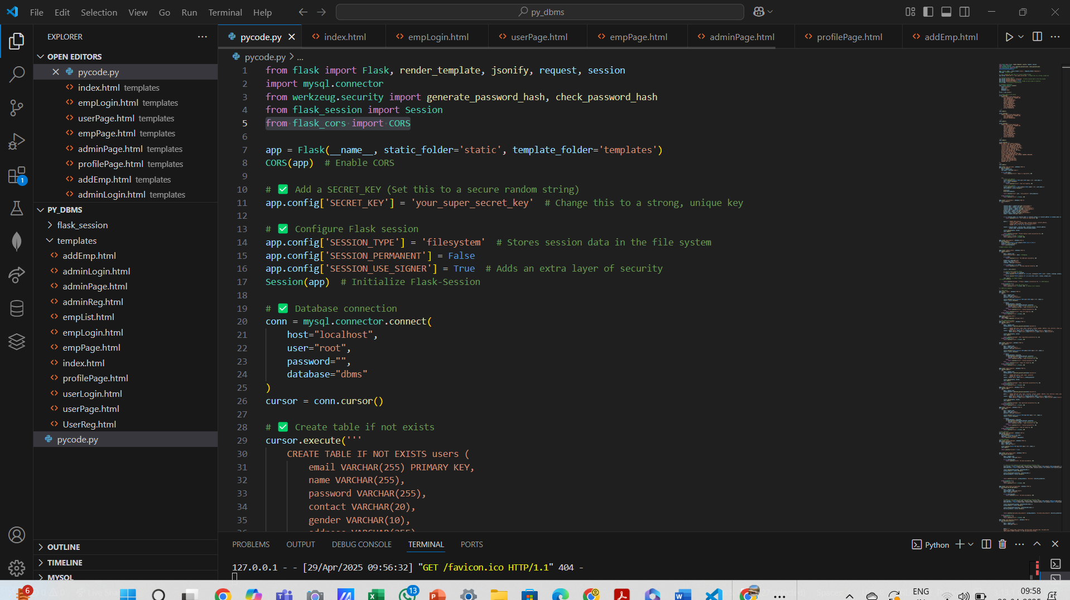

Slide 29
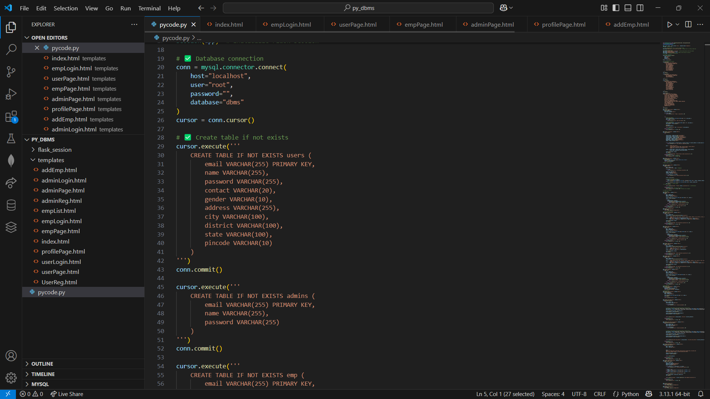

Slide 30
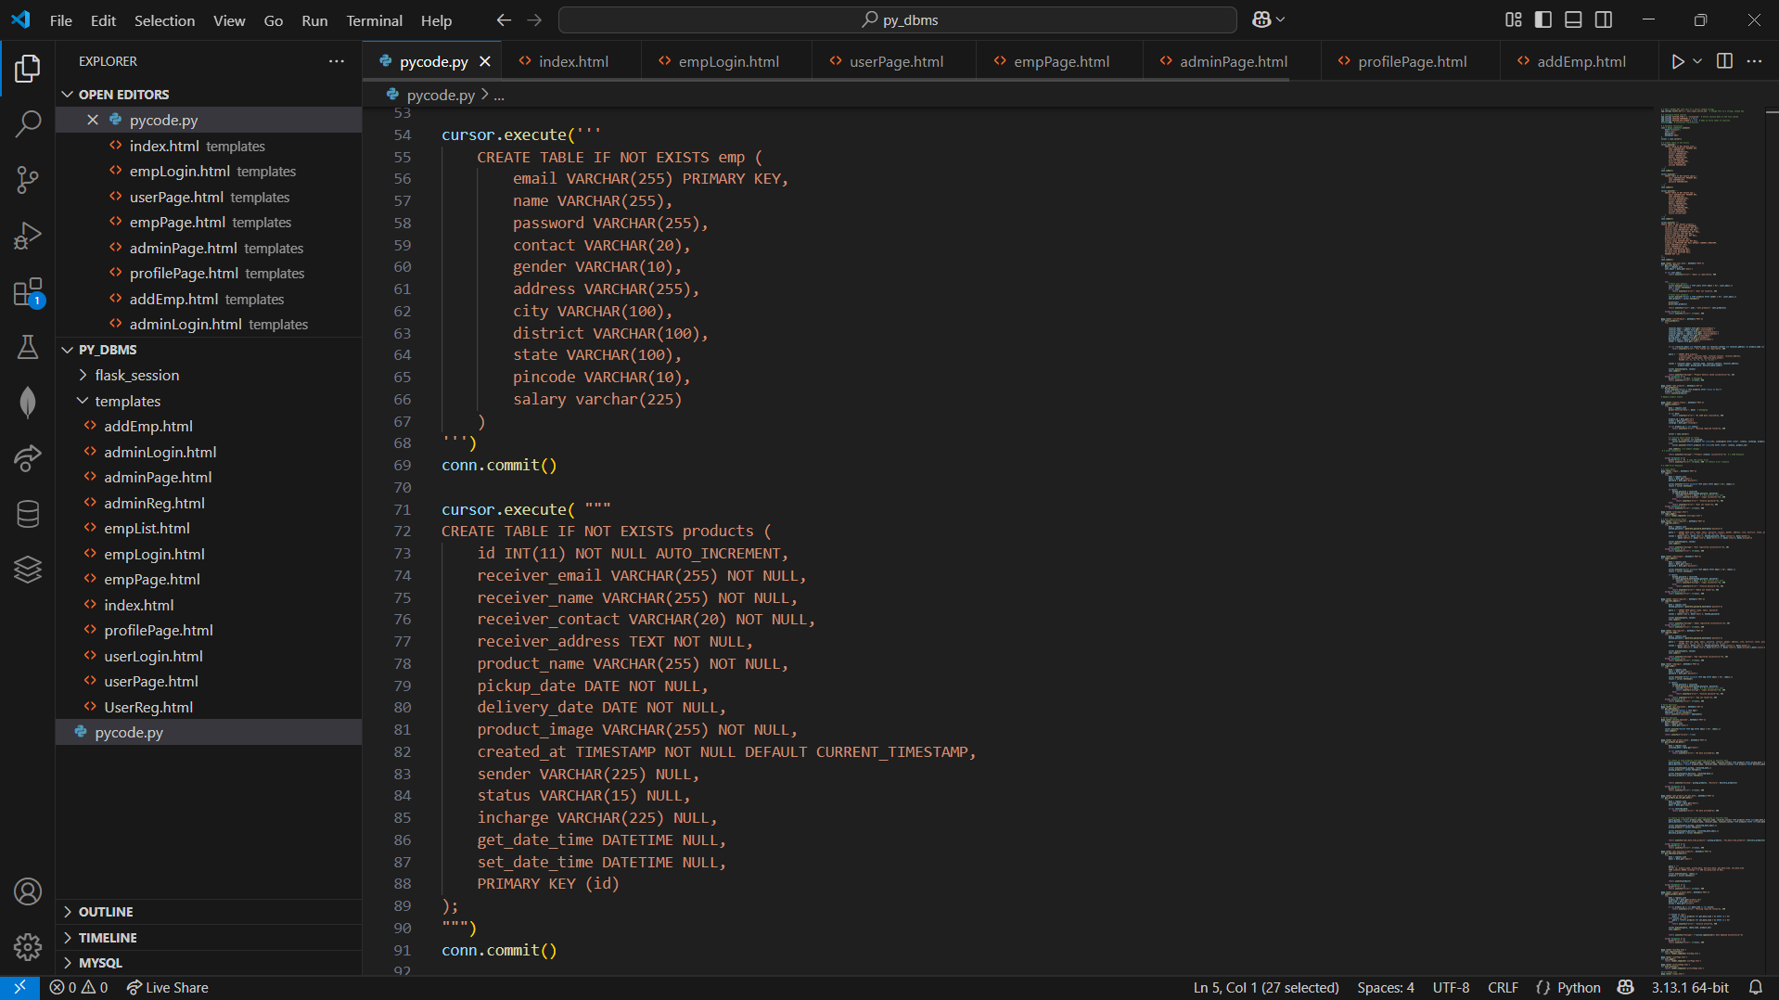

Slide 31
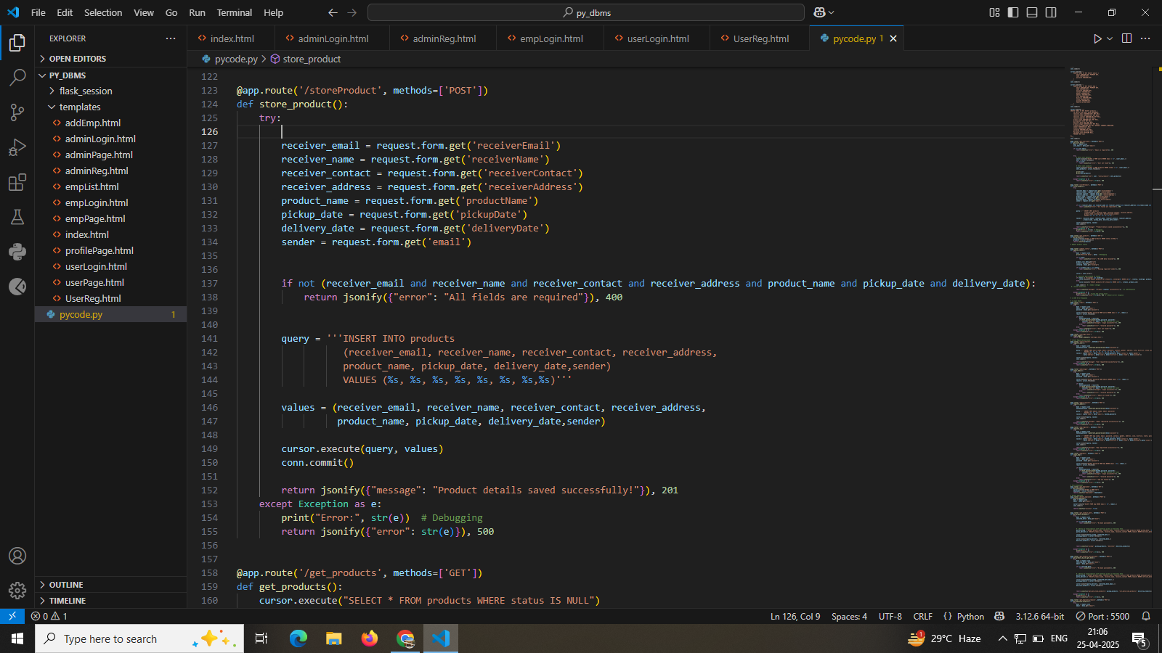

Slide 32
Project Source Code
https://github.com/Mohaideen-Abdul-Kathar-S/Online-Courier-System

Slide 33
Thank you!

