Slide 1
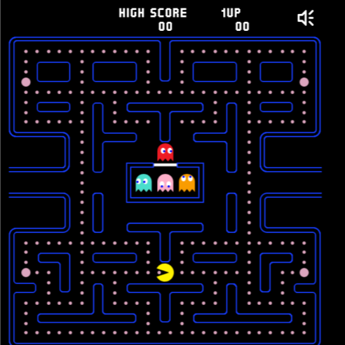



Slide 29
PAC
MAN

Slide 30
HIGH
SCORE

Slide 31
HELP
Use arrow key to move.
Avoid the ghosts.

Slide 32
MENU

