Slide 1





sorting algorithm visualizer
Mohaned El Behairy 231000095
Eyad Ahmed 231000644
Mariam shahinn 231001745
Ahmed Mohamed Fahmy 231000587

Slide 2

What is a sorting algorithm?
Importance in computer science and software development
Purpose of a visualizer: to make sorting algorithms easier to understand through animations

Slide 3


Objective of the Project
Explain the goal of your visualizer
Educate users
Demonstrate time complexity differences
Interactive learning tool, etc.

Slide 4

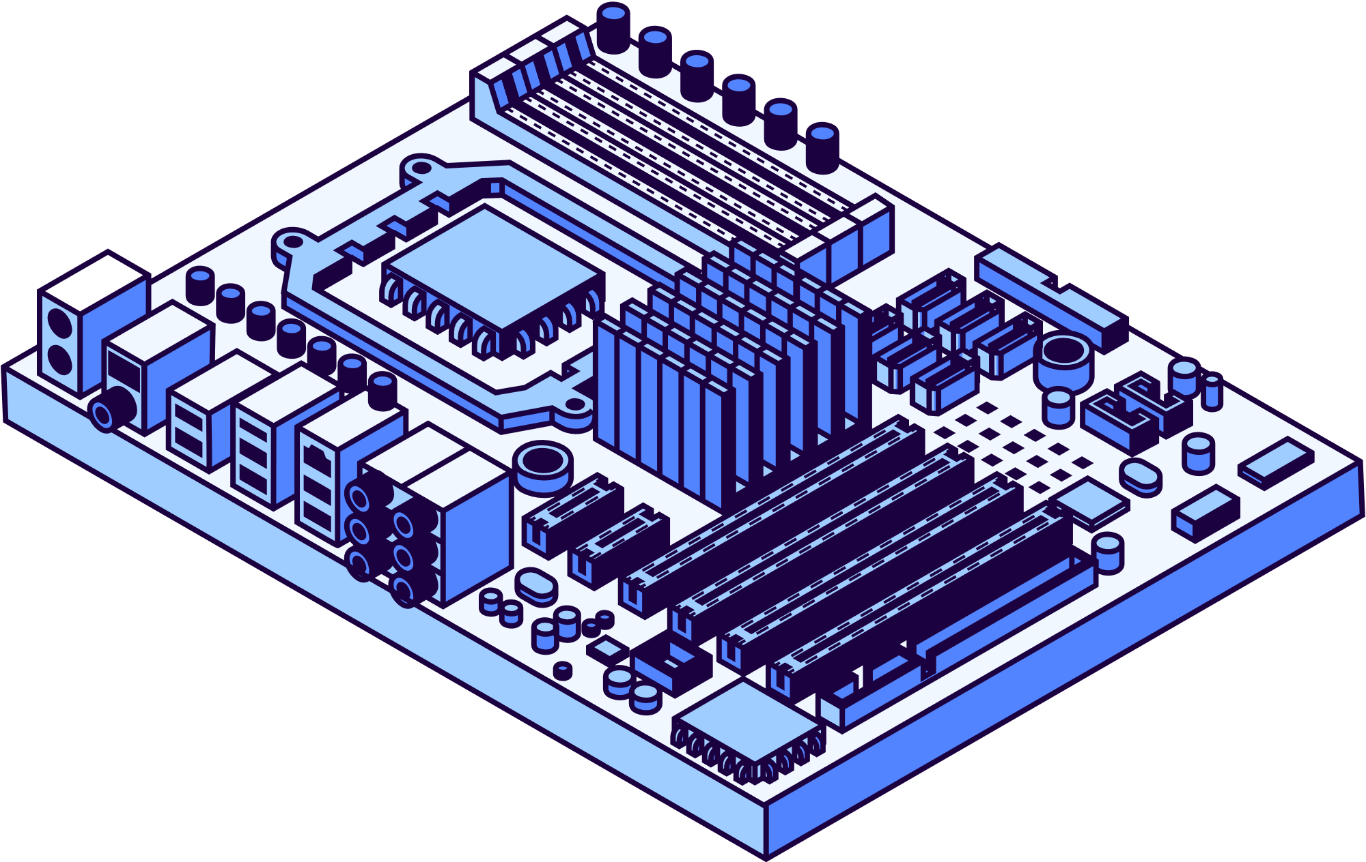
Algorithms Demonstrated
Bubble Sort
Insertion Sort
Selection Sort
Merge Sort
Quick Sort

Slide 5

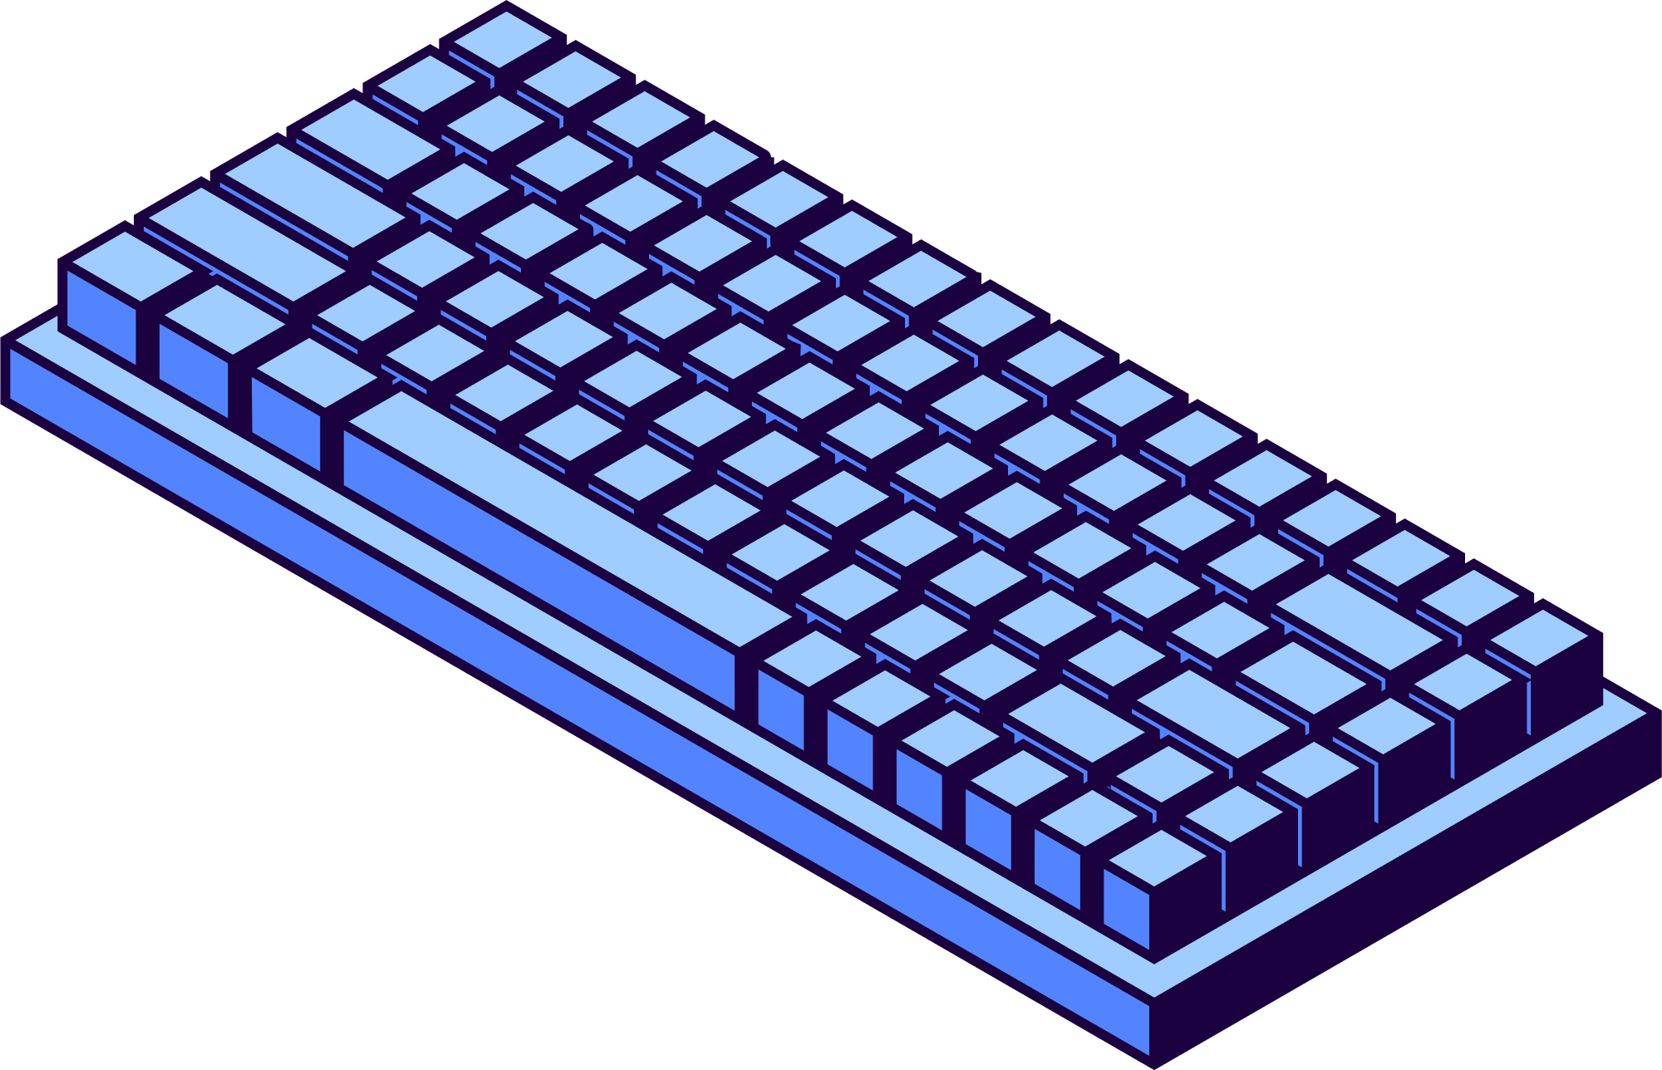
Bubble Sort
Compares and swaps adjacent elements to "bubble" the largest to the end. Repeats until the list is sorted.
Selection Sort
Finds the smallest element and swaps it with the current position. Repeats this for each position in the list.
Insertion Sort
Takes one element at a time and inserts it into its correct position in the sorted part. Works well on small or nearly sorted lists.
Merge Sort
Divides the list into halves, sorts them, then merges them. Guarantees O(n log n) performance.
Quick Sort
Picks a pivot and partitions elements around it, then sorts the partitions. Fast in practice but worst-case is O(n²).

Slide 6
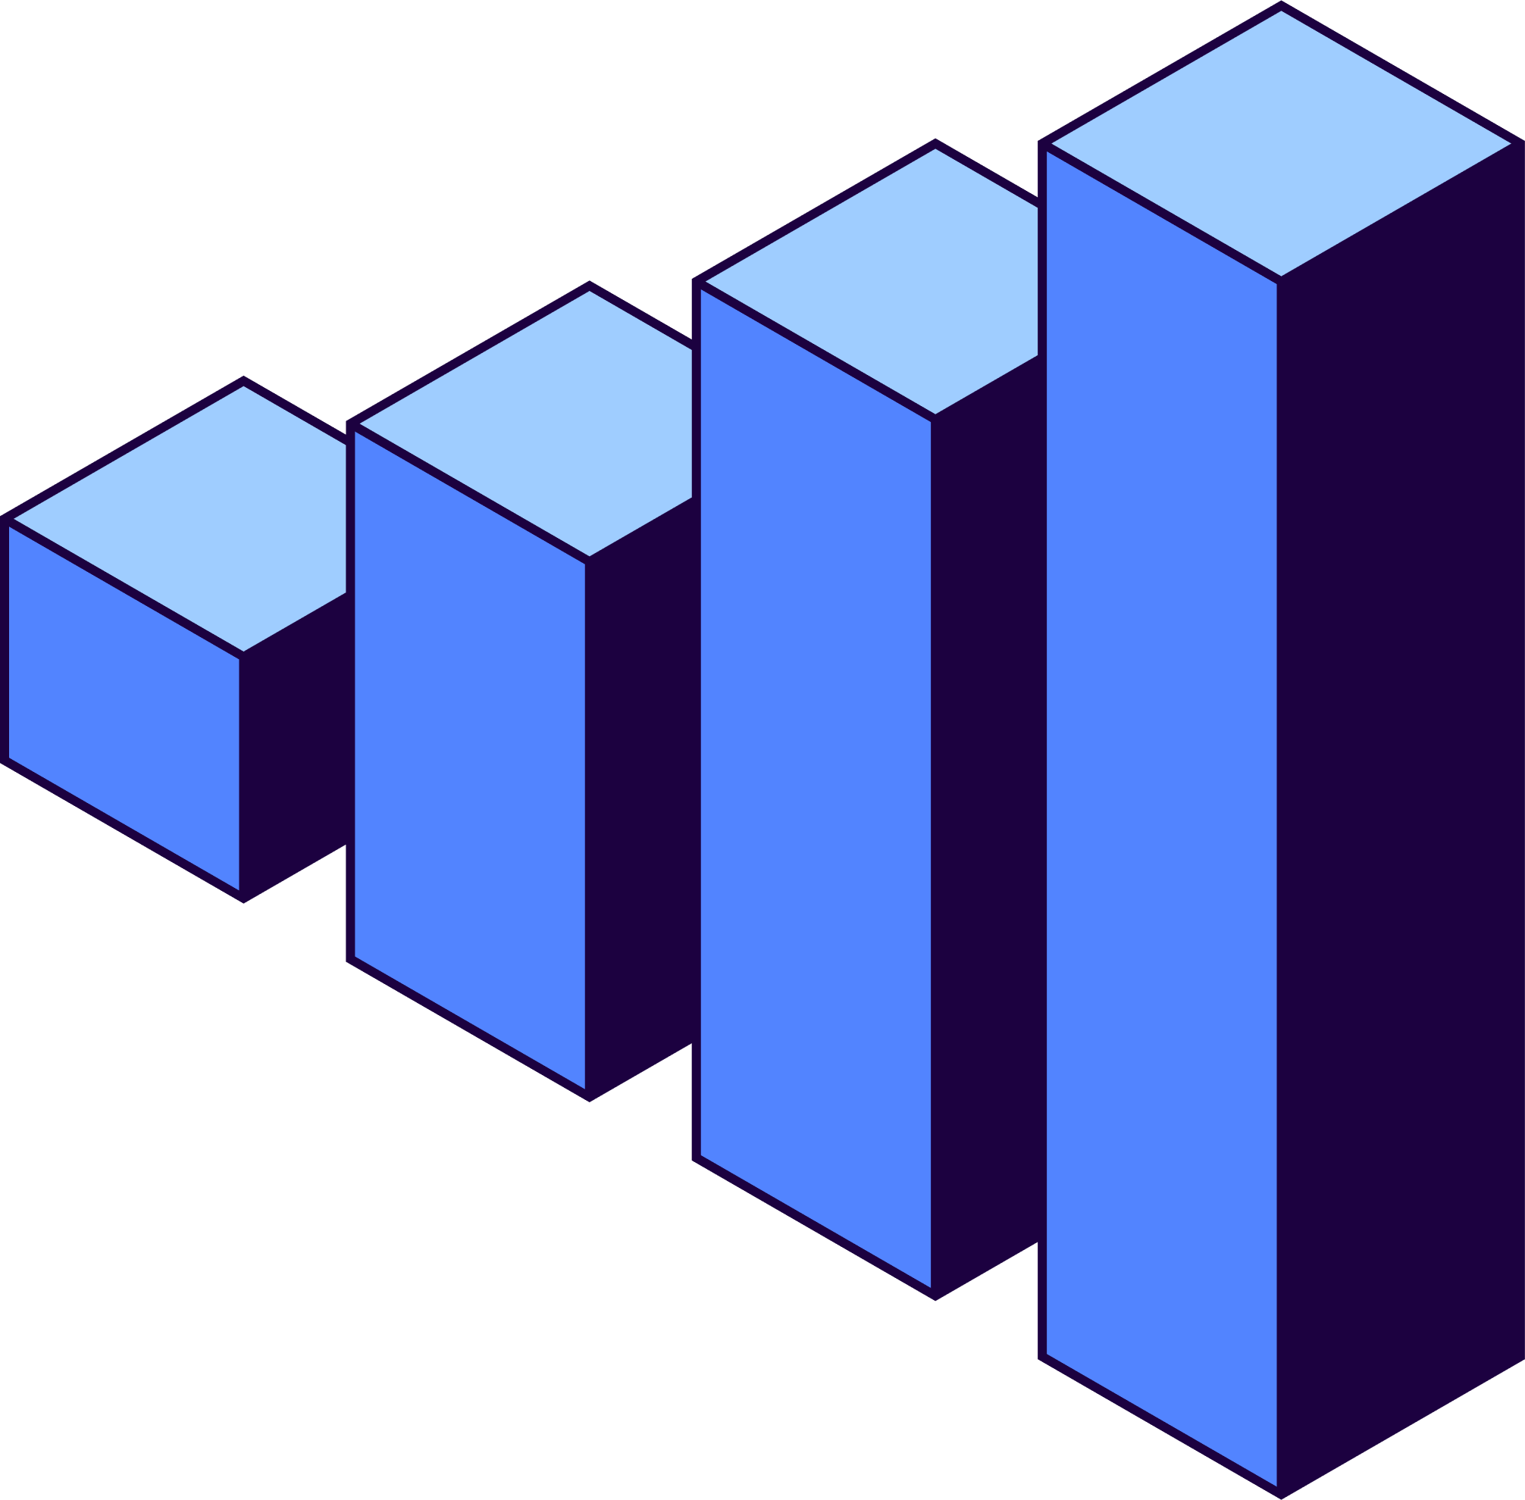
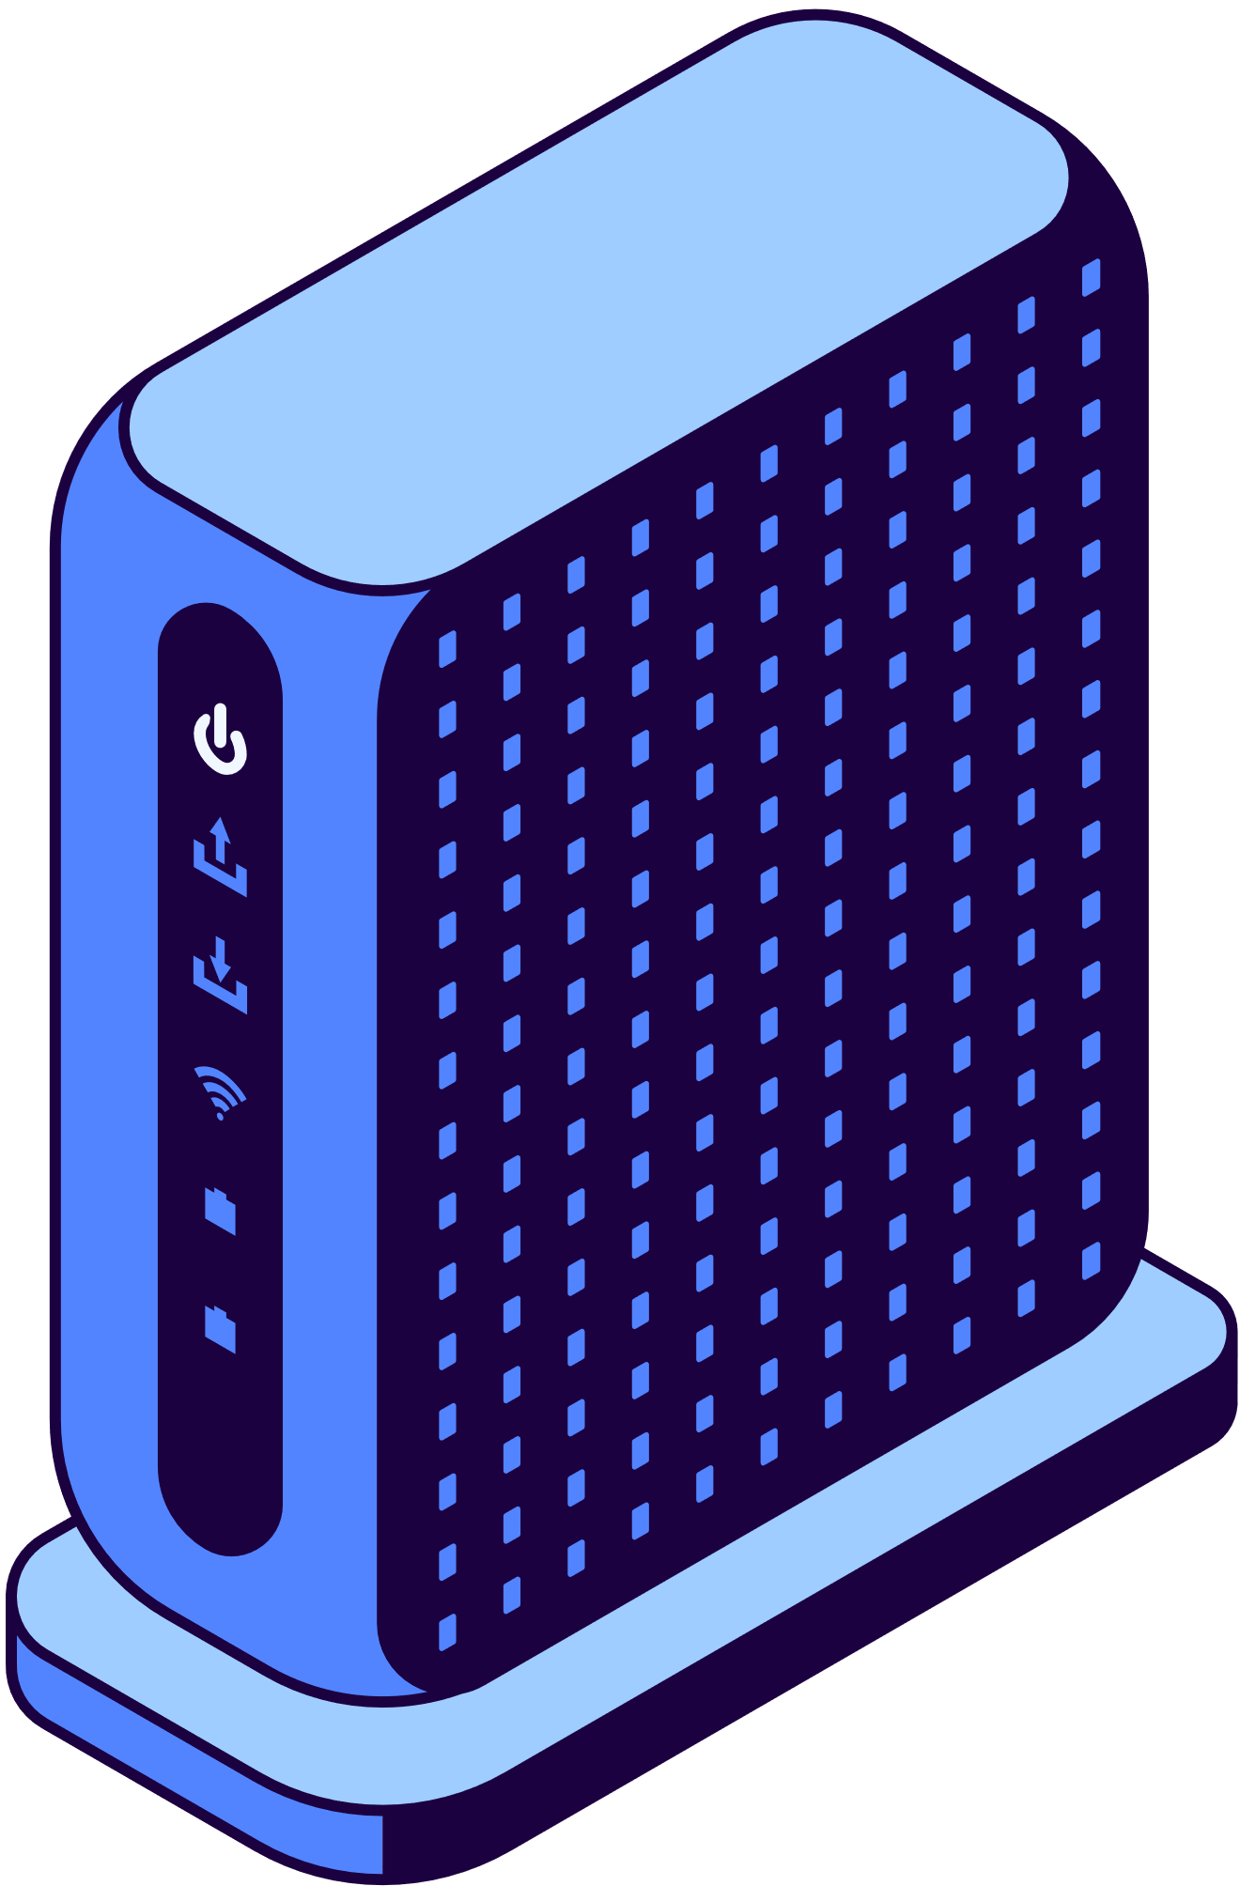
Visualizer Features
Interactive Sorting Experience
Animated representation of sorting steps
Speed adjustment controls
Dynamic input (array size and values)
Option to view algorithm code or pseudo-code alongside animation

Slide 7


Technical Stack
Language: Python
Libraries Used:
Tkinter – for building the GUI interface
Time – to control animation delays
Random – to generate randomized data arrays
itertools (IT) – for efficient looping and iteration
Animation Approach:
Sorting steps are animated by updating the canvas with colored bars representing values. Delays between steps (via time.sleep) create smooth visual feedback during sorting.

Slide 8
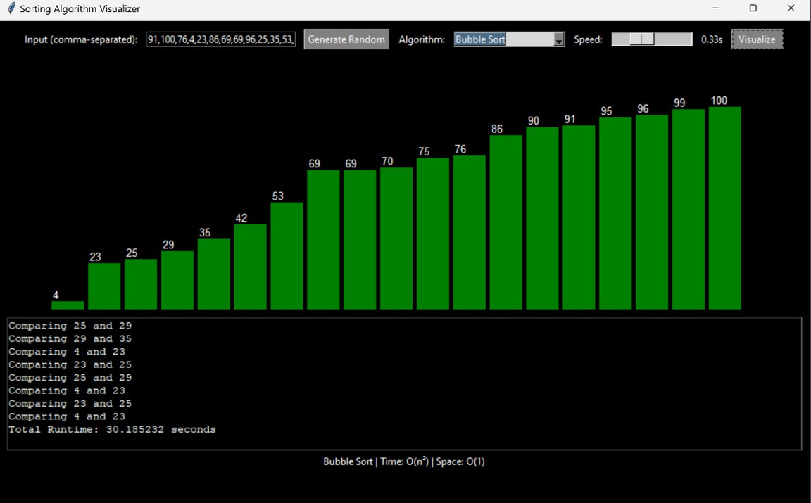
Demo and Screenshots
Bubble Sort in Action
Real-time animation with comparisons, runtime, and complexity displayed.

Slide 9

Bubble Sort – Visual & Analysis
Theoretical Analysis:
Time Complexity: O(n²) worst & average, O(n) best (already sorted)
Space Complexity: O(1) (in-place)
Empirical Observation:
Sorting 18 elements took ~30 seconds at 0.33s speed/frame
High number of comparisons and swaps observed in unsorted input

Slide 10

Challenges Encountered
Real-Time Rendering:
Displaying large arrays smoothly without freezing or flickering was a key challenge.
Synchronization with Algorithm Logic:
Timing animations precisely with comparisons and swaps required careful coordination.
User Interface Clarity:
Designing an intuitive layout that clearly shows input, progress, and results was essential for usability.

Slide 11
Future Enhancements
Add more algorithms (e.g., Shell, Radix)
Mobile and tablet support
Faster, smoother animations
Interactive tutorials and quizzes

Slide 12
Conclusion
Built an interactive sorting algorithm visualizer
Helped clarify how algorithms work step-by-step
Visual tools boost understanding and engagement
Questions or feedback?

Slide 13

Thank You!
Get In Touch
With us

