Slide 1
Source Code Management Project
Team Details: Mohak Taneja, 2410991377
Harsh Chaudhary, 2410991317
Harshit Katiyar, 2410991330
Faculty Coordinator: Dr. Sunil Gupta
:
Chitkara University Institute of Engineering and Technology,
Chitkara University, Punjab

Slide 2
Table of Contents
Introduction
Problem Statement
Technical Details
Key Features
Project Highlights
Conclusion
References/Links used

Slide 3
Introduction
Title of our Project – An Automobile Website
Team members – Harsh Chaudhary
Harshit Katiyar
Mohak Taneja
Our goal is to work on git and github and to create a website to discover the latest trends, news, updates from the world of cars and make a community.

Slide 4
Problem Statement
The following points are the issues often faced :
Complex Navigation: Many users find it difficult to navigate automobile websites due to cluttered interfaces, unclear menus, and excessive dropdown options. This can make finding specific information like car models, prices, or services challenging.
Outdated Information: Users often find outdated car models, incorrect prices, or expired promotions, which reduces trust in the site's credibility.
Poor Comparison Tools: Many users look to compare multiple vehicles, but not all websites offer easy-to-use or comprehensive comparison tools, which can hinder decision-making.
Limited Search Functionality: Some websites do not offer advanced search filters, making it difficult for users to refine searches based on preferences like price, fuel type, or vehicle features..

Slide 5
Technical Details
GIT – Git is a version control system that tracks changes in code, while GitHub is a collaborative platform for storing, sharing, and managing Git repositories. Together, they streamline teamwork, code management, and deployment in software development projects.
HTML – HTML is used to create the basic structure and content of a webpage. It consists of a series of elements, represented by tags, which are used to wrap around content and apply meaning to it. HTML tags are used to define headings, paragraphs, images, links, forms, tables, and other elements that make up a webpage.
CSS – CSS is used to control the layout, visual styling, and user experience of a website. It is used to separate the presentation of a document from its structure, which is defined in HTML. CSS is used to add colors, fonts, spacing, and other visual effects to a webpage, making it more visually appealing and user-friendly.
Java-script - JavaScript is a programming language that is used to add interactivity and dynamic effects to a website. It is executed on the client-side (in the user's web browser) and is used to create interactive web pages, web applications, and mobile applications.

Slide 6
Key Features
Version Control: Tracks changes in code and allows reverting to previous versions if needed.
Collaboration: Enables teams to work together seamlessly by merging changes and resolving conflicts.
Branching and Merging: Allows experimentation with different features or ideas without affecting the main codebase.
Hosting Repositories: Provides a centralized platform for storing and sharing code.
Issue Tracking: Helps manage bugs, tasks, and enhancements efficiently.
Pull Requests: Facilitates code review and collaboration before merging changes.
GitHub Pages: Offers free hosting for static websites directly from repositories.

Slide 7
Key Feature of our Website
1. Modern and Sleek Design:
The website features a clean and responsive layout with a minimalist aesthetic. The black background and high-quality car images give it a sleek, automotive-focused design that resonates with car enthusiasts.
2. Interactive Car Body Shapes Section:
A section focused on car body shapes, giving users insight into various designs and their features. This helps users understand more about the aesthetic and functional aspects of different car models.
3. Responsive Design:
The site is fully responsive, ensuring that it works seamlessly across desktop, tablet, and mobile devices. Users can navigate the site easily no matter which device they use.
4. Car Gallery:
A gallery section that showcases stunning images of different car models, especially featuring iconic cars like the Porsche 911, adding a visual appeal to the site and providing users with a more immersive experience.

Slide 8
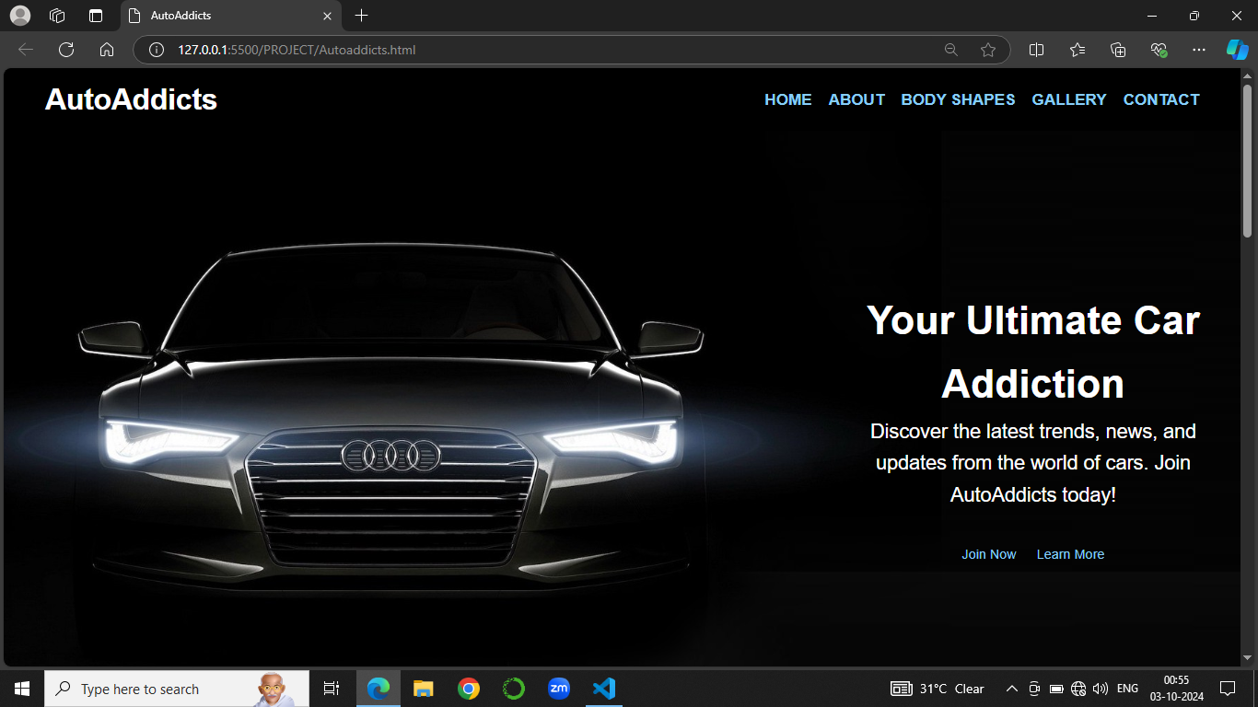
Project Highlights

Slide 9
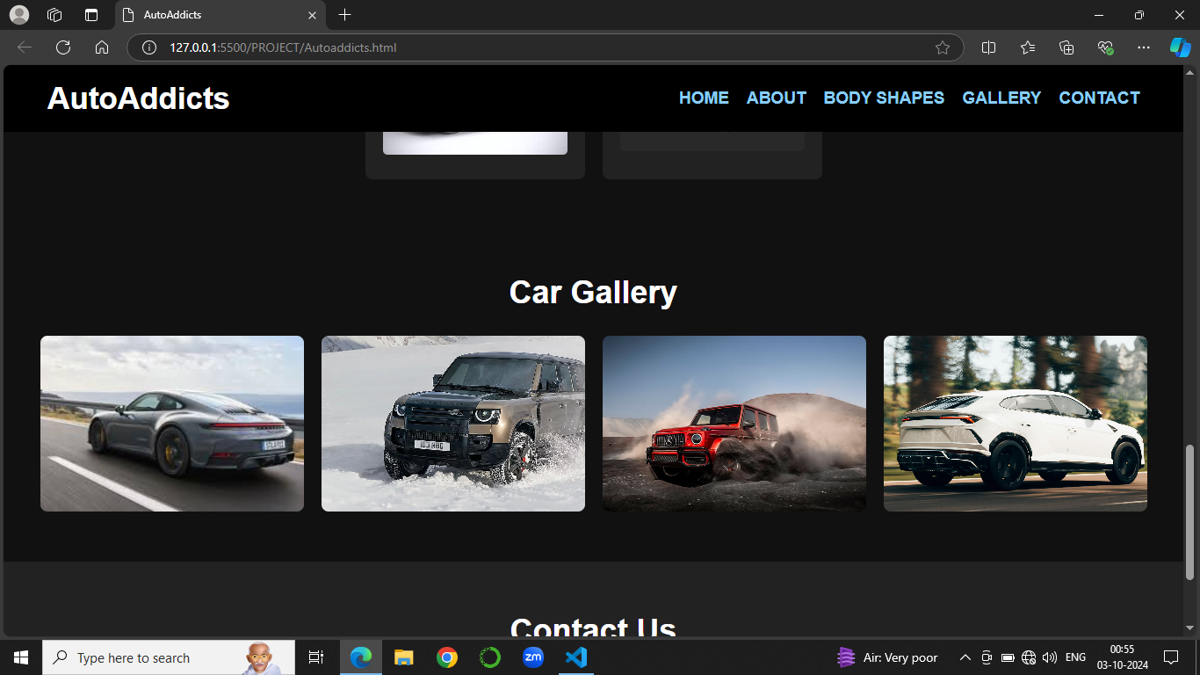
PROJECT HIGHLIGHTS

Slide 10
Conclusion
“AutoAddicts” is your ultimate destination for staying updated on the latest trends, releases, and innovations in the automobile industry. From exclusive news on cutting-edge technology to insights into iconic car models, AutoAddicts caters to all car enthusiasts, delivering fresh, relevant content. Whether you're passionate about electric cars, autonomous vehicles, or high-performance sports cars, AutoAddicts brings you closer to the world of automobiles.
Stay informed, explore the future of driving, and fuel your automotive passion with AutoAddicts.

Slide 11
References/Links used
https://github.com/dashboard
https://www.jaguar.in/index.html
https://motoroctane.com/#google_vignette

Slide 12


