Slide 1
SYSTEMS THINKING
Systems Thinking
for Software Developers
Seeing the systems inside and around our code.
1
Notes:
Let the title sit for a moment. Do not define systems thinking yet.

Slide 2
OPENING
A one-line change. Three weeks later.
AN AFTERNOON, TOPS
if (ready) ship();
3 WEEKS
The line was never the whole problem. Everything around it was.
2
Notes:
“A one-line change. You were sure: an afternoon, tops. It shipped three weeks later. You have been there.”
“Here is the strange part: the line was never the whole problem. Everything around the line was.”
Keep this calm. It is recognition, not a dramatic incident story.

Slide 3
OPENING
A field we already partly know
Ecology
Economies
Organisations
Cities
Software engineers already trace…
dependencies
queues
feedback
Formal systems thinking gives us useful names—and a wider boundary.
Sources: Donella Meadows; MIT OCW 15.871
3
Notes:
“There is a whole field that studies why systems keep behaving a certain way, even when the people inside them are trying to improve them.”
Systems thinking is commonly applied to ecology, economies, organisations, cities, management, and product design.
“Software engineers are not starting from zero. We already trace dependencies, watch queues, build feedback into tests and monitoring, and expect one change to affect another part of the system.”
“Formal systems thinking gives us useful names. More importantly, it teaches us to choose a wider boundary.”

Slide 4
OPENING
Keep following the effect
Code
Delivery
AI
Product
People
Different tool each time. Same move: do not stop tracing too early.
The vocabulary is not the test.
4
Notes:
“We usually stop tracing when we find the code path. Today, we keep going—from the code all the way to the people who live with what it changes.”
“Do not worry about collecting five new terms. Notice the move: each time, we keep following the effect.”
Promise better recognition and better questions, not a fix for every system in 25 minutes.

Slide 5
CODE · NAME IT
Code
Delivery
AI
Product
People
Feedback loops
The result comes back
and affects what happens next.
Plain idea first. Formal name when the behaviour is visible.
5
Notes:
“A feedback loop happens when the result comes back and affects what happens next.”
Keep the definition short. The example will make it concrete.

Slide 6
CODE · RECOGNISE IT
Code
Delivery
AI
Product
People
You have already seen a result feed itself
Fork bomb
Infinite re-render
Render
State changes
1 2 4 8…
6
Notes:
Flash the fork bomb and infinite re-render quickly. The audience only needs to recognise the shape: a result feeds the next round.
Do not turn either example into a mini-lecture.

Slide 7
CODE · EXPLAIN IT
Code
Delivery
AI
Product
People
A reasonable retry can become a reinforcing loop
More failures
REINFORCING FEEDBACK LOOP
More retries
More load
What comes back and changes what happens next?
Source: Google SRE, Addressing Cascading Failures
7
Notes:
Build the retry loop in ordinary words: more failures lead to more retries; retries add load; more load creates more failures.
“One retry can be sensible. When every failed request creates another request, the recovery action adds load to the thing already struggling.”
“Someone wrote that retry. It was the right call—retrying a flaky call is good engineering. The loop is what turned a good call into a bad day.”
Then name it: a reinforcing feedback loop.
Carry forward: “What comes back and changes what happens next?”
Transition: “In running code, a loop can happen in seconds. In delivery, the effects can take weeks, which makes them much easier to miss.”

Slide 8
DELIVERY · NAME IT
Code
Delivery
AI
Product
People
Stocks, flows, and delays
Stock
Flow
Delay
Something that piles up.
What adds to it or removes from it.
The wait before we see the result.
8
Notes:
“A stock is something that piles up. A flow adds to it or removes from it. A delay is the wait before we see the result.”
Use simple examples: backlog, open pull requests, a test queue, and work that looks done but has not been tested end to end.

Slide 9
DELIVERY · RECOGNISE IT
Code
Delivery
AI
Product
People
Think about the software projects you have worked on
How often did they finish
when you first expected them to?
Always
Usually
Sometimes
Rarely
Never
Quick show of hands
9
Notes:
Show of hands: “Think about the software projects you have worked on. How often did they finish when you first expected them to?”
Ask in order: Always → Usually → Sometimes → Rarely → Never.
“Interesting. We are good engineers. We plan, estimate, track work, and learn from previous projects. So why is this still so hard?”
Do not blame planning, managers, or engineers. Let the question lead to the diagram.

Slide 10
DELIVERY · EXPLAIN IT
Code
Delivery
AI
Product
People
A plan cannot show work we do not know is coming back
hidden stock
discovery flow
Work still
to do
Work looks
complete
Problems not
found yet
Rework
delay before discovery
Where does work keep piling up, and why do we only notice when we’re already late?
Source: MIT OCW ESD.36, Lecture 7: The Rework Cycle
10
Notes:
Start with “work still to do” and “work looks complete.” Reveal “problems not found yet” as the hidden stock, then the delayed return as rework.
“A plan can show what we intend to finish. It cannot show work we do not yet know is coming back.”
“Someone marked that work done. They were not wrong—it looked done. The rework was hiding where no plan could show it.”
Treat the MIT rework cycle as a model to investigate, not proof that one mechanism explains every late project.
Carry forward: “Where does work keep piling up, and why do we only notice when we are already late?”

Slide 11
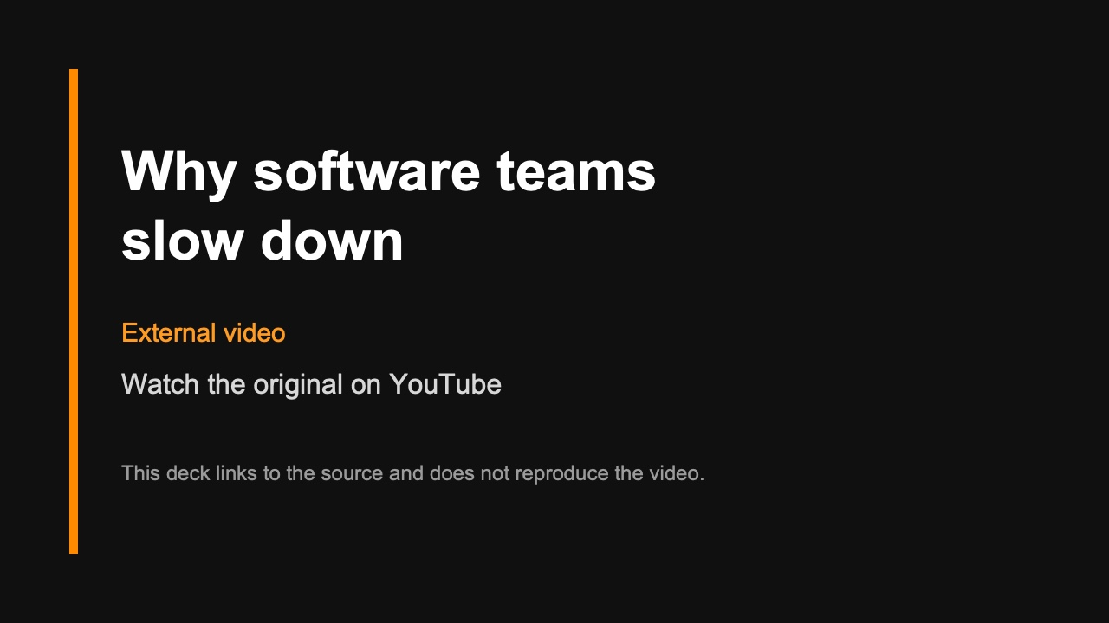
►
Notes:
Play the embedded Uncle Bob video.
Do not add a spoken summary, transcript, extracted lesson, or interpretation. Let the video play and continue.
Transition: “Now imagine we make one flow much faster: creating code. Does the whole delivery system become faster with it?”

Slide 12
AI · INTERLUDE
Code
Delivery
AI
Product
People
A force across the system
AI can speed work across the path
Code
Delivery
Product
People
Making one step faster helps until another step becomes the limit.
That limiting step is the bottleneck.
12
Notes:
“AI is not another boundary outside Delivery. It is a force that can speed up parts across the system.”
“Making one step faster helps until another step becomes the limit. That limiting step is the bottleneck.”
Keep the claim local: teams and workflows differ.

Slide 13
AI · RECOGNISE IT
Code
Delivery
AI
Product
People
Three quick questions
1
Who uses AI while coding?
2
Who feels writing code became faster?
3
Who feels reviewing, understanding, testing, and shipping became equally faster?
Watch where the hands change.
13
Notes:
Show of hands:
1. “Who uses AI while coding?”
2. “Who feels writing code became faster?”
3. “Who feels reviewing, understanding, testing, and shipping became equally faster?”
Pause and let the pattern in the room be visible.

Slide 14
AI · EXPLAIN IT
Code
Delivery
AI
Product
People
The bottleneck moves
new constraint
Understand
and review
Test and
integrate
Run and
maintain
Create
Code creation is one flow—not the whole outcome.
What became faster, and what became the new bottleneck?
14
Notes:
Walk through Create → Understand and review → Test and integrate → Run and maintain. Widen only the first flow.
“Code creation is one flow, not the whole outcome. If later steps do not improve too, the constraint moves and work waits somewhere new.”
“Someone accepted that AI-generated pull request. Faster was the whole point. The waiting did not vanish—it moved to the reviewer.”
Carry forward: “What became faster, and what became the new bottleneck?”
Transition: “Even if we make the whole path faster, we still have another question: did the software help anyone?”

Slide 15
PRODUCT · NAME IT
Code
Delivery
AI
Product
People
The loop that steers
CODE
PRODUCT
Reinforcing
Balancing
The loop amplifies the change.
Compare the result with the target—
then act to close the gap.
15
Notes:
“Code showed us a loop that amplifies. Product gives us a loop that can steer.”
“A balancing loop compares what is happening with what we want, then acts to close the gap.”

Slide 16
PRODUCT · RECOGNISE IT
Code
Delivery
AI
Product
People
Think of a feature your team shipped successfully
It worked. It was released. The ticket was closed.
How did you know
it actually helped anyone?
Take a moment. No hands needed.
16
Notes:
Silent reflection: “Think of a feature your team shipped successfully. It worked. It was released. The ticket was closed. How did you know it actually helped anyone?”
Pause. No hands.
“Someone closed that ticket. It shipped, it worked, the ticket was green. Nobody was told whether it helped a single user.”

Slide 17
PRODUCT · EXPLAIN IT
Code
Delivery
AI
Product
People
The user’s response closes the loop
OPEN
CLOSED
Build
Ship
Close ticket
Build
and ship
User
response
Next
decision
One move: connect one useful signal to a decision somebody can make.
What changed for the user—and how will that change what we do next?
Source: Google SRE, Service Level Objectives
17
Notes:
Show the open path: Build → Ship → Close ticket. Then show the return path: user response → next decision → next change.
“Shipping tells us what we did. The user’s response tells us what changed. When that response shapes what we do next, that is a feedback loop.”
One leverage demonstration: “The move is not to add another dashboard. Wire one useful signal back to a decision that somebody can actually make.”
Carry forward: “What changed for the user—and how will that change what we do next?”
Transition: “Code does not decide to retry. Work does not decide it is done. AI does not decide a pull request is ready. People make those choices inside the structure around them.”

Slide 18
PEOPLE · DESTINATION
Code
Delivery
AI
Product
People
Every system today already had a person in it
wrote the retry
People
marked it done
accepted the PR
closed the ticket
Each made a sensible choice inside the structure around them.
18
Notes:
“Every system today already had a person in it—the one who wrote the retry, the one who marked the work done, the one who accepted the pull request, and the one who closed the ticket.”
“Each made a sensible choice. That is why we end here.”
“Structure shapes behaviour” is the generalisation of the choices the audience has already seen, not a new stop.

Slide 19
PEOPLE · RECOGNISE IT
Code
Delivery
AI
Product
People
Who does everyone call when something breaks?
What happens
when they’re not there?
Keep the answer to yourself.
19
Notes:
Private reflection: “Think of the person everyone calls when something breaks. What happens when they are not there?”
Do not ask anyone to identify the person or confess a team problem aloud.

Slide 20
PEOPLE · EXPLAIN IT
Code
Delivery
AI
Product
People
Rescue can deepen the dependency
Only one person
understands it
DEPENDENCE
GROWS
The deeper
improvement waits
They rescue
the incident
Immediate
relief
seconds → weeks → users → somebody’s Saturday
What behaviour does this setup reward—even by accident?
Sources: Google SRE Postmortem Culture; work-system research synthesis
20
Notes:
Walk through the hero loop: one person understands the system → they rescue the incident → immediate relief → deeper improvement waits → dependence grows.
“The engineer did something valuable. Thank them. But if the same person must save the system every time, the rescue is also telling us something about the system.”
“The retry cost seconds. Hidden rework cost weeks. An open product loop can cost users. A hero system can cost someone their Saturday.”
Do not diagnose burnout from one example. The warning sign is repeated dependence on the same people’s time and attention.

Slide 21
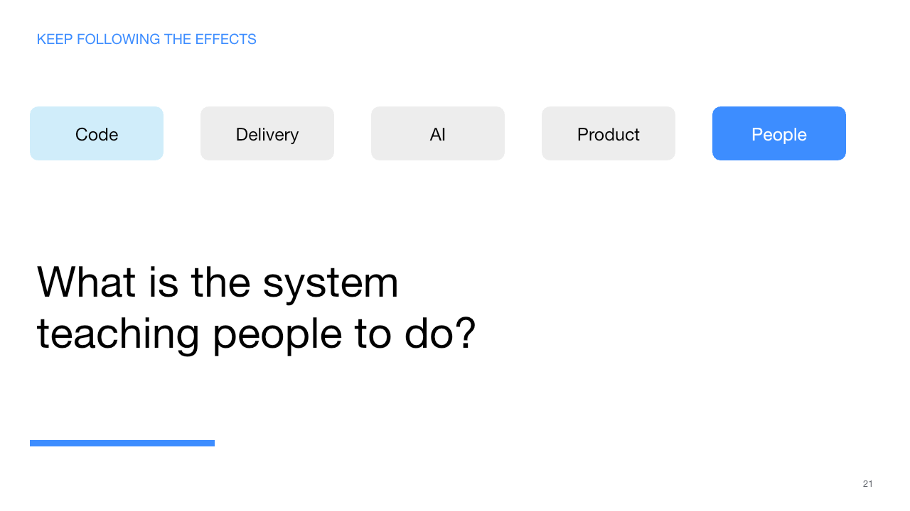
Notes:
Let the completed journey sit behind the question.
“What is the system teaching people to do?”
Do not recap the five definitions or five carry-forward questions.
Final spoken line: “Start with the code. Follow what it changes. End with the people.”
Then stop.

