Slide 1
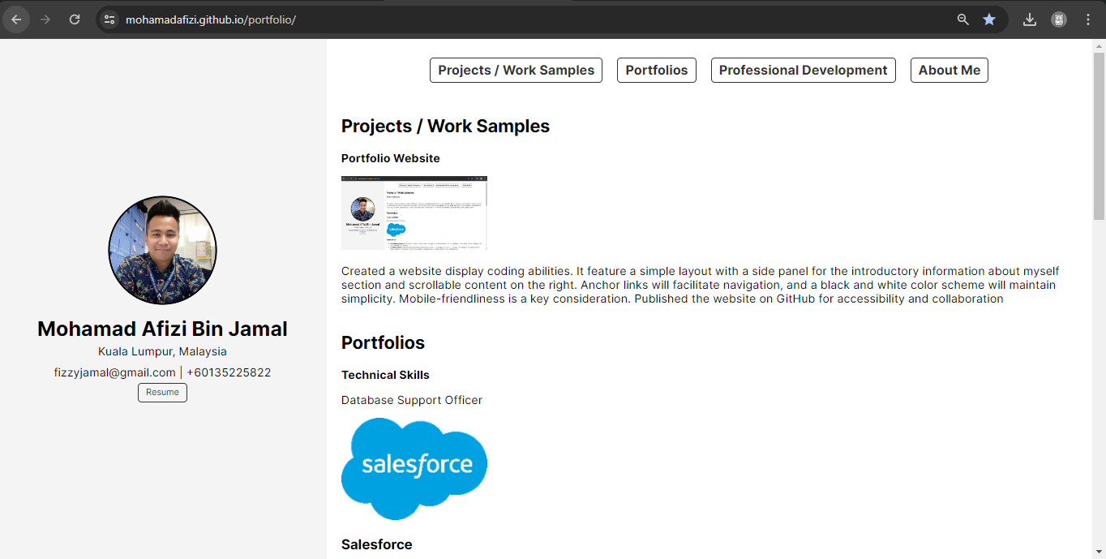
Portfolio Website

Slide 2

Salesforce

Slide 3

Evergiving

Slide 4

Civis

Slide 5

Asana

