Slide 1
OurHotel
Hotel Checkout Assignment for AirAisa

Slide 2
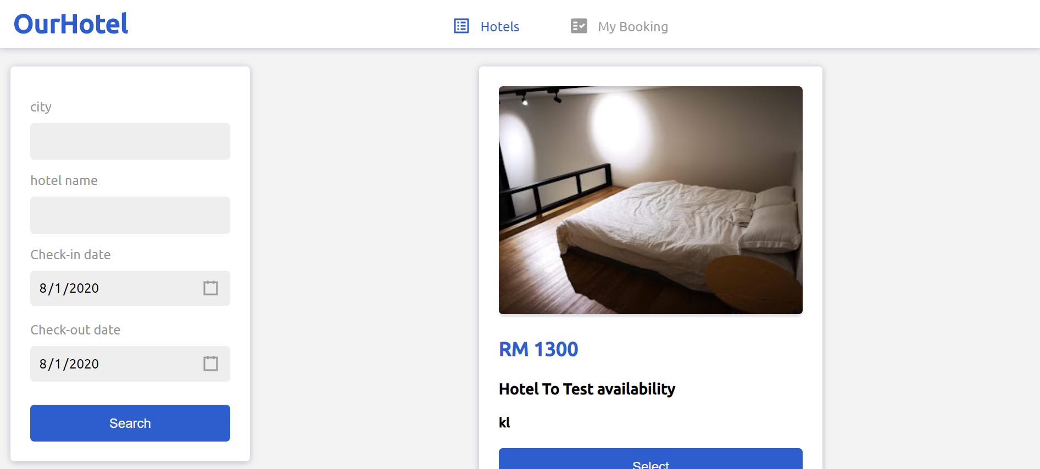
Introduction for UI
My Booking tab To search by reference number (the reference number is ID).
search widget
Hotel list

Slide 3
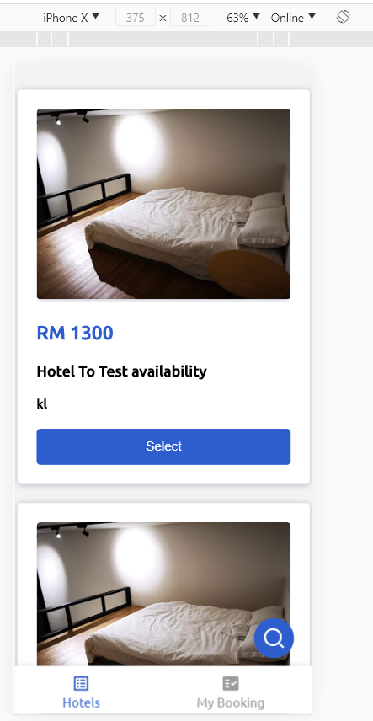
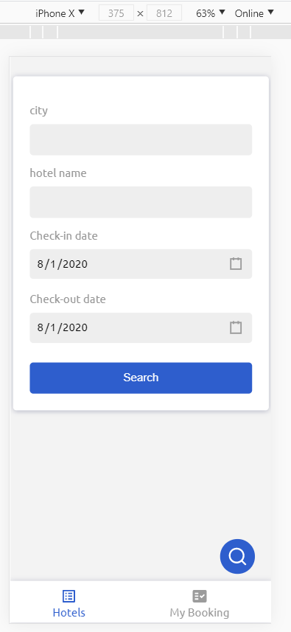
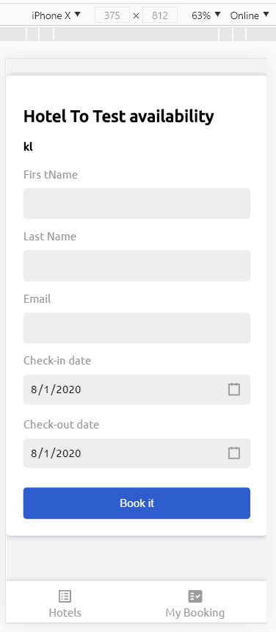
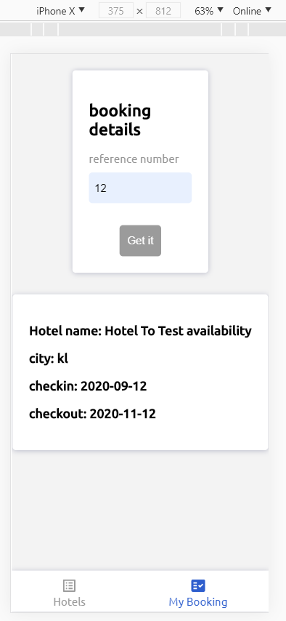
the app is responding for mobile

Slide 4
File structure
// import ---------------------------------------------
function {
// state ---------------------------------------------
// API calls-------------------------------------------
// Events handler--------------------------------------
// Life Cycle events------------------------------------
// ender components-----------------------------------
}
Tech stack
Front-end
ReactJs
React’s Hooks
SASS
TypeScript
Webpack
Back-end (not completed but you can check the code)
Nodejs
Express
sequelize
Postgrasql

Slide 5

Titlebar.tsx
Main component
MainList.tsx
Menu.tsx
Titlebar.tsx
SearchWidget.tsx
Cards.tsx
HotelList.tsx

Slide 6
Notes:
I mocking response for all APIs and but It’s flexible so we can change the environment and move it to PROD
I’ve built apis service, but I could not complete it because it’s going to take time, but you can check the code to.
I did the best to build high-performance app by using (React’s hooks – SASS - memo – did not use many library- make reusable component like card, list, dynamic menu and more)
I made a brief about the app, and the code is clean and clear to check ☺
fetch booking details by passing product id (I didn’t generate a reference number)
Please if you want me to add anything else or anything missing just let me know and I’ll back to you soon
Thank you so much for your time. I am looking forward for your feedback

