Slide 1

SEMEVAL-2026 TASK 9
Multilingual Online
Polarization Detection
A Teacher-Student Knowledge Distillation Approach for Robust Cross-Lingual Generalization
Presented By Group 25:
Mohamad, Eid, Layan, Ata, Yasin

Slide 2
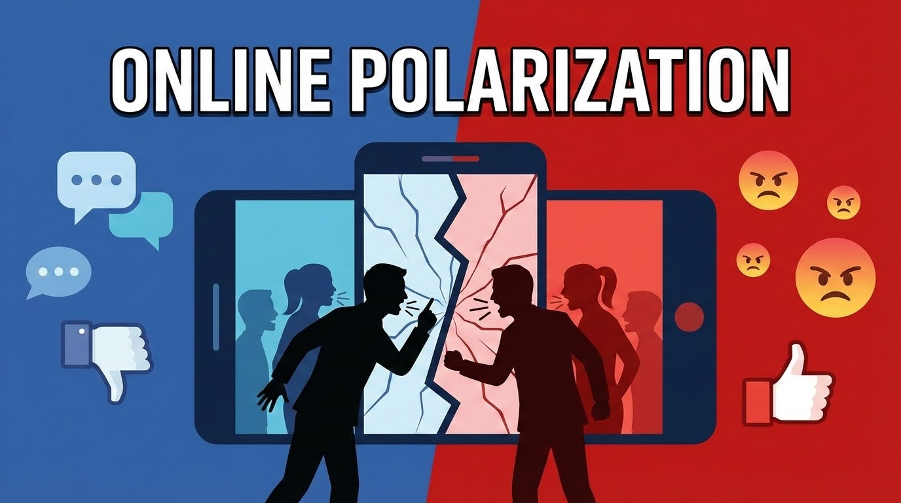
Introduction: Defining Polarization
What is Polarization?
In this project, we define polarization not just as negativity, but as:
•
"Us vs. Them" Framing: Strong in-group/out-group distinction.
•
Hostility: Aggressive posturing towards opposing views.
•
Firmly Held Beliefs: Unwavering ideological stance.
Polarization ≠ Toxicity ≠ Subjectivity
While related, polarization is distinct from general toxicity (insults) or subjectivity (opinions).

Slide 3


The Core Challenge
Multilingual Scale
Resource Imbalance
The task spans 22 languages, including diverse scripts (Latin, Cyrillic, Arabic) and cultural contexts.
High-resource languages (Like English, Spanish, German…etc) dominate the available models, while others lag behind.
Problem: Purely supervised training often fails in low-resource settings where labeled data is scarce.
Solution Strategy: Use a Teacher-Student approach to transfer knowledge from a strong multilingual teacher to a student model.

Slide 4
Related Work: Context & Definitions
Topic-Level Polarization
Toxicity & Discourse
He et al. (2021) proposed PaCTE, measuring polarization by ranking topics based on ideological separation in contextual embeddings.
Nugraha et al. introduced multi-labeled discourse datasets covering toxicity, polarization, and demographics.
Their work showed that auxiliary signals can help, but also highlighted the risk of confounding variables—a key lesson for our project.
Relevance: Motivated our initial interest in topic-based signals (which we later audited).

Slide 5









Related Work: Modeling Foundations
XLM-ROBERTa
Knowledge Distillation
BERTopic
Conneau et al. showed that scaling multilingual pretraining improves cross-lingual transfer.
Hinton et al. (2015) formalized Teacher-Student distillation. Zhang et al. (2023) applied this to cross-lingual stance detection.
Grootendorst (2022): extracting topics using Transformer embeddings. Used in our (failed) Teacher B experiment.

Slide 6
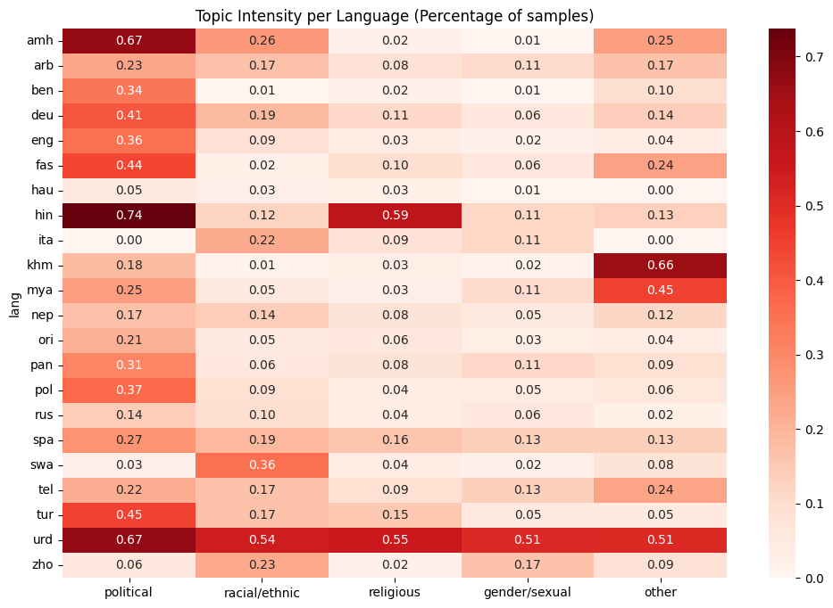
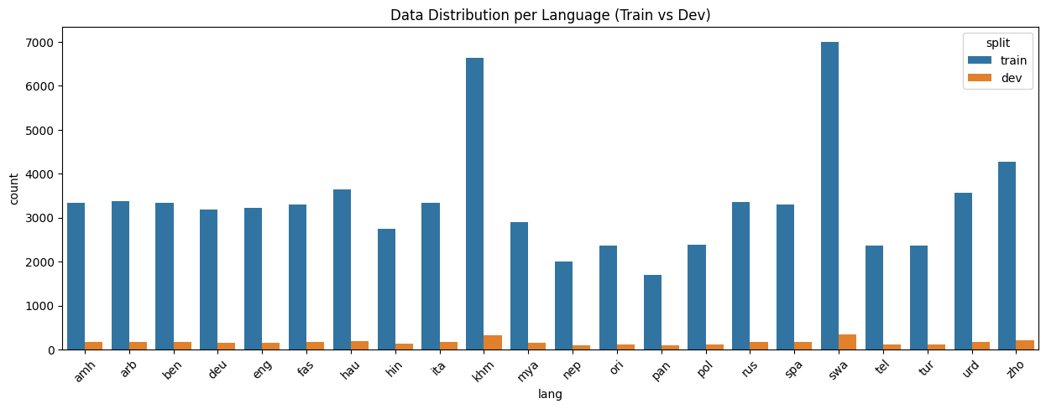
Methodology: Dataset & Reproducibility
The POLAR Dataset
We used the official training folder (it included 22 languages files, then we merged them into one dataset (master_dataset.csv).
•
Total Rows: 77,368
•
Train Split Used: 73,681 rows
•
Languages: 22 distinct languages
Key Constraint: The official dev set was unlabeled. We created an internal validation split.

Slide 7





Methodology: The Translation Pipeline
Goal: Create a column to allow the Teacher (trained on 7 langs) to supervise all 22 langs.
Parallel Sharding
The Logic
Failure Handling
Distributed across 5 team members × 2 sessions.
If lang is in Teacher set → Copy text.
5,768 rows failed translation (rate limits/markers).
Else → Translate to English.
Split via logic.
Strategy: Retain rows, use hard labels only.

Slide 8
Methodology: Synthetic Data (Phase 1)
Augmentation Strategy
Critical Safeguard: Group-Aware Splitting
To strengthen the Teacher model, we generated synthetic examples focusing on the polarized class.
group_id = source_row_id (if synthetic)
•
Seed Pool: 9,040 polarized rows from train split.
•
We ensured that a seed row and its synthetic paraphrases always ended up in the same split (Train or Val) to prevent data leakage.
Method: LLM-based Paraphrasing & Rewriting.
•
Output: 26,121 new synthetic rows.

Slide 9


Methodology: Teacher A (The Expert)
Teacher A: Language Expert
•
Model: XLM-ROBERTa Large
•
Training Data: Carefully selected subset of 7 high-resource languages:
Rationale: These cover diverse scripts (Latin, Cyrillic, Arabic) and typologies (Indo-European, Agglutinative) to maximize transfer capability.

Slide 10

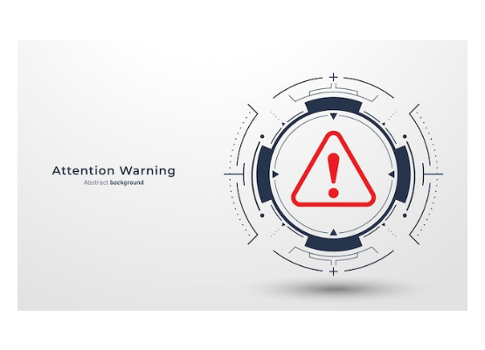
Methodology: The Leakage Lesson
Teacher B (Topic Expert) - DROPPED
We initially implemented a second teacher that operates on both the text and topics. However, we discovered a critical flaw.
•
Observation: Topic vector features were effectively present only for polarized rows.
•
Result: Non-polarized rows often had zero-vectors.
•
Impact: Feature presence became a direct proxy for the label ("Leakage").
Outcome: We discarded Teacher B to ensure honest generalization.

Slide 11
Methodology: Distillation Targets
Generating Soft Targets
The Output
We ran Teacher A inference on the real (non-synthetic) train rows.
We exported the Logits (raw prediction scores) and probabilities.
Constraint: Inference was only run where was available (translated or original).
These were merged back into the master training table as for the student to learn from.

Slide 12
Student Training: Architecture & Design
The Student Model
Input Strategy
We use XLM-ROBERTa Base as our single student model.
Critically, the Student does NOT use the translated English text.
•
Purpose: Inference efficiency. The Large teacher is too heavy for rapid, real-time deployment.
Input = Original Multilingual Text (raw)
•
Knowledge Transfer: The Base model learns to mimic the complex decision boundaries of the Large teacher.
This ensures the model learns native patterns in the 22 target languages, rather than relying on the translation artifact used only for teacher supervision.
•
Test-Time Behavior: "Teachers are discarded." Only this student model is used for the final submission.

Slide 13

Student Training: Setup & Split
Internal Split Strategy
We created a custom internal train/validation split from the official labeled training data.
The Validation Challenge
The official development set provided by organizers was unlabeled.
•
Fixed Seed: To ensure reproducibility across runs.
•
Label Stratification: To maintain class balance in both splits.
This meant we could not use it for hyperparameter tuning or early stopping.
•
Group-Aware: Although used primarily for synthetic data, our pipeline respects group IDs to prevent future leakage.

Slide 14


Student Training: Final Data Structure
Enriched Training File
We transformed the original dataset into master_with_teacherA_logits.csv, adding critical signals for distillation:
~/data/processed/master_with_teacherA_logits.csv
row_id | text | label | teacherA_p1
00008b2f | RT @user: This is absol... | 0 | 0.00034
0001a2c9 | عاجل: يجب أن نقف صف... | 1 | 0.99821
0002c9a1 | The debate was clearly... | 1 | 0.87510
0003d1b5 | No me importa lo que... | 0 | 0.12401
0004e8f2 | Zcela souhlasím s tím... | 0 | 0.00192
0005f1a9 | Это предательство... | 1 | 0.95430
•
row_id Deterministic hash for safe splitting (by organizers).
•
teacherA_p1 Teacher's soft probability (0.0 - 1.0).
•
text_en Used only for loss condition check.
TRAINING SIGNAL
Target = Hard Label + Soft Logits

Slide 15


Student Training: The Loss Function
We employ a Mixed Supervision objective that combines ground-truth hard labels with teacher soft targets.
: Cross Entropy
: KL Divergence
Standard classification loss against the hard ground-truth label (Polarized vs Not Polarized).
Distillation loss minimizing the difference between the Student's output and the Teacher's probability distribution.
Goal: Correctness.
Goal: Mimicry & Generalization.

Slide 16
Student Training: "Partial Distillation"
The Solution: Conditional Loss
The Problem
We implemented a dynamic switch in the training loop:
•
If Translation Exists:
Apply Hard Label Loss + Distillation Loss.
Due to translation failures, ~5,700 rows (7.4%) lacked the . required to get a valid prediction from the Teacher.
•
If Translation Missing:
Apply Hard Label Loss Only.
Why this matters: Dropping these rows would have biased the model against harder-to-translate languages. Our method ensures 100% data coverage while maximizing teacher utilization.

Slide 17



Inference & Submission Pipeline
1. Load Student
2. Process Languages
3. Format & Zip
Load the fine-tuned XLM-R Base model (Teacher is no longer needed).
Iterate through all 22 evaluation files.
Generate files with (id, polarization) columns.
Input raw text directly to the model.
Zip for Codabench.

Slide 18
Results: Internal Validation
Training Dynamics
Epoch | Train Loss | Val Loss | Macro F1
1 | 0.4643 | 0.4374 | 0.7910
2 | 0.4129 | 0.4219 | 0.7964
3 | 0.3839 | 0.4255 | 0.8100
4 | 0.3558 | 0.4507 | 0.8089
Key Metrics (Epoch 3)
•
Accuracy: 0.8104
•
Macro Precision: 0.8098
•
Macro Recall: 0.8109
•
PR-AUC: 0.8864
Selected Epoch 3: Best balance of loss and F1 score.

Slide 19
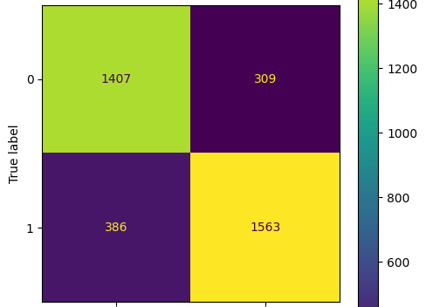

Results: Confusion Matrix Analysis
Breakdown
•
True Negatives (TN): 1407
•
False Positives (FP): 309
•
False Negatives (FN): 386
•
True Positives (TP): 1563
Positive Precision: 0.8349
Positive Recall: 0.8019
The model maintains a balanced performance between detecting polarized content and avoiding false alarms.

Slide 20
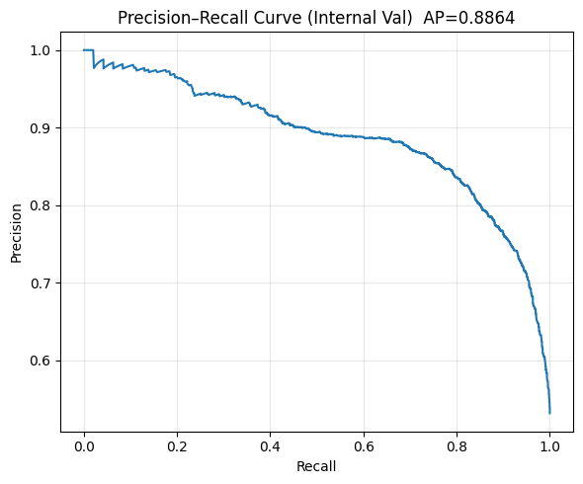
Results: Precision-Recall Analysis
PR-AUC Score: 0.8864
The Precision-Recall curve illustrates the trade-off between precision and recall for different threshold.
A high Area Under the Curve (0.88+) indicates that the model can maintain high precision even as we increase recall, which is crucial for moderation tasks where we want to catch most polarized content without flagging too much benign text.

Slide 21
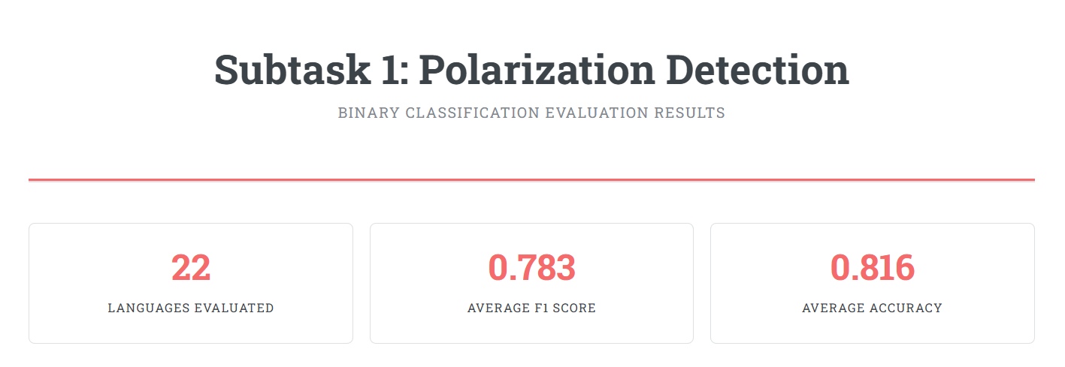
Results: Official Codabench Evaluation
0.783
0.816
AVERAGE MACRO F1
AVERAGE ACCURACY

Slide 22






Discussion: Dataset Constraints
Missing Translations
Unlabeled Dev Set
Rate limits and marker constraints left ~5,700 rows untranslated.
The official dev set had no labels.
Impact: We relied on internal validation, which is a proxy. Threshold tuning on the real target distribution was not possible.
Impact: Reduced distillation coverage for these examples.

Slide 23
Discussion: Architecture Analysis
Advantages
Disadvantages
•
Cross-Lingual Transfer: Works even on languages not seen by the teacher via translation bridge.
•
Translation Noise: External tools introduce semantic drift and lose cultural nuance.
•
Inference Efficiency: Uses only the smaller Student at test time.
•
Heterogeneous Supervision: Mixing hard-only and soft-target losses makes optimization complex.
•
Robustness: Partial distillation handles preprocessing failures gracefully.

Slide 24
Milestone vs. Final System
Milestone Plan | Final System | Reason for Change
Two Teachers (Language + Topic) | Single Teacher (Language A) | Topic Teacher B leaked label information.
13 Languages | 22 Languages (Official Release) | Dataset expansion by organizers.
Full Translation | Partial Translation | Rate limits & safeguards.

Slide 25
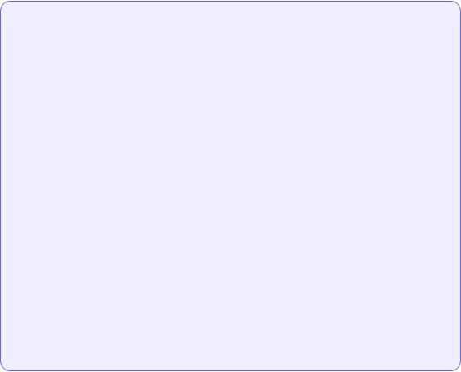
Our Novel Contributions
Our Specific Contributions
•
Partial Distillation Loss: A novel conditional loss function to handle missing translations without discarding data (unlike standard distillation).
Adopted Frameworks
We built upon established foundations (Cited):
•
•
Topic Leakage Audit: We empirically proved that topic vectors act as leaky proxies for polarization in this dataset, refuting the assumption that they add valid context.
Teacher-Student Distillation: Adapted from Hinton et al. (2015) and Zhang et al. (2023).
•
XLM-R Embeddings: Leveraged Conneau et al. (2020) for cross-lingual representation.
•
Group-Aware Sharding: A custom validation strategy to prevent LLM-augmented paraphrases from leaking into test sets.

Slide 26
Limitations & Future Work
Future Improvements
Current Limitations
•
Language-Aware Calibration: Per-language thresholds instead of a global one.
•
Binary Framing: Loses the nuance of graded polarization.
•
Comprehensive Augmentation: Generate hard non-polarized examples, not just using the polarized ones.
•
Proxy Validation: Internal val scores (~0.81) were higher than official (~0.78), indicating distribution shift.
•
Direct Multilingual Teacher: Train teacher to handle more scripts natively to reduce translation dependence.

Slide 27


Conclusion
We addressed the 22-language Polarization Detection task using a Teacher-Student Distillation Pipeline.
Robustness
Performance
Efficiency
Prioritized honest generalization by removing leaky features and handling missing data safely.
Achieved 0.783 Macro F1 on the official evaluation.
Delivered a compact student model suitable for deployment.

Slide 28
Team Contributions
Member | Role & Contribution
Mohamad | System Architecture, Student Training Pipeline, Submission Code
Eid | Synthetic Data Generation (Phase 1), Seed Selection
Layan | Translation Pipeline, Sharding Logic, Integrity Checks
Ata | Teacher A Training, Leakage-Safe Splits
Yasin | Teacher Logits Generation & Export

Slide 29
References
•
Conneau et al. (2020). Unsupervised Cross-lingual Representation Learning at Scale (XLM-R).
•
Hinton et al. (2015). Distilling the Knowledge in a Neural Network.
•
He et al. (2021). Detect and Understand the Polarization in News (PaCTE).
•
Nugraha et al. Multi-labeled Indonesian discourse dataset (Toxicity/Polarization).
•
Zhang et al. (2023). Dual Distillation for Cross-Lingual Stance Detection.
•
Grootendorst (2022). BERTopic: Neural topic modeling with a class-based TF-IDF procedure.

Slide 30
Q & A
Thank you for your attention.

Slide 31


Image Sources
•
https://img.freepik.com/premium-photo/futuristic-classroom-with-robot-teacher-instructing-group-attentive-students_856795-104932.jpg
Source: www.freepik.com
•
https://img.freepik.com/premium-vector/concept-hacker-warning-red-attention-danger-symbol-circuit-board-data-breach-malware-cyber-attack-hacking-security-protection-concept-vector-illustration_974730-1062.jpg
Source: www.freepik.com

