Slide 1


Slide 2
Outlines:
Introduction
Data Collection
Discovery For Data
EDA (Exploratory Data Analysis)
Data Cleaning
Missing value treatment
Outliers Treatement
Preprocessing
Feature Engineering
Feature Encoding
Correlation and VIF
One Hot Encoding
Feature Selection/Feature Importance
Handling Imbalance classes (SMOTETomek)
Handling Imbalanced Classes (NearMiss)
Model Building
Model Evaluation
Finding Best Model

Slide 3
Introduction:
This project focuses on analyzing a bank marketing dataset to understand which customers are more likely to subscribe to a term deposit. The data includes information about clients such as their age, account balance, and the duration of previous marketing calls, and campaign details. Following data modeling steps: preprocessing, exploratory analysis, and building the classification model, our aim is to identify the factors that influence customer decisions in order to build a model that can predict subscription outcomes accurately. This helps improve targeting strategies and supports better decision-making in future marketing campaigns.

Slide 4
Project Phases:
Data Collection
The dataset for this project was taken from the UCI Machine Learning Repository, a well-known source for high quality, and machine learning related datasets. It contains real information from a Portuguese bank’s marketing campaign, where the bank called clients to ask if they would subscribe to a term deposit. In this phase, we obtained the dataset, load it properly on our IDE, and make sure all columns and records were ready for the project’s next steps.
Dataset link: UCI
Used Data Name: bank-full.csv

Slide 5
Discovery For Data
We started by checking the shape of the dataset to see the total number of rows and columns. Next, we saw the data types of all columns, then we listed the names of numeric and categorical columns we are handling separately. Then we saw the statistical summary to understand the distribution of the numeric variables. After that, we described the dataset in more detail, including the number of columns, rows, and the kinds of values stored in each feature. We checked for missing values, unique values, and values each column consists of, we checked the target variable distribution (Imbalanced check), and for convenience we convert month names to month numbers

Slide 6
EDA (Exploratory Data Analysis)
During the EDA phase, we first visualized the class imbalance in the target variable to understand how imbalanced the “yes” and “no” responses were. We then created a pairplot to explore the relationships between some of the main numeric variables. For the categorical features, we visualized the top categories in each column to see which values were most common. We also compared all categorical variables with the target y using bar charts, which helped us observe how each category relates of subscribing to a term deposit.
The Visualizations will be presented as follows:

Slide 7
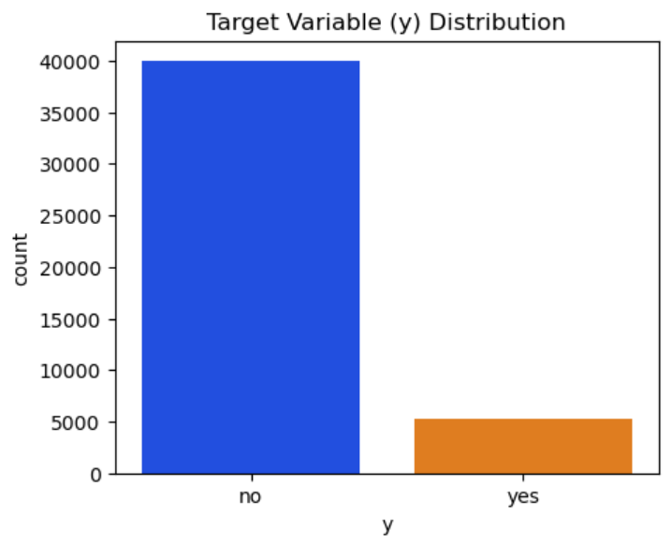
Interpretation: Number of “no” responses is much higher than the “yes” response which shows how imbalance the target column (y) is.

Slide 8
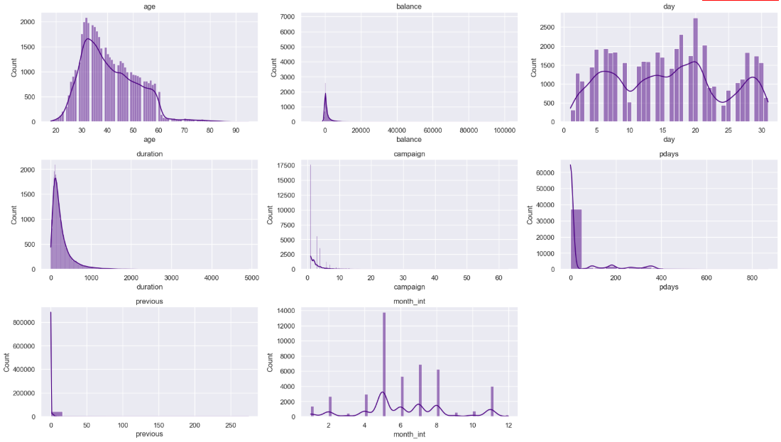
Numeric Variables Pairplot

Slide 9
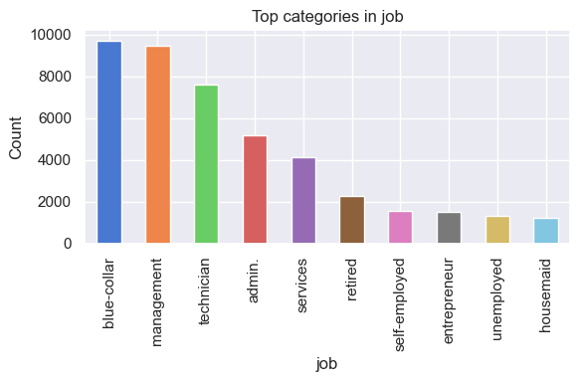

Slide 10
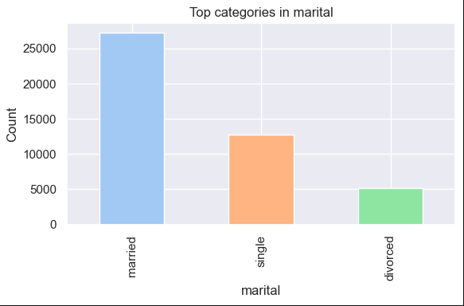

Slide 11
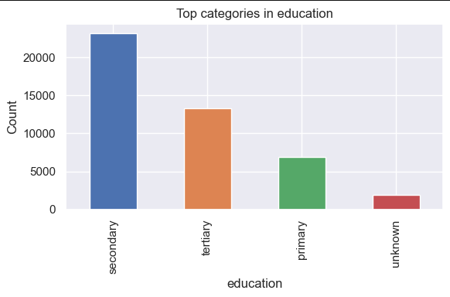

Slide 12
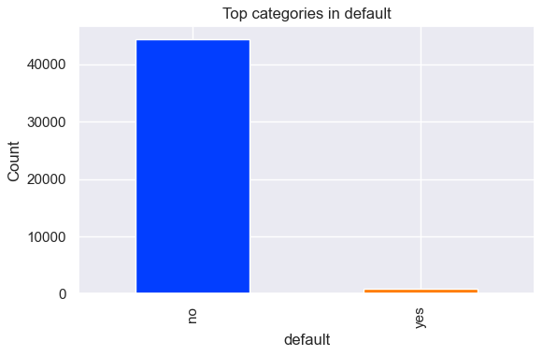

Slide 13
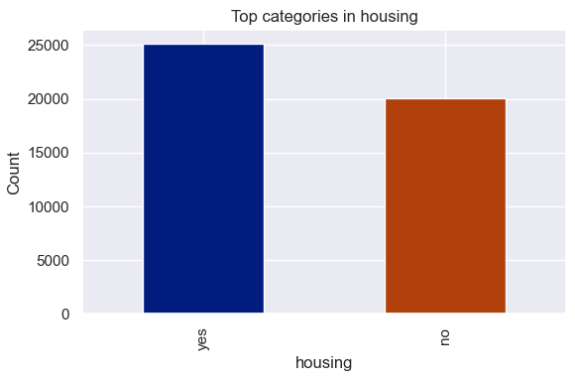

Slide 14
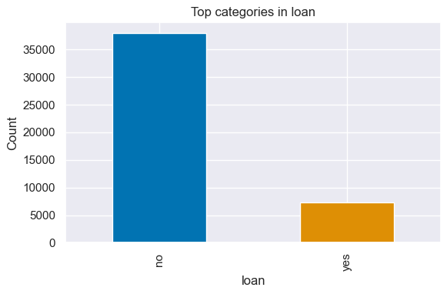

Slide 15
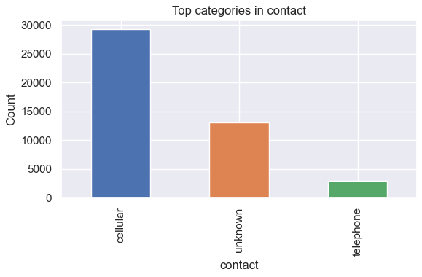

Slide 16
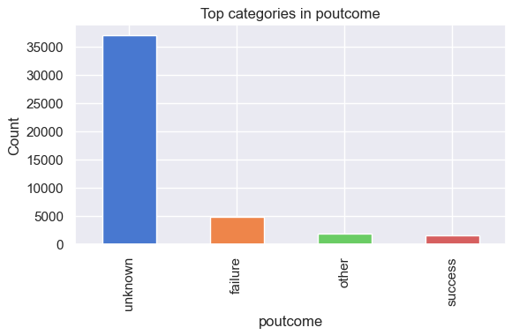

Slide 17
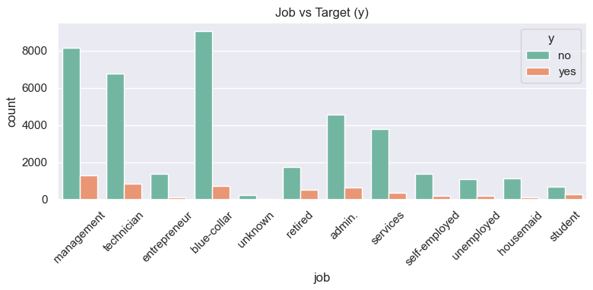
Comparing all categorical variables with the target (y)

Slide 18
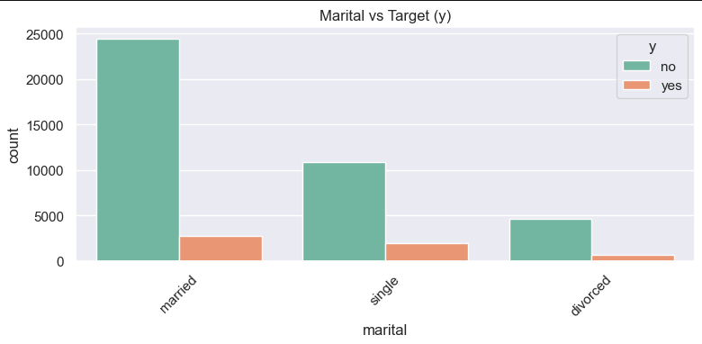

Slide 19
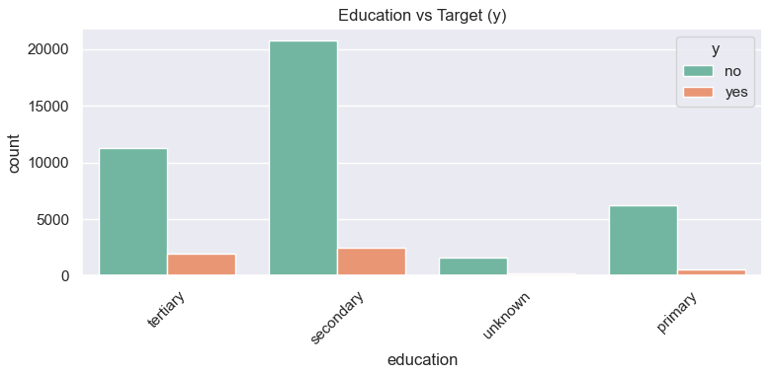

Slide 20
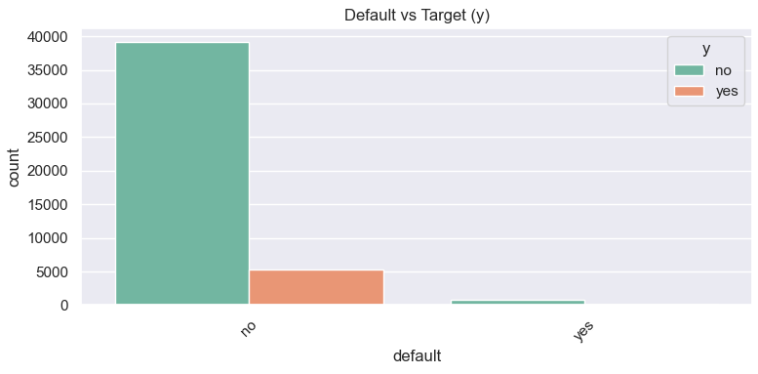

Slide 21
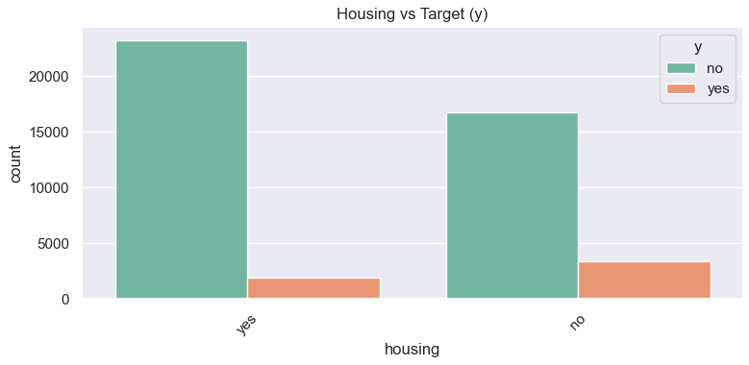

Slide 22
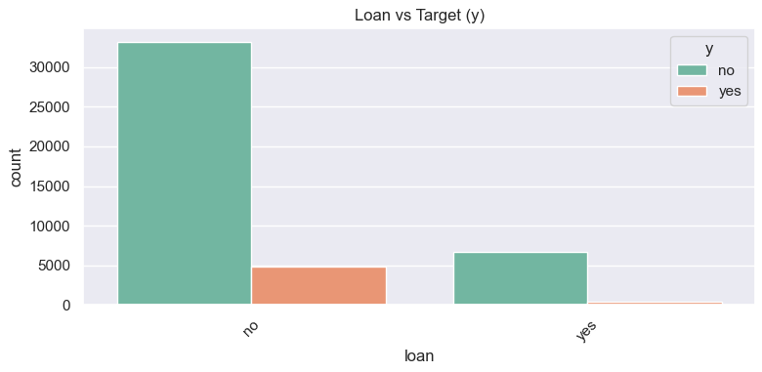

Slide 23
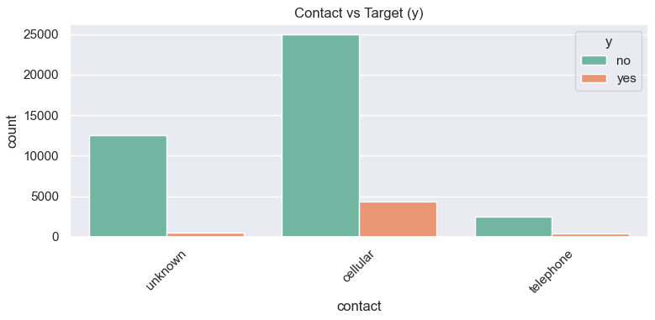

Slide 24
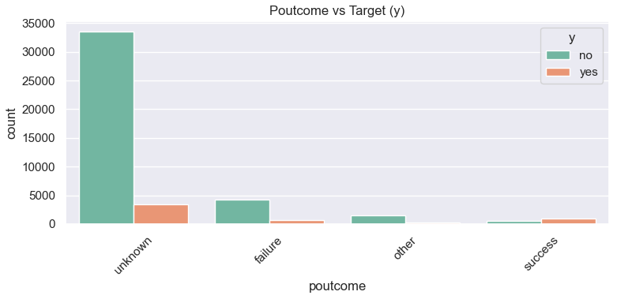

Slide 25
Data Cleaning
In the data cleaning phase, we first handled the missing values, and since this dataset represents missing information using the label "unknown", we counted these values to understand whether they appeared randomly or followed a pattern. The results showed no meaningful pattern, so each column with “unknown” was treated independently. Some “unknown” values were replaced with “other” when they simply represented an unspecified category. For the poutcome column, the value “unknown” actually means the client was never contacted in a previous campaign, so we replaced it with a more meaningful label such as “nonexistent” to avoid confusion and to improve processing.

Slide 26
In the next step, we identified outliers using boxplots, which showed that the balance column had very high values on the upper end that could negatively affect modeling. Based on age distribution shape and IQR, the reasonable upper limit was around 3500, but because bank balances naturally vary among clients, we used a more flexible threshold of 5000. To avoid losing the already small number of positive (“yes”) cases, we removed only the extreme outliers where the client did not subscribe, and kept all records where the balance was high but the client subscribed. This approach reduces noise without harming model performance on the minority class.

Slide 27
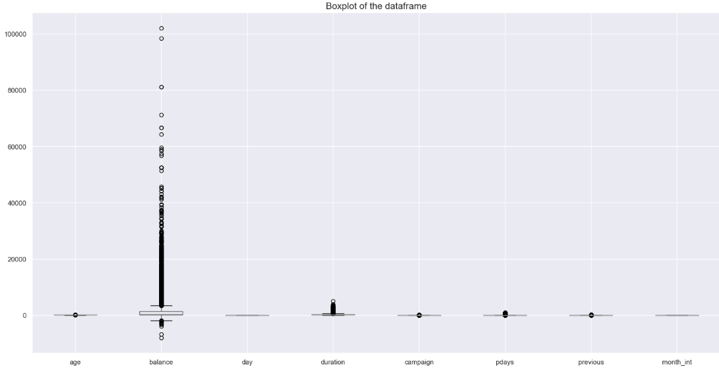

Slide 28
Feature Engineering
This step involves creating or transforming features to help the model understand the data better and improve its performance. In this project, we applied a logical transformation to the day column. Since the days of the month (1–30) do not have a meaningful ordinal weight, using them directly can negatively affect the model. To fix this, we converted the day numbers into week categories. We assumed a simple structure where a month has 4 weeks:
Days 1–7 → Week 1
Days 8–14 → Week 2
Days 15–21 → Week 3
Days 22–31 → Week 4
This transformation allows the model to understand which part of the month the contact happened, instead of treating every day as a separate numeric value.

Slide 29
Feature Encoding
Computers cannot understand text like humans, so categorical columns must be converted into numeric values through feature encoding. In our dataset, we applied encoding to several columns such as marital, education, housing, loan, and the target variable y, converting their categories into numeric labels like 0, 1, 2, or 3.
Additionally, we removed an unimportant feature that was no longer needed after creating its alternative. This keeps the dataset cleaner and helps the model focus on the most useful information.

Slide 30
Correlation
Correlation helps us understand how strongly two features are related to each other, which helps the model in prediction. To visualize these relationships, we created a correlation heatmap, which shows how much each numeric variable is connected to the others.

Slide 31
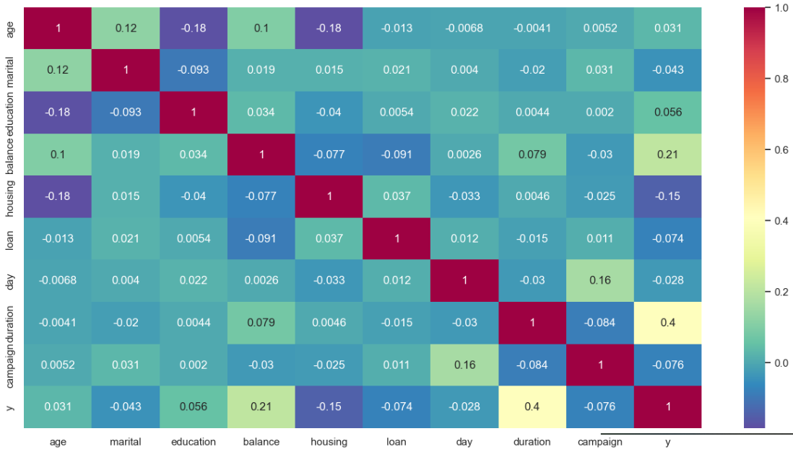

Slide 32
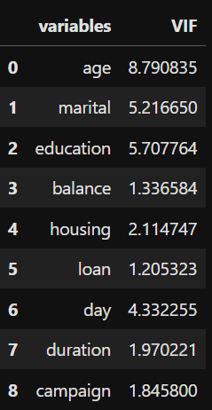
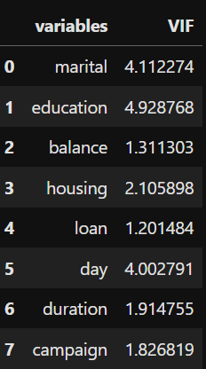
VIF Calculation
We also calculated the Variance Inflation Factor (VIF), VIF values help us see whether a feature is too dependent on the rest. The general rule is to consider a VIF above 5 as high, this threshold can vary depending on the situation. In our case, we used a threshold of 5, and all features were below this value only age. So, we train models with and without age, because multicollinearity of age ( age can be predicted from other variables) affects the logistic regression model. After removing age all VIF were under 5.
Before removing “age” variable :
After removing “age” variable :

Slide 33
One-hot Encoding
We applied one-hot encoding using dummy variables to convert categorical columns into binary columns, allowing the model to identify each category without assuming any numerical order between them
Feature Selection
We first separated the dependent variable (y) from the independent variables. Then we applied ANOVA (SelectKBest) to pick the top features. Duration came out as the most influential feature, which matches our earlier observation that it strongly affects subscription rates. Then we drop all features less than 5.
Since “day” also has converted to “weeks numbers” and is less important so we removed it.
So in this phase we selected the important variables for our modeling, using ANOVA (SelectKBest) method.

Slide 34
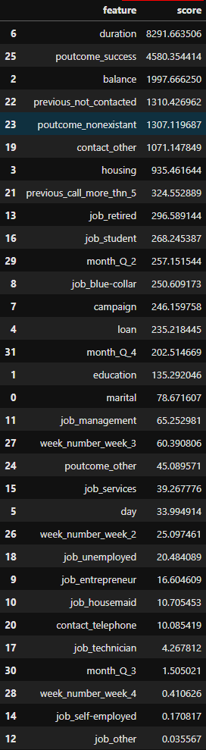
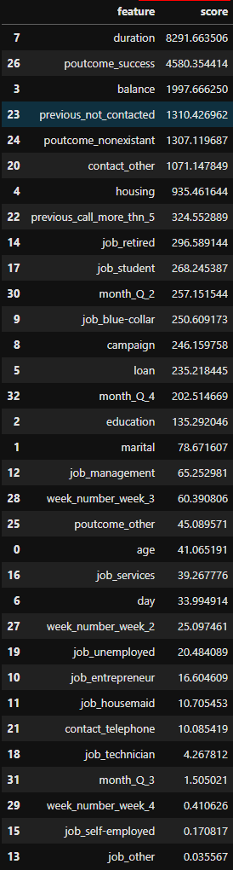

Slide 35
Train-Test Split Data
We tried three different train–test splits (70–30, 75–25, and 80–20) and compared their class ratios. We noticed that because the target variable is imbalanced, the model may predict only the majority class (‘No’) and get high accuracy, while completely failing on the minority class (‘Yes’) which is important for our study more than the “No” class. Also, metrics like F1, ROC-AUC, and recall for the ‘Yes’ class will be very low, we decided to handle the imbalance using oversampling with SMOTETomek before training our models.

Slide 36
Handling Imbalanced Classes (Oversampling)
To fix the imbalance between “Yes” and “No,” we used SMOTETomek:
SMOTE adds samples to increase the minority class.
Tomek Links cleans up confusing majority samples.
We used SMOTE (to add more samples for the minority class) and Tomek Links (to remove some extra samples from the majority class). This gave us a balanced dataset.
After balancing, we scaled all numerical features so they stay on the same range. This helps many classification algorithms learn better and prevents features with large values from affecting the model.

Slide 37
Handling Imbalanced Classes (Undersampling using NearMiss)
NearMiss undersampling was applied as a second strategy to solve how the majority class is affecting the model’s performance. The method removes majority-class samples by selecting those closest to minority-class observations, creating a more balanced and informative training set.
We apply NearMiss fitting then we split data into train and test, then and same as before we scaled the data.

Slide 38
Model Building
For model building, we used five classification algorithms: Logistic Regression, SVM, Random Forest, Gradient Boosting, and XGBoost. We evaluated each model on three different dataset versions (with and without age column):
Dataset A → test size 0.30
Dataset B → test size 0.25
Dataset C → test size 0.20
Each model was trained and tested on all three splits to compare performance by computing the confusion matrix for each algorithm used in each dataset.
We also computed ROC curves for every model to visually assess how well each one distinguishes between the “Yes” and “No” classes.

Slide 39
Model Evaluation
SMOTETomek (Oversampling + Cleaning)
After applying SMOTETomek, all models showed better recall and F1-score for the minority class, meaning they became better at detecting clients who would subscribe. Accuracy fell slightly (normal in imbalanced data), but the overall performance became more balanced and reliable. SMOTETomek gave the strongest and most stable results among all methods.
• NearMiss (Undersampling)
NearMiss balanced the data but caused loss of information, which led to lower accuracy and precision. Some models improved in recall, but overall performance became less stable especially for Logistic Regression and SVM. Tree-based models handled it better, but still not as strong as SMOTETomek. Briefly, NearMiss increased sensitivity but reduced overall predictive strength.

Slide 40
Finding Best Model

Slide 41
Dataset | Age | Model | Class | Precision | Recall | F1 | Support | Accuracy
A | Without | Logistic Regression | 0 | 0.94 | 0.90 | 0.92 | 11256 | 0.86
 |  |  | 1 | 0.45 | 0.56 | 0.50 | 1587 | 0.86
 |  | SVM | 0 | 0.94 | 0.91 | 0.93 | 11256 | 0.87
 |  |  | 1 | 0.48 | 0.57 | 0.53 | 1587 | 0.87
 |  | Random Forest | 0 | 0.94 | 0.93 | 0.93 | 11256 | 0.88
 |  |  | 1 | 0.52 | 0.57 | 0.54 | 1587 | 0.88
 |  | Gradient Boosting | 0 | 0.95 | 0.90 | 0.92 | 11256 | 0.87
 |  |  | 1 | 0.47 | 0.66 | 0.55 | 1587 | 0.87
 |  | XGBoost | 0 | 0.94 | 0.92 | 0.93 | 11256 | 0.88
 |  |  | 1 | 0.50 | 0.60 | 0.54 | 1587 | 0.88
B |  | Logistic Regression | 0 | 0.94 | 0.90 | 0.92 | 9380 | 0.86
 |  |  | 1 | 0.45 | 0.56 | 0.50 | 1322 | 0.86
 |  | SVM | 0 | 0.94 | 0.91 | 0.93 | 9380 | 0.87
 |  |  | 1 | 0.49 | 0.58 | 0.53 | 1322 | 0.87
 |  | Random Forest | 0 | 0.94 | 0.93 | 0.93 | 9380 | 0.89
 |  |  | 1 | 0.53 | 0.58 | 0.56 | 1322 | 0.89
 |  | Gradient Boosting | 0 | 0.95 | 0.90 | 0.92 | 9380 | 0.87
 |  |  | 1 | 0.48 | 0.66 | 0.55 | 1322 | 0.87
 |  | XGBoost | 0 | 0.94 | 0.92 | 0.93 | 9380 | 0.88
 |  |  | 1 | 0.50 | 0.60 | 0.54 | 1322 | 0.88
C |  | Logistic Regression | 0 | 0.94 | 0.90 | 0.92 | 7504 | 0.86
 |  |  | 1 | 0.45 | 0.56 | 0.50 | 1058 | 0.86
 |  | SVM | 0 | 0.94 | 0.91 | 0.93 | 7504 | 0.87
 |  |  | 1 | 0.48 | 0.57 | 0.52 | 1058 | 0.87
 |  | Random Forest | 0 | 0.94 | 0.93 | 0.93 | 7504 | 0.88
 |  |  | 1 | 0.52 | 0.57 | 0.55 | 1058 | 0.88
 |  | Gradient Boosting | 0 | 0.95 | 0.90 | 0.92 | 7504 | 0.87
 |  |  | 1 | 0.47 | 0.66 | 0.55 | 1058 | 0.87
 |  | XGBoost | 0 | 0.94 | 0.92 | 0.93 | 7504 | 0.88
 |  |  | 1 | 0.50 | 0.60 | 0.55 | 1058 | 0.88

Slide 42
Dataset | Age | Model | Class | Precision | Recall | F1 | Support | Accuracy
A | Without | Logistic Regression | 0 | 0.94 | 0.90 | 0.92 | 11256 | 0.86
 |  |  | 1 | 0.45 | 0.56 | 0.50 | 1587 | 0.86
 |  | SVM | 0 | 0.94 | 0.91 | 0.93 | 11256 | 0.87
 |  |  | 1 | 0.48 | 0.57 | 0.53 | 1587 | 0.87
 |  | Random Forest | 0 | 0.94 | 0.93 | 0.93 | 11256 | 0.88
 |  |  | 1 | 0.52 | 0.57 | 0.54 | 1587 | 0.88
 |  | Gradient Boosting | 0 | 0.95 | 0.90 | 0.92 | 11256 | 0.87
 |  |  | 1 | 0.47 | 0.66 | 0.55 | 1587 | 0.87
 |  | XGBoost | 0 | 0.94 | 0.92 | 0.93 | 11256 | 0.88
 |  |  | 1 | 0.50 | 0.60 | 0.54 | 1587 | 0.88
B |  | Logistic Regression | 0 | 0.94 | 0.90 | 0.92 | 9380 | 0.86
 |  |  | 1 | 0.45 | 0.56 | 0.50 | 1322 | 0.86
 |  | SVM | 0 | 0.94 | 0.91 | 0.93 | 9380 | 0.87
 |  |  | 1 | 0.49 | 0.58 | 0.53 | 1322 | 0.87
 |  | Random Forest | 0 | 0.94 | 0.93 | 0.93 | 9380 | 0.89
 |  |  | 1 | 0.53 | 0.58 | 0.56 | 1322 | 0.89
 |  | Gradient Boosting | 0 | 0.95 | 0.90 | 0.92 | 9380 | 0.87
 |  |  | 1 | 0.48 | 0.66 | 0.55 | 1322 | 0.87
 |  | XGBoost | 0 | 0.94 | 0.92 | 0.93 | 9380 | 0.88
 |  |  | 1 | 0.50 | 0.60 | 0.54 | 1322 | 0.88
C |  | Logistic Regression | 0 | 0.94 | 0.90 | 0.92 | 7504 | 0.86
 |  |  | 1 | 0.45 | 0.56 | 0.50 | 1058 | 0.86
 |  | SVM | 0 | 0.94 | 0.91 | 0.93 | 7504 | 0.87
 |  |  | 1 | 0.48 | 0.57 | 0.52 | 1058 | 0.87
 |  | Random Forest | 0 | 0.94 | 0.93 | 0.93 | 7504 | 0.88
 |  |  | 1 | 0.52 | 0.57 | 0.55 | 1058 | 0.88
 |  | Gradient Boosting | 0 | 0.95 | 0.90 | 0.92 | 7504 | 0.87
 |  |  | 1 | 0.47 | 0.66 | 0.55 | 1058 | 0.87
 |  | XGBoost | 0 | 0.94 | 0.92 | 0.93 | 7504 | 0.88
 |  |  | 1 | 0.50 | 0.60 | 0.55 | 1058 | 0.88

Slide 43
Dataset | Age | Model | Class | Precision | Recall | F1 | Support | Accuracy
A | Without | Logistic Regression | 0 | 0.94 | 0.90 | 0.92 | 11256 | 0.86
 |  |  | 1 | 0.45 | 0.56 | 0.50 | 1587 | 0.86
 |  | SVM | 0 | 0.94 | 0.91 | 0.93 | 11256 | 0.87
 |  |  | 1 | 0.48 | 0.57 | 0.53 | 1587 | 0.87
 |  | Random Forest | 0 | 0.94 | 0.93 | 0.93 | 11256 | 0.88
 |  |  | 1 | 0.52 | 0.57 | 0.54 | 1587 | 0.88
 |  | Gradient Boosting | 0 | 0.95 | 0.90 | 0.92 | 11256 | 0.87
 |  |  | 1 | 0.47 | 0.66 | 0.55 | 1587 | 0.87
 |  | XGBoost | 0 | 0.94 | 0.92 | 0.93 | 11256 | 0.88
 |  |  | 1 | 0.50 | 0.60 | 0.54 | 1587 | 0.88
B |  | Logistic Regression | 0 | 0.94 | 0.90 | 0.92 | 9380 | 0.86
 |  |  | 1 | 0.45 | 0.56 | 0.50 | 1322 | 0.86
 |  | SVM | 0 | 0.94 | 0.91 | 0.93 | 9380 | 0.87
 |  |  | 1 | 0.49 | 0.58 | 0.53 | 1322 | 0.87
 |  | Random Forest | 0 | 0.94 | 0.93 | 0.93 | 9380 | 0.89
 |  |  | 1 | 0.53 | 0.58 | 0.56 | 1322 | 0.89
 |  | Gradient Boosting | 0 | 0.95 | 0.90 | 0.92 | 9380 | 0.87
 |  |  | 1 | 0.48 | 0.66 | 0.55 | 1322 | 0.87
 |  | XGBoost | 0 | 0.94 | 0.92 | 0.93 | 9380 | 0.88
 |  |  | 1 | 0.50 | 0.60 | 0.54 | 1322 | 0.88
C |  | Logistic Regression | 0 | 0.94 | 0.90 | 0.92 | 7504 | 0.86
 |  |  | 1 | 0.45 | 0.56 | 0.50 | 1058 | 0.86
 |  | SVM | 0 | 0.94 | 0.91 | 0.93 | 7504 | 0.87
 |  |  | 1 | 0.48 | 0.57 | 0.52 | 1058 | 0.87
 |  | Random Forest | 0 | 0.94 | 0.93 | 0.93 | 7504 | 0.88
 |  |  | 1 | 0.52 | 0.57 | 0.55 | 1058 | 0.88
 |  | Gradient Boosting | 0 | 0.95 | 0.90 | 0.92 | 7504 | 0.87
 |  |  | 1 | 0.47 | 0.66 | 0.55 | 1058 | 0.87
 |  | XGBoost | 0 | 0.94 | 0.92 | 0.93 | 7504 | 0.88
 |  |  | 1 | 0.50 | 0.60 | 0.55 | 1058 | 0.88

Slide 44
Dataset | Age | Model | Class | Precision | Recall | F1 | Support | Accuracy
A | Without | Logistic Regression | 0 | 0.94 | 0.90 | 0.92 | 11256 | 0.86
 |  |  | 1 | 0.45 | 0.56 | 0.50 | 1587 | 0.86
 |  | SVM | 0 | 0.94 | 0.91 | 0.93 | 11256 | 0.87
 |  |  | 1 | 0.48 | 0.57 | 0.53 | 1587 | 0.87
 |  | Random Forest | 0 | 0.94 | 0.93 | 0.93 | 11256 | 0.88
 |  |  | 1 | 0.52 | 0.57 | 0.54 | 1587 | 0.88
 |  | Gradient Boosting | 0 | 0.95 | 0.90 | 0.92 | 11256 | 0.87
 |  |  | 1 | 0.47 | 0.66 | 0.55 | 1587 | 0.87
 |  | XGBoost | 0 | 0.94 | 0.92 | 0.93 | 11256 | 0.88
 |  |  | 1 | 0.50 | 0.60 | 0.54 | 1587 | 0.88
B |  | Logistic Regression | 0 | 0.94 | 0.90 | 0.92 | 9380 | 0.86
 |  |  | 1 | 0.45 | 0.56 | 0.50 | 1322 | 0.86
 |  | SVM | 0 | 0.94 | 0.91 | 0.93 | 9380 | 0.87
 |  |  | 1 | 0.49 | 0.58 | 0.53 | 1322 | 0.87
 |  | Random Forest | 0 | 0.94 | 0.93 | 0.93 | 9380 | 0.89
 |  |  | 1 | 0.53 | 0.58 | 0.56 | 1322 | 0.89
 |  | Gradient Boosting | 0 | 0.95 | 0.90 | 0.92 | 9380 | 0.87
 |  |  | 1 | 0.48 | 0.66 | 0.55 | 1322 | 0.87
 |  | XGBoost | 0 | 0.94 | 0.92 | 0.93 | 9380 | 0.88
 |  |  | 1 | 0.50 | 0.60 | 0.54 | 1322 | 0.88
C |  | Logistic Regression | 0 | 0.94 | 0.90 | 0.92 | 7504 | 0.86
 |  |  | 1 | 0.45 | 0.56 | 0.50 | 1058 | 0.86
 |  | SVM | 0 | 0.94 | 0.91 | 0.93 | 7504 | 0.87
 |  |  | 1 | 0.48 | 0.57 | 0.52 | 1058 | 0.87
 |  | Random Forest | 0 | 0.94 | 0.93 | 0.93 | 7504 | 0.88
 |  |  | 1 | 0.52 | 0.57 | 0.55 | 1058 | 0.88
 |  | Gradient Boosting | 0 | 0.95 | 0.90 | 0.92 | 7504 | 0.87
 |  |  | 1 | 0.47 | 0.66 | 0.55 | 1058 | 0.87
 |  | XGBoost | 0 | 0.94 | 0.92 | 0.93 | 7504 | 0.88
 |  |  | 1 | 0.50 | 0.60 | 0.55 | 1058 | 0.88

Slide 45
Dataset | Age | Model | Class | Precision | Recall | F1 | Support | Accuracy
A | With | Logistic Regression | 0 | 0.94 | 0.90 | 0.92 | 11256 | 0.86
 |  |  | 1 | 0.44 | 0.56 | 0.50 | 1587 | 0.86
 |  | SVM | 0 | 0.94 | 0.91 | 0.93 | 11256 | 0.87
 |  |  | 1 | 0.49 | 0.58 | 0.53 | 1587 | 0.87
 |  | Random Forest | 0 | 0.94 | 0.93 | 0.93 | 11256 | 0.88
 |  |  | 1 | 0.53 | 0.59 | 0.56 | 1587 | 0.88
 |  | Gradient Boosting | 0 | 0.95 | 0.90 | 0.92 | 11256 | 0.87
 |  |  | 1 | 0.48 | 0.67 | 0.56 | 1587 | 0.87
 |  | XGBoost | 0 | 0.94 | 0.92 | 0.93 | 11256 | 0.88
 |  |  | 1 | 0.50 | 0.59 | 0.54 | 1587 | 0.88
B |  | Logistic Regression | 0 | 0.94 | 0.90 | 0.92 | 9380 | 0.86
 |  |  | 1 | 0.45 | 0.57 | 0.50 | 1322 | 0.86
 |  | SVM | 0 | 0.94 | 0.91 | 0.93 | 9380 | 0.87
 |  |  | 1 | 0.49 | 0.59 | 0.54 | 1322 | 0.87
 |  | Random Forest | 0 | 0.94 | 0.93 | 0.93 | 9380 | 0.88
 |  |  | 1 | 0.53 | 0.59 | 0.56 | 1322 | 0.88
 |  | Gradient Boosting | 0 | 0.95 | 0.90 | 0.92 | 9380 | 0.87
 |  |  | 1 | 0.48 | 0.67 | 0.56 | 1322 | 0.87
 |  | XGBoost | 0 | 0.94 | 0.92 | 0.93 | 9380 | 0.88
 |  |  | 1 | 0.52 | 0.61 | 0.56 | 1322 | 0.88
C |  | Logistic Regression | 0 | 0.94 | 0.90 | 0.92 | 7504 | 0.86
 |  |  | 1 | 0.45 | 0.56 | 0.50 | 1058 | 0.86
 |  | SVM | 0 | 0.94 | 0.91 | 0.93 | 7504 | 0.87
 |  |  | 1 | 0.49 | 0.59 | 0.53 | 1058 | 0.87
 |  | Random Forest | 0 | 0.94 | 0.93 | 0.94 | 7504 | 0.89
 |  |  | 1 | 0.54 | 0.60 | 0.57 | 1058 | 0.89
 |  | Gradient Boosting | 0 | 0.95 | 0.90 | 0.92 | 7504 | 0.87
 |  |  | 1 | 0.47 | 0.67 | 0.55 | 1058 | 0.87
 |  | XGBoost | 0 | 0.94 | 0.92 | 0.93 | 7504 | 0.88
 |  |  | 1 | 0.51 | 0.60 | 0.55 | 1058 | 0.88

Slide 46
Dataset | Age Feature | Model | Class | Precision | Recall | F1-score | Support | Accuracy | Macro F1 | Weighted F1
A | Without | Logistic Regression | 0 | 0.97 | 0.67 | 0.79 | 11256 | 0.69 | 0.60 | 0.75
 |  |  | 1 | 0.27 | 0.86 | 0.41 | 1587
 |  | SVM | 0 | 0.97 | 0.73 | 0.83 | 11256 | 0.75 | 0.64 | 0.79
 |  |  | 1 | 0.31 | 0.85 | 0.45 | 1587
 |  | Random Forest | 0 | 0.98 | 0.62 | 0.76 | 11256 | 0.66 | 0.58 | 0.72
 |  |  | 1 | 0.25 | 0.90 | 0.39 | 1587
 |  | Gradient Boosting | 0 | 0.97 | 0.49 | 0.65 | 11256 | 0.54 | 0.49 | 0.61
 |  |  | 1 | 0.20 | 0.90 | 0.33 | 1587
 |  | XGBoost | 0 | 0.97 | 0.49 | 0.65 | 11256 | 0.54 | 0.49 | 0.61
 |  |  | 1 | 0.20 | 0.91 | 0.33 | 1587
B |  | Logistic Regression | 0 | 0.97 | 0.67 | 0.79 | 9380 | 0.69 | 0.60 | 0.75
 |  |  | 1 | 0.27 | 0.85 | 0.41 | 1322
 |  | SVM | 0 | 0.97 | 0.73 | 0.83 | 9380 | 0.75 | 0.64 | 0.79
 |  |  | 1 | 0.31 | 0.86 | 0.45 | 1322
 |  | Random Forest | 0 | 0.98 | 0.62 | 0.76 | 9380 | 0.66 | 0.58 | 0.72
 |  |  | 1 | 0.25 | 0.90 | 0.39 | 1322
 |  | Gradient Boosting | 0 | 0.97 | 0.48 | 0.65 | 9380 | 0.54 | 0.49 | 0.61
 |  |  | 1 | 0.20 | 0.90 | 0.32 | 1322
 |  | XGBoost | 0 | 0.98 | 0.49 | 0.65 | 9380 | 0.54 | 0.49 | 0.61
 |  |  | 1 | 0.20 | 0.92 | 0.33 | 1322
C |  | Logistic Regression | 0 | 0.97 | 0.67 | 0.79 | 7504 | 0.69 | 0.60 | 0.74
 |  |  | 1 | 0.26 | 0.84 | 0.40 | 1058
 |  | SVM | 0 | 0.97 | 0.72 | 0.83 | 7504 | 0.74 | 0.64 | 0.78
 |  |  | 1 | 0.30 | 0.85 | 0.45 | 1058
 |  | Random Forest | 0 | 0.98 | 0.60 | 0.75 | 7504 | 0.64 | 0.56 | 0.70
 |  |  | 1 | 0.24 | 0.90 | 0.38 | 1058
 |  | Gradient Boosting | 0 | 0.97 | 0.47 | 0.63 | 7504 | 0.52 | 0.47 | 0.59
 |  |  | 1 | 0.19 | 0.90 | 0.32 | 1058
 |  | XGBoost | 0 | 0.98 | 0.48 | 0.64 | 7504 | 0.53 | 0.49 | 0.61
 |  |  | 1 | 0.20 | 0.91 | 0.33 | 1058

Slide 47
Dataset | Age Feature | Model | Class | Precision | Recall | F1-score | Support | Accuracy | Macro F1 | Weighted F1
A | With | Logistic Regression | 0 | 0.97 | 0.67 | 0.79 | 11256 | 0.69 | 0.60 | 0.75
 |  |  | 1 | 0.27 | 0.86 | 0.41 | 1587
 |  | SVM | 0 | 0.97 | 0.74 | 0.84 | 11256 | 0.75 | 0.65 | 0.79
 |  |  | 1 | 0.32 | 0.86 | 0.46 | 1587
 |  | Random Forest | 0 | 0.98 | 0.62 | 0.76 | 11256 | 0.66 | 0.58 | 0.72
 |  |  | 1 | 0.25 | 0.91 | 0.39 | 1587
 |  | Gradient Boosting | 0 | 0.97 | 0.50 | 0.66 | 11256 | 0.55 | 0.50 | 0.62
 |  |  | 1 | 0.20 | 0.91 | 0.33 | 1587
 |  | XGBoost | 0 | 0.98 | 0.52 | 0.68 | 11256 | 0.57 | 0.51 | 0.64
 |  |  | 1 | 0.21 | 0.91 | 0.34 | 1587
B |  | Logistic Regression | 0 | 0.97 | 0.68 | 0.80 | 9380 | 0.70 | 0.61 | 0.75
 |  |  | 1 | 0.27 | 0.86 | 0.41 | 1322
 |  | SVM | 0 | 0.97 | 0.74 | 0.84 | 9380 | 0.75 | 0.65 | 0.79
 |  |  | 1 | 0.32 | 0.86 | 0.46 | 1322
 |  | Random Forest | 0 | 0.98 | 0.61 | 0.76 | 9380 | 0.65 | 0.57 | 0.71
 |  |  | 1 | 0.25 | 0.91 | 0.39 | 1322
 |  | Gradient Boosting | 0 | 0.97 | 0.51 | 0.67 | 9380 | 0.56 | 0.51 | 0.63
 |  |  | 1 | 0.21 | 0.90 | 0.34 | 1322
 |  | XGBoost | 0 | 0.98 | 0.53 | 0.69 | 9380 | 0.58 | 0.52 | 0.65
 |  |  | 1 | 0.22 | 0.91 | 0.35 | 1322
C |  | Logistic Regression | 0 | 0.97 | 0.67 | 0.79 | 7504 | 0.69 | 0.60 | 0.75
 |  |  | 1 | 0.27 | 0.85 | 0.41 | 1058
 |  | SVM | 0 | 0.97 | 0.74 | 0.84 | 7504 | 0.75 | 0.65 | 0.79
 |  |  | 1 | 0.31 | 0.86 | 0.46 | 1058
 |  | Random Forest | 0 | 0.98 | 0.61 | 0.75 | 7504 | 0.65 | 0.57 | 0.71
 |  |  | 1 | 0.25 | 0.90 | 0.39 | 1058
 |  | Gradient Boosting | 0 | 0.97 | 0.49 | 0.65 | 7504 | 0.54 | 0.49 | 0.61
 |  |  | 1 | 0.20 | 0.90 | 0.33 | 1058
 |  | XGBoost | 0 | 0.98 | 0.54 | 0.69 | 7504 | 0.58 | 0.52 | 0.65
 |  |  | 1 | 0.22 | 0.91 | 0.35 | 1058

Slide 48
Interpretation:
Using SMOTETomek and after modeling (with Age column) the best model was the Gradient Boosting model, by taking (test_size = 0.3 and test_size = 0.25) with (Precision = 0.48 , Recall = 0.67 , and F1-score = 0.56) , while without Age column the best model was also the Gradient Boosting model (test_size = 0.25) with (Precision = 0.48 , Recall = 0.66 , and F1-score = 0.55).
Both with and without are almost the same, and this is normal because we have applied this method on the purpose of the Logistic Regression only.
Using NearMiss and after modeling (with Age column) the best model was the SVM model, by taking (test_size = 0.3 and test_size = 0.25) with (Precision = 0.32 , Recall = 0.86 , and F1-score = 0.46) , while without Age column the best model was also the SVM model (test_size = 0.25) with (Precision = 0.31 , Recall = 0.86 , and F1-score = 0.45).
Both with and without are almost the same, and this is normal because we have applied this method on the purpose of the Logistic Regression only.

Slide 49
Interpretation:
Method | Model | Precision | Recall | F1-score
SMOTETomek | Gradient Boosting | 0.48 | 0.67 | 0.56
NearMiss | SVM | 0.32 | 0.86 | 0.46
Gradient Boosting (SMOTETomek) Is Better:
1. Higher F1-score (0.56):
This means it balances false positives and false negatives better than the SVM with NearMiss.
2. Higher precision (0.48)
SVM’s precision is much lower (0.32). In marketing, precision matters because:
A low precision means many customers are incorrectly classified as “yes”
This leads to wasted marketing calls, wasted budget, and annoyed customers.
3. Good recall (0.67)
Not as high as SVM, but still strong. It catches most customers who will subscribe.

Slide 50
Challenges
During the procedure of our project, we faced some challenges and difficulties that made us struggle to find an appropriate solution for it.
Some of these challenges are:
The target variable (“y”) was highly imbalanced, and this created a critical challenge in the project. Handling this issue required using specific techniques so that the model’s accuracy and predictions wouldn’t be affected.
.
Most of the features in the dataset were Categorical, which meant we had to do extra work and apply specific techniques to process them. This included applying feature encoding and several additional steps, which required more time and effort.

Slide 51
References
Dataset: UCI
VIF
SMOTETenc

Slide 52
Thanks for Listening
Prepared by: Mohamad Badra

