Slide 1
CYBERSHIELD
Cyberbullying Type Detection on Social Media
Author:
Mohamad Badra

Slide 2
Presentation Outline
01
Problem Statement
02
Dataset & EDA
Why detecting cyberbullying type matters
47,000 tweets across 6 categories
03
Preprocessing & Features
04
Model Development
Text cleaning pipeline, TF-IDF, RoBERTa embeddings
Classical ML vs fine-tuned RoBERTa transformer
05
Evaluation & Error Analysis
06
Explainability
F1 scores, confusion matrices, class-level analysis
SHAP global importance + LIME local explanations
07
Deployment
FastAPI REST API + CyberShield web interface

Slide 3
Problem Statement
The Challenge
Our Solution: CyberShield
37% of young people experience cyberbullying online
Classify tweets into 6 specific cyberbullying types:
age
Bullying targeting age group
Platforms process millions of posts daily — manual review impossible
ethnicity
Racial / ethnic harassment
gender
Gender-based bullying
Binary classifiers detect IF bullying occurred, not WHAT TYPE
religion
Religious discrimination
Without type info, targeted moderation cannot be applied
other_cyberbullying
Other forms of online abuse
not_cyberbullying
Normal, harmless content

Slide 4
Dataset Overview
~47,000
6
Twitter
70/15/15
Total Tweets
Categories
Data Source
Train/Val/Test
Class
Description
Example Tweet
age
Bullying targeting age group
"People your age are useless"
ethnicity
Racial or ethnic harassment
"Go back to your country"
gender
Gender-based bullying
"Women don't belong here"
religion
Religious discrimination
"Ashamed of your religion"
other_cyberbullying
Other forms of online abuse
General harassment
not_cyberbullying
Normal, harmless text
"Beautiful weather today!"

Slide 5
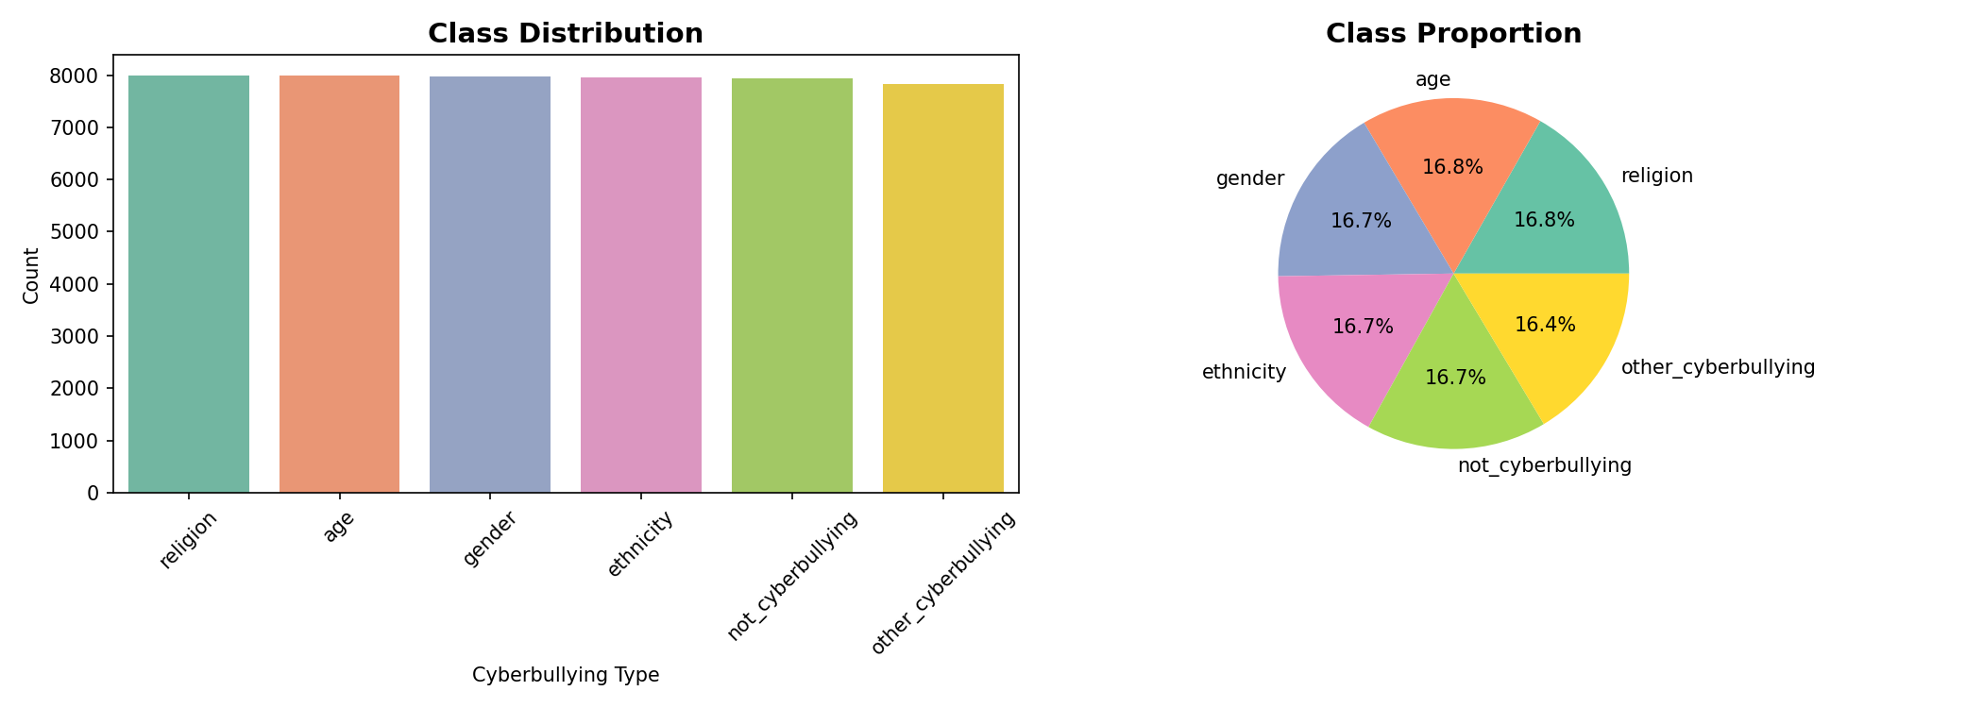
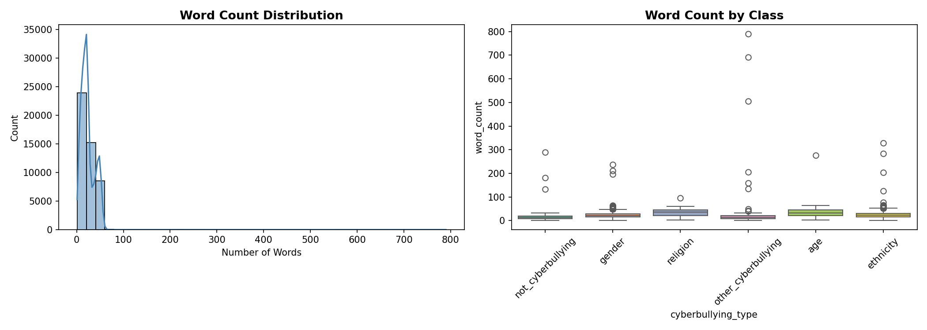
Exploratory Data Analysis
Key Findings:
Dataset balanced ~16-17% per class | Tweets range 1-40 words, median ~18 words | not_cyberbullying shows the most varied vocabulary

Slide 6
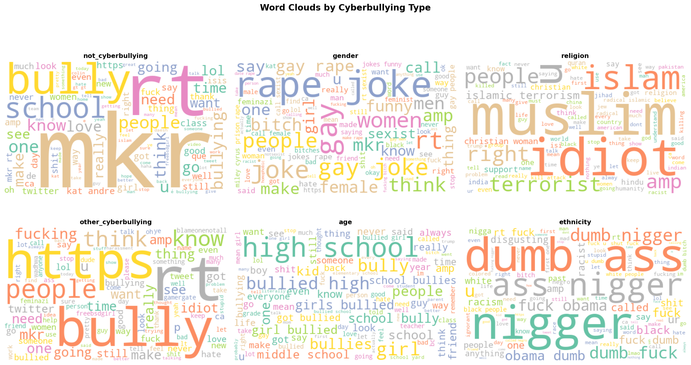
Vocabulary Analysis — Word Clouds & N-grams

Slide 7
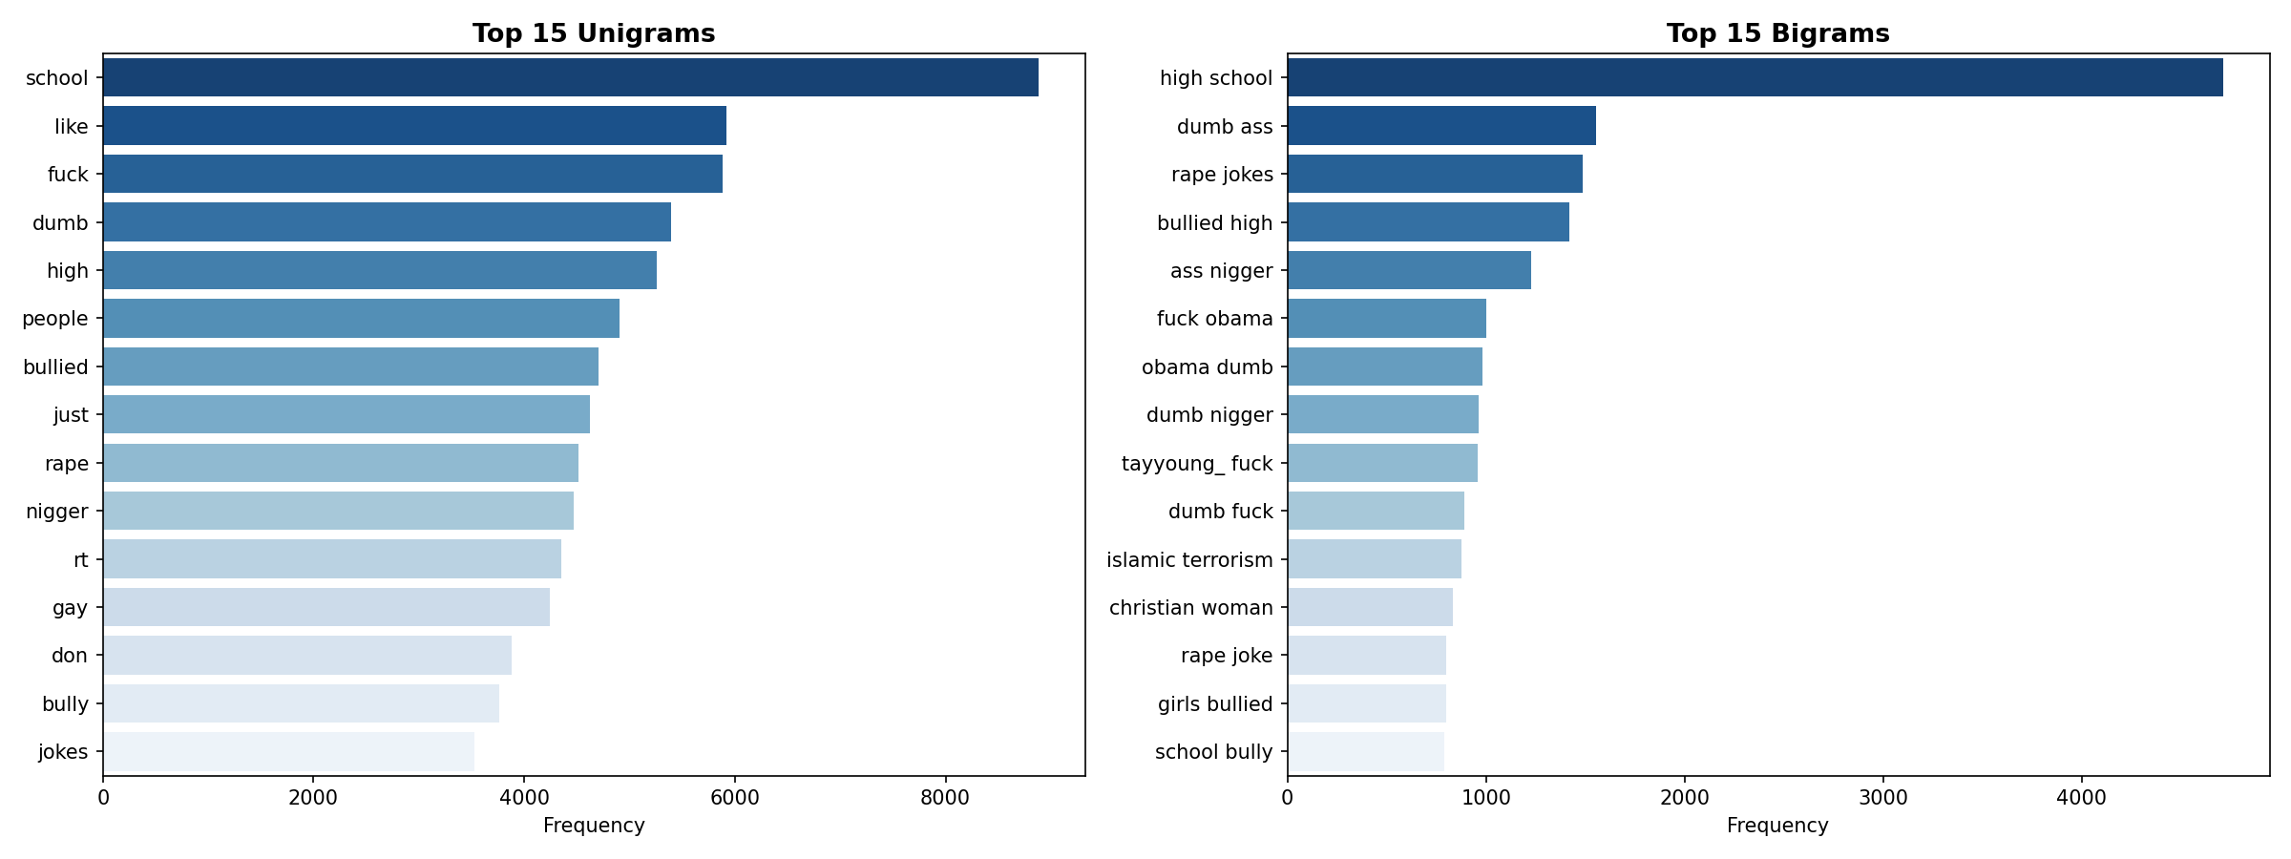
Vocabulary Analysis — Word Clouds & N-grams

Slide 8
Text Preprocessing Pipeline
1
Lowercasing
2
URL & Mention Removal
3
Punctuation & Digits
Normalize all text to lowercase
Strip http links, @usernames removed
Non-alphanumeric characters discarded
4
Stopword Removal
5
Lemmatization
6
Short Token Filter
NLTK English stopword list applied
WordNet reduces words to base forms
Tokens of length 2 or fewer discarded
Data Split — Stratified Sampling — Random Seed = 42
Train: 70% (32,998 samples) Validation: 15% (7,088 samples) Test: 15% (7,088 samples)

Slide 9
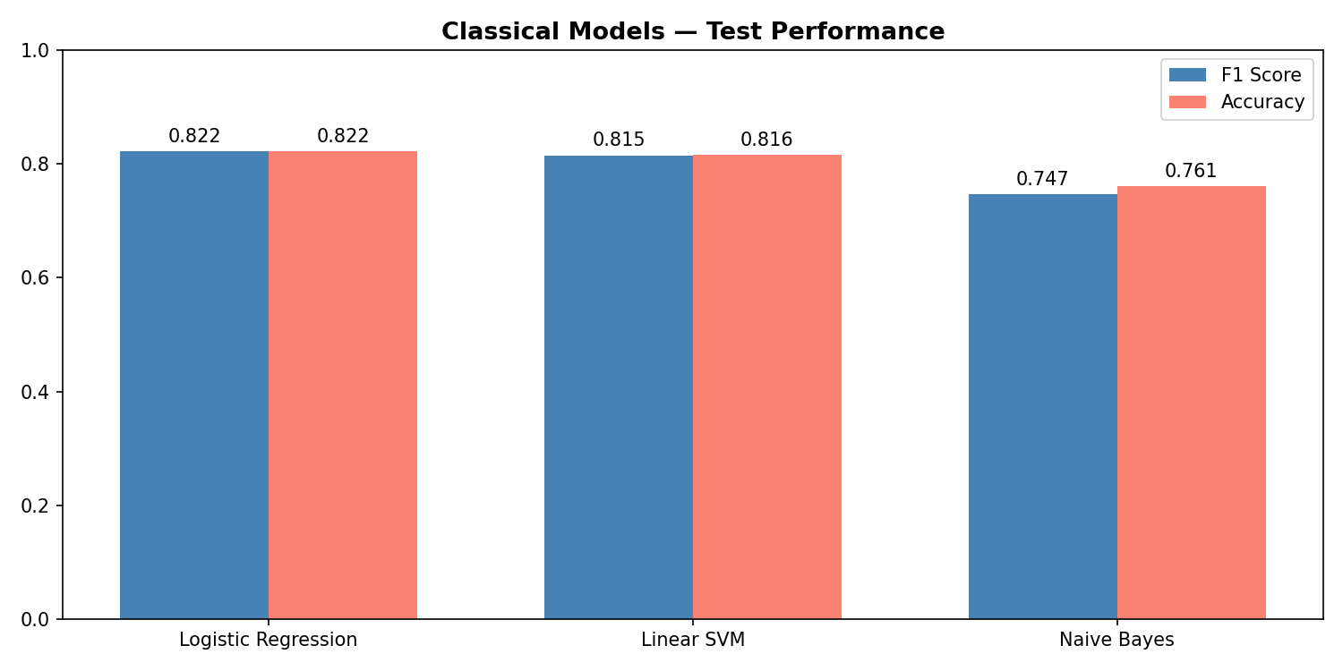
Classical ML Models — TF-IDF Pipeline
TF-IDF Configuration: max_features=30,000 | ngram_range=(1,2) | sublinear_tf=True | min_df=2
Logistic Regression
Linear SVM
Naive Bayes
C=1.0, max_iter=1000
One-vs-Rest strategy
C=1.0, max_iter=2000
LinearSVC
alpha=0.1
Multinomial NB
F1: 0.82
F1: 0.82
F1: 0.75

Slide 10
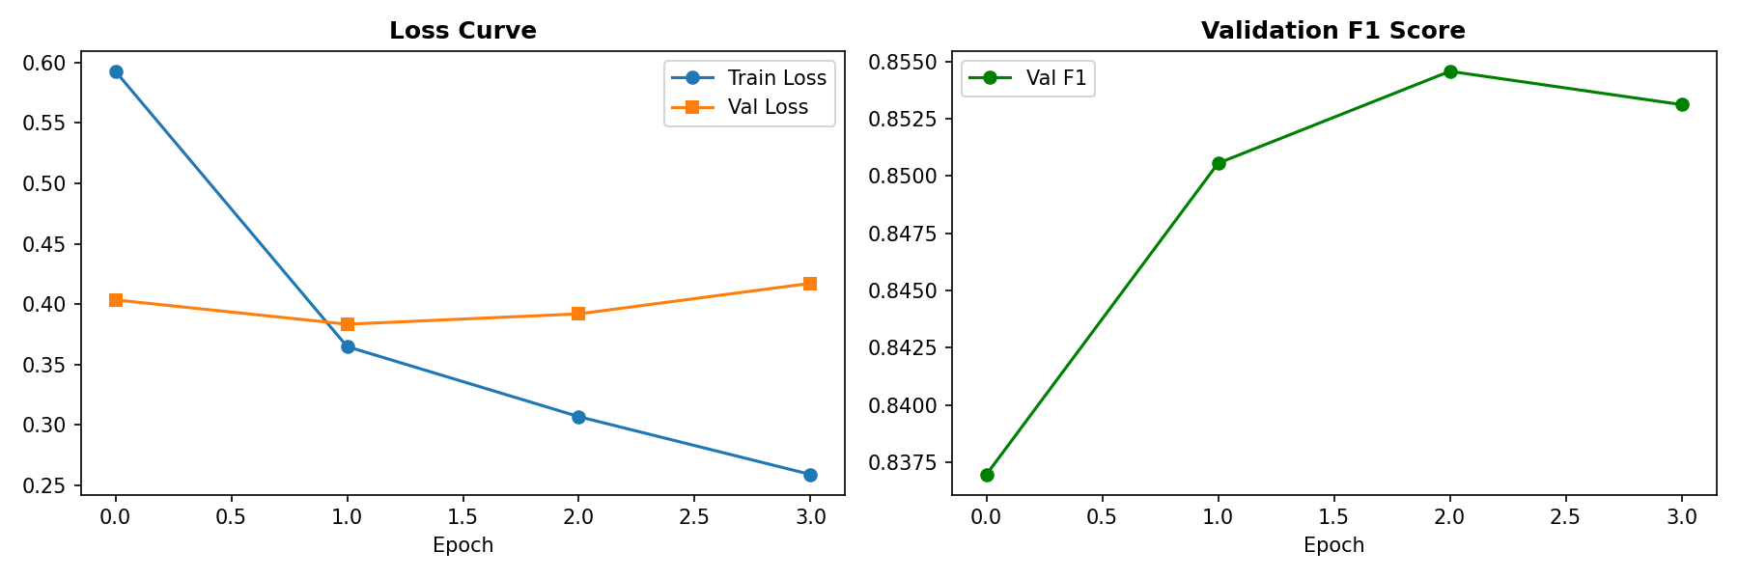
Transformer Model — Fine-tuned RoBERTa
Training Configuration
Model
roberta-base (HuggingFace)
Optimizer
AdamW + weight decay 0.01
Learning Rate
2e-5 with linear warmup (10%)
Max Tokens
128
Batch Size
16
Max Epochs
4 (early stopping, patience=2)
Gradient Clip
max norm 1.0
Loss Function
Cross-Entropy Loss
Best Test F1
0.84 | Accuracy: 0.85

Slide 11
Results — Model Performance Comparison
Model
Precision
Recall
F1 (Weighted)
Accuracy
Naive Bayes (TF-IDF)
0.74
0.76
0.75
0.76
Linear SVM
0.81
0.82
0.82
0.82
Logistic Regression
0.82
0.82
0.82
0.82
* RoBERTa (Fine-tuned) BEST
0.85
0.85
0.84
0.85
Key weakness: not_cyberbullying (F1=0.59) and other_cyberbullying (F1=0.67) are the most ambiguous and hardest categories for both models.

Slide 12
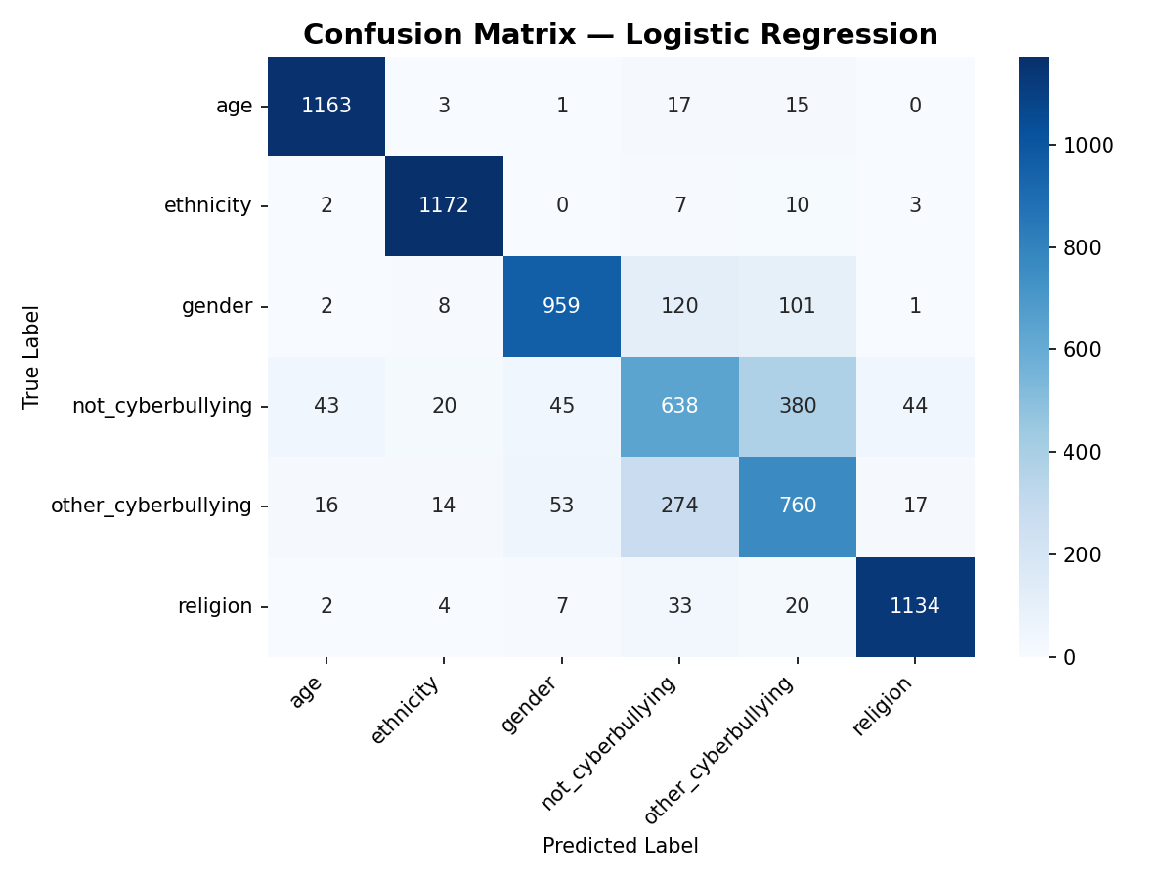
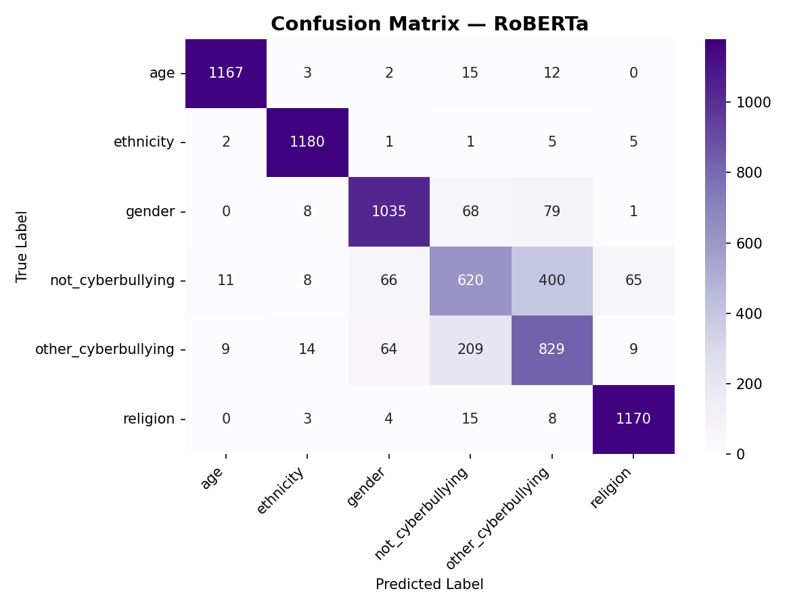
Confusion Matrix Analysis
Logistic Regression
RoBERTa (Fine-tuned)
Main confusion: not_cyberbullying vs other_cyberbullying | ethnicity vs religion misclassification visible in both models

Slide 13
Error Analysis
not_cyberbullying (F1: 0.59)
Most confused class — everyday language overlaps with mild harmful content. 400 samples misclassified as other_cyberbullying by RoBERTa.
other_cyberbullying (F1: 0.67)
Catch-all category with heterogeneous content — by definition the most diverse class, making it hardest to model consistently.
ethnicity vs religion confusion
Both models confuse these classes. Harassment frequently targets both attributes simultaneously in the same tweet.
Short tweets (less than 5 words)
Insufficient context for classification — both models struggle equally with extremely short inputs regardless of architecture.

Slide 14
Hyperparameter Optimization
Grid Search | 3-Fold Cross-Validation | 12 configurations | 36 total fits
Best Configuration
max_features
30,000
ngram_range
(1, 2)
C
1.0
CV F1
0.8212
Test F1
0.8209
Insight: 30,000 features achieves the same F1 as 50,000 — the model generalizes well with a smaller, more efficient vocabulary.

Slide 15
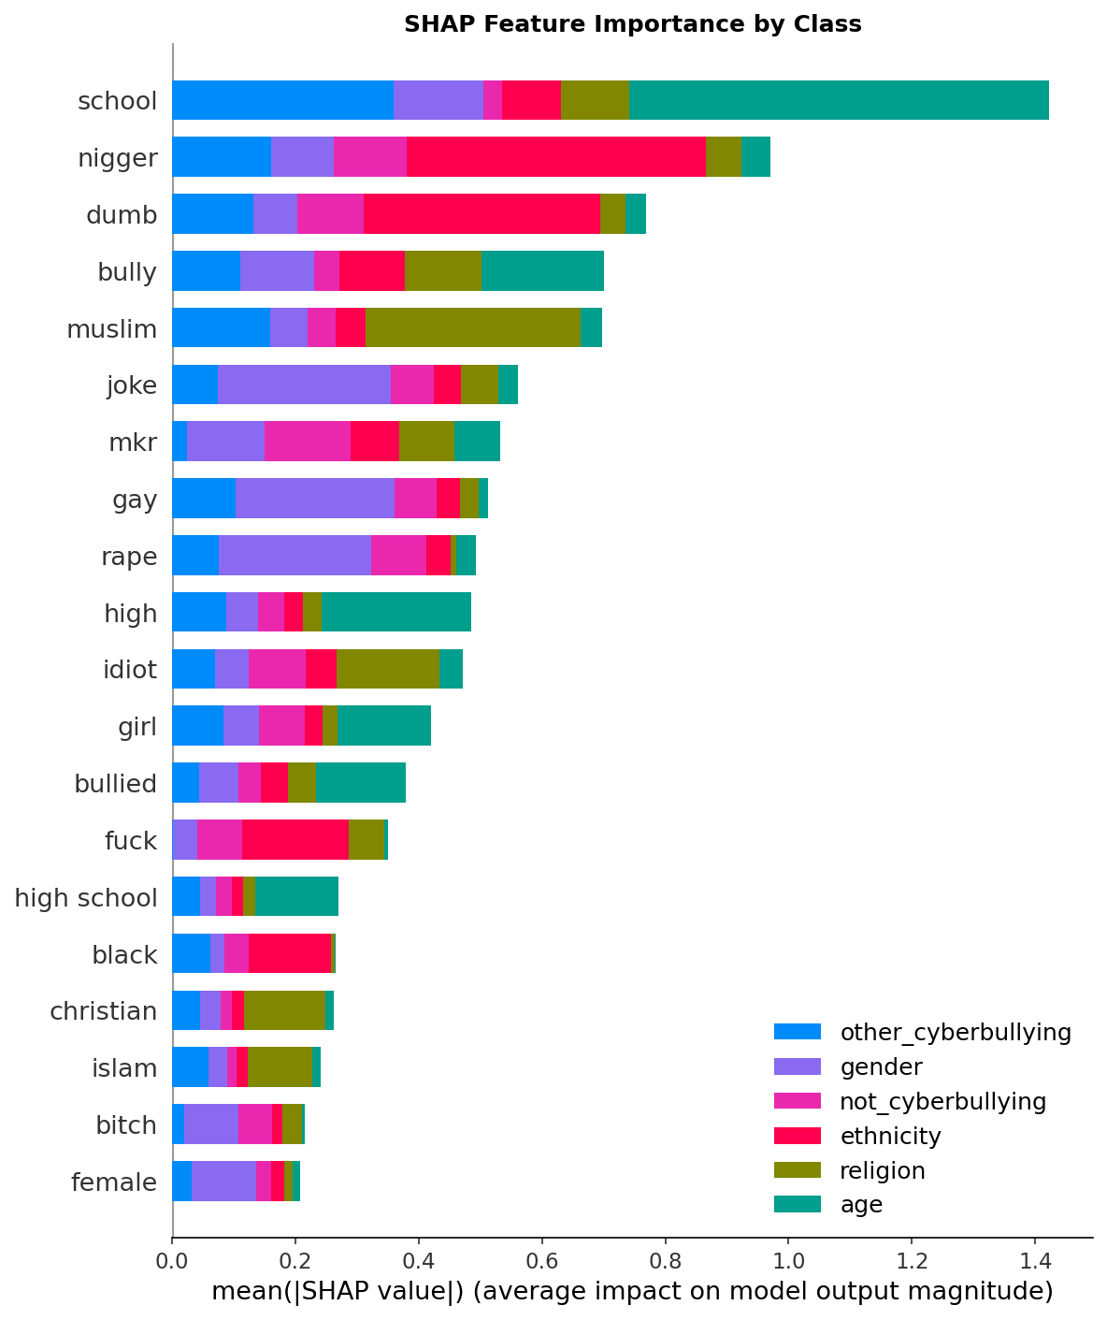
Model Explainability — SHAP
SHapley Additive exPlanations — Global feature importance across all test samples
SHAP findings: Top features are "school", "nigger", "dumb", "bully", "muslim" | Religious terms dominate religion class | Racial terms dominate ethnicity class | Predictions are linguistically grounded

Slide 16
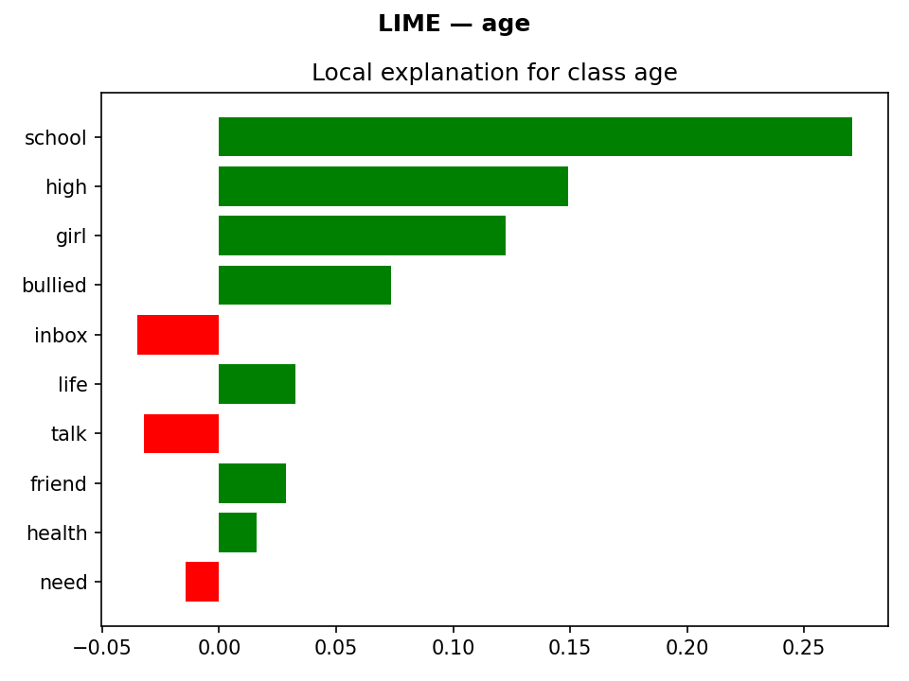
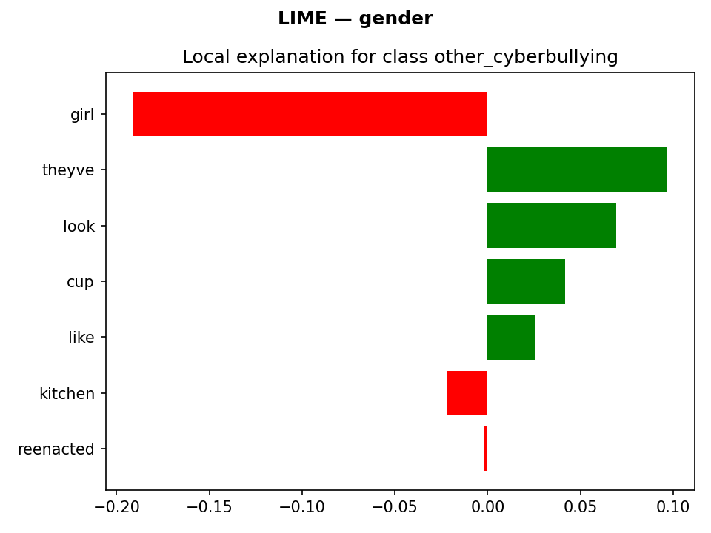
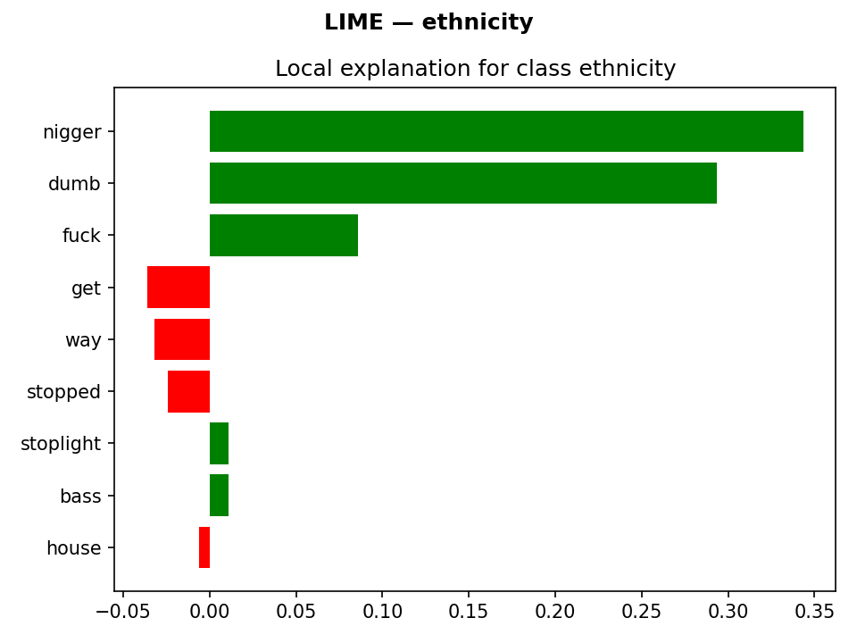
Model Explainability — LIME
Local Interpretable Model-agnostic Explanations — per-instance word contribution weights
LIME — age class
"school, high, girl, bullied"
are top positive contributors
LIME — gender class
"girl" negative, "theyve, look"
positive for other_cb category
LIME — ethnicity class
"nigger, dumb, fuck"
are top positive contributors
LIME provides per-instance justification — shows exactly which words drove the model decision for each individual tweet.

Slide 17
Ethical Considerations
Bias Detection
Fairness & Balance
Per-class F1 identifies performance disparities across demographic groups. Social media training data inherits real-world biases. Class-level SHAP reveals if any group is disproportionately flagged.
False positives suppress free speech; false negatives harm victims. Both carry distinct costs requiring careful balance per platform policy and community standards.
Human-in-the-Loop
Responsible Deployment
System assists — never replaces — human moderators. No automated account suspensions based solely on model output. All predictions should require human review.
Regular retraining as online language evolves. Users must have a clear appeals process for moderation decisions. Not to be used as the sole basis for banning.

Slide 18
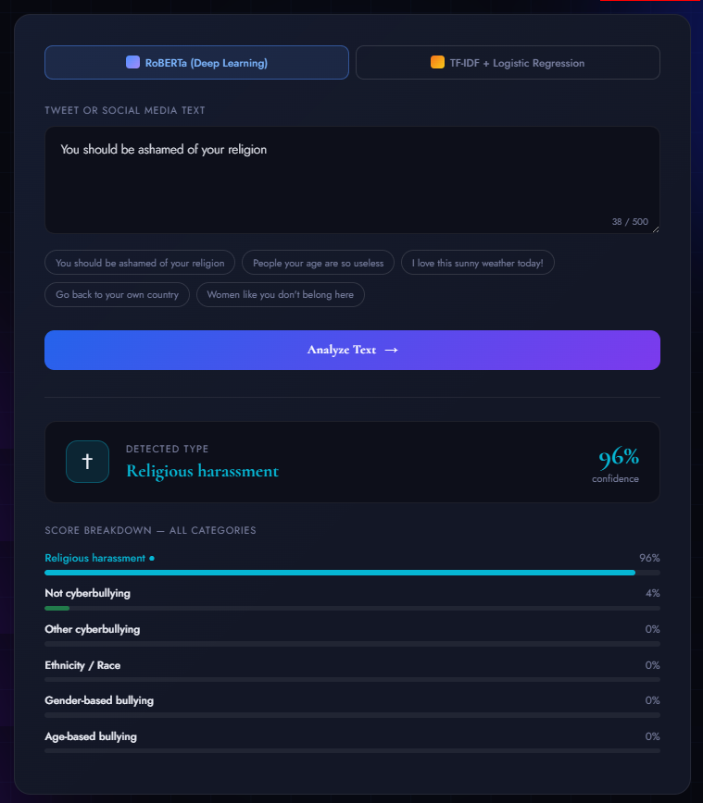
Deployment — FastAPI + CyberShield
CyberShield Web Interface
Real-time tweet analysis (Enter key shortcut)
Animated confidence bars for all 6 categories
Color-coded verdict card + emoji per type
One-click example tweets for demonstration
CORS-enabled — works from any browser

Slide 19
Conclusion & Key Takeaways
RoBERTa outperforms classical ML
01
Weighted F1: 0.84 vs 0.82 (Logistic Regression) — contextual embeddings capture semantic nuance TF-IDF cannot represent
Multi-class beats binary classification
02
6-way classification gives actionable insight for moderation — not just yes/no detection; platforms can apply targeted policies
Explainability validates the model
03
SHAP + LIME confirm predictions driven by linguistically meaningful words — not spurious correlations; builds trust in deployment
End-to-end reproducible pipeline
04
From raw tweet to deployed REST API — seed 42 fixed, all library versions pinned, full pipeline documented and reproducible
Future work: multilingual extension, code-switching handling, user-level features, horizontal API scaling

Slide 20
Thank You
CyberShield — Cyberbullying Type Detection on Social Media
Mohamad Badra
Natural Language Processing | 2026

