Slide 1


Web Programming Course Spring 2021 Mohamad ChamanMotlagh Course lecturer: Parham Alvani CE Department, Amirkabir University of Technology
JWT

Slide 2
TABLE OF CONTENTS
1.
3.
2.
4.
Brief Introduction
Proper usage
A brief about Digital sign, Encryption and JSON
How can we use JWT the best?
What is JWT?
Hands-on usage
Taking a look at JWT itself, it’s structure and applications
Let’s code with JWT!

Slide 3
Brief Introduction
Encryption
Data transfer
Bob
Alice
Intruder

Slide 4
Brief Introduction
Encryption
Key
Data transfer
Bob
Alice
Key
?
Intruder

Slide 5
Brief Introduction
Plain text
Data
Encryption
Key
Decryption algorithm
1100111001110011010101111000
Data
Encryption algorithm
Output
Plain text
Ciphertext

Slide 6
Brief Introduction
Encryption
Aforementioned type encryption is called Symmetric
Because both parties use the same key
problem: Too many keys to hold!
workaround: Asymmetric encryption
Group size | Number of needed symmetric keys
2 | 1
3 | 3
10 | 45
100 | 4,950
1,000 | 499,500
10,000 | 49,995,000

Slide 7
Brief Introduction
Plain text
Data
Encryption
Asymmetric Encryption
Data transfer
Alice’s public key
Alice’s private key
Decryption algorithm
Bob
Alice
1100111001110011010101111000
Data
Encryption algorithm
Output
Plain text
Ciphertext

Slide 8
Brief Introduction
Digital signature
Bob’s private key
Bob’s public key
Send signature
Verify
Bob
Alice
1100111001110011010101111000
Signature
Encryption algorithm
Output
Ciphertext

Slide 9
Brief Introduction
JSON
JSON is a lightweight format for storing and transporting data
{ "name": "Mohamad", "last_name": "ChamanMotlagh", "active_courses": ["Web programming"], "current_semester": 8 }

Slide 10
JWT
What is JWT?

Slide 11
JWT
JWT is short for JSON Web Token
Based on RFC 7510 open standard from Internet Engineering Task Force(IETF)
It’s a comprehensive way for securely transmitting information between parties as a JSON object
JSON objects are singed and verified using public/private key pairs (JWT is a “Signed Token”)
JWT can also be encrypted to provide secrecy between parties

Slide 12
JWT
Signed Tokens
Signed tokens, is a token containing some data
It can verify the integrity of the contents inside!
Are you verified?!
Data
JSON

Slide 13
JWT
Structure
A JWT always has three parts:
Header
Payload
Signature
A JWT typically has the <header>.<payload>.<signature> format

Slide 14
JWT
JWT HEADER
Header is JSON itself and usually contains two fields
alg which is used signing algorithm
typ which is type of the token (JWT!)
{ "alg": "HS256", "typ": "JWT" }
This JSON is Base64Url encoded to form the first part of the JWT

Slide 15
JWT
JWT Payload
Payload is JSON itself contains three type of data (called claims)
Registered claims: set of predefined claims which are not mandatory but recommended
Most important ones: nbf (not before), exp (expiration time), sub (subject), aud (audience), iss (issuer)
Public claims: These will be defined at will by those using JWTs,
Most important one: iat (issued at)
Private claims: These are the custom claims created to share information between parties

Slide 16
JWT
JWT Payload
{ "sub": "1234567890", "name": "Mohamad", "last_name": "ChamanMotlagh", "active_courses": ["Web programming"], "current_semester": 8, "admin": true }
The payload is then Base64Url encoded to form the second part of the JWT

Slide 17
JWT
JWT Signature
Taking the encoded header, the encoded payload, a secret, the algorithm specified in the header, and sign that
Depending on the specified algorithm in header (alg field), signature is produced differently
For example, for HMAC SHA256 encryption algorithm (default algorithm in many libraries), the Signature looks as follows:
HMACSHA256( base64UrlEncode(header) + "." + base64UrlEncode(payload), secret)

Slide 18
Let’s take a look a JWT debugger!

Slide 19
JWT
JWT applications
Two main applications are specified by JWT document:
Authorization
Most common usage.
It’s done by including JWT in each request.
Information Exchange
Secure way of sending JSON to make sure the content hasn't been tampered with

Slide 20
Proper usage
How does one use JWT?!

Slide 21
Proper usage
JWT usage
As mentioned, JWT has two main applications,
Information Exchange
Simply sending and receiving JWT between entities (instead of pure JSON!)
Authorization
JWT document has specified an elegant way to use JWTs for authorization

Slide 22
Proper usage
JWT Authorization
JWT base authorization is achieved in 6 steps:
Inside the Web server, do:
Create a json containing user’s authorization data (like username, role, …)
Sign the mentioned JSON using JWT methods
Send the signed JWT to client-side applications
Inside client-side application
Save JWT (in browser’s local storage instead of cookies)
Send JWT on each request inside the authorization header

Slide 23
Proper usage
What is local storage?
Each browser has different sections for storing Data,
All of them are key/value pair storages
These storages include:
Cookies
Local storage
Session Storage
Cache storage
Indexed DB

Slide 24
Proper usage
local storage vs Cookie
local storage | Up to 10 MB of storage Not session based, requires manual manipulation Available in client-side only Relatively newer Data stored will only be available on the same origin.
Cookie | Maximum of 4 KB storage Expiration is based on web server’s setting Available in both client-side and web server Older The data is sent back to the server for every HTTP request

Slide 25
Proper usage
Accessing local storage form JS!
localStorage.setItem('myCat', 'Tom'); // Key-value pair (myCat = tom) const cat = localStorage.getItem('myCat'); // cat = TOM localStorage.removeItem('myCat'); // Removing the record const storage = window.localStorage; // storage is now contains all of local storage items localStorage.clear(); // Clear the record

Slide 26
Proper usage
Authorization header
The HTTP Authorization request header contains the credentials to authenticate a user agent with a server
Syntax
Authorization: <type> <credentials>
JWT’s document advice: type should be Bearer!
Bearer: another standard by IETF (RFC 6750)
Bearer (Generally authorization type) defines the type of encoding used for sending authorization header
Using header instead of cookie solves the CORS issue!

Slide 27
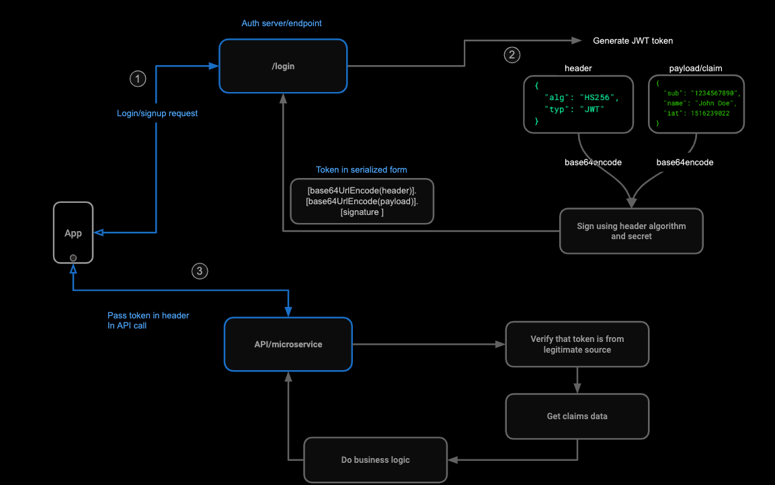

Slide 28
Hands-on usage
Let’s code with JWT!

Slide 29
Popular libraries
Go: library available here!
JavaScript (NodeJS): official npm package is available here!
You can use module bundlers (i.e. Browserify, Webpack) for browser’s JavaScript environment usage

Slide 30
GO library (1)
import ( jwt "github.com/dgrijalva/jwt-go" ) type JwtWrapper struct { SecretKey string Issuer string ExpirationHours int64 } // JwtClaim adds username, role as a claim to the token type JwtClaim struct { username string role string jwt.StandardClaims }

Slide 31
GO library (2)
//Creating claims (payload) claims := &JwtClaim{ username: username, role: "admin", StandardClaims: jwt.StandardClaims{ ExpiresAt: time.Now().Local().Add(time.Hour * time.Duration(j.ExpirationHours)).Unix(), Issuer: j.Issuer, }, } // Create token and sign token := jwt.NewWithClaims(jwt.SigningMethodHS256, claims) signedToken, err = token.SignedString([]byte(j.SecretKey)) // Validating token token, err := jwt.ParseWithClaims( signedToken, &JwtClaim{}, func(token *jwt.Token) (interface{}, error) { return []byte(j.SecretKey), nil }, ) // Decoding claims, ok := token.Claims.(*JwtClaim)

Slide 32
JS library
const jwt = require(“jsonwebtoken");
const payload = {"username": username, "role" : "admin"}; const token = jwt.sign(payload, secret); const decoded = jwt.decode(token); // verify a token symmetric jwt.verify(token, secret, function(err, decoded) { // }); // verify a token asymmetric const cert = fs.readFileSync('public.pem'); // get public key jwt.verify(token, cert, function(err, decoded) { // });

Slide 33
Refrences
jsonwebtoken
Handbook of Applied Cryptography by Alfred Menezes, Paul van Oorschot, and Scott Vanstone
https://developer.mozilla.org/
https://jwt.io/
https://datatracker.ietf.org/doc/html/rfc7519
https://datatracker.ietf.org/doc/html/rfc6750
https://github.com/auth0/node-jsonwebtoken
https://github.com/dgrijalva/jwt-go

Slide 34
THANKS!
DO YOU HAVE ANY QUESTION?
github.com/MohamadCM

